Slide 1
the genetic control of the vertebrate immune system
Immunity
is the balanced state of having adequate biological defenses to fight infection, disease, or other unwanted biological invasion, while having adequate tolerance to avoid inflammation, allergy, and autoimmune diseases.

Slide 2
The immune system is a system of biological structures and processes within an organism that protects against disease. To function properly, an immune system must detect a wide variety of agents, known as pathogens, from viruses to parasitic worms, and distinguish them from the organism's own healthy tissue.

Slide 3
Two general categories of defense mechanism against infection
Nonspecific defense
Specific defense

Slide 4
Nonspecific defense
Do not discriminate between one threat and another. These defenses include physical and chemical barriers
First line of defense:
This role is carried out by skin, mucus, sweat and tears

Slide 5
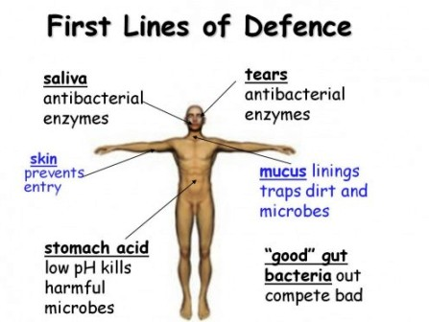

Slide 6
Nonspecific defense
Second line of defense
Via inflammatory response
Fever
interferon

Slide 7
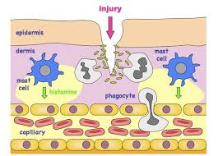

Slide 8
Specific defense
Immune response
Triggered by antigen (virus, bacteria etc.)
Two type of lymphocytes (B and T)
B-Cell for Humoral Immunity
T-Cells for cell mediated immunity

Slide 9
Humoral Immunity
Pathogens antigen—B cell—plasma cell/memory B cells
Plasma cell —releases antibodies
Memory B cell —produced antibodies after second natural infection and second generation of MEMORY B cells

Slide 10
cell mediated immunity
Body primary defense against its own cells when they become cancerous or infected by viruses
During cell mediate immunity
T cell divide and differentiate into
Killer T cells (cytotoxic cells)
Helper T cells
Suppressor T cells
Memory T cells

