Slide 1
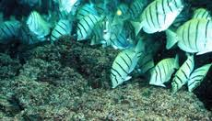
ICHTHYOLOGY
Muhammad Akmal (Lecturer )
Fisheries and Aquaculture Department

Slide 2
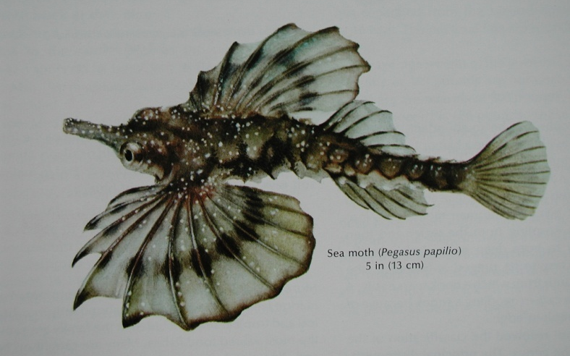
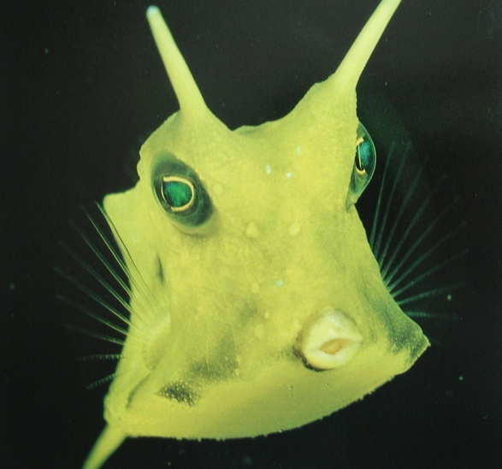
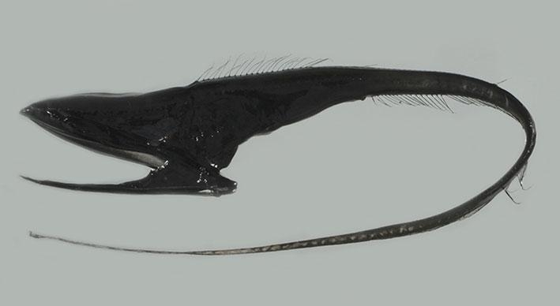
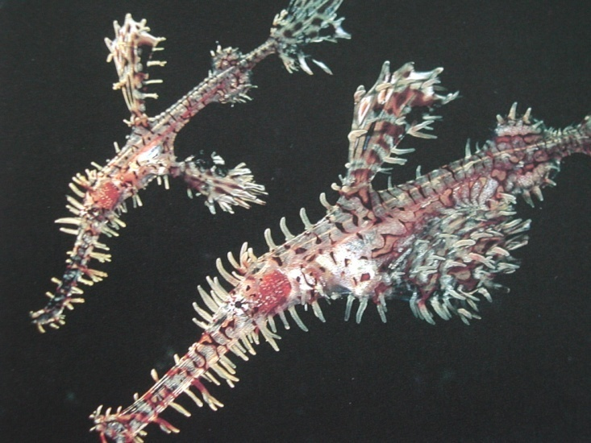
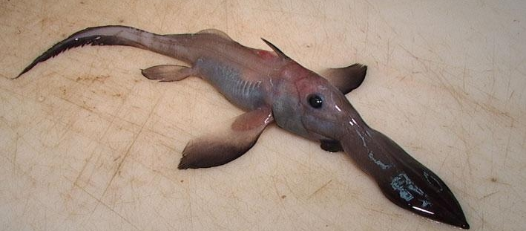
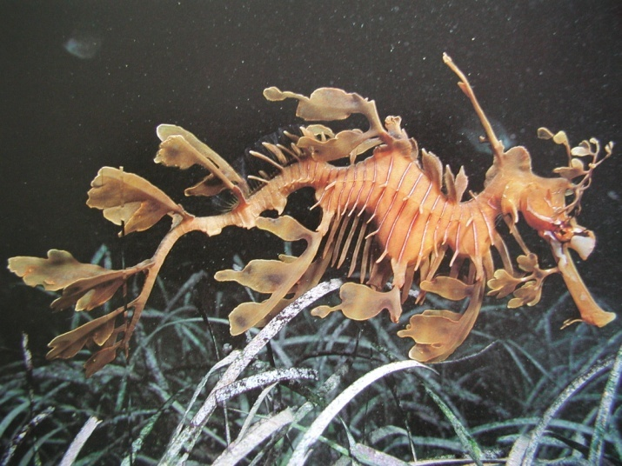
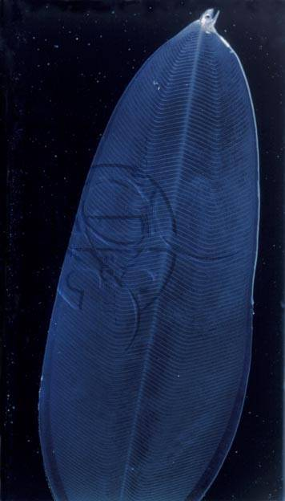
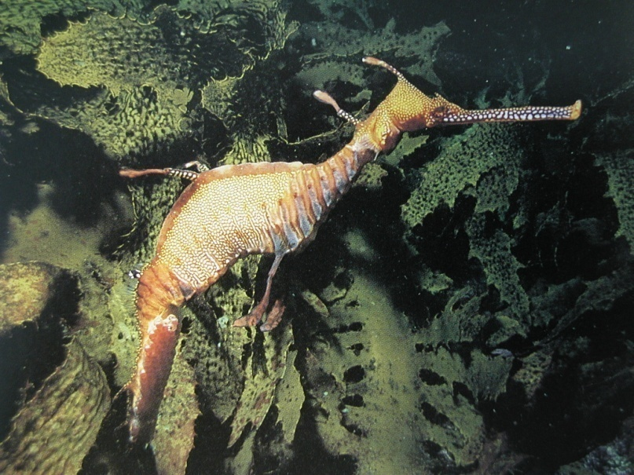
Notes:
What is a fish?
Consider the consequence of the lack of constraints imposed by gravity….

Slide 3
ICHTHYOLOGY
Ichthyology (from Greek: ikhthus, "fish"; and logos, "study"), also known as Fish Science.
“ The branch of biology devoted to the study of fishes is called Ichthyology.”
This includes
Bony Fishes (Osteichthyes)
Cartilaginous Fishes (Chondrichthyes)
Jawless Fishes (Agnatha)

Slide 4
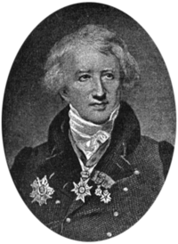
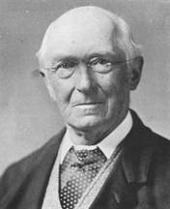
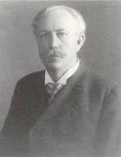
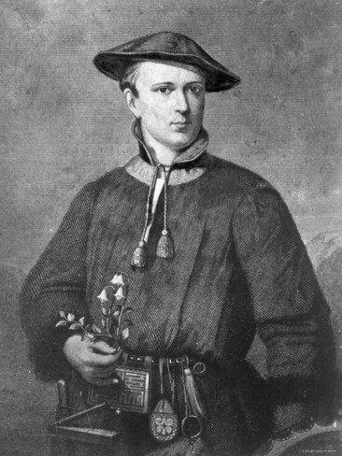
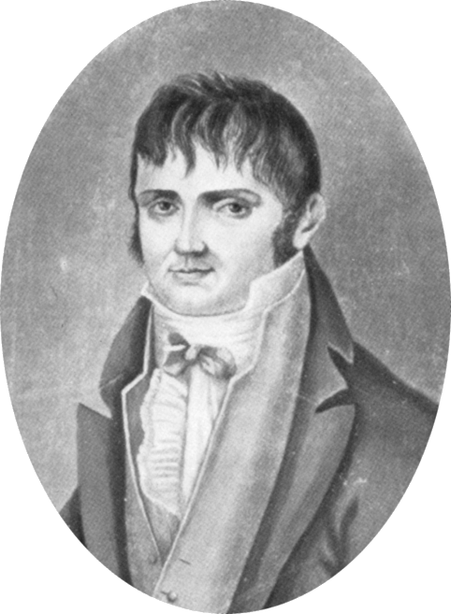
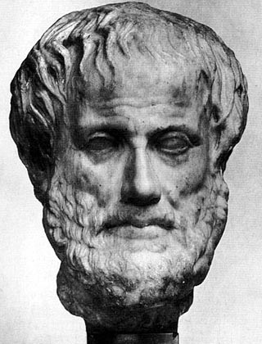
Founders of Ichthyology

Slide 5
Aristotle
First known ichthyologist - 348-322 BC
Recognized 117 species of fish, distinguished fish from whales

Slide 6
Peter Artedi
“Father of Ichthyology” - 1705-1734
Classification system of fishes
Standardized measurements and counts that remain basis of fish taxonomy today

Slide 7
Peter Artedi
Friend of Carolus Linneaus, who published his works after Artedi died by drowning in a canal in Amsterdam after a night of drinking

Slide 8
Carolus Linneaus
1707-1778 - adapted Artedi’s system to use in his Systema Naturae - basis for all future classification systems
Extremely arrogant - some believe he may have been connected to Artedi’s death (competition between them)

Slide 9
Georges Cuvier
1769-1832 - classified all known species of fishes
Conducted detailed studies of fish anatomy
Compiled early history of ichthyology

Slide 10
Constantine Rafinesque
1783-1840 - produced the most detailed early account of fish in North America - Ichthyologia Ohiensis - 1820
Natural history of fishes of the Ohio River and its tributaries

Slide 11
Louis Agassiz
1807-1873 - important volumes on classification based on fossil fishes
Strong non-believer of evolution, but work laid foundation for evolution studies of fish
Popularizer of science to American public

Slide 12
Johannes Muller
1801-1858 - in Germany - revised Agassiz’s classification system to include most major groups still used today

Slide 13
Albert Gunther
1830-1914 - British Museum - last person to attempt to describe all species of fishes in the world

Slide 14
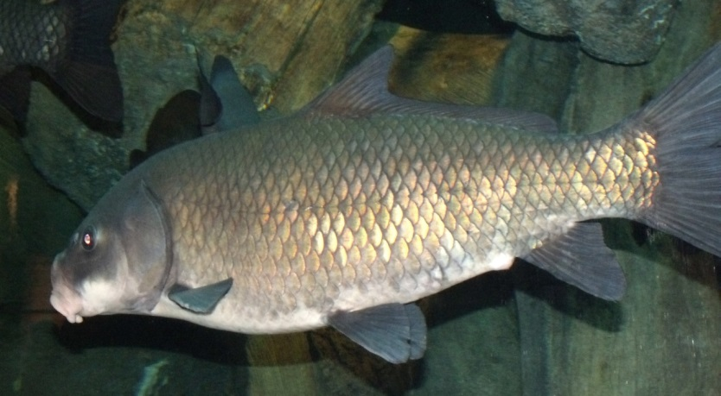
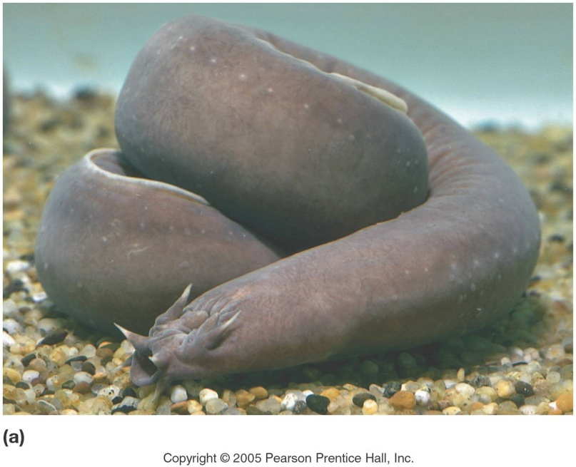
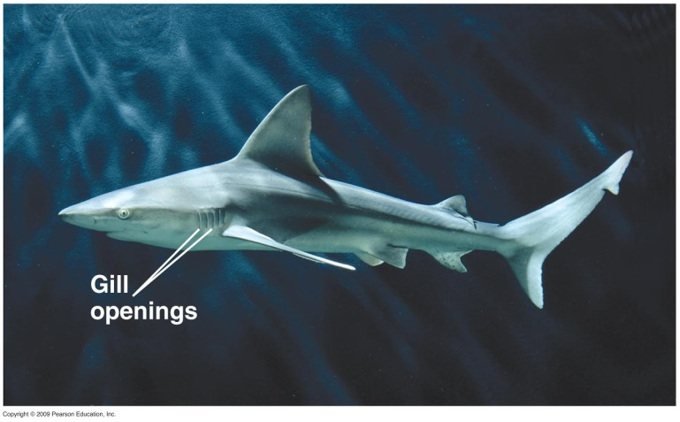
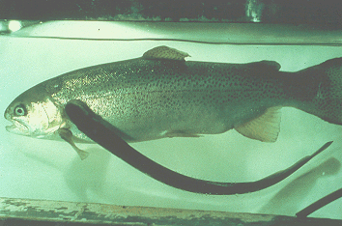
Ichthyology
~26000 species of fishes
85 jawless species
850 cartilagenous species
25000 bony species
~200 new species described per year!
Notes:
name examples of which are jawless, cartilagenous and bony
How mammals there are FIND OUT!!!!!

Slide 15
Ichthyology Jobs
Applied research - state, federal agencies - fisheries management
University teaching/research
Museum research/curatorship
Collection management
Public aquaria & aquarium hobby
Conservation agencies (protection)

Slide 16
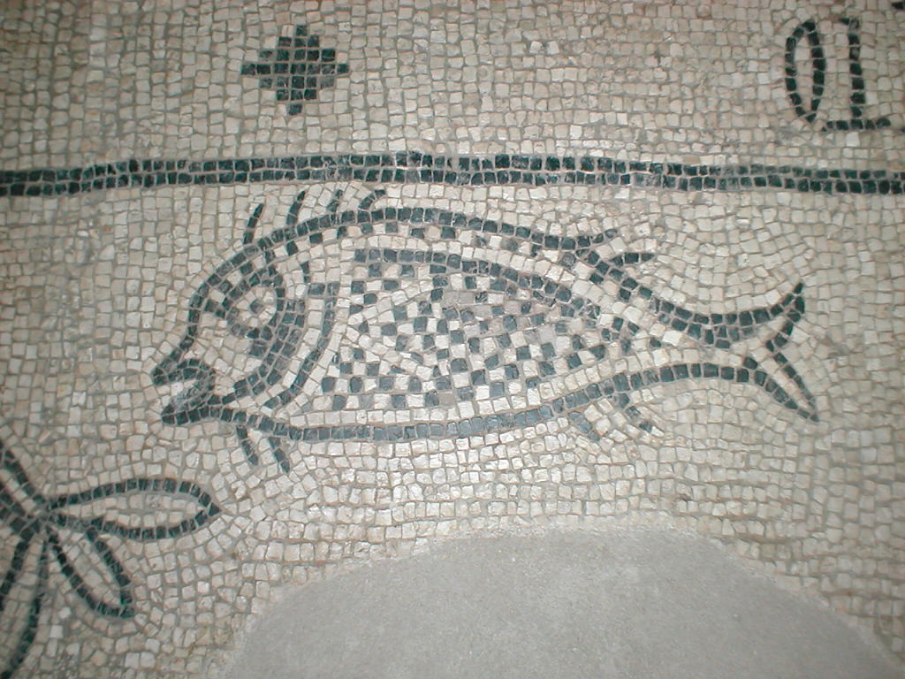
What is a Fish?
“a poikilothermic, aquatic chordate with appendages developed as fins, respiring mainly through gills and with a body covered by scales” (Berra 1981)
(Tuna, eel, catfish, lungfish)

Slide 17
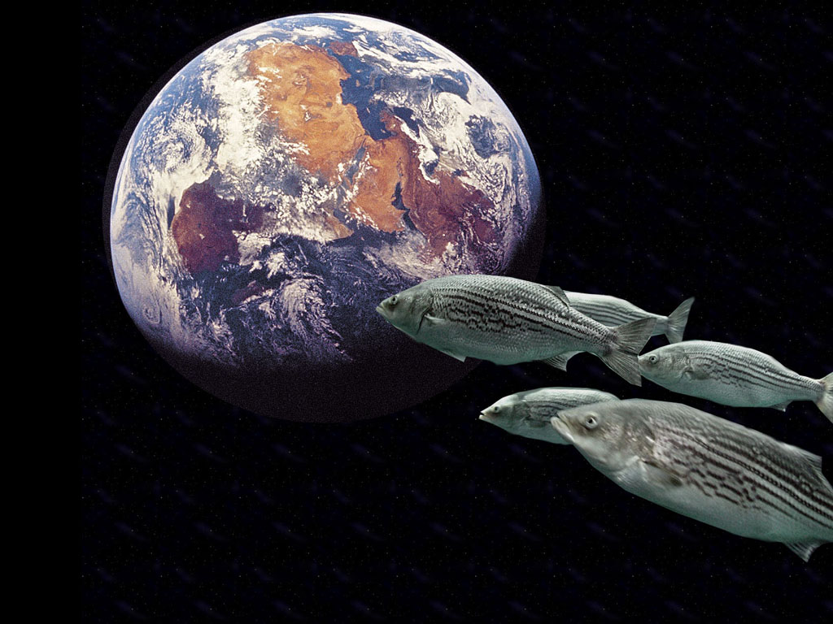
What is a Fish?
“An aquatic vertebrate with gills and with limbs in the shape of fins” (Nelson 1994)

Slide 18
Characteristics of Fishes
All fish share four common characteristics
1. Fish have an endoskeleton
2. Fish have gills
3. Fish have closed-loop circulation
4. Fish have Kidneys
These adaptations allow fishes to live in oceans and freshwater habitats around the world

Slide 19
Fish species by habitat
41% freshwater
58% seawater
1% both fresh and seawater
Water by Volume
97% Oceans
0.0093% Rivers- Lakes
Notes:
Why of high number of freshwater species – Speciation / Islands
- thermal vents, alkaline springs, hipersaline lakes, sunless caves, anoxic swamps, temporary ponds, torrential rivers, high altitude locations.....

Slide 20
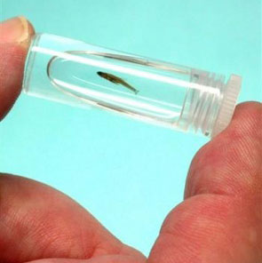
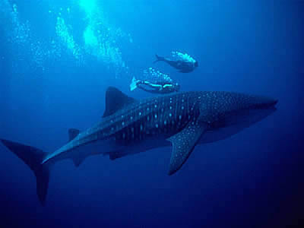
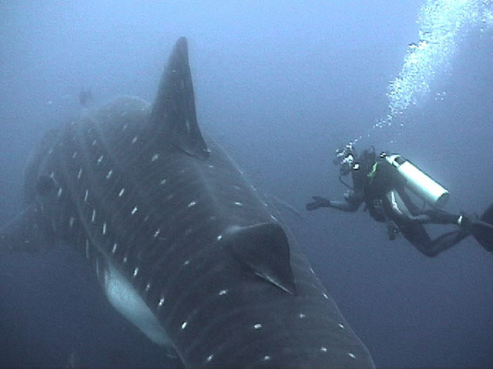
Fish extremes:
Largest (SW): whale shark (12 m)
Smallest: dwarf goby (Trimmatom nanus) – 8.0 mm
carp Paedocypris progenetica – 7.9 mm
Notes:
Carp discovered in Indonesia in 2006 – also world’s smallest vertebrate. Has virtually no skull
Why are fish so diverse? Water (and lack of gravity); also subdivision of habitat leading to reproductive isolation

Slide 21
Amazing About Fish can
Create light
Live up to 150 years
Change sex
Detect and produce electricity
And many, many more…..

