Slide 1
Salient Feature of Fish
They are exclusively water living animals
Their skin is covered with scales/plates.
They obtain oxygen dissolved in water by using gills.
Their body is streamlined, and a muscular tail is used for movement.
They are cold-blooded.
Gills are borne by true gills arche.
Some fish varieties have their skeletons made of both bone and cartilage
such as Anabas, Sea horse, Rohu, and some have their skeletons made entirely of bone, e.g., Torpedo fish and Sting ray (Trygon).
Integument contains mucous glands and chromatophores.
Cerebum is primarily an olfactory organ.
The gonads possess true gonoducts.

Slide 2
Fish Classification
Fish are members of the Animalia Kingdom (animals) and are also classified into the Phylum Chordata.
In order to be a chordate an animal must have
A notochord (a slim and flexible rod that supports the body) at some point in their lives;
A tubular nerve chord along their back (dorsal surface) with the brain developing from a swelling found at the anterior end (front) of this tube;
Paired gill slits at some stage of their life history;
Segmentation of at least part of their body;
A post-anal tail at some stage in their life history; a ventral heart; and an endoskeleton

Slide 3
Fish are further classified into the Vertebrata Subphylum
In order to be a vertebrate, an animal must have a
Vertebral column, or backbone. This backbone encloses, supports and protects the spinal cord.
Fish are vertebrates that live in water and breathe with gills.
Fish have either backbones of cartilage or bone.
Most fish are adapted to live in salt or fresh water.
Most fish have fins and scales, which cover and protect the body.
The body systems of the fish, such as the digestive, circulatory, etc. are well developed.

Slide 4
Classification of Fish
Kingdom Animalia
Phylum Chordata
Sub Phylum Verteberata
Class
Agnahtha
Chrondrinchytes
III. Osteichthyes- 1 Rayed finned fishes (class Actinopterygii)
2 lobe-finned fishes (class Actinistia)
3 lungfishes (class Dipnoi).

Slide 5
The fish are further classified into three classes. These classes are the
Agnatha, jawless fish such as the hagfish and lampreys;
Chrondrichthyes/ Cartilagenous, fish whose skeleton is made of cartilage such as sharks, rays and skates; and the
Osteichthyes/Bony fishes, fish whose skeleton is composed mostly of bone such as bass, perch, catfish, and flounder.
There are approximately 50 species of jawless fish, 600 species of cartilaginous fish and more than 30,000 species of bony fish.
The bony fish, Osteichthyes, are then further classified into two main groups called the ray-finned group (e.g., perch, and catfish)
and the lobe-finned group (e.g., lungfish). Most bony fish belong to the “ray-finned” group. There are approximately 70 fish orders known to biologists.

Slide 6
Characteristic of Agnatha
Jaws are absent
Paired fins are absent
Bony scales and skin plates were present in the ancient species but are absent in the living species
Gill pouches are present. They have seven or more pouches
Stomach is absent in the digestive system

Slide 7
Continue
They also lack the internal skeleton system. They have a circular tooth mouth (cyclostomic) by which they bore the body of their victim and suck their blood.
These are classified in to two major types. They are Hagfish and Lampreys.

Slide 8
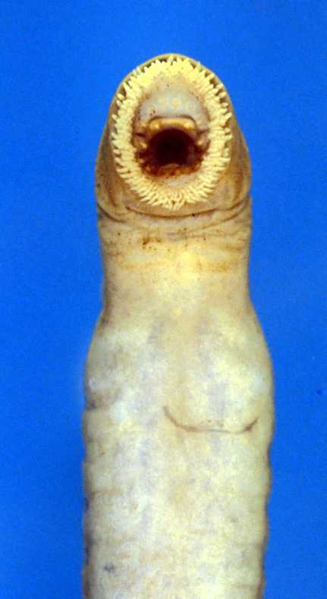
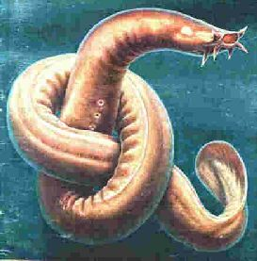
Lampreys and Hagfishes

Slide 9
Hagfishes
Subphylum Vertebrata
Class Pteraspidomorphi
Family: Myxinidae (Hagfishes, slime eels, or slime hags)
Common Species
Atlantic Hagfish (Myxine glutinosa)

Slide 10
Hagfish Feeding Habits
Remarkable due to their lack of external features
Feed on benthic invertebrates and scavenge on dead and dying fish
Ventral mouth has tongue and 4 rows of keratin teeth

Slide 11
One Word: Mucus
Have large numerous mucus pores
Have 70 – 200 pairs of slime glands
Mucus function is not completely understood
The hagfish ties itself in an overhand knot to rid itself of the slime
Leather made of “eel skin” are sometimes made from hagfish

Slide 12
Structure
3 pairs of barbels around the nostril and mouth used as tactile organs
Sides of body have 1–14 gill openings
Rudimentary eyes on the top of the head

Slide 13
Hagfish Reproduction
Both ovaries and testes are present but only one is functional
Female lays large sausage shaped (2-3cm.) eggs, numbering 20-30

Slide 14
Lampreys
Subphylum Vertebrata
Class: Cephalspidomorphi
Family: Petromyzontidae
Common Species
Sea Lamprey (Petromyzon marinus)

Slide 15
Sea Lamprey Habits
Latches on sides of fish sucking blood and body juices (lymph)
Some species are more predatory than others removing bone and organs

Slide 16
Sea Lamprey Structure
2 separate dorsal fins with a maximum size of 47”
Distinct oral disc with tooth like plates of keratin on eversible tongue
Seven pairs of gill openings on each side of the head, lacks paired fins
Unlike hagfish, have well-developed eyes

Slide 17
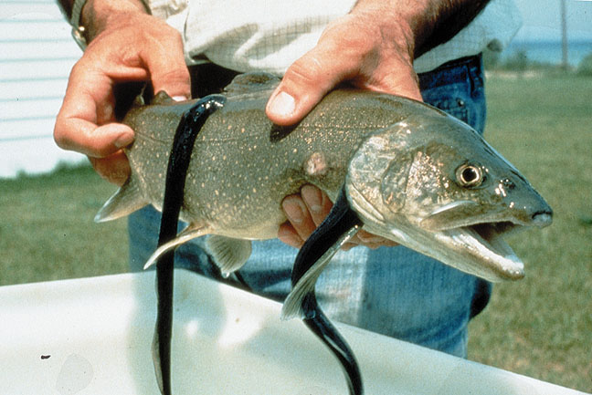
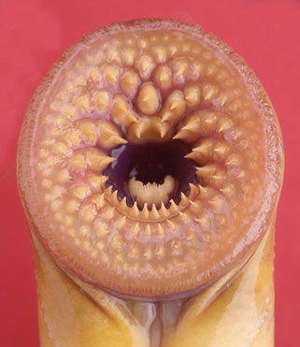
Sea Lamprey Structure

Slide 18
Lamprey Reproduction
Anadromous
Also, have both reproductive organs but only one is functional
Male creates nest with stones, and female spawns up to 124,000-260,000 eggs
River Lamprey

Slide 19
Ammocoete
Larval lamprey = ammocoete, lives secretive life buried where it filter feeds on algae and detritus

Slide 20
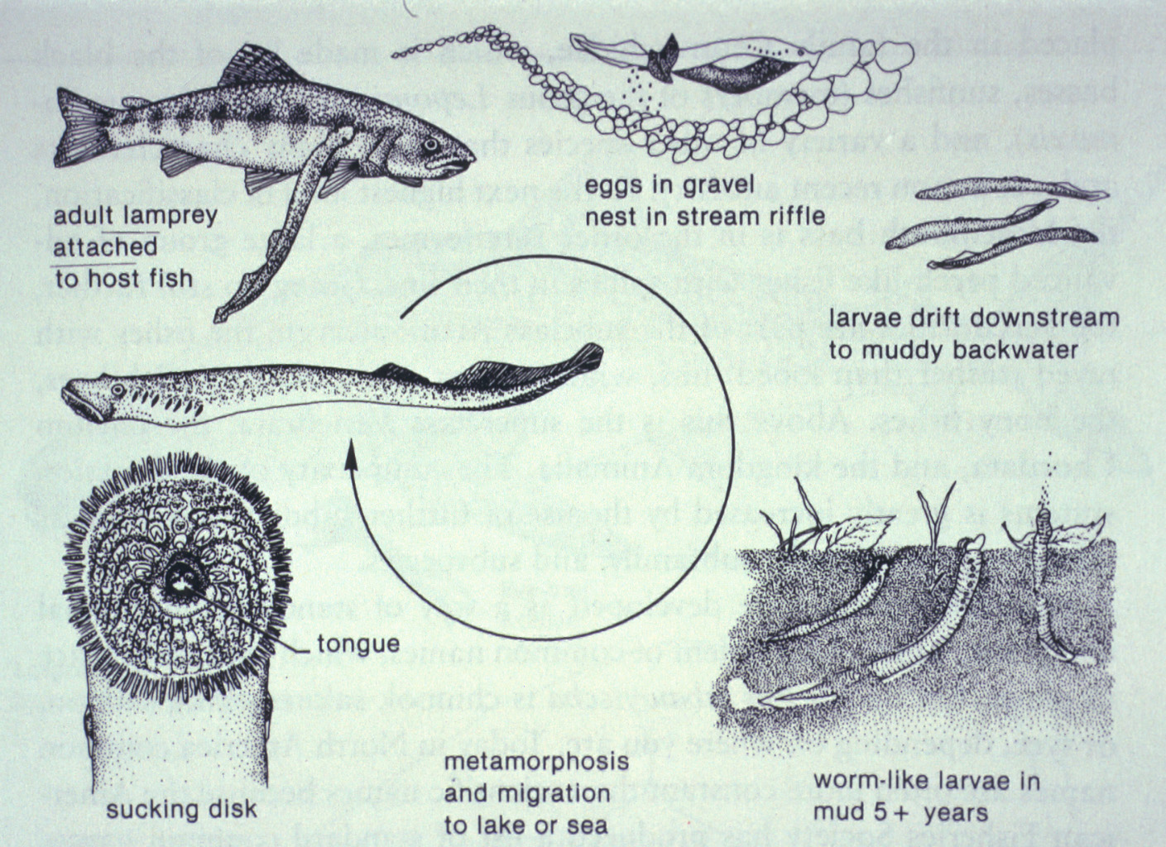
Sea Lamprey Lifecycle

