Slide 1
Respiratory System
Dr Sajid Khan Tahir
Department of Physiology
UVAS, Lahore

Slide 2
Divisions of Respiratory System
Two Divisions:
Conducting portion: Consists of;
The nasal cavities, pharynx, larynx, trachea, extrapulmonary bronchi, and a series of intrapulmonary bronchi and bronchioles with decreasing diameters that end as terminal bronchioles.
2. Respiratory portion: Consists of;
Respiratory bronchioles, alveolar ducts, alveolar sacs and alveoli.

Slide 3
Functions of Respiration
Respiration can be divided into four major functions:
Pulmonary ventilation, which means the inflow and outflow of air between the atmosphere and the lung alveoli.
(2) Diffusion of oxygen and carbon dioxide between the alveoli and the blood.
(3) Transport of oxygen and carbon dioxide in the blood and body fluids to and from the body’s tissue cells.
(4) Regulation of ventilation.

Slide 4
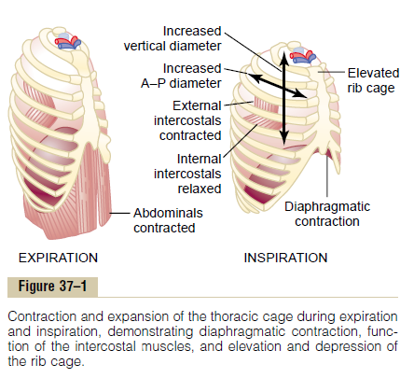
Mechanics of Pulmonary Ventilation
Lungs can be expanded and contracted in two ways:
Downward and upward movement of the diaphragm to lengthen or shorten the chest cavity
(2) Elevation and depression of the ribs to increase and decrease the anteroposterior diameter of the chest cavity.

Slide 5
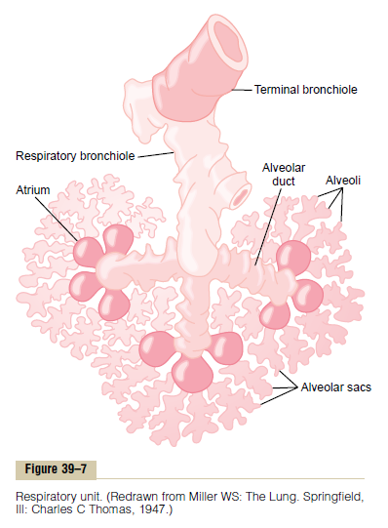
Diffusion of Gases Through the Respiratory Membrane
Respiratory unit (also called “respiratory lobule”), which is composed of
a respiratory bronchiole,
alveolar ducts,
atria,
alveoli.

Slide 6
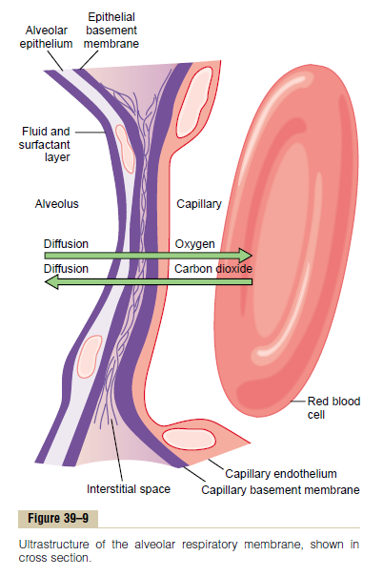
Respiratory Membrane
Layers of the respiratory membrane:
1. A layer of fluid lining the alveolus and containing surfactant that reduces the surface tension of the alveolar fluid
2. The alveolar epithelium composed of thin epithelial cells
3. An epithelial basement membrane
4. A thin interstitial space between the alveolar epithelium and the capillary membrane
5. A capillary basement membrane that in many places fuses with the alveolar epithelial basement membrane
6. The capillary endothelial membrane

Slide 7
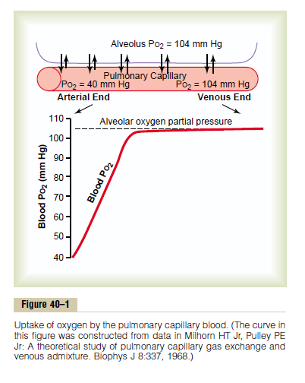
Transport of Oxygen from the Lungs to the Body Tissues
1. Diffusion of Oxygen from the Alveoli to the Pulmonary Capillary Blood.

Slide 8
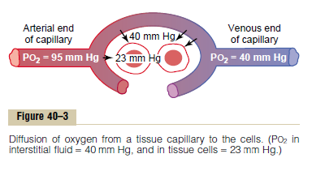
2. Diffusion of Oxygen from the Peripheral Capillaries into the Tissue Fluid.
3. Diffusion of Oxygen from the Peripheral Capillaries to the Tissue Cells.

Slide 9
Diffusion of Carbon Dioxide from the Peripheral Tissue Cells into the Capillaries and from the Pulmonary Capillaries into the Alveoli
1. Intracellular Pco2, 46 mm Hg; interstitial Pco2, 45 mm Hg. Thus, there is only a 1 mm Hg pressure differential.
2. Pco2 of the arterial blood entering the tissues, 40 mm Hg; Pco2 of the venous blood leaving the tissues, 45 mm Hg. Thus, the tissue capillary blood comes almost exactly to equilibrium with the interstitial Pco2 of 45 mm Hg.
3. Pco2 of the blood entering the pulmonary capillaries at the arterial end, 45 mm Hg; Pco2 of the alveolar air, 40 mm Hg.
Thus, only a 5 mm Hg pressure difference causes all the required carbon dioxide diffusion out of the pulmonary capillaries

Slide 10
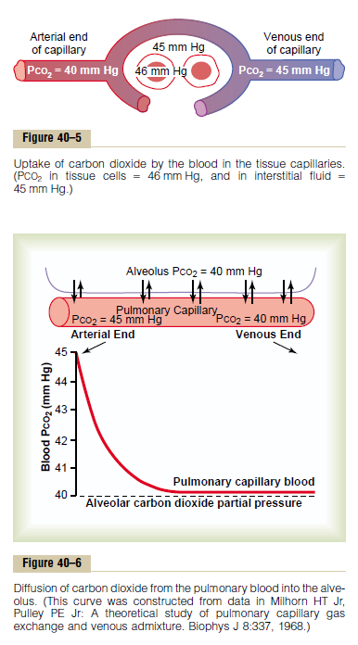

Slide 11
