Slide 1
Cardiovascular System
Dr. Sajid Khan Tahir
Department of Physiology
UVAS, Lahore

Slide 2
Cardiac muscle as a
functional Syncytium
The cardiac muscle is formed of a network of branching muscle fibers. Each muscle fiber has a separate cell membrane. The sites of contact (end to end contact) between the different fibers are called intercalated discs. Also, the membranes of the adjacent fibers fuse for considerable distances producing gap functions.
These functions provide low electrical resistance for rapid spread of the excitation wave (=cardiac action potential) from one fiber to the other ones. Thus, the cardiac muscle acts as functional sanctum and it contracts as one unit.

Slide 3
It should be noted that:
a) The valves open or close depending upon the pressure gradient of the blood on both sides of the valves e.g.
The AV valves:
- Open when the atrial pressure becomes higher than the ventricular pressure or
- Close when the ventricular pressure becomes higher that the atrial pressure.
The semilunar valves:
- Open when the ventricular pressure becomes higher than the arterial pressure and
- Close when the arterial pressure becomes higher than the ventricular pressure.

Slide 4
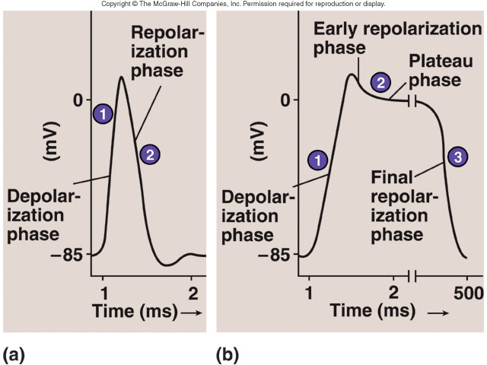
Action Potentials in Skeletal and Cardiac Muscle

Slide 5
The Cardiovascular System
A closed system of the heart and blood vessels
The heart pumps blood
Blood vessels allow blood to circulate to all parts of the body

Slide 6
What Does C-V System do?
Circulate blood throughout entire body for
Transport of oxygen to cells
Transport of CO2 away from cells
Transport of nutrients (glucose) to cells
Movement of immune system components (cells, antibodies)
Transport of endocrine gland secretions

Slide 7
The Heart: Coverings
Pericardium – a double serous membrane
Visceral pericardium
Next to heart
Parietal pericardium
Outside layer
Serous fluid fills the space between the layers of pericardium

Slide 8
The Heart: Heart Wall
Three layers
Epicardium
Outside layer
This layer is the parietal pericardium
Connective tissue layer
Myocardium
Middle layer
Mostly cardiac muscle
Endocardium
Inner layer
Endothelium

Slide 9
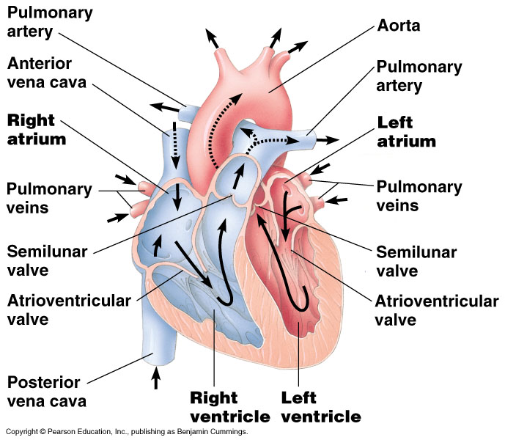

Slide 10
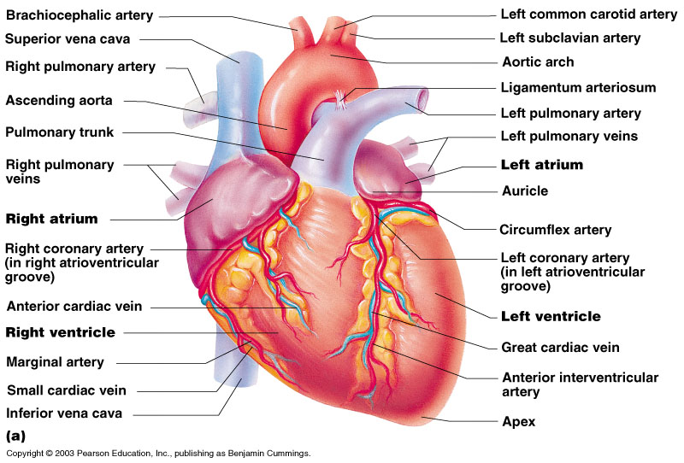
External Heart Anatomy

Slide 11
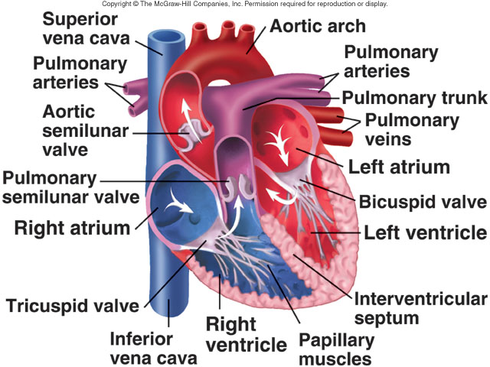
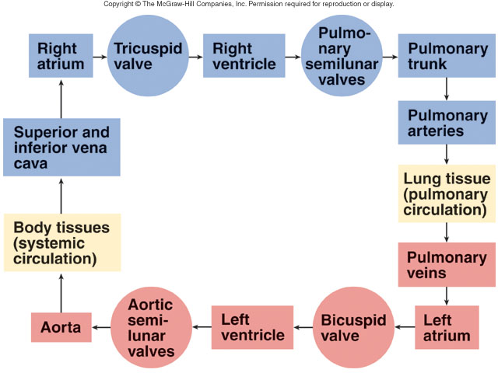
Blood Flow Through Heart

Slide 12
The Heart: Chambers
Right and left side act as separate pumps
Four chambers
Atria
Receiving chambers
Right atrium
Left atrium
Ventricles
Discharging chambers
Right ventricle
Left ventricle

Slide 13
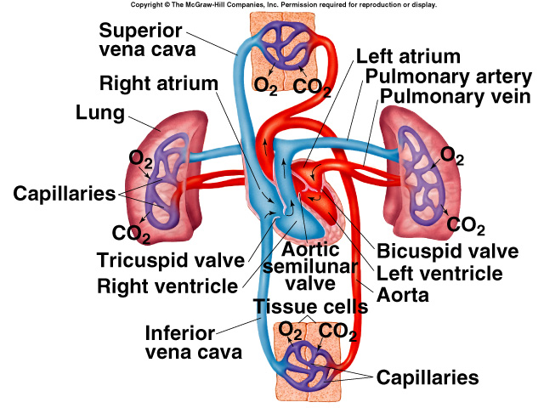
Pulmonary and Systemic Circulations
Pulmonary circulation:
Path of blood from right ventricle through the lungs and back to the heart.
Systemic circulation:
Oxygen-rich blood pumped to all organ systems to supply nutrients.
Rate of blood flow through systemic circulation = flow rate through pulmonary circulation.

Slide 14
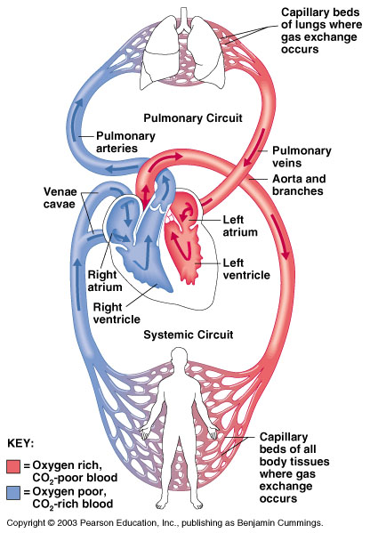
Blood Circulation

Slide 15
The Heart: Valves
Allow blood to flow in only one direction
Four valves
Atrioventricular valves – between atria and ventricles
Bicuspid valve (left)
Tricuspid valve (right)
Semilunar valves between ventricle and artery
Pulmonary semilunar valve
Aortic semilunar valve

Slide 16
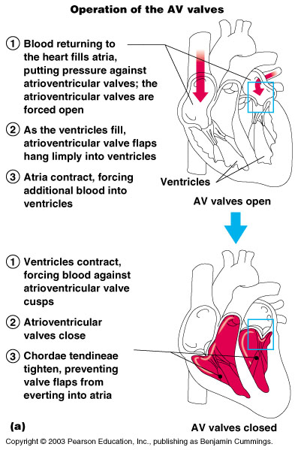
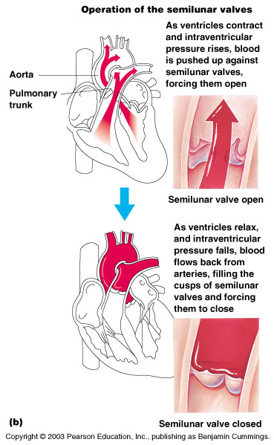
Operation of Heart Valves

Slide 17
Coronary Circulation
Blood in the heart chambers does not nourish the myocardium
The heart has its own nourishing circulatory system
Coronary arteries
Cardiac veins
Blood empties into the right atrium via the coronary sinus

Slide 18
Cardiac Cycle
Heart is two pumps that work together, right and left half
Repetitive contraction (systole) and relaxation (diastole) of heart chambers
Blood moves through circulatory system from areas of higher to lower pressure.
Contraction of heart produces the pressure

Slide 19
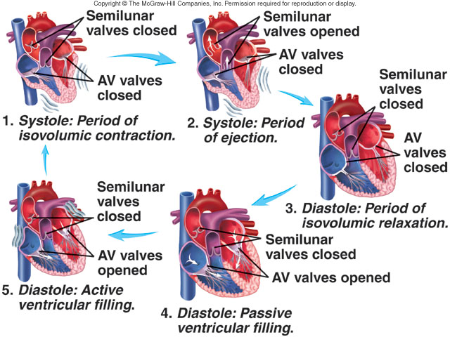
Cardiac Cycle

Slide 20
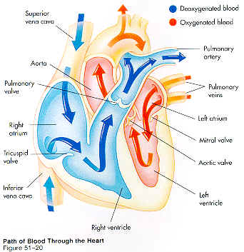
After passing through the capillaries of the lungs, the blood which is now oxygenated returns to the heart in the pulmonary veins.
From lungs

Slide 21
The left atrium receives blood from the pulmonary vein.

Slide 22
Blood passes through the mitral valve into the left ventricle.

Slide 23
Contraction of the left ventricle pushes blood through the aortic semilunar valve into the aorta. Blood travels to all regions of the body where it feeds cells with oxygen picked up from the lungs and nutrients from the digestive tract.
To rest of body

Slide 24
Deoxygenated blood returns from the rest of the body through the superior and inferior vena cava.

Slide 25
The right atrium receives the deoxygenated blood.

Slide 26
Blood then enters the right ventricle through the tricuspid valve.

Slide 27
Contraction of the right ventricle pushes blood through the pulmonary semilunar valve into the pulmonary arteries in which it travels to the lungs.
To lungs

Slide 28
Heart Sounds
First heart sound or “lubb”
Atrioventricular valves and surrounding fluid vibrations as valves close at beginning of ventricular systole
Second heart sound or “dupp”
Results from closure of aortic and pulmonary semilunar valves at beginning of ventricular diastole, lasts longer
Third heart sound (occasional)
Caused by turbulent blood flow into ventricles and detected near end of first one-third of diastole

Slide 29
The Heart: Conduction System
Special tissue sets the pace
Sinoatrial node (right atrium)
Pacemaker
Atrioventricular node (junction of r&l atria and ventricles)
Atrioventricular bundle (Bundle of His)
Bundle branches (right and left)
Purkinje fibers

Slide 30
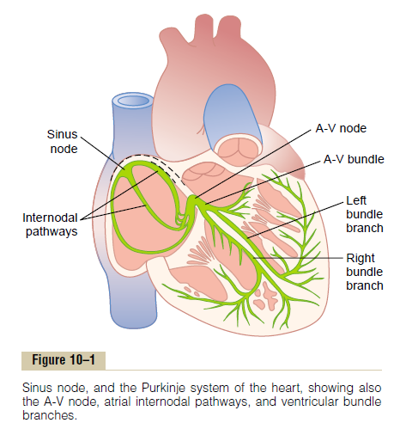

Slide 31
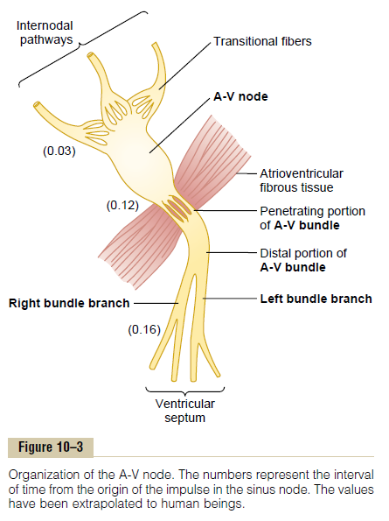

Slide 32
Conduction Speeds in Cardiac Tissue
Conduction Speeds in Cardiac Tissue
Tissue | Conduction Rate (m/s)
SA node | 0.05
Atrial pathways | 1
AV node | 0.05
Bundle of His | 1
Purkinje system | 4
Ventricular muscle | 1

Slide 33
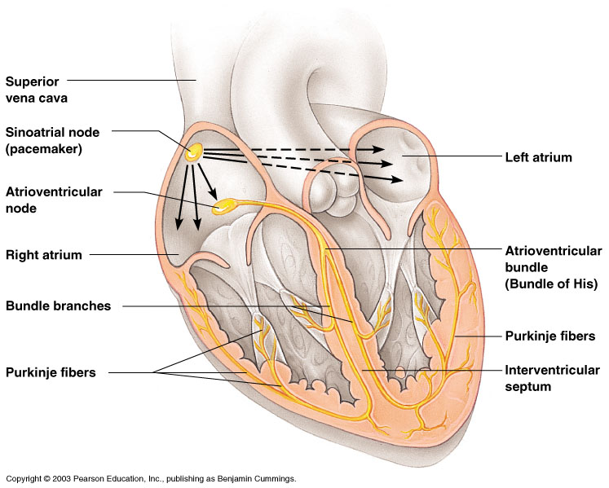
Heart Contractions

Slide 34
Vascular System
There are 3 types of blood vessels
a. ARTERY
b. VEIN
c. CAPILLARY

Slide 35
Differences Between Blood Vessel Types
Walls of arteries are the thickest
Lumens of veins are larger
Walls of capillaries are only one cell layer thick to allow for exchanges between blood and tissue

Slide 36
Artery/Vein differences
 | Arteries (aa.) | Veins (vv.)
Direction of flow | Blood Away from Heart | Blood to Heart
Pressure | Higher | Lower
Walls | THICKER: Tunica media thicker than tunica externa | THINNER: Tunica externa thicker than tunica media
Lumen | Smaller | Larger
Valves | No valves | Valves (see next)

