Slide 1
Muscular System
Dr Sajid Khan Tahir
Department of Physiology
UVAS, Lahore

Slide 2
Functions
Body movement (Locomotion)
Maintenance of posture
Respiration
Diaphragm and intercostal contractions
Communication (Verbal and Facial)
Constriction of organs and vessels
Peristalsis of intestinal tract
Vasoconstriction of blood vessels and other structures (pupils)
Heart beat
Production of body heat (Thermogenesis)

Slide 3
Properties
Excitability: capacity of muscle to respond to a stimulus
Contractility: ability of a muscle to shorten and generate pulling force
Extensibility: muscle can be stretched back to its original length
Elasticity: ability of muscle to recoil to original resting length after stretched

Slide 4
Types of Muscles
Muscles are responsible for all movement of the body
There are three basic types of muscle
Skeletal
Cardiac
Smooth

Slide 5
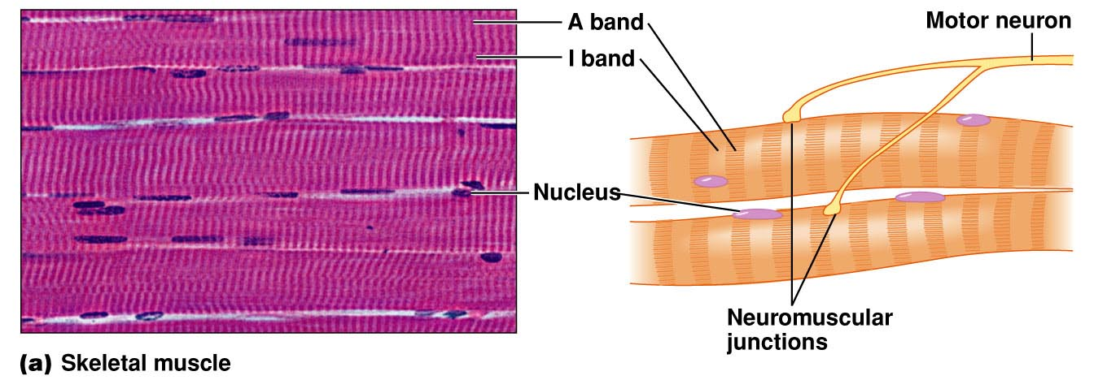
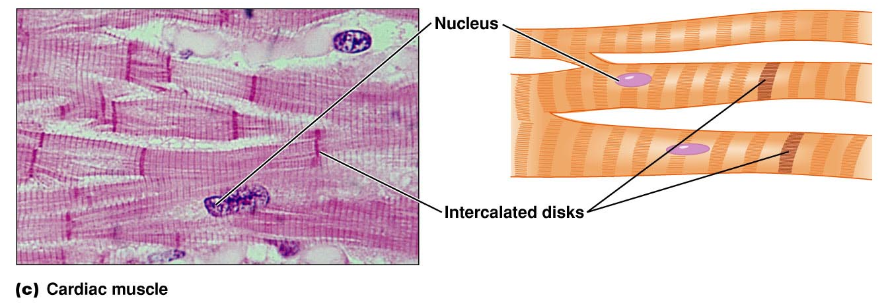
Types

Slide 6
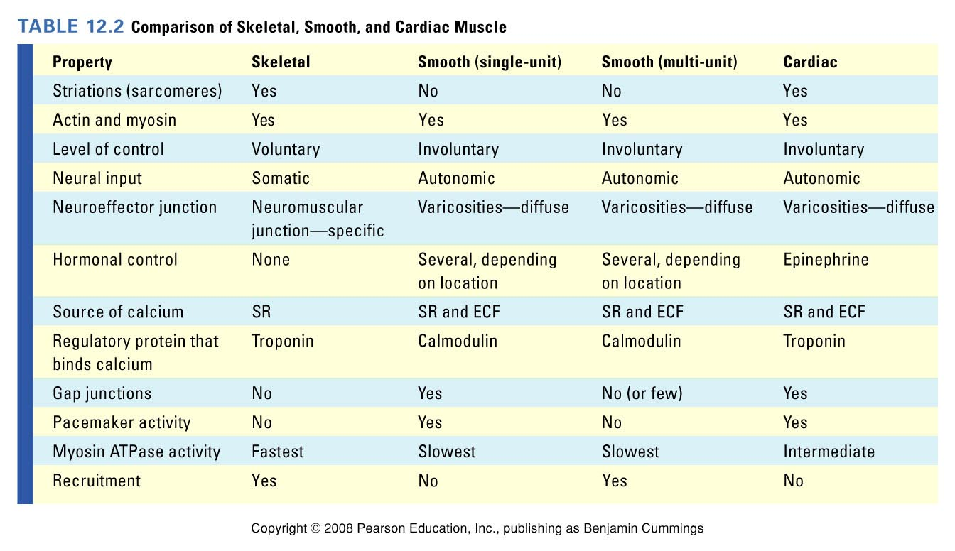

Slide 7
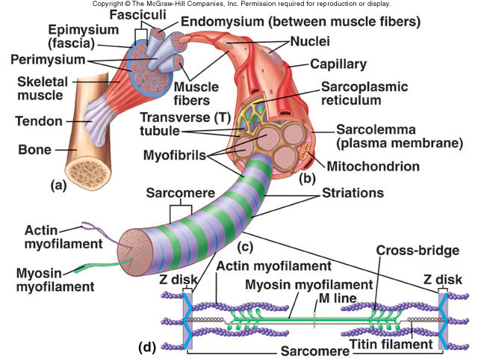
Parts of a Muscle

Slide 8
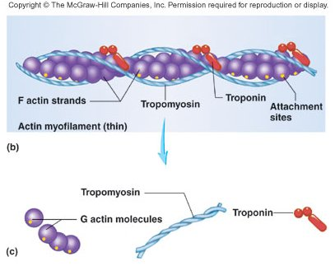
Actin (Thin) Myofilaments
Thin Filament: composed of 3 major proteins
F (fibrous) actin
Tropomyosin
Troponin
Two strands of fibrous (F) actin form a double helix extending the length of the myofilament; attached at either end at sarcomere.
Composed of G actin monomers each of which has a myosin-binding site (see yellow dot)
Actin site can bind myosin during muscle contraction.
Tropomyosin: an elongated protein winds along the groove of the F actin double helix.
Troponin is composed of three subunits:
Tn-A : binds to actin
Tn-T :binds to tropomyosin,
Tn-C :binds to calcium ions.

Slide 9
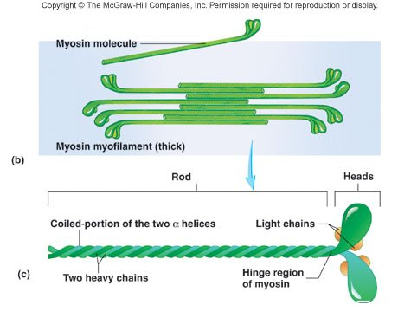
Myosin (Thick) Myofilament
Many elongated myosin molecules shaped like golf clubs.
Single filament contains roughly 300 myosin molecules
Molecule consists of two heavy myosin molecules wound together to form a rod portion lying parallel to the myosin myofilament and two heads that extend laterally.
Myosin heads
Can bind to active sites on the actin molecules to form cross-bridges. (Actin binding site)
Attached to the rod portion by a hinge region that can bend and straighten during contraction.
Have ATPase activity: activity that breaks down adenosine triphosphate (ATP), releasing energy. Part of the energy is used to bend the hinge region of the myosin molecule during contraction

Slide 10
Myosin structure
Many myosin molecules per filament, golf club shape
Long tail topped by a thickening: the head → forms crossbridges with the thin filament
Presence of the enzyme, ATPase in the head → release energy for contraction

Slide 11
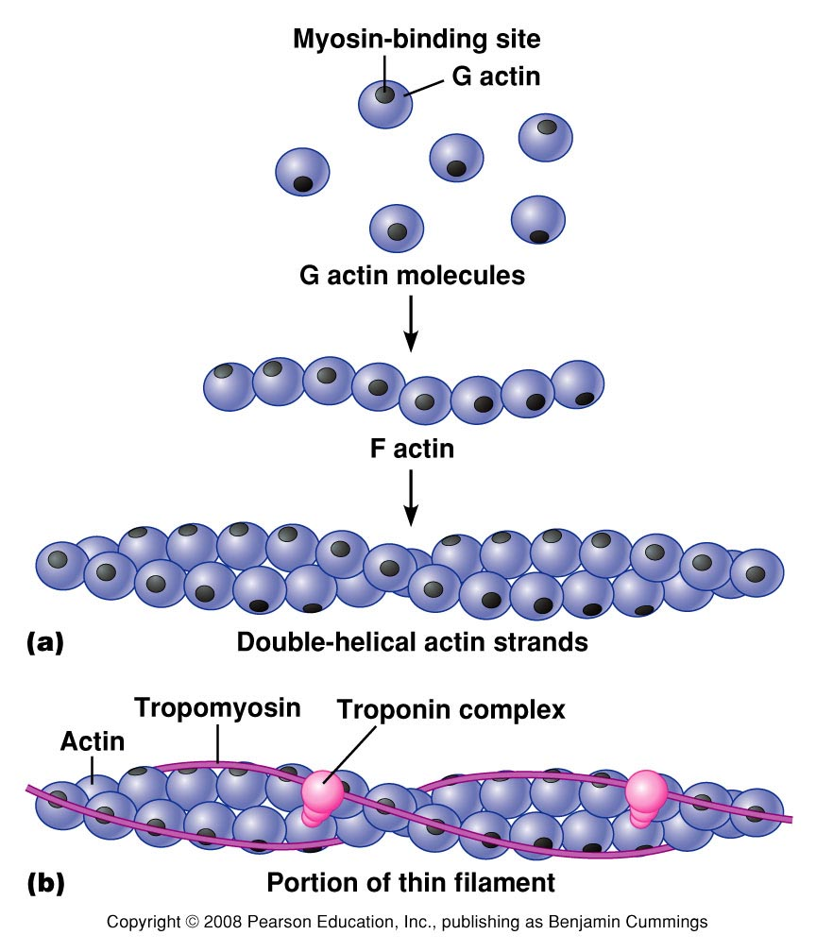
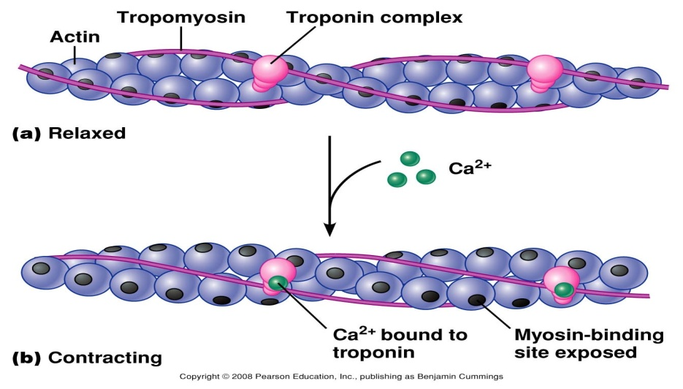
Actin structure
Formed by 3 different proteins:
- globular (G) actins: bind to myosin heads
- tropomyosin: long, fibrous molecule, extending over actin, and preventing interaction between actin and myosin
- troponin: binds reversibly to calcium and able to move tropomyosin away from the actin active site
Figure 12.4

Slide 12
Organization of myofilaments I:

Slide 13
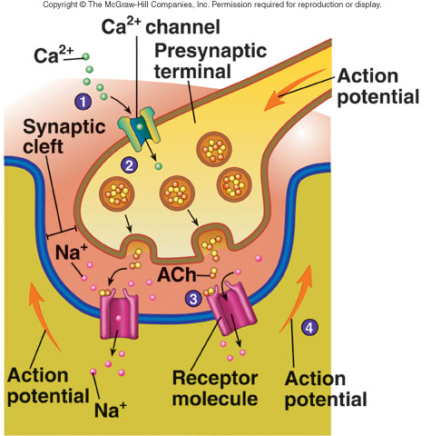
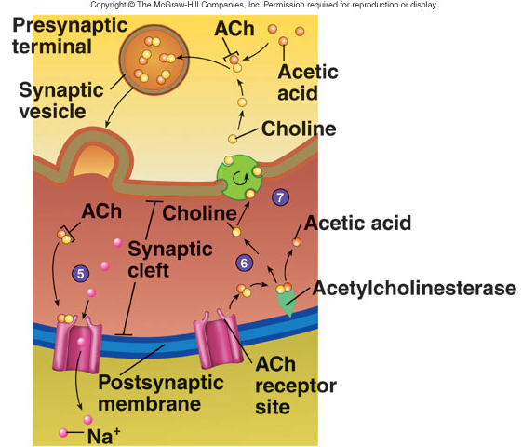
Function of Neuromuscular Junction

Slide 14
Synaptic events
The AP reaches the axonal bulb
Voltage-gated calcium channels open
The influx of calcium in the bulb activates enzymes →the vesicles containing the neurotransmitter molecule dock and release the neurotransmitter in the synapse
The neurotransmitter for skeletal muscles is always acetylcholine
The receptors on the muscle fiber are cholinergic receptors
These receptors are nicotinic (fast) acting receptors

Slide 15
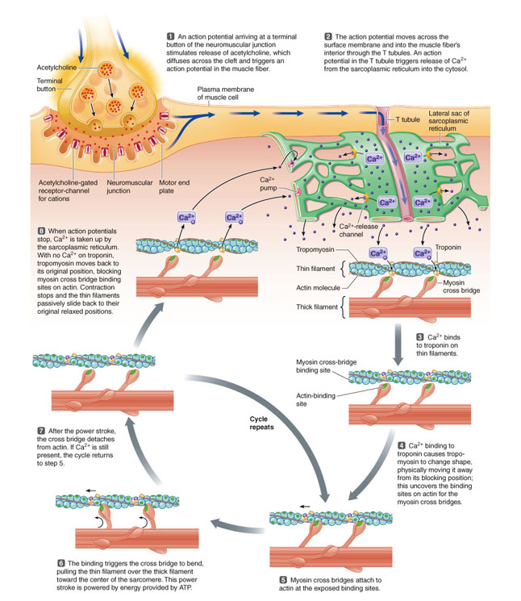

Slide 16
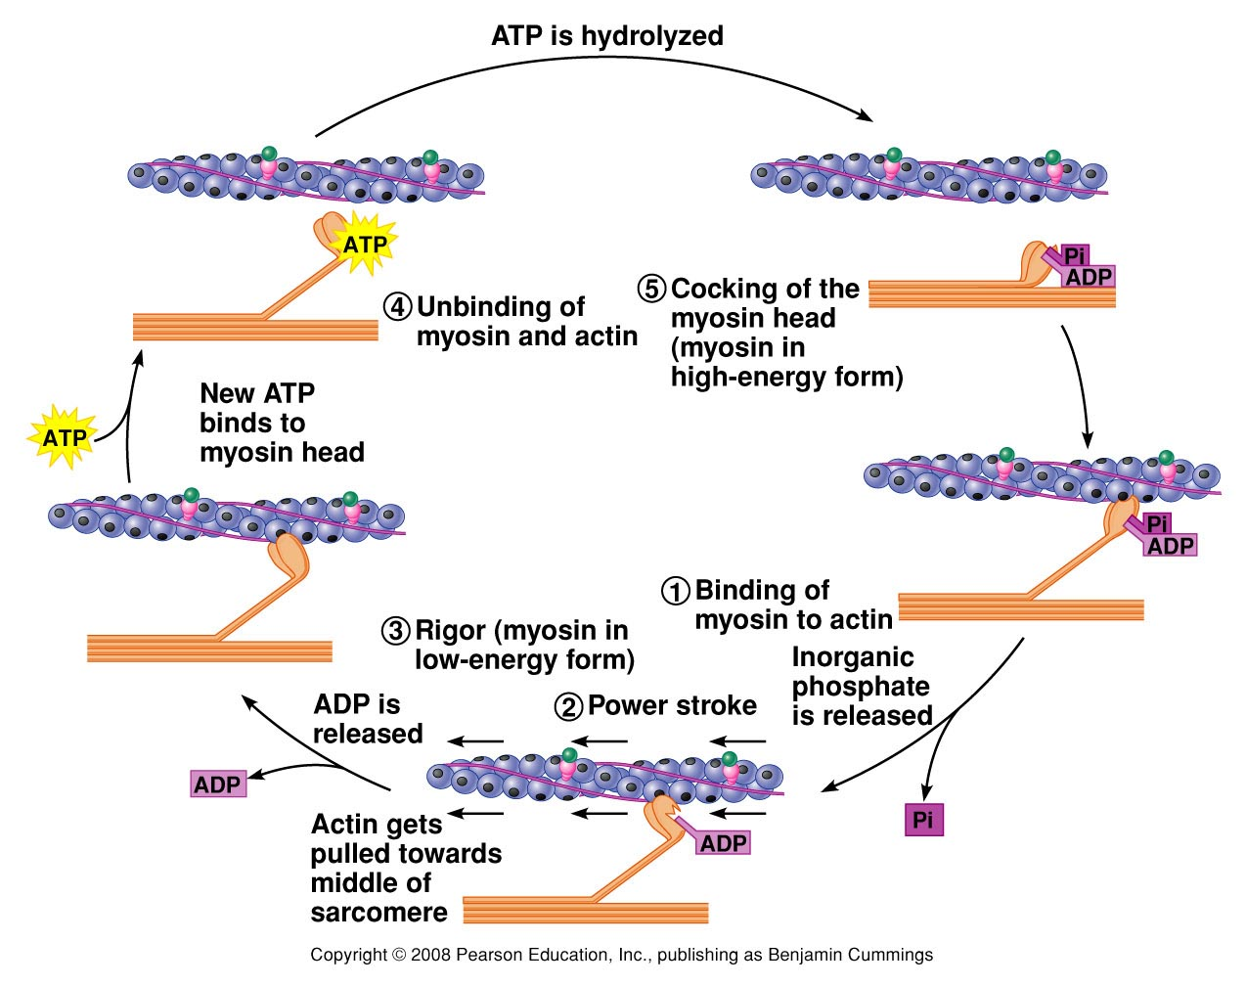
Figure 12.7

Slide 17
Muscle relaxation
Ach is removed from the receptors by acetylcholinesterase
Ligand-gated Na+channels close
Na/K pumps reestablish the RMP
Ca++ ions leave troponin and are brought back into the cisternae (this process needs energy)
Tropomyosin moves back over the actin active site
The myosin heads release their binding to actin
The filaments passively move back into resting position

Slide 18
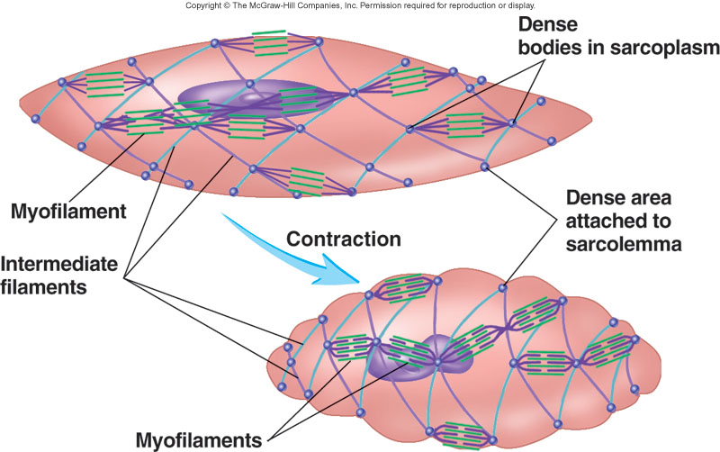
Smooth Muscles
Cells are not striated
Fibers smaller than those in skeletal muscle
Spindle-shaped; single, central nucleus
More actin than myosin
No sarcomeres
Not arranged as symmetrically as in skeletal muscle, thus NO striations.
Caveolae: indentations in sarcolemma;
May act like T tubules
Dense bodies instead of Z disks
Have noncontractile intermediate filaments

Slide 19
Structural Characteristics
No Z-line
No troponin
More actin filaments than myosin
Presence of
Calmodulin
Dense bars

Slide 20
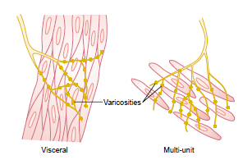

Slide 21
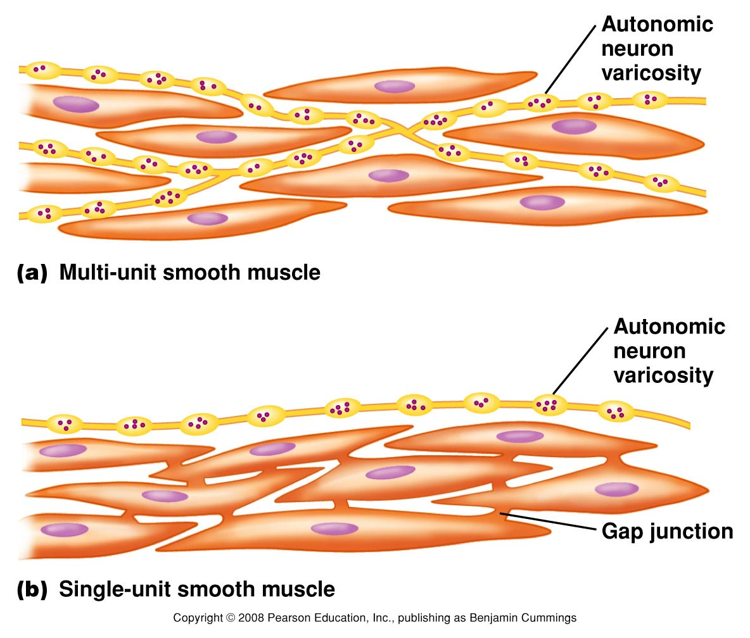

Slide 22
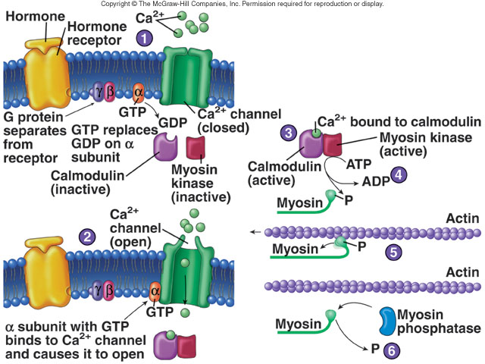
Smooth Muscle Contraction

Slide 24
