Slide 1
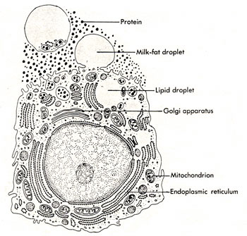
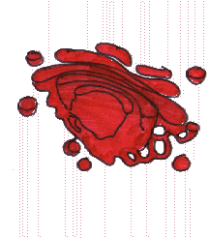
Golgi Complex

Slide 2
Discovery of Golgi body
The Golgi apparatus is noticeable with both light and electron microscope. It is also called Golgi complex.
The Golgi complex was discovered by an Italian physician and Noble Laureate Camillo Golgi in 1898 during an investigation of the nervous system.
Its electron microscopic structure was described by Dalton and Felix in 1954.

Slide 3
Location
The Golgi apparatus is present in all Eukaryotic cells and absent in Prokaryotes.
The Golgi apparatus is specially extensive in the secretory cells.
It is absent in few cell types, such as the mammalian RBCs, sperm cells of Bryophytes and Pteridophytes and sieve tubes of plants.

Slide 4
A cell may have one large Golgi complex or several very small ones. It occupies different positions in different kind of cells.
In secretory and absorptive cells, it usually lies between the nucleus.
The invertebrate and plant cells usually have several small Golgi complexs, called Dictyosomes, scattered throughout the cytoplasm.

Slide 5
Structure of Golgi complex
Golgi complex varies in size and form in different cell types but usually has similar organization for any one kind of cells.
Electron microscope shows it as a central stack (pile) of parallel, flattened, intercommunicating sacs or cisternae and many peripheral tubules and vesicles.

Slide 6
Cisternae:
The cisternae vary in number from 3-7 in most animal cells and from 10-20 in plant cells.
Usually equally spaced in the stack, separated from each other by thin layers of intercisternal cytoplasm.
Cisternae may be flat but are often curved.
Golgi complex has a distinct polarity, the two poles are called cis face and trans face, which act respectively as the receiving and shipping departments.
Convex side of stack -> forming (cis) face.
Concave side of stack -> maturing (trans) face.
Secretory materials reach the Golgi complex from Smooth Endoplasmic Reticulum (SER) by way of transport vesicles which bud off from SER and fuse with golgi cisternae on the cis face.
From the trans face Secretory vesicles arises that carry the processed material to their destination.

Slide 7
Tubules: Small, round tubules arise from the periphery of the cisternae. Some of these enlarge at their ends to form vesicles.
Vesicles: the vesicles lie near the ends and concave surface of the Golgi complex.
They are of two types: smooth or secretory vesicles and coated vesicles.
All the Golgi elements are filled with a fluid, the Golgi matrix.

Slide 8
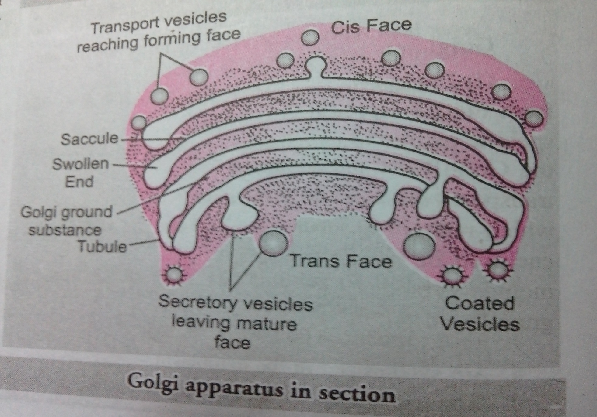

Slide 9
Golgi complex

Slide 10
Functions of Golgi Complex
Secretion
Synthesis
Sulfation
Apoptosis
Phosphorylation
Cell-specific functions

Slide 11
SECRETION-
Although the golgi apparatus is involved in many different cellular processes ,its principle role in many cells is in secretion.
Golgi plays an important role in the synthesis of proteoglycans, which are molecules present in the extracellular matrix of animals.

Slide 12
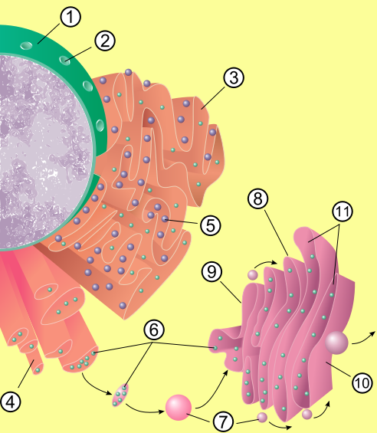
Path of secretion
Diagram of secretory process from endoplasmic reticulum (orange) to Golgi apparatus (pink).
1. Nuclear membrane
2. Nuclear pore
3. Rough endoplasmic reticulum (RER)
4. Smooth endoplasmic reticulum (SER)
5. Ribosome attached to RER
6. Macromolecules
7. Transport vesicles
8. Golgi apparatus
9.Cis face of Golgi apparatus
10. Trans face of Golgi apparatus
11. Cisternae of the Golgi Apparatus

Slide 13
2. SYNTHESIS
It is also a major site of carbohydrate synthesis
This includes the production of glycosaminoglycans
(GAGs), long unbranched polysaccharides which the Golgi then attaches to a protein synthesised in the endoplasmic reticulum to form proteoglycans.
Enzymes in the Golgi polymerize several of these GAGs via a xylose link onto the core protein.

Slide 14
3. SULFATION
Another task of the Golgi involves the sulfation of certain molecules passing through its lumen via sulfotranferases that gain their sulfur molecule from adenosine 3'-phosphate 5'-phosphosulfate.
This process occurs on the GAGs of proteoglycans as well as on the core protein.
Sulfation is generally performed in the trans-Golgi network.
The level of sulfation is very important to the proteoglycans' signalling abilities as well as giving the proteoglycan its overall negative charge.

Slide 15
4. APOPTOSIS
The Golgi has a putative role in apoptosis, with several Bcl- 2 family members localised there, as well as to the mitochondria.
A newly characterized protein, GAAP (Golgi anti-apoptotic protein), almost exclusively resides in the Golgi and protects cells from apoptosis by an as-yet undefined mechanism.

Slide 16
5. PHOSPHORYLATION
The phosphorylation of molecules requires energy in the form of ATP .
ATP is imported into the lumen of the Golgi utilised by resident kinases such as casein kinase1 and casein kinase 2.
One molecule that is phosphorylated in the Golgi is Apolipoprotein, which forms a molecule known as VLDL that is a constituent of blood serum.
It is thought that the phosphorylation of these molecules is important to help aid in their sorting for secretion into the blood serum.

Slide 17
VESICULAR TRANSPORT
Vesicles leaving RER transported to the cis face of GA, fuse with the membrane and empty the contents into the lumen.
Molecules inside the lumen are modified and sorted for transport to the next destination.
Proteins destined for places other than ER and GA, moves to trans face.
Gets placed on either of the 3 vesicles, i.e.
Exocytotic , Secretory and Lysosomal vesicles.

Slide 18
CELL SPECIFIC FUNCTIONS
Formation of cell wall and cell plate in Plant Tissues.
Acrosome development in sperm cells.
Secretion of Zymogen in the Exocrine cells of Pancreas.
Secretion and transformation of Lipid in the liver cells.
Similar secretory functions are carried out in the Brunner’s gland cells, alveolar epithelium, Paneth cells, connective tissues as well.

