Slide 1
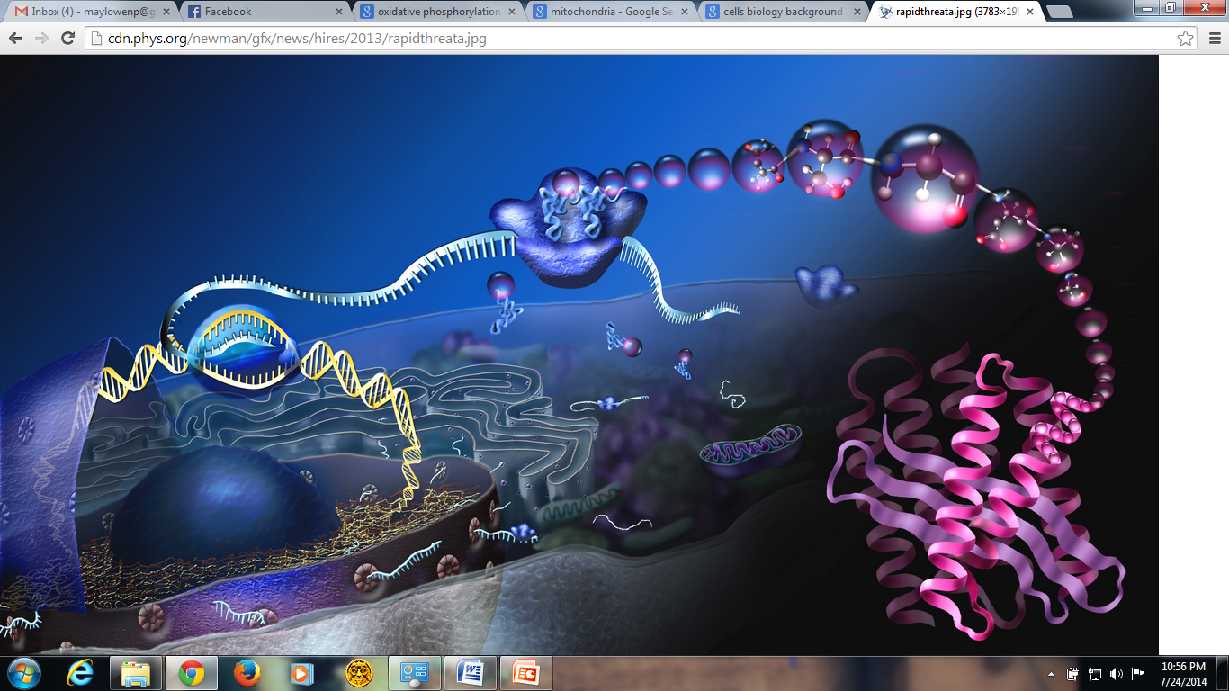
Energy Conversion:
Mitochondria
and ATP Production

Slide 2
Mitochondria
Mitochondria are the cell's power producers. They convert energy into
forms that are usable by the cell.
Seen in the cytoplasm, they are the
sites of cellular respiration which
ultimately generates fuel for the cell's activities.

Slide 3
Origin of Mitochondria
The first observations of intracellular structures that probably represent mitochondria were published in the
1840s.
Richard Altmann, in 1894, established
them as cell organelles and called
them "bioblasts".
The term "mitochondria" itself was
coined by Carl Benda in 1898

Slide 4
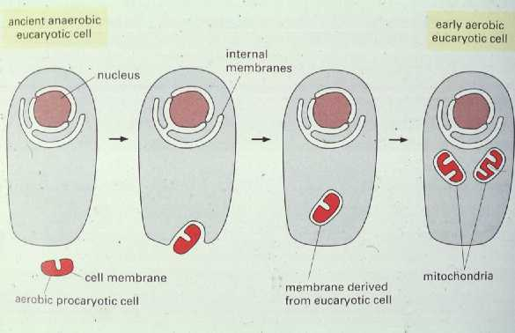
Endosymbiotic Theory
The endosymbiotic hypothesis for the origin of mitochondria suggests that mitochondria descended from specialized bacteria (nonsulfur bacteria) that somehow survived endocytosis by another species of prokaryote or some other cell type, and became incorporated into the cytoplasm

Slide 5
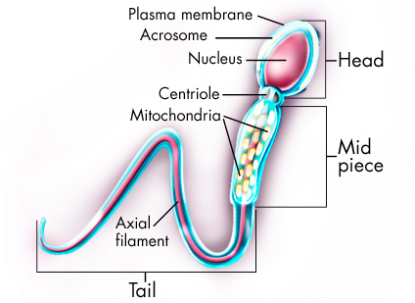
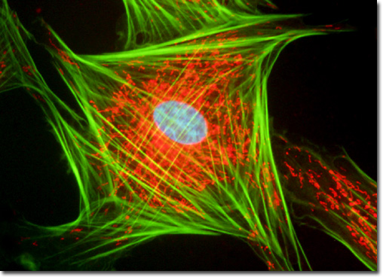
Location
Cells with high energy requirements: Muscle, sperm tail, flagella
Generally located where energy consumption is highest in the cell
Mitochondria (fibroblasts)
Mitochondria (sperm)
Packed around initial segment
Energy for sperm motility

Slide 6
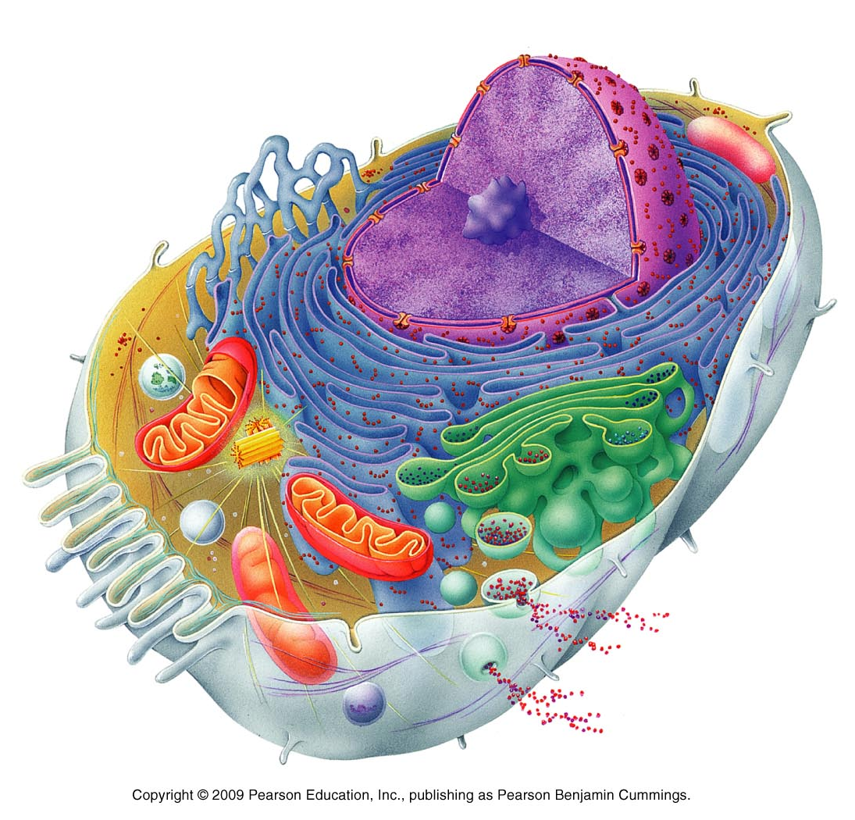
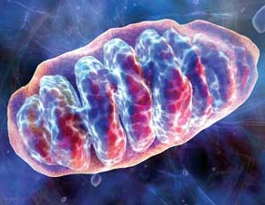

Slide 7
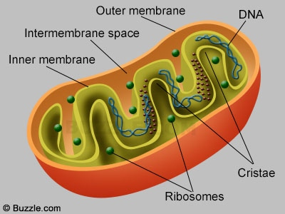

Slide 8
Structure of the Mitochondria
Outer Membrane
Contains large numbers of
integral proteins called
porins.
Allow molecules to freely
diffuse from one side of the
membrane to the other.
2. Intermembrane space
It is also known as Perimitochondrial space.
Equal to cytosol

Slide 9
3. Inner Membrane
Phospholipid layer, cardiolipid, impermeable to ions and small molecules except by specific membrane-transport proteins
It is the site of the production of ATP
4. Cristae
The folding of the inner membrane that allows more surface area, enhancing its ability to produce ATP.
5. Matrix
Fluid material that fills the area inside the inner membrane
The matrix is the space enclosed by the inner membrane.
It contains about 2/3 of the total protein in a mitochondrion.

Slide 10
6. Mitochondrial DNA
Contains 37 genes, all of which are essential for normal mitochondrial function.
13 electron transport
22 for tRNA
2 for mRNA
7. Mitochondrial ribosome
Biosynthesis of protein for ATP synthesis
Same as prokaryotic ribosome

Slide 11
The role of anaerobic and aerobic metabolism in exercise
Muscle cells contain a store of creatine phosphate (CrP )
CrP + ADP Cr + ATP
Human skeletal muscles consist of fast-twitch fibers and slow-twitch fibers

Slide 12
Fast-twitch fibers
Contract very rapidly; 15 – 40 msec
Nearly devoid of mitochondria
Unable to make much ATP by aerobic respiration

Slide 13
Slow-twitch fibers
Contract more slowly; 40 – 100 msec
Have large numbers of mitochondria

Slide 14
Aerobic exercise
Energy source
Initially by glucose stored as glycogen in muscles
After a few minutes the muscles depend increasingly on free fatty acids released into blood from adipose (fat) tissue
The longer the exercise period, the greater the dependency on fatty acids

Slide 15
Functions of Mitochondria
Produce ATP through respiration:
Citric acid cycle, or the Krebs Cycle
Electron transport chain
Chemiosmosis – ATP synthesis
Regulate cellular metabolism:
Heat production – brown adipose tissue
Calcium ion storage
Apoptosis – program cell death

Slide 16
ATP Production
Glycolysis
Citric Acid Cycle
Electron Transport Chain
ATP Synthesis

Slide 17
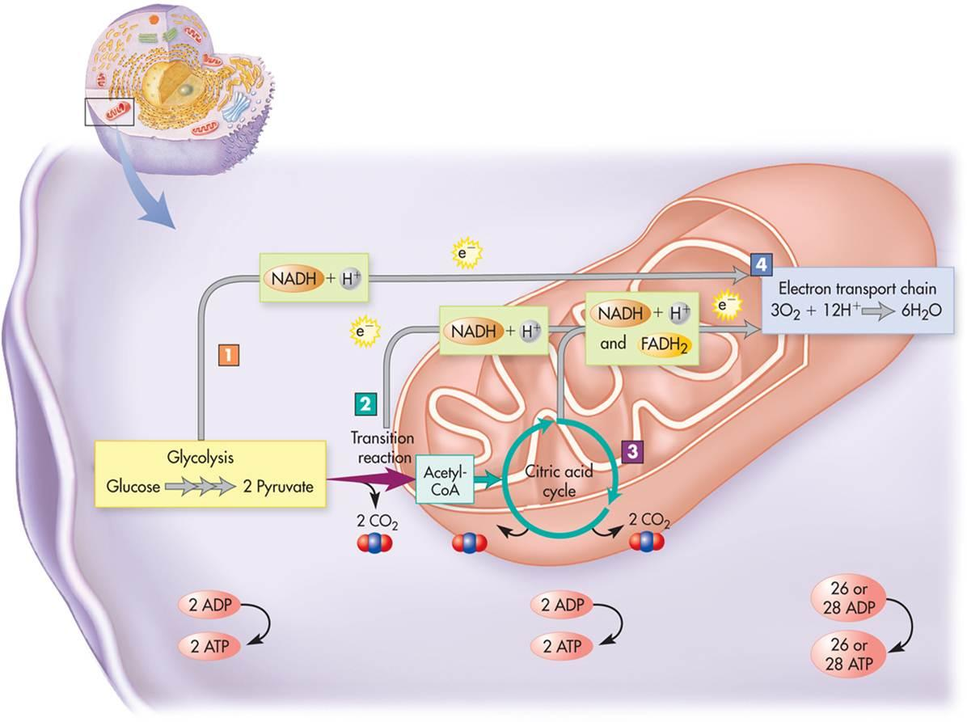
Overview of Processes

Slide 18
Glycolysis
Hexokinase
Phosphoglucoisomerase
Phosphofructokinase
Aldolase

Slide 19
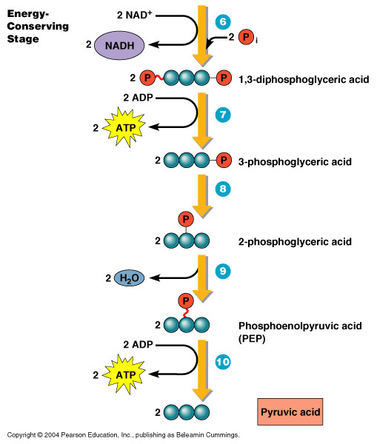
Triose phosphate dehydrogenase
Phosphoglycerokinase
Phosphoglyceromutase
Enolase
Pyruvate kinase

Slide 20
Product of Glycolysis
In summary, a single glucose molecule produces a total of:
2 molecules of pyruvic acid
2 molecules of ATP
2 molecules of NADH
2 molecules of water

Slide 21
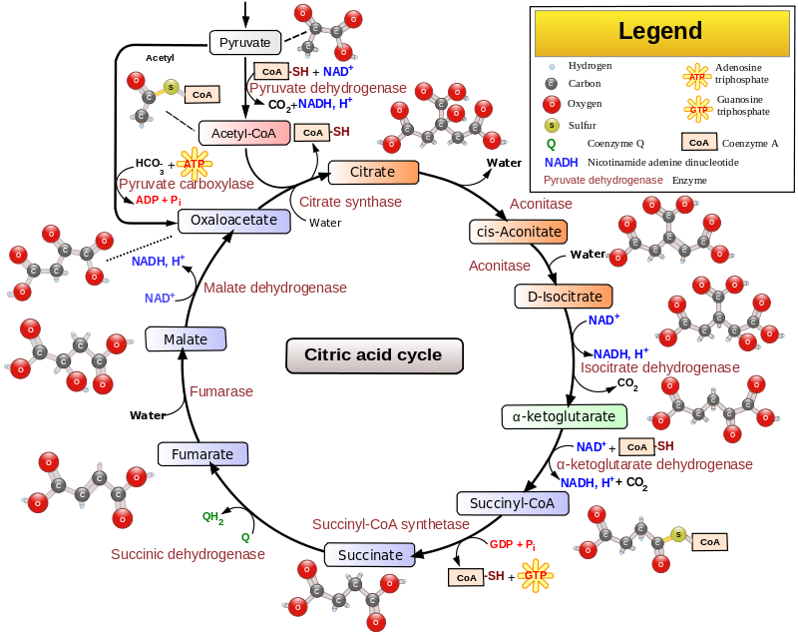
TCA Cycle / Krebs Cycle

Slide 22
Krebs Cycle Produces:
6 CO2
8 NADH
2 FADH2
2 ATP

Slide 23
Oxidative Phosphorylation Electron Transport Chain

Slide 24
The Electron Carriers
I (NADH-dehydrogenase): An integral protein that receives electrons in the form of hydride ions from NADH and passes them on to ubiquinone
II (Succinate dehydrogenase from the TCA cycle): A peripheral protein that receives electrons from succinate to yield fumarate and [FADH2]. From succinate the electrons are received by [FAD] which then become [FADH2]. The electrons are then passed off to ubiquinone.

Slide 25
Q (Ubiquinone) receives electrons from several different carriers; from I, II, Glycerol-3-phosphate dehydrogenase, and ETF. It is now the reduced form (ubiquinol) which passes its electron off to III.
III (Ubiquinol-cytochrome c oxidioreductase): An integral protein that receives electrons from ubiquinol which are then passed on to Cytochrome c
IV (Cytochrome c oxidase):An integral protein that that receives electrons from Cytochrome c and transfers them to oxygen to produce water within the mitochondria matrix.

Slide 26
ATP Synthesis

Slide 27
ATP Synthase
An integral protein consisting of several different subunits. This protein is directly responsible for the production of ATP via chemi-osmotic phosphorylation.
It uses the proton gradient created by several of the other carriers in the ETC to drive a mechanical rotor.
The energy from that rotor is then used to phosphorylate ADP to ATP.

Slide 28
Glycolysis: 2 ATP
Krebs Cycle: 2 ATP
Electron Transport Phosphorylation: 32 ATP
Each NADH produced in Glycolysis is worth 2 ATP (2 x 2 = 4) - the NADH is worth 3 ATP, but it costs an ATP to transport the NADH into the mitochondria, so there is a net gain of 2 ATP for each NADH produced in gylcolysis
Plants are a bit more efficient and they don't have to spend 2 ATP to transport NADH into their mitochondria
Each NADH produced in the conversion of pyruvate to acetyl CoA and Krebs Cycle is worth 3 ATP (8 x 3 = 24)
Each FADH₂ is worth 2 ATP (2 x 2 = 4)
4 + 24 + 4 = 32
Net Energy Production: 36 ATP

