Slide 1
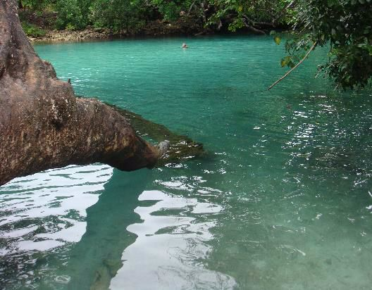
ECOLOGICAL CLASSIFICATION OF AQUATIC BIOME

Slide 2
BIOME
Biomes are very large ecological areas on Earth’s surface with fauna and flora adapting to their environment.
Biomes are climatically and geographically defined as the areas with similar climatic conditions on Earth, such as communities of plants, animals, soil organisms and viruses, often referred as ecosystems.

Slide 3
BIOME
Five types of biomes are present on Earth:
DESERT BIOME
AQUATIC BIOME
FOREST BIOME
GRASSLAND BIOME
TUNDRA BIOME

Slide 4
AQUATIC BIOME

Slide 5
AQUATIC BIOME
An aquatic biome can be defined as the areas of ocean and other water bodies which have similar climatic condition on Earth.
An aquatic biome includes ;
Water Bodies
Abiotic Factors
Light Intensity
Oxygen & Carbon dioxide Levels
Organic & Inorganic Nutrients

Slide 6
AQUATIC BIOME
3. Biotic Factors
Phytoplanktons
Zooplanktons
Aquatic Weeds
Fishes
Aquatic Invertebrates
And many other Creatures….

Slide 7
AQUATIC BIOME
Aquatic biomes are often determined by ‘SALINITY’ and ‘DEPTH’ of the water, as opposed to precipitation and temperature
Aquatic biome is a habitat that can be divided into zones based on characteristics like temperature, depth, tidal flow and its closeness to landmass.

Slide 8
AQUATIC BIOME
SALINITY
The salinity of ocean water is 30 parts per thousands, whereas salinity of freshwater is about 0.5 parts per thousands. Water that has reading in between these (0.5 to 30 ppt) , is called brackish.
There are several hyper saline lakes including GREAT SALT LAKE and MONO LAKE in CALIFORNIA. The salinity is measured at 40 parts per thousands.

Slide 9
AQUATIC BIOME
SUNLIGHT
Aquatic biomes are also impacted by the amount of sunlight that can penetrate in water.
On the basis of light penetration, following division of zones is present;
Photic Zone ( Light can penetrate )
Aphotic Zone ( Water below photic zone )
Benthic Zone ( bottom zone )

Slide 10
TYPES OF AQUATIC BIOME
Based on the saline conditions of water, it is divided into two major groups which include;
FRESHWATER HABITAT
MARINE WATER HABITAT

Slide 11
TYPES OF AQUATIC HABITAT
Another factor in which this biome can be distinguished is the degree of light penetration into the water.
CHARACTERISTICS;
Largest of all biomes
Dominated by water
Life first evolved in aquatic habitat
Play a major role in world’s climate

Slide 12
AQUATIC BIOME CLIMATE
Climatic conditions of both freshwater and marine water vary from each other.
These biomes are distributed unevenly across the globe and the climate of these biomes differ depending on the regions in which they are located.
The climate can also vary with seasonal changes in both freshwater and marine habitats.

Slide 13
WHAT VITAL ROLES DO AQUATIC SYSTEM PLAY?
Increase biodiversity
Effects climate
Increase biological productivity
Effects biogeochemical cycles
Provides shell fish
Minerals
Recreation
Transportation routs

Slide 14
CLASSIFICATION OF AQUATIC BIOME
Aquatic biome or ecosystem includes all water bodies that are present on Earth.
They are classified into;
Freshwater Biomes ( Lakes, Ponds, Rivers, Streams, Wetlands. )
Marine Biomes ( Oceans, Coral reefs. )
These biomes make up about 73% of the total Earth’s surface. So, they are of more importance.

Slide 15
FRESHWATER BIOME

Slide 16
FRESHWATER BIOME
Freshwater biome is defined as the water having a low salt concentration, usually less than 1% .
Plants and animals in freshwater regions are adjusted to the low salt content and would not be able to survive in areas of high salt concentration ( Oceans ).
Usually, they are adapted to only freshwater environment.

Slide 17
FRESHWATER BIOME
Freshwaters are closely linked to soils and biotic components of terrestrial biomes through which they pass.
Its characteristics are influenced by;
Patterns and speed of water flow
Climate of area in which its located

Slide 18
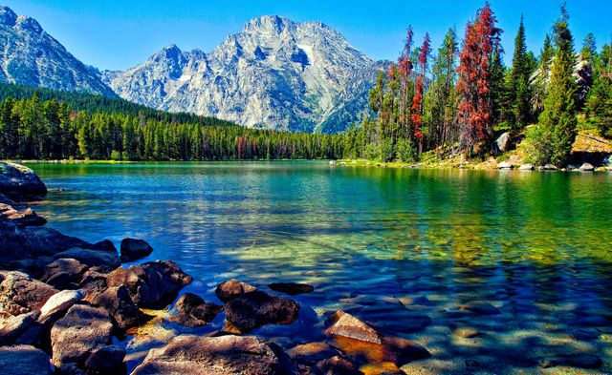

Slide 19
TYPES OF FRESHWATER BIOME
Freshwater biome includes;
LAKES
PONDS
STREAMS
RIVERS
WETLANDS

Slide 20
TYPES OF FRESHWATER BIOME
Lakes and ponds are considered as ‘Still Waters’ or ‘Lentic Water’ since they do not move fast.
Rivers and Streams move water from one area to another and are known as ‘Moving Waters’ or ‘Lotic Water’.
Both still and moving waters offer a home to many different types of plants and animals.
Many of these organisms are structured to live in a specific type of freshwater habitat.

Slide 21
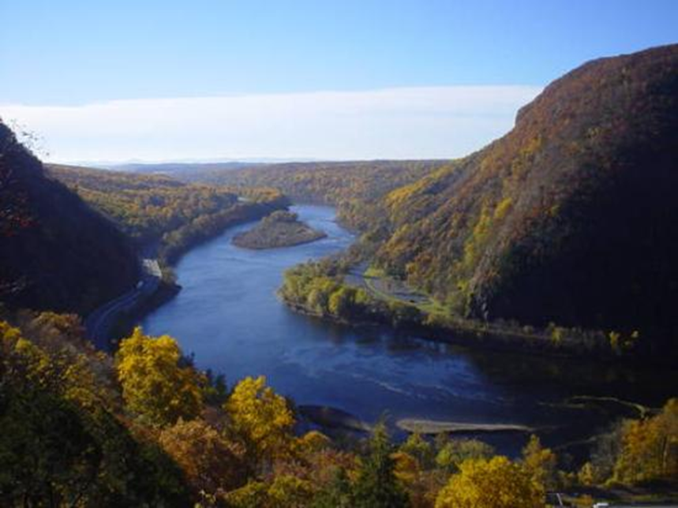

Slide 22
TYPES OF FRESHWATER BIOME
For example, some plants thrive in the nice calm waters of a lake but they do not survive in rivers and streams, unless they have a specific structure or can hold to objects like rocks.
Wetlands are not always considered as freshwaters because they usually have higher salt content.
Estuaries are the areas between the moving and still waters. Some of the animals in estuaries have a unique ability to survive in both freshwater and marine water.

Slide 23
TYPES OF FRESHWATER BIOME
LAKES
They are large natural bodies of standing freshwater, formed when precipitation, runoff, ground water seepage fills depressions in Earth surface.
WETLANDS
An area covered with water at some point in year that supports aquatic plants. Their conditions favor specially adapted plants called ‘Hydrophytes’.

Slide 24
FRESHWATER
WETLAND

Slide 25
TYPES OF FRESHWATER BIOME
RIVERS AND STREAMS
They are bodies of water moving continuously in one direction.
Their flow is downward from surface water and ground water from mountain highland to sea.
PONDS
Ponds are still bodies of freshwater usually smaller than lakes.

Slide 26
LAKE & POND’S ZONES
Lakes and ponds are divided into five zones, determined by depth and shoreline
LITTORAL ZONE ( Warmest, shallow, absorb more sunlight )
LIMNETIC ZONE ( Well-lighted, near surface water )
PROFUNDAL ZONE ( Little light penetration, colder, denser )

Slide 27
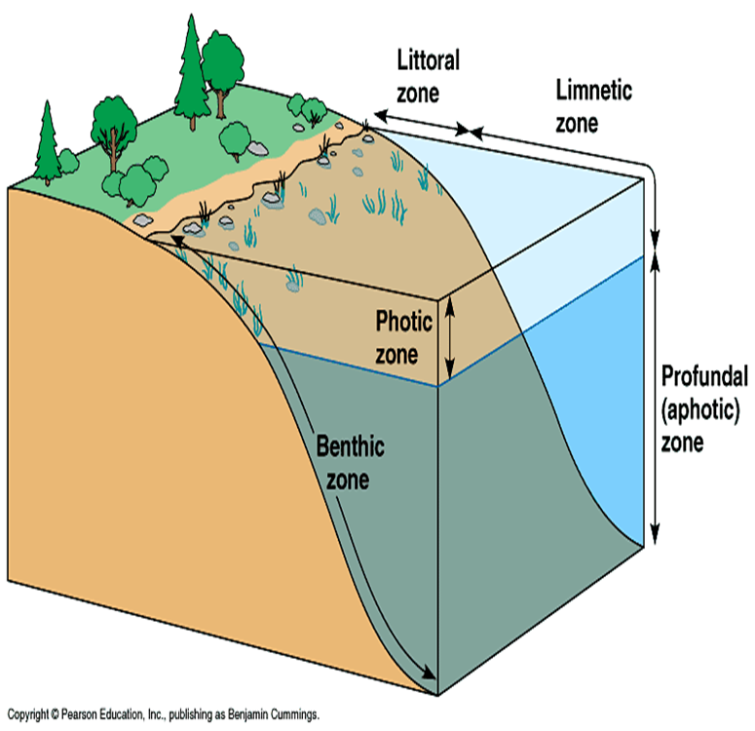

Slide 28
LAKE & POND’S ZONES
4. PHOTIC ZONE ( Major zone of primary production, which depends upon light penetration. )
5. BENTHIC ZONE ( Bottom zone consisting of bottom dwellers )

Slide 29
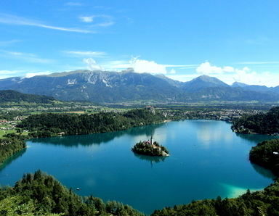

Slide 30
LOCATION OF FRESHWATER BIOMES
75% of world covered with water. Out of which 97% is salt water and 3% is freshwater.
2% of freshwater is locked up in glaciers. 1% freshwater is free.
Freshwater biomes are found all over the world and are major component of aquatic biomes.

