Slide 1
Ecosytem
An ecosystem consists of the biological community that occurs in some locale, and the physical and chemical factors that make up its non-living or abiotic environment.
There are many examples of ecosystems -- a pond, a forest, an estuary, a grassland. The boundaries are not fixed in any objective way, although sometimes they seem obvious, as with the shoreline of a small pond. Usually the boundaries of an ecosystem are chosen for practical reasons having to do with the goals of the particular study.
The study of ecosystems mainly consists of the study of certain processes that link the living, or biotic, components to the non-living, or abiotic, component

Slide 3
AQUATIC ECOSYTEM
An aquatic ecosystem is a group of interacting organisms dependent on one another and their water environment for nutrients (e.g., nitrogen and phosphorus) and shelter. Familiar examples are lakes and rivers, but aquatic ecosystems also include areas such as floodplains and wetlands, which are flooded with water for all or only parts of the year.
The two main types of aquatic ecosystems are marine ecosystems and freshwater ecosystems

Slide 4
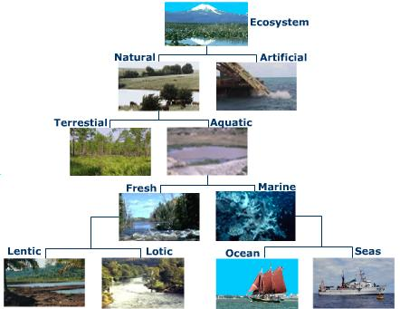

Slide 5
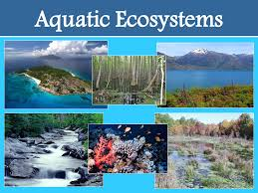

Slide 6
FRESH WATER ECOSYTEM
Freshwater ecosystems are a subset of Earth's aquatic ecosystems.
The include lakes and ponds, rivers, streams, springs, and wetlands. They can be contrasted with marine ecosystems, which have a larger salt content. Freshwater habitats can be classified by different factors, including temperature, light penetration, and vegetation.

Slide 7
Contin
Freshwater ecosystems cover 0.80% of the Earth's surface and inhabit 0.009% of its total water. They generate nearly 3% of its net primary production. Freshwater ecosystems contain 41% of the world's known fish species.
There are three basic types of freshwater ecosystems:
Lentic: slow moving water, including pools, ponds, and lakes.
Lotic: faster moving water, for example streams and rivers.
Wetlands: areas where the soil is saturated or inundated for at least part of the time

Slide 8
Ponds Ecosytem
A pond is a body of standing water, either natural or artificial, that is usually smaller than a lake.

Slide 9
POND ECOSYTEM
An ecosystem is a dynamic complex of plant, animal,and microorganism communities and the nonliving environment, interacting as a functional unit. Remember that the organisms living in an ecosystem are broken down into categories: producers, consumers, and decomposers.
A pond is a quiet body of water that is too small for wave action and too shallow for major temperature differences from top to bottom. It usually has a muddy or silty bottom with aquatic plants around the edges and throughout.

Slide 10
However, it is often difficult to classify the differences between a pond and a lake, since the two terms are artificial and the ecosystems really exist on a continuum. Generally, in a pond, the temperature changes with the air temperature and is relatively uniform. Lakes are similar to ponds, but because they are larger, temperature layering or stratification takes place in summer and winter, and these layers turnover in spring and fall.

Slide 11
Ponds get their energy from the sun. As with other ecosystems, plants are the primary producers. The chlorophyll in aquatic plants captures energy from the sun to convert carbon dioxide and water to organic compounds and oxygen through the process of photosynthesis. Nitrogen and phosphorus are important nutrients for plants. The addition of these substances may increase primary productivity. However, too many nutrients can cause algal blooms, leading to eutrophication.

Slide 12
Ponds are small bodies of freshwater with shallow and still water, marsh, and aquatic plants. They can be further divided into four zones: vegetation zone, open water, bottom mud and surface film.The size and depth of ponds often varies greatly with the time of year; many ponds are produced by spring flooding from rivers. Food webs are based both on free-floating algae and upon aquatic plants. There is usually a diverse array of aquatic life, with a few examples including algae, snails, fish, beetles, water bugs, frogs, turtles, otters and muskrats.

Slide 13
Top predators may include large fish, herons, or alligators. Since fish are a major predator upon amphibian larvae, ponds that dry up each year, thereby killing resident fish, provide important refugia for amphibian breeding. Ponds that dry up completely each year are often known as vernal pools. Some ponds are produced by animal activity, including alligator holes and beaver ponds, and these add important diversity to landscapes.

Slide 14
Ponds and Lakes
divided into four different “zones” determined by depth and distance from the shoreline
littoral zone
limnetic zone
profundal zone
Photic zone
Benthic zone

Slide 15
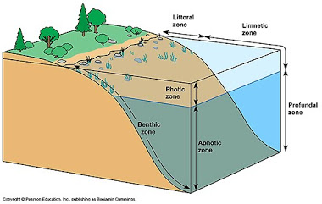

Slide 16
Littoral Zone
warmest since it is shallow and can absorb more of the Sun’s heat
sustains a fairly diverse community
several species of algae (like diatoms)
rooted and floating aquatic plants
grazing snails
Clams
Insects
Crustaceans
Fishes
amphibians

Slide 17
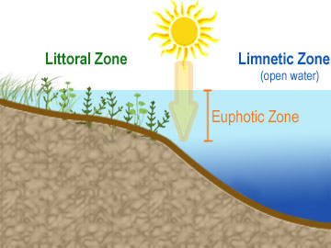
Littoral Zone
the egg and larvae stages of some insects are found in this zone
vegetation and animals living in the littoral zone are food for other creatures such as turtles, snakes, and ducks

Slide 18
Limnetic Zone
near-surface open water surrounded by the littoral zone
well-lighted (like the littoral zone) and is dominated by plankton, both phytoplankton and zooplankton
plankton are small organisms that play a crucial role in the food chain – most life would not be possible without them
variety of freshwater fish also occupy this zone

Slide 19
Profundal Zone
much colder and denser
little light penetrates all the way through the limnetic zone into the profundal zone
Plankton have short life spans—when they die, they fall into the deep-water part of the lake/pond
Animals found are decomposers

Slide 20
Photic zone
Primary production in the photic zone is influenced by three major factors
Nutrients
Light- For photosynthesis
Grazing pressure-the rate at which the plants are eaten by herbivores.

Slide 21
Photic zone
Nutrients, especially phosphate and nitrate, are often scarce in the photic zone because they are used up quickly by plants during photosynthesis.
External inputs of nutrients are received through:
Rainfall
Riverflow
Weathering of rocks and soil
Human activities- sewage dumping.

Slide 22
Benthic Zone
The area of the bottom.
Many groups and varieties of animals live here, a few are worms, crustaceans, and protozoa.
The life in this zone is mostly made up of bottom dwellers which get most of their food from dead and decaying organisms.
most of the organisms in the benthic zone are scavengers because they depend on dead flesh as their main food source.

Slide 23
PRODUCERS
• Phytoplankton, literally “wandering plants,” are microscopic
algae that float in the open water and give it a green
appearance. They carry out photosynthesis using carbon
dioxide that is dissolved in the water and release oxygen that
is used by the bacteria and animals in the pond.
Phytoplankton are not actually plants-they are protists!
• Periphytic algaeare microscopic algae that attach themselves to substrates and give the rocks and sticks a greenish brown slimy appearance. They also carry out
photosynthesis and produce oxygen, often near the bottom of the pond where it can be used by decomposers.
•

Slide 24
Submerged plants grow completely under
water
• Floating plants include plants that float on
the surface and plants that are rooted on the
bottom of the pond but have leaves and/or
stems that float.
• Emergent plants are rooted in shallow water
but their stems and leaves are above water
most of the time.
• Shore plants grow in wet soil at the edge of the pond

Slide 25
CONSUMERS
• Zooplankton are microscopic animals that eat phytoplankton or smaller zooplankton. Some are single-celled animals, tiny crustaceans, or tiny immature stages of larger animals.
Zooplankton float about in the open water portions of the pond and are important food for some animals.
• Invertebrates include all animals without backbones.
Macro invertebrates are big enough to be seen with the naked eye. Some of them are only found in clean water.
• Vertebratesare animals with backbones. In a pond these might include fish, frogs, salamanders, and turtles.

