Slide 1
EVOLUTION OF MAN

Slide 2
Classification of Homo sapiens
Kingdom: Animalia
Phylum: Chordata
Class: Mammalia
Order: Primates
Sub-order: Lemuroidea – Lemurs & Lorises
Sub-order: Tarsiodea - Tarsier
Sub-order: Anthropoidea
Super-family: Ceboidea – New World Monkeys
Super-family: Cercopithecidae – Old World Monkeys
Super-family: Hominoidea – Apes and Humans
Family: Pongidae - Apes
Family: Hominidae - Humans

Slide 4
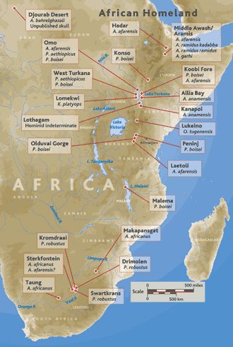
Hominid Sites
Earliest fossil hominid sites are in Africa
They now span the latest Miocene to the early Pleistocene from about 6-7 mya to about 1.6 mya
The major groups of sites are:
Ethiopia = Middle Awash valley & Hadar (Australopithecus afarensis)
Kenya = Lake Turkana
Tanzania = Olduvai Gorge
South Africa = various sites in limestone caverns centered around Sterkfontein

Slide 5
Australopithecus: the first hominids
Oldest member: Australopithecus afarensis
Lived 3.6 million years ago in Africa and became extinct about 3 million years ago.
Bipedal but with rather ape-like skeletal features and general appearance
Cranial capacity of about 650 c.c.
Split into four branches:
Australopithecus africanus
Australopithecus robustus
Australopithecus boisei
Homo habilis

Slide 6
Homo habilis
The first tool makers
Evolved from Australopithecus about 2 billion years ago
Became extinct 1.6 million years ago
Cranial capacity of 700-800 c.c.
Made tools
Lived in small groups
Gathered and shared food

Slide 7
Homo erectus
Replaced Homo habilis
Date back about 1.5 million years to 0.3 million years.
Diverse and abundant cultural artifacts recovered along with their fossils
Cranial capacity of 900 c.c.
Walked upright
Made better tools than H. habilis
Clothed themselves with animal skins
Moved into caves and established home sites for sharing food and raising young
Used fire for cooking and keeping themselves warm

Slide 8
Homo sapiens
Probably evolved from Homo erectus about 0.3 million years ago.
Gave rise to two varieties:
Homo sapiens neanderthalensis (Cranial capacity: 1450-1500 c.c.)
Homo sapiens sapiens (Cranial capacity: 1400 c.c.)
Cro-Magnon man replaced Neanderthals about 35,000 years ago and ceased to exist as a separate race by 10, 000 years ago.

Slide 9
Modern man
Modern man emerged 10, 000 years ago from dark, damp caves; built huts; domesticated wild dogs and learned to plant crops and store food grains.
Cranium globular with cranial capacity of 1200-1500 c.c.
Thinking and speech centres well developed.
From that point onwards, human evolution has clearly been cultural rather than biological, with groups spreading throughout the world.

