Slide 1
Taxonomy: Classifying Life
An Introduction
Notes:
Estimated numberTaxonomy
(Greek, taxis = arranged; nomos = law)
☻ Making and maintaining collection
☻ Differentiating species
☻ Identification (Keys) and diagnosis of species and genera
☻ Naming and describing species and genera
Systematics
(Greek, systema = a whole made of several parts)
☻ Develops the classification of organisms
☻ Species comparison and grouping into higher categories
☻ Organisms are arranged in definite, hierarchical order
☻ The order of the system is based on hypotheses of common descent
( “ Study of the kinds and diversity of organisms and the relationships between them”)

Slide 2
THE NEED FOR CLASSIFICATION
Since life first appeared on Earth 3.5 billion years ago,
many new types of organisms have evolved. Many of these organisms have become extinct, while some have developed into the present fauna and flora of the world. Extinction and diversification continue,
THE OVER ALL INCREASE IN BIODIVERSITY
10 million to 13 million species on Earth
Notes:
All this contributing to the changing biodiversity

Slide 3
THE CONFUSING REGIONAL NAMES , the need for Binomial Nomenclature
the bird Europeans commonly call a robin is a different species of bird from the robin Americans recognize.

Slide 4
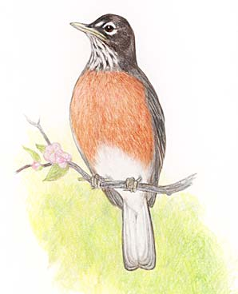
European Robin
Erithacus rubecula,
American Robin
Turdus migratorius.

Slide 5
HISTORY OF TAXONOMY

Slide 6
herbs, shrubs, and trees,
Traditionally, organisms were grouped by physical resemblances,
Grouping plants, animals, and microorganisms into increasingly broader categories based on shared features.
Notes:
Since the prehistoric times

Slide 7
Aristotle 300s bc
Taxonomy is one of the oldest sciences, still a vigorous field full of new discoveries and methods.
great thinkers have shaped the course of classification.
An earliest classification schemes was established by the Greek philosopher Aristotle,
According to him complexity of life could be divided into a natural order based on dichotomies.
those with blood and those without blood,
Notes:
those with blood and those without blood, a classification that roughly corresponds to the division between vertebrates and invertebrates used in contemporary classification schemes.

Slide 8
the Middle Ages: 5th century to the 15th century ad
scholars translated the common names of organisms into Latin—at the time the language of educated persons.
These names were often long and cumbersome, and included numerous descriptive terms. This complex naming process was simplified into a binomial, naming system in the mid-16th century to mid-17th century by a group of naturalists known as herbalists.
Notes:
As sometime back Persian, and now English

Slide 9
16th-century
Italian botanist Andrea Cesalpino was the first scientist to classify plants primarily according to structural characteristics, such as their fruits and seeds.
He developed a method of character weighting in which he defined certain key characteristics that were important for recognizing plant groups.
This method was adapted by Swiss botanist Caspar Bauhin, who catalogued an extensive list of plants. More importantly, Bauhin was the first to organize plants into a crude system that resembles modern genera and species.

Slide 10
Animal classification also advanced in the 16th century.
French naturalist Pierre Belon extensively studied and catalogued birds. He was the first to use adaptation to habitat to divide birds into such groups as
aquatic birds, Wading birds
, birds of prey, perching birds, and land birds, categories still used informally today.
Notes:
bird of prey noun
bird that kills for food: a bird that kills for food and has sharp talons and a sharp curved beak. Owls, eagles, and hawks are birds of prey.
Microsoft® Encarta® 2009. © 1993-2008 Microsoft Corporation. All rights reserved.
passerine pas·ser·ine [pássə rn, pássə rn]
adjective
relating to perching songbirds: relating or belonging to a group of mainly perching songbirds, which forms the largest order of birds including more than half of all bird species. Order: Passeriformes
noun (plural pas·ser·ines)
passerine bird: any bird that belongs to the passerine order
[Late 18th century. < late Latin passerinus "of sparrows" < Latin passer "sparrow"]
Microsoft® Encarta® 2009. © 1993-2008 Microsoft Corporation. All rights reserved.
perch [purch]
noun (plural perch·es)
1. place for bird to sit: a place for a bird to land or rest, e.g. a branch or a pole in a cage 2. resting place: any temporary resting place for a person or thingMicrosoft® Encarta® 2009. © 1993-2008 Microsoft Corporation. All rights reserved.

Slide 11
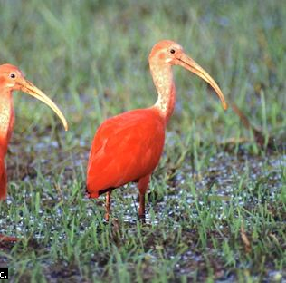
Wading Birds
Scarlet Ibis
European Cranes

Slide 12
17th century,
English naturalist John Ray was the first to apply the character weighting method to structural features in animals. He used key characteristics, such as the shape and size of the bird beak, to classify birds.

Slide 13
mid-1700s, Carolus Linnaeus
Linnaeus(1707-1778) was born into a religious family in a small town in rural Småland. His father, a minister with a passion for plants, had a large garden through which he introduced his son to botany. Linnaeus became enamored with natural history and pursued this interest in every subsequent educational setting. In 1727 he entered the University to study medicine, largely because the training included materia medica (the study of botany). The following year, he studied in Uppsala because the university there had better botanical holdings and a large community of botanists. Linnaeus discovered problems in the systematic arrangement for botany and began to sketch his own classification method as early as 1730. By the time he left Sweden in 1735 to complete his medical education in Holland, Linnaeus's reputation as a botanist was secure.

Slide 14
developed formal rules for a two-name system
similar organisms are grouped into a genus, and each organism is given a two-word Latin name.
The first word is the genus name, and the second word is usually an adjective describing the organism, its geographic location, or the person who discovered it. Using this system, the domestic dog is Canis familiaris. Canis is the genus name for the group of animals that includes dogs, wolves, coyotes, and jackals. The word familiaris acts as a descriptor to further differentiate the domestic dog from its wild cousins.
Notes:
Swedish naturalist Carolus Linnaeus

Slide 15
The Immutable Species
In 1751 Linnaeus published Philosophia botanica, his most influential work. In it, he claimed that a natural system of classification could be derived from God's original, immutable creation of all species.
Linnaeus was the first to formalize the use of higher taxa in his book Systema Naturae (1735), establishing the standard hierarchy taxonomy still in use today.

Slide 16
The Linnaeus System
The Linnaeus System of Classification was based on the similarities and differences and thus it was an arbitrary logical classification but many of his taxa are still accepted, though today the dominant theme of taxonomy based on shared ancestry, which is called as natural classification.

Slide 17
Development of the Natural System and the Success of Linnaean system
classify by any criterion we choose. This is true in classifying organisms, as well.
There is however a practical question: what do we learn from our classification? How useful is it
If we classify by an arbitrary criterion, then knowing an organism's placement within the classification can be remarkably uninformative. For example, if we classify bacteria on the basis of shape.
Ideally, classification , on their genealogy. This is uniquely useful because knowing that two organisms are closely related tells us that they will have many properties in common.
Notes:
classify by any criterion we choose. This is true in classifying organisms, as well. We can classify by size, shape, color, alphabetical order .^{l}There is however a practical question: what do we learn from our classification? How useful is it? Is there a preferred classification of organisms from which we can learn more than we can from alternative classifications?
If we classify by an arbitrary criterion, then knowing an organism's placement within the classification can be remarkably uninformative. For example, if we classify bacteria on the basis of shape (i.e., rod, coccus, spiral, etc.), then knowing an organism's classification tells us little more than its shape. We cannot begin to guess whether it is pathogenic.
Ideally, classification on the relationships of the organisms, that is, on their genealogy or phylogeny. This is uniquely useful because knowing that two organisms are closely related tells us that they will have many properties in common.

Slide 18
Linean Classification is Still Acceptable
Darwin referred to a classification based on evolutionary history as a natural system.
In recognizing the parallel between phylogenetic closeness and species similarity, Darwin explained why the Linnaean system had been so successful for macroscopic plants and animals: they had been placed into the hierarchical groups of the Linnaean classification on the basis of similarities, and because these similarities reflected the evolutionary closeness of the respective species, the classification tended to reflect their historical relationships.
In general, when similarities due to common ancestry are easy to recognize and measure, a classification of the organisms tends to approximate a natural system.
The original successes of the Linnaean system were largely limited to higher plants and animals which have numerous features that can be seen and compared.
similarities really are the result of inheritance from a common ancestor that also possessed the shared feature.

Slide 19
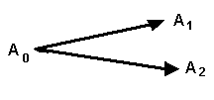
A Consequence of Common Ancestry Is Residual Similarity of Species
Species A₁ and A₂ must each bear residual similarity to A₀ (their most recent common ancestor), so they must also be similar to each other.
Turning this around, the most similar species today tend to be those that share the most recent common ancestry.
Similarly, More distinct species tend to have more remote common ancestry.
Darwin saw that once we accept this perspective, then we inevitably have accepted the common ancestry of all life.
Notes:
Most similarities between present-day species are due to their common ancestry. To first approximation, the more recent their common ancestry, the more similar two species will be (the more properties they will share).
THUS ALTHOUGH LINNAEUS BELIEVED IN THE IMMUTABILITY OF SPECIES, YET DUE TO THE ABOVE MENTIONED PHENOMENON THE CLASSIFICATION THAT HE DEVELOPED WAS A NATURAL ONE.

Slide 20
The Taxa
hierarchical categories called taxa (taxon, singular
The base level in the taxonomic hierarchy is the species
Each successive taxon is distinguished by a broader set of characteristics
Notes:
By the time Lineaus complted his deleberations the main idea of the taxa like Species Genus Family Order Classs Phylum Kindome had been estiblished.
Species is a group of interbreeding organisms and isolated from other such groups.

Slide 21
The Taxa
Each successive taxon is distinguished by a broader set of characteristics
CLASS
ORDER
FAMILY
GENUS
SPECIES
PHYLUM

Slide 22
How to Remember Classification Order
King Phillip Came Over For Great Spaghetti
Kings Play Cards On Fat Green Stools

Slide 23
The Darwinian Period, the immutability of Species was dicarded
Before the 19th century, Linnaeus and other taxonomists classified organisms in an arbitrary but logical way that made it easier to communicate scientific information. But with the publication of On the Origin of Species in 1859 by British naturalist Charles Darwin, the purpose of classification took on new meaning. Darwin argued that classification systems should reflect the history of life—that is, species should be related based on their shared ancestry. He defined species as groups that have diverged from a shared ancestry in recent history, while organisms in higher taxa, such as genera, class, or order, diverged from a shared ancestor further back in history

Slide 24
Use of microscopes in the late 16th century
single-celled organisms, new classification problems, for scientists, still relying on a two-kingdom classification system.
Doing photosynthesis were classified in Kingdom Plantae, and organisms that ingested food were placed in Kingdom Animalia.
By the 19th century, microscopic organisms with diverse cell anatomies, specialized internal structures called organelles, and reproductive patterns that did not easily fit into the plant or animal classification system. This great diversity prompted German biologist Ernst Haeckel to propose placing these unicellular forms in a third kingdom, the Protista.

Slide 25
Haeckel placed bacteria within the Kingdom Protista in a separate group Monera, recognizing their lack of nuclei.
And lack of membrane-bound organelles, such as mitochondria, Led French Marine Biologist
Edouard Chatton to make a crucial distinction between prokaryotes,, and eukaryotes
Today Kingdome PROKARYOTE

Slide 26
In the 1950s, American biologist Robert H. Whittaker proposed adding a fifth kingdom, Kingdom Fungi, based on fungi’s unique method of obtaining food
Carl Woese initially proposed a six-kingdom classification system, in which he separated prokaryotic organisms into two kingdoms, the Archaebacteria and Eubacteria, or true bacteria, and placing eukaryotic organisms into the Kingdoms Plantae, Animalia, Fungi, and Protista.
later advocated the use of a new category the domain. I, all life forms are grouped into three domains: bacteria, archaea, and eukarya.

Slide 27
METHODS OF CLASSIFICATION

Slide 28
For many organisms, molecular systematics studies have supported traditional classification; however, in some cases, the evidence from genetics studies has indicated that organisms should be reclassified.
Skunks, for example, traditionally have been classified with badgers, and minks in the family Mustelidae. But recent studies of molecular traits indicate that skunks differ significantly from these animals and may warrant classification in their own family.

Slide 29
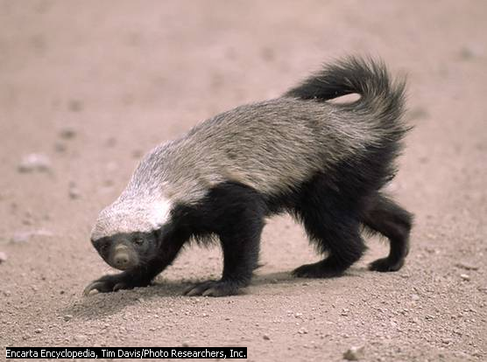
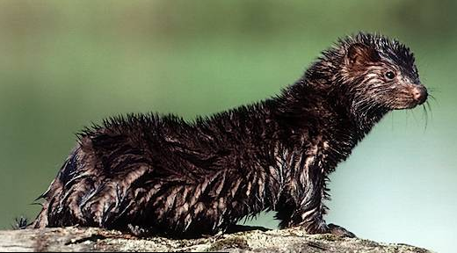
Skunk
Badger
Mink
Notes:
skunk skunk [skungk]
noun (plural skunks or skunk)
1. black-and-white mammal: a black-and-white animal of the weasel family that ejects a foul-smelling liquid from an anal gland as a defensive action. Native to: North, South America. 2. offensive term: an offensive term for a person considered to be despicable (slang insult) 3. drugs Same as skunkweed (sense 2) (slang)
transitive verb (past and past participle skunked, present participle skunk·ing, 3rd person present singular skunks) (slang)
1. defeat somebody soundly: to defeat an opponent soundly, especially by not allowing him or her to score any points in a sports competition 2. cheat: to cheat somebody out of something
[Mid-17th century. < Massachusett]
Mink are mammals whose sleek bodies make them very agile in water, where they hunt for fish and shellfish, the staples of their diet. The North American mink, shown here, averages about 60 cm (about 24 in) in length, including the tail. Luxurious, durable mink fur is a valuable commodity; to satisfy the fur industry, the animals are bred for specific color varieties and raised on large farms.
Encarta En
Microsoft ® Encarta ® 2009. © 1993-2008 Microsoft Corporation. All rights reserved.

Slide 30
How Organisms are Grouped
Morphology
physiology
Biochemistry
Ethology
Molecular taxonomy
Based on DNA similarities or differences
Notes:
Due to the massive diversification and extinctions that have taken place in the past history of Earth, scientists are frequently encountering fluctuations that may affect the way an organism is classified.

Slide 31
The Classical Approach, based on morphological similarities and differences
Bats and Birds Insects Animalia
Insects Arthropoda
Bats mammals
Birds Aves

Slide 32
IDEAL classification should be based on
homology; that is, shared characteristics inherited from a common ancestor.
The more recently two species have shared a common ancestor, the more homologies they share, and
the more similar these homologies are.

Slide 33
Until recent decades, the study of homologies was limited to
anatomical structures and
pattern of embryonic development
birth of molecular biology,
homologies studied at the level of
_____proteins and
_____ DNA
DNA-DNA Hybridization
Chromosome Painting
Comparing DNA Sequences

Slide 34
Anatomical homology: an example
different functions as throwing, swimming, and flying, the same basic structural plan is evident in them all. in color is the radius.
Body parts are considered homologous if they have the same basic structure, the same relationship to other body parts, and, develop in a similar manner in the embryo.
we interpret the persistence of the basic pattern as evidence of inheritance from a common ancestor, we see that the various modifications are adaptations of the plan to the special needs of the organism. It tells us that evolution is opportunistic, working with materials that have been handed down by inheritance.

Slide 35
Embryonic Development

Slide 36
Embryonic Development
The embryonic development of all vertebrates shows remarkable similarities.
The top row are of the embryonic stage pharyngula.
all contain a:
notochord
dorsal hollow nerve cord
post-anal tail, and
paired branchial grooves.
The branchial grooves are matched on the inside by a series of paired gill pouches. In fishes, the pouches and grooves eventually meet and form the gill slits, which allow water to pass from the pharynx over the gills and out the body.
Notes:
In fishes, the pouches and grooves eventually meet and form the gill slits, which allow water to pass from the pharynx over the gills and out the body.
In the other vertebrates shown here, the grooves and pouches disappear. In humans, the chief trace of their existence is the eustachian tube and auditory canal which (interrupted only by the eardrum) connect the pharynx with the outside of the head.

Slide 37
Recapitulation
"ontogeny recapitulates phylogeny" Ernst Haeckel; that is, embryonic development (ontogeny) repeats phylogeny (the genealogy of the species).
This is a distortion of the truth. It implies, for example, that early in our embryonic development we go through a fishlike stage.
Rather, we pass through some (not all) of the embryonic stages that our ancestors passed through. Therefore, we find that the more distantly related two vertebrates are, the shorter the period during which they pass through similar embryonic stages (fish and human) and vice versa (fish and salamander).

Slide 38
Molecular Biology
Protein Sequences
Protein sequencing provides a tool for establishing homologies from which genealogies can be constructed and phylogenetic trees drawn.
Human and other animals Hemoglobin An example of molecular homology.
On The Next Slide The numbers represent the number of amino acid differences between the beta chain of humans and the hemoglobins of the other species. In general, the number is inversely proportional to the closeness of kinship.

Slide 40
Cytochrome C
Cytochrome c is found in the mitochondria of every aerobic eukaryote — animal, plant, and protist. The amino acid sequences of many of these have been determined, and comparing them shows that they are related.
Human cytochrome c contains 104 amino acids, and 37 of these have been found at equivalent positions in every cytochrome c that has been sequenced.
Assumption: each of these molecules has descended from a precursor cytochrome in a primitive microbe that existed over 2 billion years ago. In other words, these molecules are homologous.
Notes:
Cytochrome c is part of the respiratory chain down which electrons are passed to oxygen during cellular respiration.
This table shows the N-terminal 22 amino acid residues of human cytochrome c with the corresponding sequences from six other organisms aligned beneath. A dash indicates that the amino acid is the same one found at that position in the human molecule

Slide 41
Cytochrome C
the more identities there are between two molecules, the more recently they have evolved from a common ancestral molecule and thus the closer the kinship of their owners.
Thus the cytochrome c of the rhesus monkey is identical to that of humans except for one amino acid, whereas yeast cytochrome c differs from that of humans at 44 positions. (There are no differences between the cytochrome c of humans and that of chimpanzees.)

Slide 42
The first step in comparing sequences is to align them to find the maximum number of positions that have the same amino acid. Sometimes gaps are introduced to maximize the number of identities in the alignment (none was needed in this table). Gaps correct for insertions and deletions that occurred during the evolution of the molecule.
All the vertebrate cytochromes (the first four) start with glycine (Gly). The Drosophila, wheat, and yeast cytochromes have several amino acids that precede the sequence shown here (indicated by <<<).
In every case, the heme group of the cytochrome is attached to Cys-14. and Cys-17.
In addition to the two Cys residues, Gly-1, Gly-6, Phe-10, and His-18 are found at the equivalent positions in every cytochrome c that has been sequenced.

Slide 43
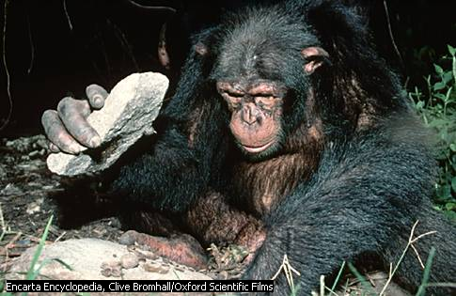
Ape, any of 13 species of large, highly intelligent primates, including chimpanzees, gorillas, gibbons, and orangutans. Apes are sometimes confused with monkeys, but unlike their smaller primate counterparts, apes do not have tails and their arms are usually longer than their legs. Apes live in tropical woodlands and forests of Africa and Asia

Slide 44
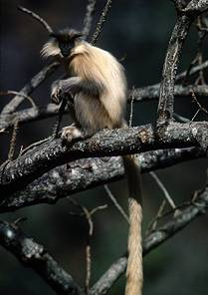

Slide 45
