Slide 1
POLYTYPIC SPECIES
Having several variant forms, especially containing more than one taxonomic category of the next lower rank.
A polytypic genus contains two or more different species, while a polytypic species consists of two or more subspecies.

Slide 2
Polytipic species
Contain two or more subspecies.
Most of the widely distributed species are polytypic.
15 subspecies of scorpion (Mesobuthus eupeus), in 15 type localities have been identified in the middle east and 35 subspecies of the kangaroo rat, the N. American rodent(Dipodomys ordii) in 35 localities.
In biological terms, rather than in relation to nomenclature, a polytypic species has two or more subspecies, races, or more generally speaking, populations that need a separate description.

Slide 3
These are separate groups that are clearly distinct from one another and do not generally interbreed (although there may be a relatively narrow hybridization zone), but which would interbreed freely if given the chance to do so.
These subspecies, races, or populations, can be named as subspecies by zoologists, or in more varied ways by botanists and microbiologists.

Slide 4
Monotypic species
without any sub species.
No distinct population or races, or rather one race comprising the whole species.
A taxonomist would not name a subspecies within such a species.
Monotypic species can occur in several ways:
1. All members of the species are very similar and cannot be sensibly divided into biologically significant subcategories.

Slide 5
2. The individuals vary considerably, but the variation is essentially random and largely meaningless so far as genetic transmission of these variations is concerned.
3. The variation among individuals is noticeable and follows a pattern, but there are no clear dividing lines among separate groups: they fade imperceptibly into one another.
Such clinal variation always indicates substantial gene flow among the apparently separate groups that make up the population(s).

Slide 6
Populations that have a steady, substantial gene flow among them are likely to represent a monotypic species, even when a fair degree of genetic variation is obvious.

Slide 7
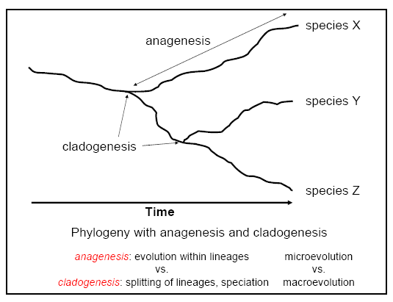

Slide 8
Micro-evolution (by mutation, genetic drift, sexual selection, and/or natural selection) leads to differences between populations
Population = a finite collection of conspecific individuals living in the same area and having the potential to mate with one another (also called demes)
When “enough” differences have accrued, macro-evolution can occur.
Macro-evolution = the production of new species

Slide 9
Polytypic species
= single species of geographically and
morphologically different populations
The Result of Microevolution
the Bengal tiger is Panthera tigris tigris, and
the Sumatran tiger Panthera tigris sumatrae.
Notes:
Zea mays parviglumis
Zea mays mays

Slide 10
Bengal and Sumatran tigers are two subspecies of the same species.
They naturally range in two different regions of Asia.
Bengali tiger has proven themselves with their abilities to survive in a range of habitats including cold mountains and hot mangroves. However, Sumatran subspecies range mostly in forested areas.
Bengal tiger is significantly bigger in size and weight than in Sumatran tigers. Sumatran tiger is the smallest tiger in their family.

Slide 11
The current population of Bengal tiger is about 2000, but Sumatran tiger are only 300 survivors presently. The IUCN has categorized Bengal and Sumatran tigers as endangered and critically endangered respectively.
The strip of the coat of the Bengal tiger is thicker than in Sumatran tiger.
Bengal tiger is a national animal of a country but Sumatran tiger has not gain that kind of value. However, both these are flagship species.

Slide 12
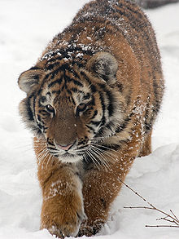
Example
Siberian Tiger
Bengal Tiger
India, Bangladesh,
Nepal, Bhutan
China and North Korea

Slide 13
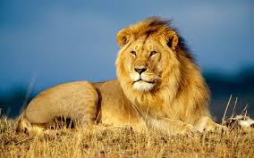
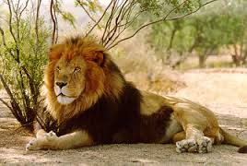
Example
African Lion
Asiatic Lion

Slide 14
The species of Linnaeus and Ray:
at a given locality a species is usually separated from other sympatric species by a complete gap.
Free of time and space, non-dimensional, local species can be delimited clearly.
In real situations every species consists of numerous local populations.
If some of these are sufficiently different from the original type population of the species and from previously named subspecies , Then it is a new species.
Notes:
In real situations every species consists of numerous local populations. If a taxonomist finds some of these as sufficiently different from the original type population of the species and from previously named subspecies he calls it a new species.

Slide 15
Importance of Polytypic Species:
In birds, mammals, butterflies, the recognition of polytypic species has led to the simplification of classification.
Many groups among them were previously described as monotypic species. For instance, the 19000 monotypic species of birds were reduced to 8,600 species.
Awarding species rank to slightly different local populations had destroyed the biological significance of species category.
Notes:
In birds, mammals, butterflies, and other well-known animals the recognition of polytypic species has led to the simplification of classification. Many groups among them were previously described as monotypic species. For instance, the 19000 monotypic species of birds were reduced to 8,600 species.
Awarding species rank to slightly different local populations had destroyed the biological significance of species category. Assorting such varieties into polytypic species restores the significance of species.

Slide 16
Establishing polytypic species,
The difficulties
Polytypic species are composed of allopatric or allochronic populations, Which are different but then all the sexually reproducing populations shows differences, so some standard is to be set before recognizing a sub species

Slide 17
Establishing polytypic species,
The difficulties
Occasionally closely related species with similar ecological requirements replace each other geographically and yet are full species and not subspecies.

Slide 18
the occurrence of polytypic species in the animal Kingdom

Slide 19
More common in widely distributed species, tend to form geographical isolates.
Up to 80 % of species are polytypic in such situations.
In specialized species e.g. host-plant specific insects do not form polytypic species.
Polytypic species are also rare in groups with slight species differences e.g. groups of sibling species.
Notes:
The phenomenon differs from group to group.
Some highly specialized species e.g host-plant specific insects do not form polytypic species. Polytypic species are also rare in groups with slight species differences e.g groups of sibling species.

Slide 20
Sibling Species
“The species which are morphologically
similar but reproductively isolated.”
Sibling species can not interbreed among
themselves.
Sibling species is one taxonomic species because
have same morphology but they are different
biological species because they cannot
interbreed.

Slide 21
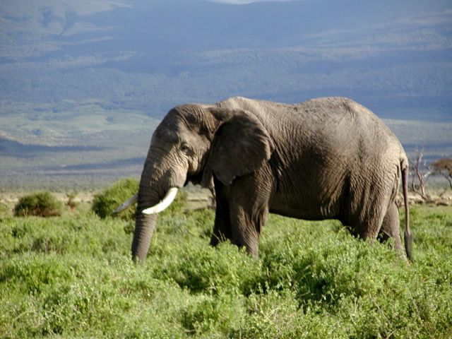
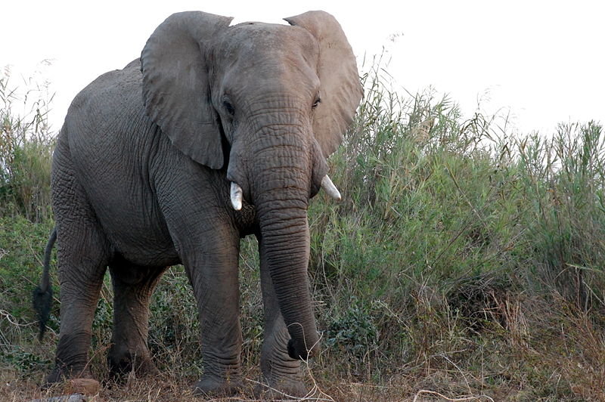
Example
The African forest elephant is the African bush elephant's sibling species.
African bush elephant
African forest elephant

Slide 22
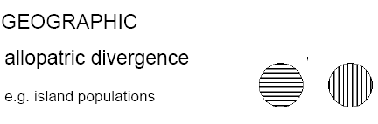

Slide 23
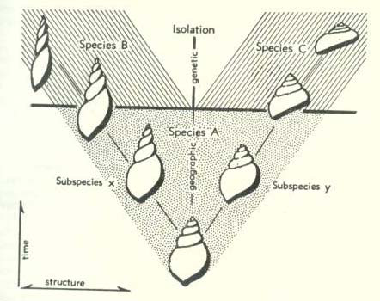
Allopatric speciation corresponding to isolation
Notes:
wagat nay keey, kia haseen situm
tum rahay tum, hum rahay na hum

Slide 24
The polytypic species is the lowest of the higher categories.
It lacks simplicity and objectivity of the non-dimensional species(Linnaeus and Ray).
Most of the difficulties of delimiting species of animals concern situations where there is doubt as to whether two allopatric populations belong to the same polytypic species or not.
Among birds, even such borderline cases are in minority.
Notes:
The claim that such difficulties are more frequent in other groups of animals still awaits verification.
Most of the difficulties of delimiting species of animals concern situations where there is doubt as to whether two allopatric populations belong to the same polytypic species or not.
Among birds, even such borderline cases are in minority.

Slide 25
Terms used for Infraspecific Categories
Varieties
Subspecies
Founders,
Clines
Rings
Notes:
The Variety The only subdivision of species recognized by Linnaeus. A variety designated any deviation from the type of the species. So the varieties of early taxonomist were a heterogeneous potpourri of individual variants and races.
Subspecies In 19th century it was used in the meaning of geographical race and replaced the term variety. It was considered a taxonomic unit like the morphological species but at a lower taxonomic level.
When an author reports several subspecies of one species from the same locality it indicates a wrong usage of the term. Subspecies are normally allopatric and allochronic.
Subspecies is a category quite different from the species. Unlike species, no non-arbitrary criterion is available to define a subspecies. Species is considered a unit of evolution but not the subspecies.
Definition: A subspecies is an aggregate of phenotypically similar populations of a species, inhabiting a geographic subdivision of the range of a species, and differing taxonomically from other populations of the species.

Slide 26
Infraspecific Categories.
Variety subdivision of species recognized by Linnaeus. A variety designated any deviation from the type of the species. a heterogeneous potpourri of individual variants and races.
Subspecies 19th century it was used for geographical race and replaced the term variety. It was considered a taxonomic unit like the morphological species but at a lower taxonomic level.
Notes:
Potpourri(pororee) collection of fragrant dried flowers: a collection of dried flower petals, leaves, herbs, and spices that is used to scent the air 2. miscellaneous mixture: a mixture of miscellaneous things.
subdivision of species recognized by Linnaeus. A variety designated any deviation from the type of the species. a heterogeneous potpourri of individual variants and races.
Subspecies 19th century it was used for geographical race and replaced the term variety. It was considered a taxonomic unit like the morphological species but at a lower taxonomic level.

Slide 27
Infraspecific Categories.
When an author reports several subspecies of one species from the same locality it indicates a wrong usage of the term.
Subspecies are normally allopatric and allochronic.
Notes:
Potpourri(pororee) collection of fragrant dried flowers: a collection of dried flower petals, leaves, herbs, and spices that is used to scent the air 2. miscellaneous mixture: a mixture of miscellaneous things.

Slide 28
Subspecies is a category quite different from the species.
Unlike species, subspecies is not a unit of evolution and no non-arbitrary criterion is available to define it.
Definition: A subspecies is an aggregate of phenotypically similar populations of a species, inhabiting a geographic subdivision of the range of a species, and differing taxonomically from other populations of the species.

Slide 29
Difficulties in the application of the Subspecies concept
.

Slide 30
Recognition of the polytypic species requires the use of the subspecies category
various aspects of geographic variation cause difficulties.
Some authors applied the term to individual variants and sibling species, many named insignificant local populations as subspecies.

Slide 31
Wilson and Brown 1953 motioned 4 aspects which reduce the usefulness of subspecies
Different characters show independent trends of geographic variation
The independent reoccurrence of similar populations in geographically separated areas.
Notes:
The tendency of different characters to show independent trends of geographic variation
The independent reoccurrence of similar or phenotypically indistinguishable populations in geographically separated areas.
The occurrence of microgeographic races with formally recognized subspecies.
The arbitrariness of the degree of distinction considered by different specialists as justifying sub-specific separation of slightly differentiated local populations.

Slide 32
Wilson and Brown 1953 motioned 4 aspects which reduce the usefulness of subspecies
The occurrence of microgeographic races with formally recognized subspecies.
The arbitrariness of the degree of distinction by different specialists as justifying sub-specific separation of slightly differentiated local populations.
Notes:
The tendency of different characters to show independent trends of geographic variation
The independent reoccurrence of similar or phenotypically indistinguishable populations in geographically separated areas.
The occurrence of microgeographic races with formally recognized subspecies.
The arbitrariness of the degree of distinction considered by different specialists as justifying sub-specific separation of slightly differentiated local populations.

Slide 33
Practical problems with Subspecies are,
How different must a population be in order to justify subspecific recognition?
How should the intermediate populations be treated?
How does one delimit subspecies against adjacent subspecies?

Slide 34
Practical problems with Subspecies are,
d. Shall one recognize polytypic subspecies for indistinguishable but geographically separated populations?
e. When should geographical isolates be called species and when subspecies

Slide 35
Species stage
Sub Species
Ancestral Stock

Slide 36
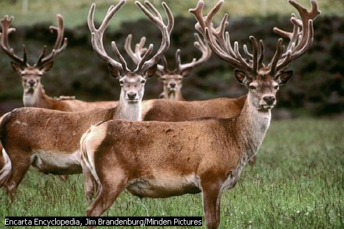
The nomenclature of subspecies Trinomial Three part name e.g The British red dear is
Cervus elaphus scoticus
Notes:
Cervus elaphus scoticus

Slide 37
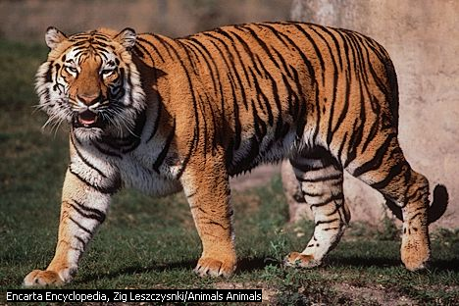
The Sub Species of Tiger Panthera tigris
Order: Carnivora,
Family: Felidae,
Genus: Pantherra
the Bengal tiger is Panthera tigris tigris,
Sumatran Panthera tigris sumatrae(in pic)
Indochinese Panthera tigris corbetti,
South China Panthera tigris amoyensis.
Notes:
the cat family, Felidae,

Slide 38
The three extinct subspecies
Caspian tiger Panthera tigris virgata
Javan tiger Panthera tigris sondaica
Bali tiger, Panthera tigris balica.
Notes:
the cat family, Felidae,

Slide 39
Temporal Subspecies
Paleontology: slightly different populations separated in time are often assigned to the subspecies category.
slightly different populations separated in time are often assigned to the subspecies category.
Subspecies found in succeeding strata may actually be geographic races that replaced each other owing to climatic changes.
The paleontologist applying subspecies category faces problems not faced by the neonatologist. There may be a differential deposition of various age classes and sexes in different horizons as well as the occurrence of non-genetic habitat forms.
Yet treating fossils as the remains of formally existing populations usually leads to a deeper analysis as well as to a better understanding of relationships and of the meaning of evolutionary trends.
Notes:
As with living species it must be kept in mind at all times that the subspecies is merely a classificatory device.
Paleontology:

Slide 40
Temporal Subspecies
The paleontologist applying subspecies category faces problems not faced by the neonatologist.
There may be a differential deposition of various age classes and sexes in different horizons as well as the occurrence of non-genetic habitat forms.
Yet treating fossils leads to a deeper analysis of relationships and meaning of evolutionary trends.
Notes:
As with living species it must be kept in mind at all times that the subspecies is merely a classificatory device.
Paleontology: slightly different populations separated in time are often assigned to the subspecies category.
Subspecies found in succeeding strata may actually be geographic races that replaced each other owing to climatic changes.
The paleontologist applying subspecies category faces problems not faced by the neonatologist. There may be a differential deposition of various age classes and sexes in different horizons as well as the occurrence of non-genetic habitat forms.
Yet treating fossils as the remains of formally existing populations usually leads to a deeper analysis as well as to a better understanding of relationships and of the meaning of evolutionary trends.

Slide 41
Species in paleontology
“Any of that large class of objects of organic origin that are of sufficiently distinctive and consistent morphology so that a competent paleontologist could define them so that another competent paleontologist could recognize them”.
Allan Shaw, 1964

Slide 42
Founder, Clines and Rings
Founder Species : Individuals isolated by chance that create a new gene pool which may diversify e.g Darwin’s Finches.
Clines: Gradient in features with in a species over space or time /A gradual change in a character or feature across the distributional range of a species or population, usually correlated with an environmental or geographic transition.

Slide 43
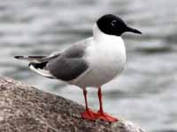
Ring Species: Cline over Space(biogeographic) that results in failure of end members to inter breed, e.g. European gulls.

Slide 44
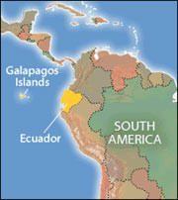
Founders
Founder species –
Individuals isolated by chance that create a new gene pool which may diversify

Slide 45
14 species of finch
Galápagos Islands are believed to have evolved from a single species Volatinia jacarina, abundant in Latin America.
Notes:
14 species of finch that inhabit the Galápagos Islands are believed to have evolved from a single species Volatinia jacarina, abundant in Latin America. The ancestral finch, with its short, stout, conical bill specialized for crushing seeds, probably migrated from the mainland to the Galápagos Island

