Slide 1
Spiders Families
Family Eresidae
Family Hersiliidae
Family Oecobiidae
Family Oonopidae
Family Pholcidae
Family Salticidae
Family Scytodidae
Family Uloboridae

Slide 2
Family Eresidae
The velvet spider (family Eresidae)
About 100 species in 10 genera
Almost totally Old World spiders (exception: a few species are known from Brazil).
The characteristics
Entelegyne (have a genital plate in the female),
Eight-eyed araneomorph spiders that build unkempt webs.
The Araneomorphae are a suborder of spiders.
They are distinguished by having fangs that oppose each other and cross in a pinching action, in contrast to the Mygalomorphae, which have fangs that are nearly parallel in alignment

Slide 3
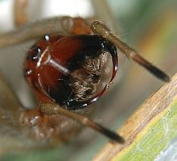
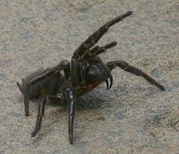

Slide 4
With the exception of Wajane, they are cribellate (use wooly silk).
Some species are nearly eusocial, lacking only a specialized caste system and a queen.
They cooperate in brood rearing, unlike almost most other spiders except for some African agelenid spiders in the genus Agelena and a few others.

Slide 5
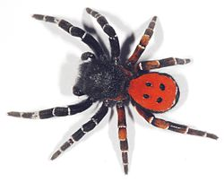
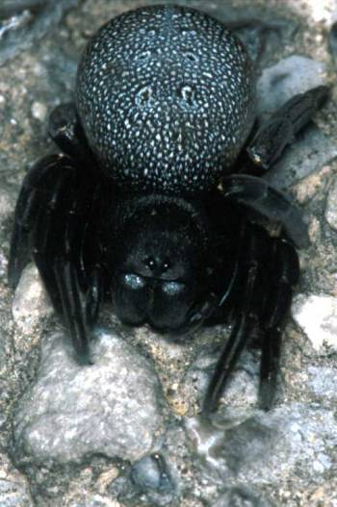
Eresus kollari
Eresus walckenaerius,

Slide 6
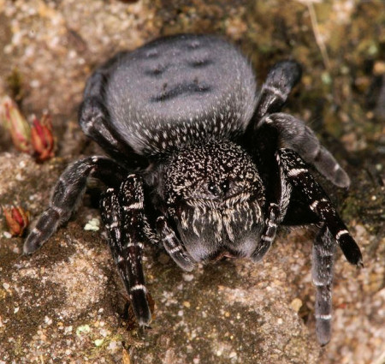
Eresus sandaliatus

Slide 7
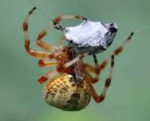
Family Hersiliidae
The tree trunk spiders are members of the tropical and semi-tropical Family Hersiliidae.
There are about 150 species in this family.
These spiders have two very prominent spinnerets that are almost as long as their abdomen.
A spinneret is a silk-spinning organ of a spider or the larva of an insect. Some adult insects also havespinnerets, such as those borne on the forelegs of Embioptera. Spinnerets are usually on the underside of a spider's abdomen, to the rear.

Slide 8
So they are also sometimes known as "two-tailed spiders.“
They range in size from about 10 mm (0.4 inch) to 18 mm (0.7 inch) long.
Being very well camouflaged for life on the varicolored trunks of trees, they have an interesting way of capturing prey.

Slide 9
Rather than making a web that captures prey directly, they lay a light coating of threads over an area of tree bark and wait hidden in plain sight for an insect to stray onto that patch.
Once that occurs, they direct their spinnerets toward their prey and circle it; all the while casting silk on it.
When the hapless insect has been thoroughly immobilized, they can bite it through its new shroud.

Slide 10
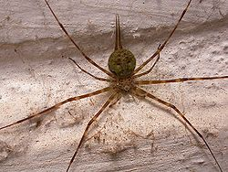

Slide 11
3.Family Oecobiidae
Also called Disc web spiders
About 100 described species so far.
Small- to moderate-sized spiders (about 2 mm to 2 cm head-and-body length, depending on the species
The larger species tend to be desert-dwelling.
The legs are unusually evenly placed around the prosoma; most other spiders have some legs directed clearly forward and the rest clearly backward, or all forward.
The first two pairs of legs of many Oecobiids point forward then curve backwards; somehow in a running spider this gives a curiously scurrying, wheel-like impression that is characteristic of many Oecobiidae, and is helpful as a rough-and-ready aid to identification in the field.

Slide 12
Characteristic of the family is the anal gland; it bears a tuft of long hairs.
Typical colour patterns range from dark-patterned cream in some smaller species, to a small number of symmetrically-placed, conspicuous round light spots (commonly yellow or white) on a background that may be anything from a dull orange colour to black.
The carapace is rounded and bears a compact group of six to eight eyes medially situated near the front of its dorsal surface.

Slide 13
Many Oecobiidae build small, temporary star-shaped webs on or under rocks, or on walls or gravel.
They hide near or below such webs and prey largely on ants, giving rise to common names such as "anteater" or "miervreter“.
Some of the Oecobiidae build tiny webs close to the ceilings in people's homes, which might have something to do with the family name (Oeco biidae meaning in essence "those who are house-living").
The species Oecobius navus occurs around the world.

Slide 14
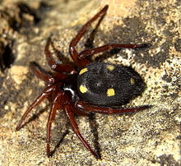
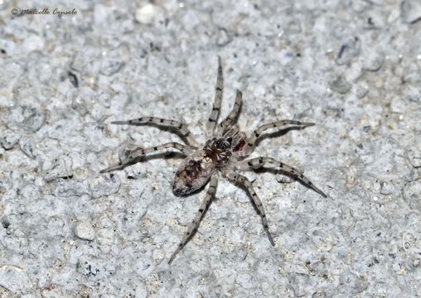
Uroctea durandi
Oecobius maculatus

Slide 15
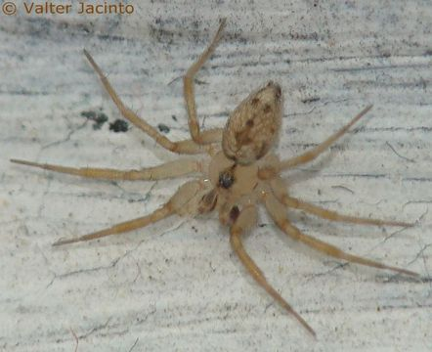
Oecobius maculatus

Slide 16
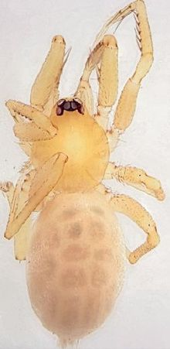
4.Family Oonopidae
Commonly known as goblin spiders
1,500 described species in about 100 genera worldwide
Total species diversity estimated at 2000 to 2500 species.
They are generally tiny (1-3 mm) haplogyne araneomorph spiders.
Some have hardened plates (scuta) on their abdomens.
Oonopids usually have six eyes, the anterior median eyes having been lost.
However, four-eyed (Opopaea viamao), two-eyed (e.g. Coxapopha,Diblemma) and even completely eyeless species (e.g. Cousinea, the cave-dwelling Blanioonops) are also known.

Slide 17
The family is permeated with unusual morphological traits, many of which are limited to males.
Examples include heavily modified mouthparts (e.g. Coxapopha,Xyccarph), sternal pouches (sometimes alternatively called holsters; e.g. Grymeus) and extensions of the carapace (e.g. Ferchestina,Unicorn).
The male pedipalps are also often highly modified
The genus Opopaea, for example, exhibits an expanded palpal patella while male Ischnothyreus are characterized by completely sclerotized, pitch-black pedipalps.

Slide 18
Members of the genus Orchestina are believed to be able to jump, as both sexes have greatly enlarged femora on the fourth leg pair.
Oonopidae are seldom seen by people as they are too small to be easily noticed.
Generally, oonopid spiders are found in the leaf litter layer and under rocks, but they also constitute a significant component of the spider fauna living in the canopy of tropical rain forests.
Three blind Afrotropical genera (Anophthalmoonops,Caecoonops, Termitoonops) are exclusively found in termite nests.
A few species, such as the pantropical Heteroonops spinimanus, are thought to be parthenogenetic as no males have yet been collected.

Slide 19
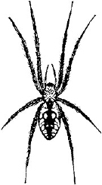
The Orb Weaver
A common spider in West Virginia.
The Orb Weaver is harmless.
Construct their webs between the foliage of plants or weeds.
Annoyance to hikers as they spin their webs among weeds and plants.

