Slide 1
Predator vs Prey

Slide 2
Predation
Act of capturing animals & being captured by
other animals as food is called as predation.
Predator: Animal that capture the other
animal as food.
Prey: Animal that is being captured.

Slide 3
Predators vs Prey
This interaction is defined as the series of adaptations among predators and prey to compete each other for survival within a specific ecosystem.
.

Slide 4
Evolutionary Arms Races
The gradual improvements among the predator’s tactics for foraging leads to the
improvements among the prey’s strategies for defense & vice versa.

Slide 5
Adaptations & Counter Adaptations
Predators
Prey
For searching
Improved visual activity.
Crypsis, mimicry, camouflage,disruptive coloration, warning coloration.

Slide 6
Count….
To recognize prey:
Evolve learning behavior
warning signals of toxicity & deceiving the predators by mimicry.
Olfactory signals.
Auditory signals.
Visual signals.

Slide 7
Count….
Escape flight
eyespots deflect attack weapons of defense.
For catching of prey
Motor skills
Secretive approaches
Speed and agility

Slide 8
Count….
For handling of prey:
subduing skills & detoxification abilities
active defense spines, tough integuments toxins etc.

Slide 9
Evolutionary arms race reveals
Uncover the evolution
Important for balancing the nature within
an ecosystem
Necessary for survival of animals
Race of adaptations and counter adaptations among all species of animals
Negative and positive interactions among predator/prey.
Dependence of populations of both (predator/prey) on eachother.

Slide 10
Mechanisms adapted by animals
Crypsis: ability of animal to hide the detection by other animals.
May be a predation strategy or anti predatory adaptation.
For example: Draco lizard, white spider for efficient predation and owl, moth as an antipredator adaptation.

Slide 11
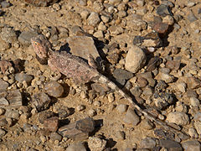
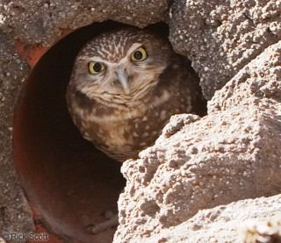
Crypsis in Draco lizard & owl

Slide 12
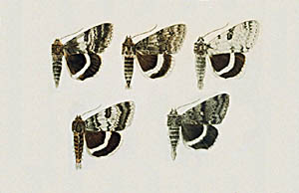
Polymorphic crypsis
Animal has more than one morphs. & rare or specific morphs are at risk, remaining are safe from predators. E.g. moth in north America.

Slide 13
Camouflage
Animals blend in with certain aspect of their environment.
Provide higher probability of reproduction and batter survival.
May be predation strategy or antipredation adaptation.
E.g. walking stick as defense, Leopard as a hunting tool

Slide 14
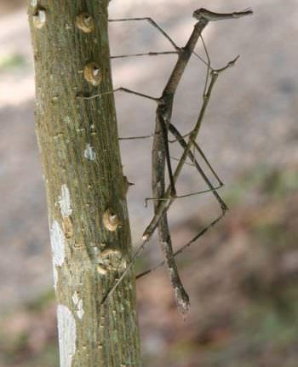
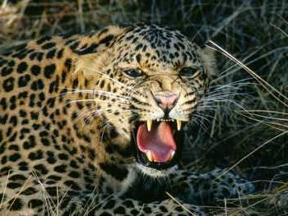
Walking stick & leopard

Slide 15
Warning coloration
serves to warn off potential predators. It is also called anosmatic coloration.
Insectivores birds associates green , blue for safety but red, yellow & orange as harm/danger so avoid insects of such colors or unpalatable insects.
so they avoid the insects of such colors for predation.
e.g. some butterflies – when birds eat them; suffered from vomiting , nausea, visual disturbance.

Slide 16
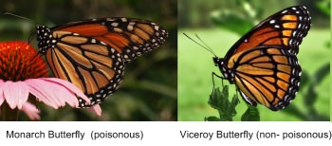
Mimicry
When an animal , insect looks like other dangerous , bad tasting or poisonous animal or insect.
E.g. king snake/ coral snake, hawk moth, butterflies.

Slide 17
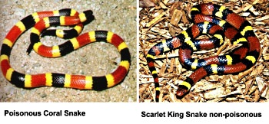
Mullerian mimicry & Batesian mimicry
When one species act as mimic & other as model.
When both mimic and model are disgust.
A predator does not have to taste both of species involved to encounter the disgust form.

