Slide 1
Camouflage & Mimicry

Slide 2
Camouflage
The act, means or result of obscuring things to
deceive an enemy.
Camouflage is a set of methods in which objects or animals remain unnoticed by blending with their environment or by resembling something else.

Slide 3
Count…
Mimesis
Dazzle Pattern
Crypsis

Slide 4
Camouflage by Mimesis
Mimesis means being seen, but resembling something else.
In Mimesis the whole animal looks like some other object
Mimesis is common in prey animals

Slide 6
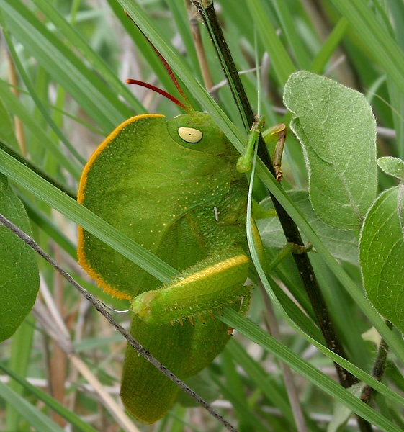

Slide 7
2- Dazzle pattern
Dazzle pattern means confusing the predator or enemy by moving a pattern
The Zebra's bold motion dazzle pattern may confuse predators, especially when many animals are close together and moving rapidly.

Slide 8
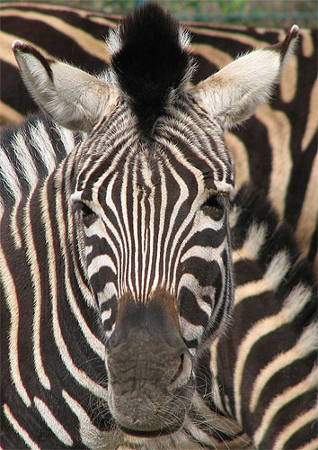

Slide 9
3. Camouflage by crypsis
Crypsis means blending with the background, making the animal hard to see. This can be achieved in many different ways including:
General resemblance to background
Disruptive pattern(breaking up outline)
Eliminating shadow
Crypsis by behaviour
Crypsis by changing skin pattern & color

Slide 10
3.1General resemblance to background
Some animals colors and patterns resemble a particular natural background
For example the Peppered Moth adult blends in with tree bark

Slide 11
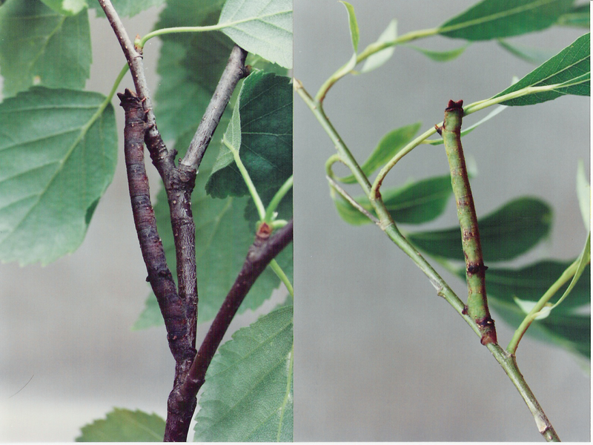

Slide 12
3.2 Disruptive pattern
Disruptive patterns use strongly contrasting markings such as spots or stripes to break up an animal's outlines
For example lion

Slide 13
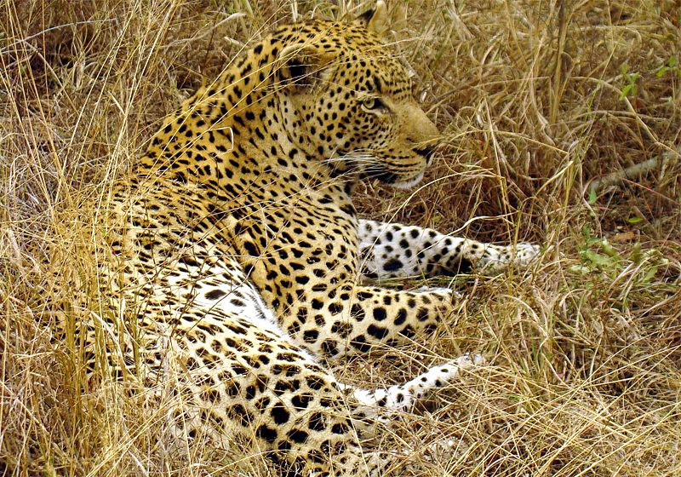

Slide 14
3.3 Eliminating shadow
Animals bodies are flattened, with the sides thinning to an edge; the animals habitually press their bodies to the ground and camouflage any dark shadow line that might fall along the body's edges
For example Horned Lizards of North America

Slide 15
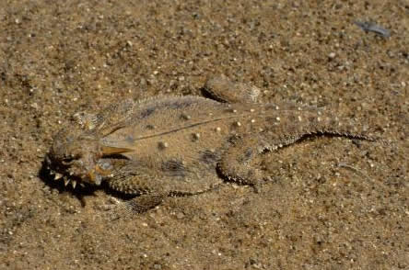

Slide 16
3.4 Crypsis by behaviour
Decoration, keeping still and lying flat
Some animals actively seek to make themselves cryptic by using materials from their environment, such as twigs, sand, or pieces of shell to conceal their outlines
For example Masked Hunter Bug nymph, camouflaged with sand grains

Slide 17
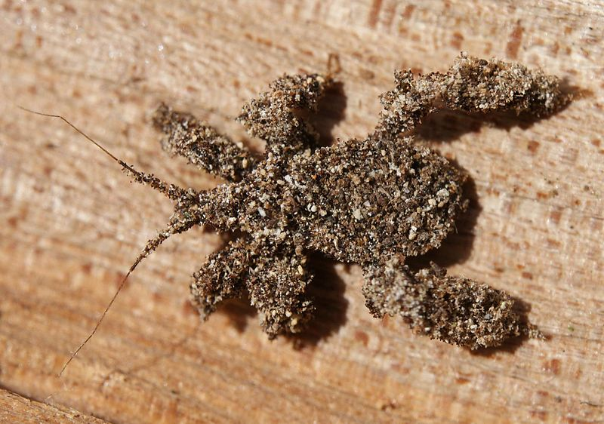

Slide 18
3.5Crypsis by changing skin pattern,colour
Animals actively and rapidly change their skin patterns and colours using special chromatophore cells to resemble their current background
For example Arctic Hares in the low arctic change from brown to white in winter

Slide 19
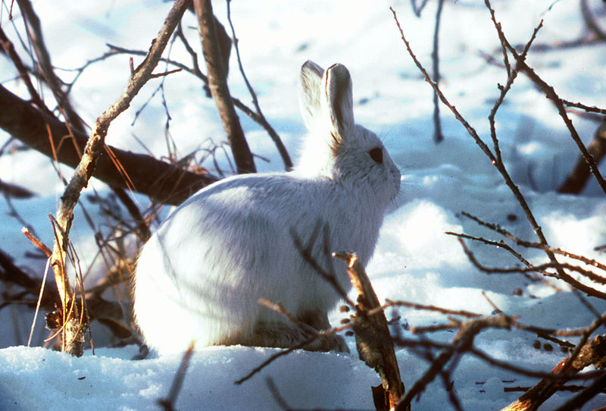

Slide 20
Mimicry
Mimicry is the similarity of one species to another which protects one or both. This similarity can be in
Appearance
Behaviour
Sound
Location

Slide 21
Classification
Defensive mimicry
Aggressive mimicry
Reproductive mimicry
Auto mimicry

Slide 22
Defensive mimicry
Defensive or protective mimicry takes place when organisms are able to avoid encounters that would be harmful to them by deceiving enemies into treating them as something else by warning coloration.

Slide 23
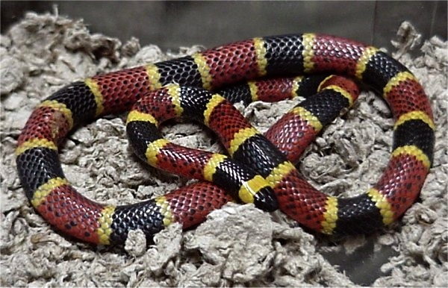

Slide 24
Auto mimicry
Auto mimicry or intra specific mimicry occurs within a single species, one case being where one part of an organism's body resembles another part.
Examples include snakes in which the tail resembles the head and show behavior such as moving backwards to confuse predators and insects and fishes with eyespots on their hind ends

Slide 25
