Slide 1
Population Ecology

Slide 2
Population
Group of individual which belongs to single species or several species occupying a particular area.
Monospecific Population
Polyspecific Population

Slide 3
Population Density
No of individual /unit area e.g lions/100 sq Km or
No of individual /volume e.g no of paramacium/L of water
This is for those animals having uniform size
But where size variation occur poplution measure in biomass

Slide 4
Count…
Crude density
Total no of individual or biomass/unit of total area or volume
Ecological density
Total no of individual or biomass/unit of total area or volume which is actually inhabited.
E.g during winter population of fish in pond

Slide 5
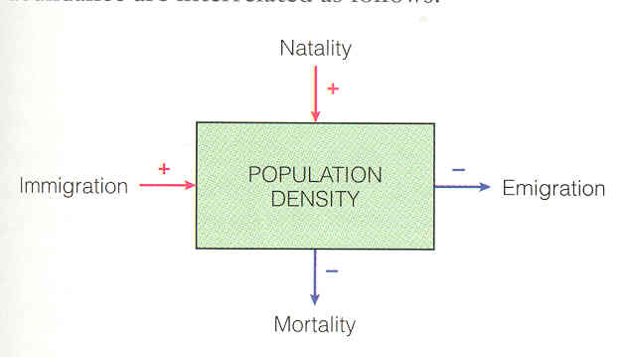

Slide 6
Population Estimation
Total count
Capture, mark and recapture
P= mc/r
Indirect methods

Slide 7
Natality
Rate at which new individual added to population
Fecundity –reproductive potential
Absolute or crude natality – number of new individuals per unit time
50 protozoa increase to 150 by division in one hour, then crude natality = 100
Specific natality – number of new individuals divided by the population size
400 births in one year in a town of 10,000
Absolute natality = 400
Specific natality = 400/10,000 = 0.04 = 4%

Slide 8
Mortality
Death rate
Natality Rates
Rate of increase or decrease of the population
Environmental factors
Age Composition
Mortality Rates

Slide 9
Mortality
Death rates/Unit time
Minimum Mortality
Theoretical
No of old age individuals die/unit time under ideal ecological conditions
Remains constant for population

Slide 10
Count…
Ecological Mortality
Actual no of individual die/unit time from a population
Ecological mortality is not constant for a population
Varies with environmental conditions
In terms of %age
In nature, actual mortality rates are high as compare to minimum mortality.

Slide 11
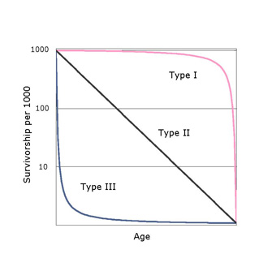
Survivalship Curves
Convex curve
e.g Humans
Concave curve
e.g Fishes
Diagonal curve
e.g Birds

Slide 12
Age Distribution
It is %age of individual of different age
e.g young, middle aged and old
Effect by both natality and mortality
Give the information about current status of population and also give information about future status.
E.g
Large no of young individuals indicaticates rapid expanding population.

Slide 13
Count…
Even distribution of age groups shows a stationary population
Large proportion of old individual indicates declining population.
Ecological ages
Pre-reproductive
Reproductive
Post-reproductive
It will vary with the species
e.g human have three ages equal in length
Plants have long pre-reproductive period.
Insects have pre-reproductive period, short reproductive period and no post-reproductive period

Slide 14
Age Pyramid
Graphical representation
Horizontal bars shows different age classes
Base --- young individuals

Slide 15
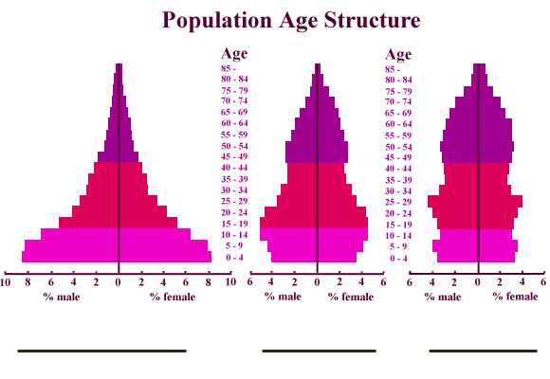
Count….
Rapid Growth Slow (stable) No growth

Slide 16
Intrinsic rate of Natural Increase of Population
Without limiting factors
E.g space, food, shelter
Population growth rate per individual will b maximum
Shows the biotic potential
Represented by “r” and called as specific growth rate.

