Slide 1
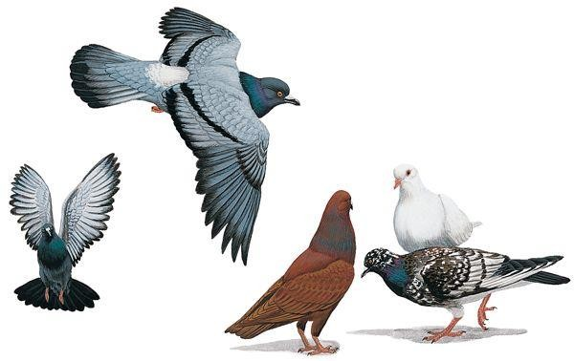
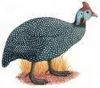
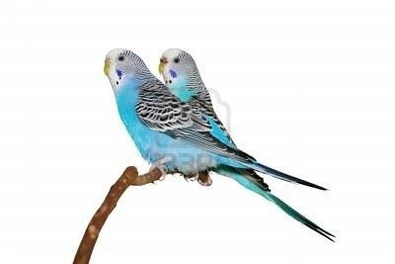
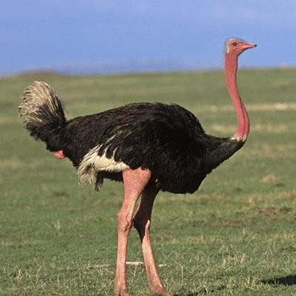
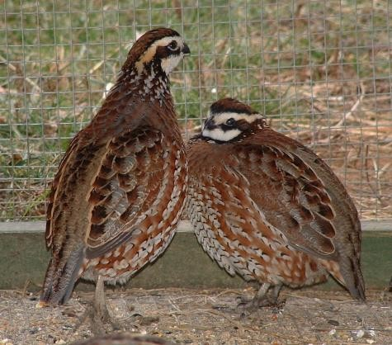
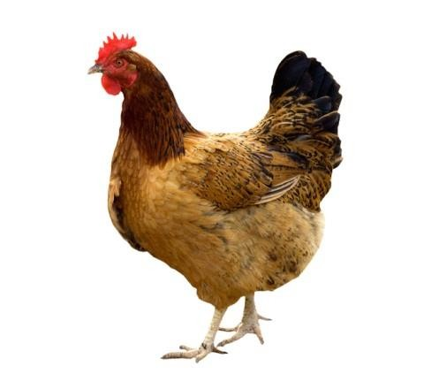
Feeding Programs For Game Birds

Slide 2
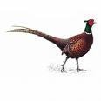
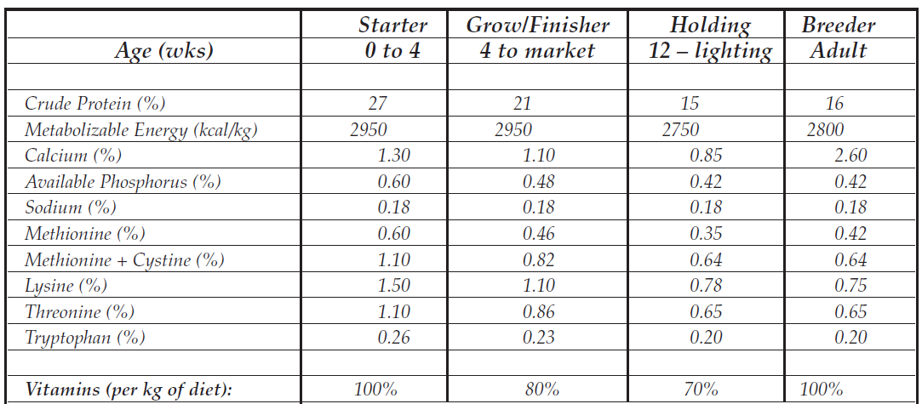
Diet Specification for Commercial and Breeder
Pheasants

Slide 3
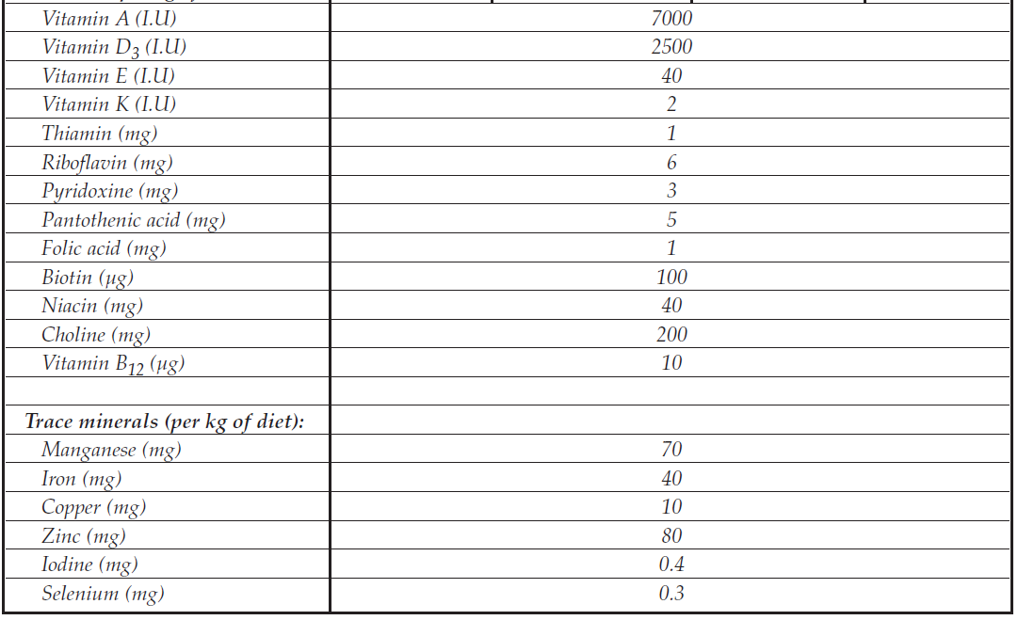

Slide 4
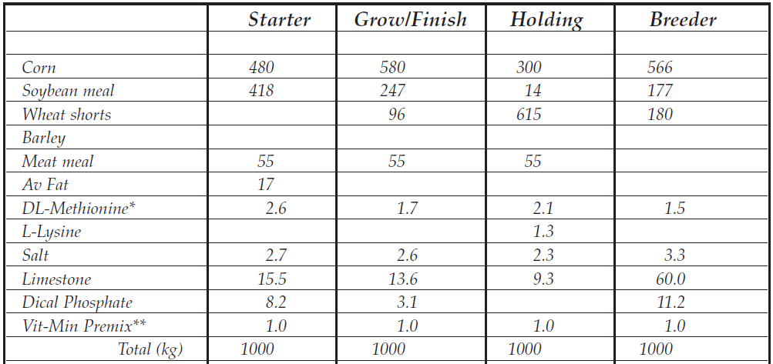

Diets for Commercial and Breeder Pheasants (kg)

Slide 5
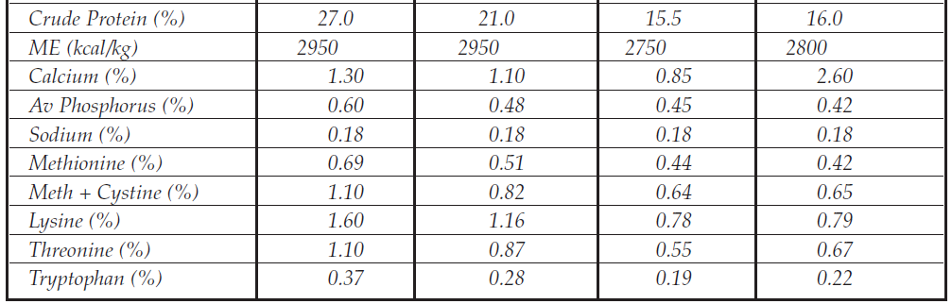

Slide 6


Growth Rate, Feed Consumption and Feed
Efficiency
of
Ring-Necked Pheasants
Average Weight (g)
Cumulative Feed Consumption (g)
1800
1600
1400
1200
1000
800
600
400
200
0
7000
6000
5000
4000
3000
2000
1000
2
4
6
8
Male
10
12
Female
14
16
18
0
2
4
6
8
Male
10
12
Female
14
16
18

Slide 7
Feed
Efficiency of Ring-Necked
Pheasants
F E E D E F F I C I E N C Y
Male
Female
6
5
4
3
2
1
0
2
4
6
8
10
12
14
16
18

Slide 8
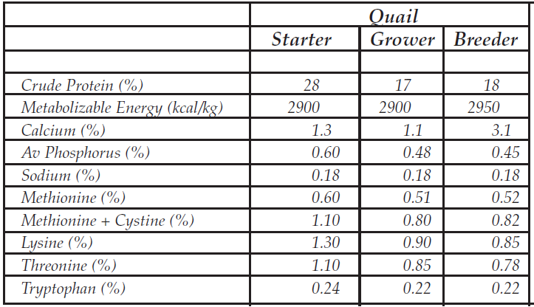
Diet Specification for Quail

Slide 9
Body
Weight and
Japanese
Feed Intake of Male and Female
Quail
to
10
Week
of Age
Cumulative Feed Intake (g)
Body Weight (g)
600
180
160
500
140
400
120
100
300
80
200
60
100
40
20
0
0
2
4
6
8
10
2
4
6
8
10
Male
Female
Male
Female

Slide 10
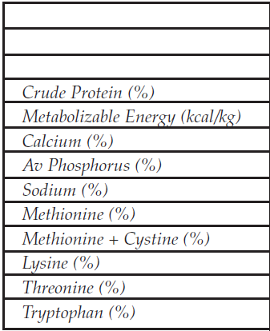
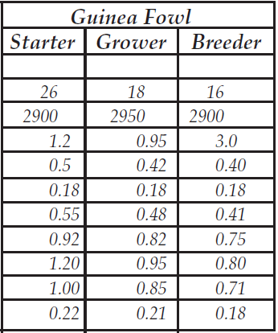
Diet Specification for Guinea Fowl

Slide 11
Growth Rate
and
Feed
Intake
of
Guinea
Fowl
Body Weight (g)
Feed Intake (g)
2000
80
1800
70
1600
60
1400
50
1200
1000
40
800
30
600
20
400
10
200
0
0
1
2
3
4
6
8
10
12
16
1
2
3
4
6
8
10
12
16
Male
Female
Male
Female

Slide 12
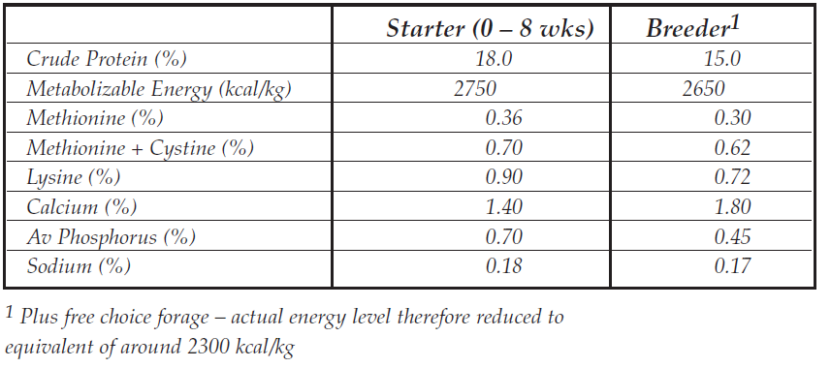
Diet Specifications for Ostriches

Slide 13
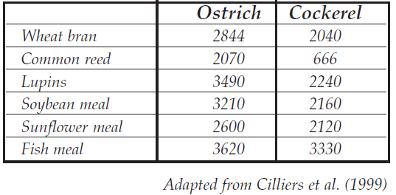
TMEn of Selected Ingredients for Mature Ostrich
and Cockerel

Slide 14
Growth Rate
and Feed Intake of
Ostriches
Fed
Commercial
Diets
Body Weight (kg)
120
Feed Intake (g/d)
3000
100
2500
80
2000
60
1500
40
1000
20
500
0
0
6
10
18
26
34
42
52
6
10
18
26
34
42
52

Slide 15
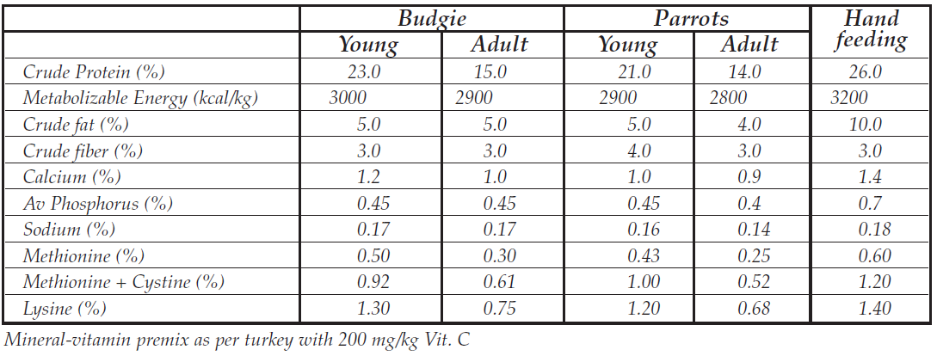
Diet Specification for Pet Birds

