Slide 1
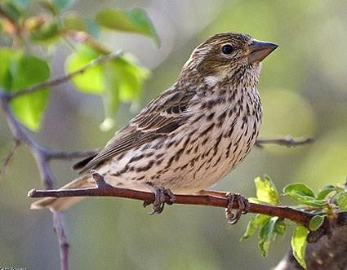
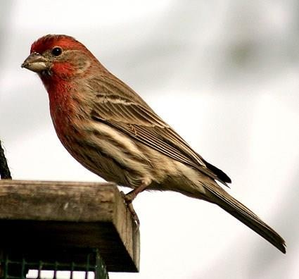
Finches
Instructor:
Sohail
Ahmad
12/4/2015
1

Slide 2
Finch
•
The true finches are small to medium-sized passerine birds
in the family Fringillidae
•
Finches
have
stout
conical
bills
adapted
for
eating
seeds
and often have colorful plumage
12/4/2015
2

Slide 3
•
Finch
occupy
a
great range
of
habitats
where
they
are
usually resident and do not migrate
•
They
have
a
world-wide
regions
distribution
except
for
Australia
and the polar
12/4/2015
3

Slide 4
Classification
of
Finches
Kingdom
Animalia
Phylum
Chordata
Sub-phylum
Vertebrata
Class
Aves
Order
Psittaciformes
Family
Fringillidae
12/4/2015
4

Slide 5
Sub-families
•
Fringillinae
•
Carduelinae
•
Euphoniinae
12/4/2015
5

Slide 6
•
Clutch size: 3 – 4
•
Mass: 8 – 12 g
•
Length:
22
–
24
cm
12/4/2015
6

Slide 7
House Finch
•
Recent introduction from western into eastern North
Hawaii), but it has received a warmer reception than like the European Starling and House Sparrow
America (and
other arrivals
•
That’s partly due to the cheerful red head and breast
of males, and
to the bird’s long, twittering song, which can now be heard in most
of the neighborhoods of the continent
12/4/2015
7

Slide 8
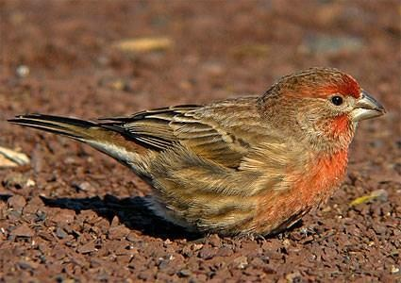
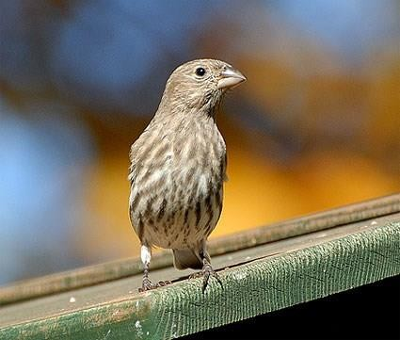
House
Finch
12/4/2015
8

Slide 9
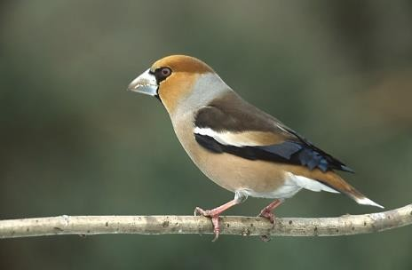
Hawfinch
12/4/2015
9

Slide 10
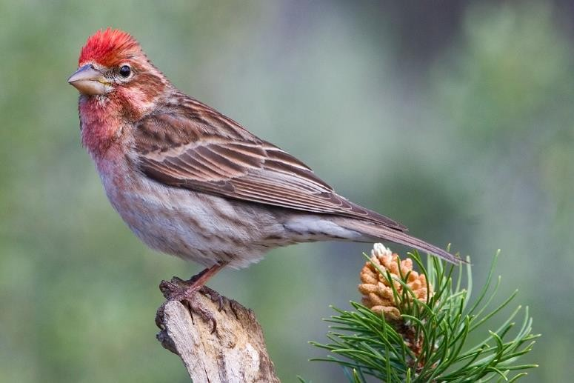
Cassin's
finch
12/4/2015
10

Slide 11
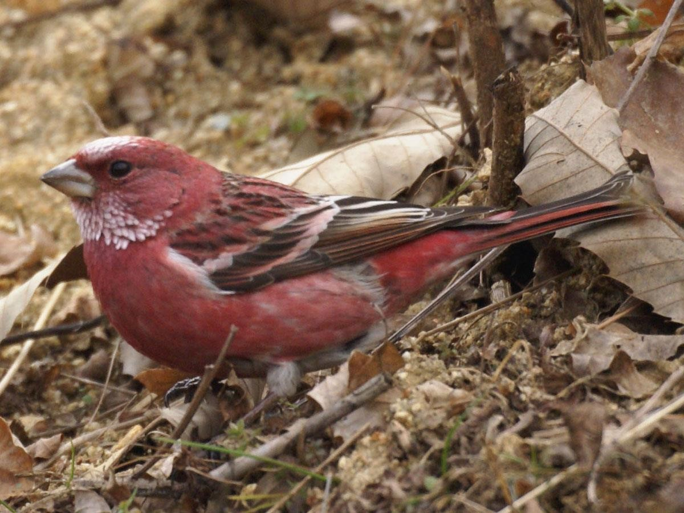
Pallas'
rose
finch
12/4/2015
11

Slide 12
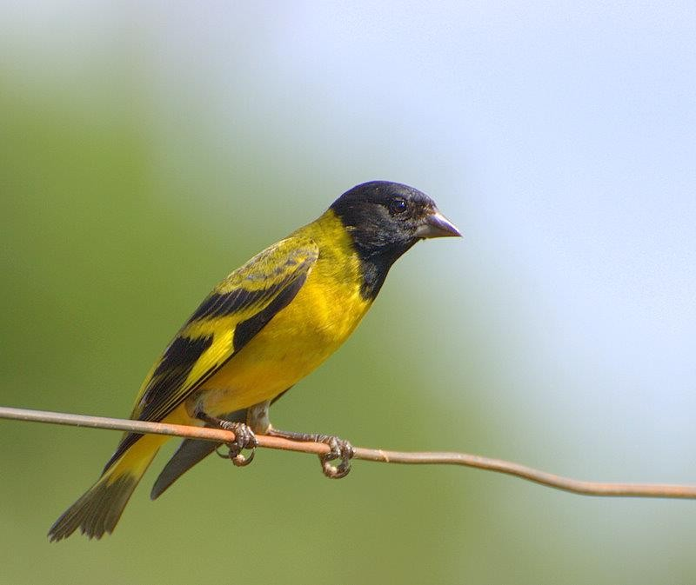
Hooded
siskin
12/4/2015
12

Slide 13
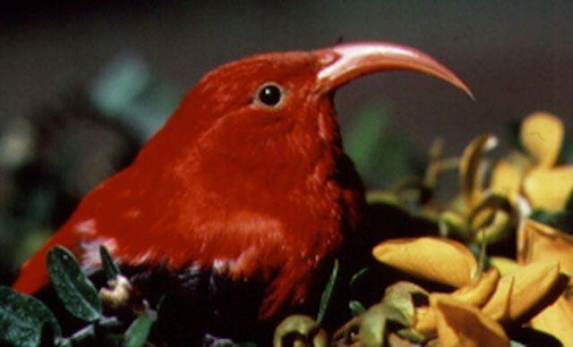
Hawaiian
honeycreeper
12/4/2015
13

Slide 14
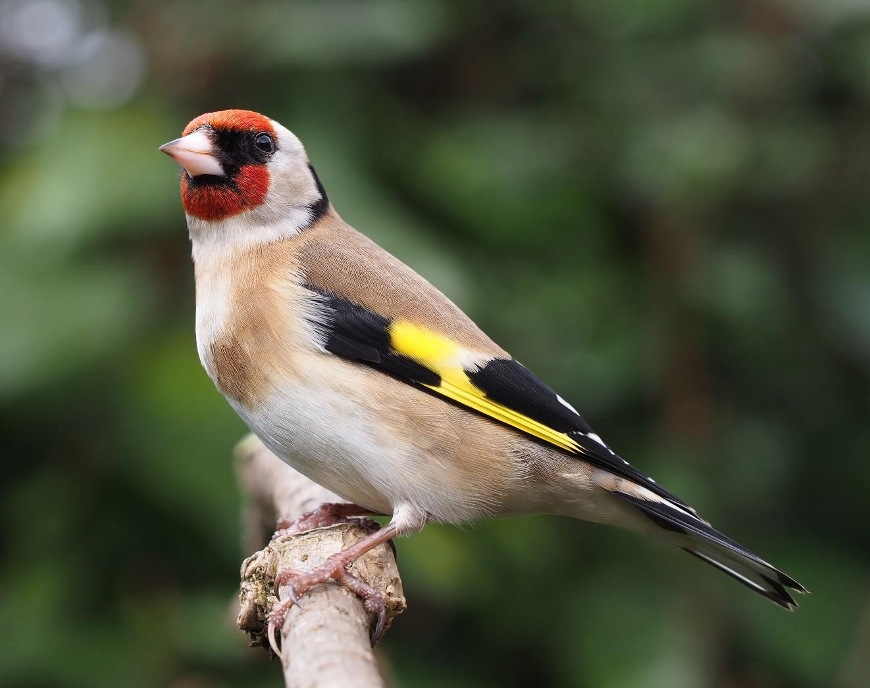
European
goldfinch
12/4/2015
14

Slide 15
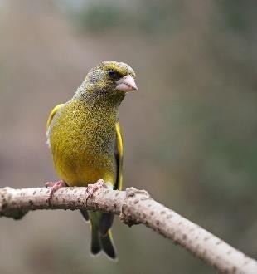
European
greenfinch
12/4/2015
15

Slide 16
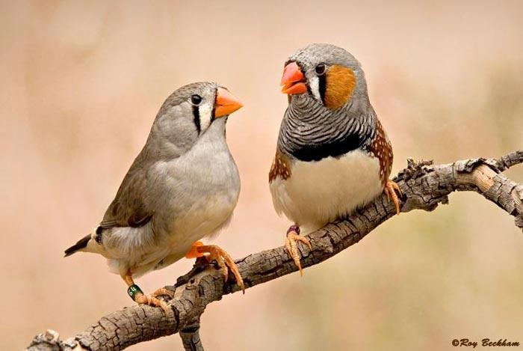
Zebra
Finches
12/4/2015
16

Slide 17
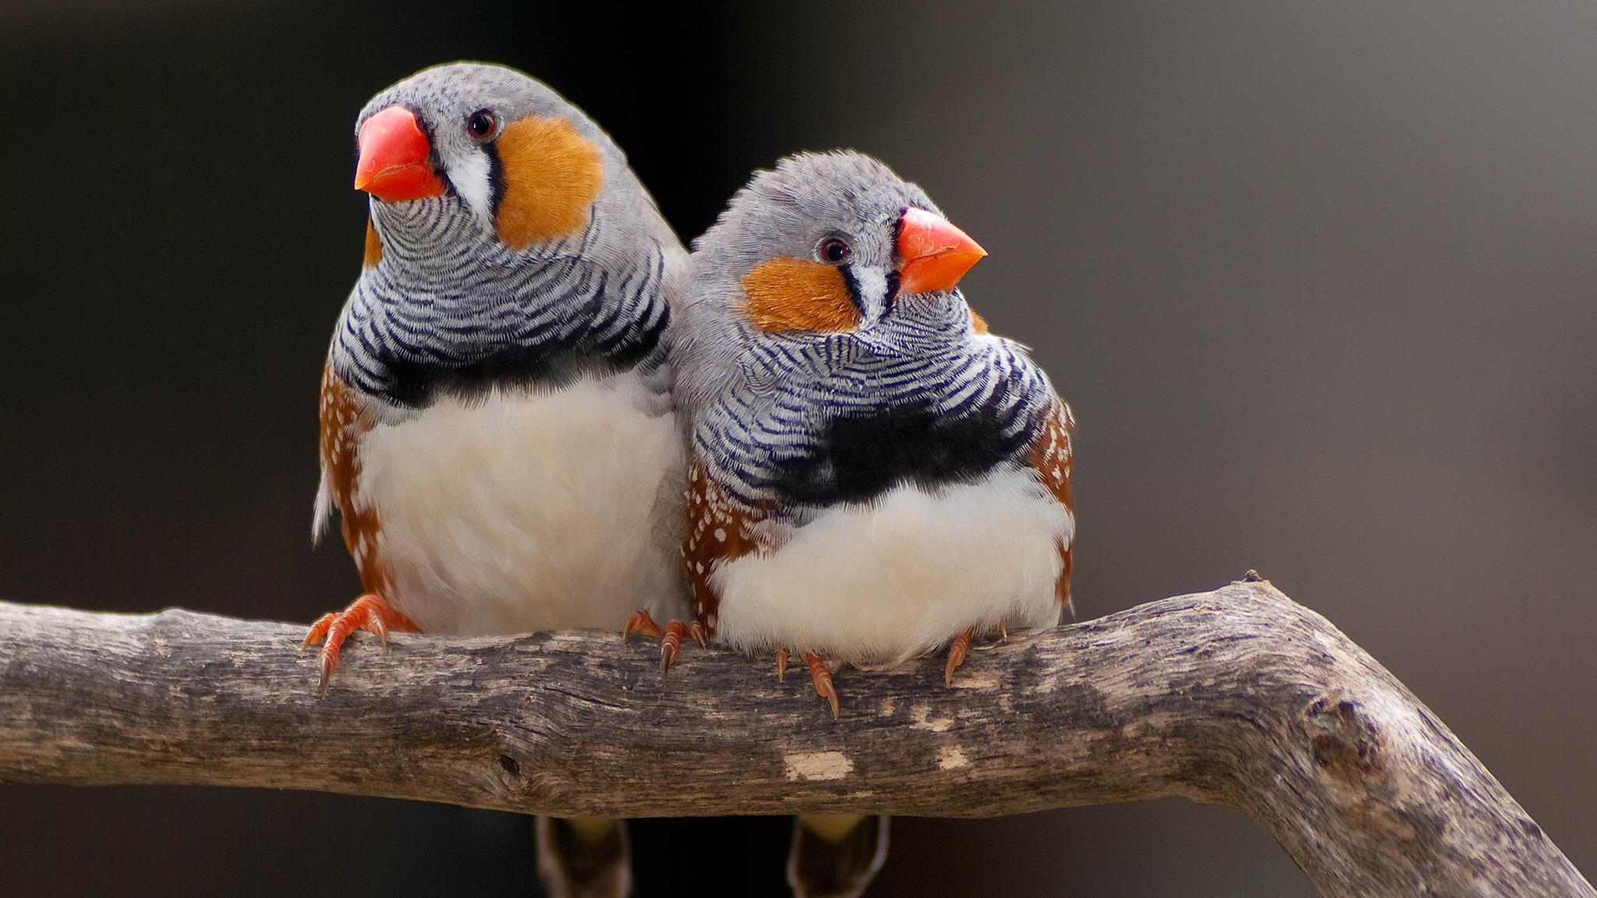
12/4/2015 17

Slide 18
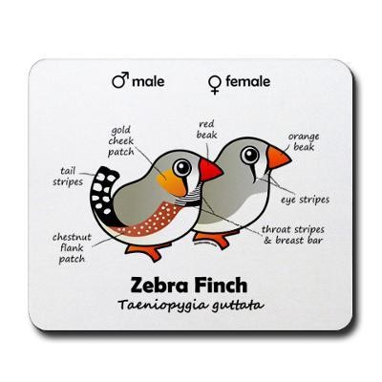
12/4/2015
18

Slide 19
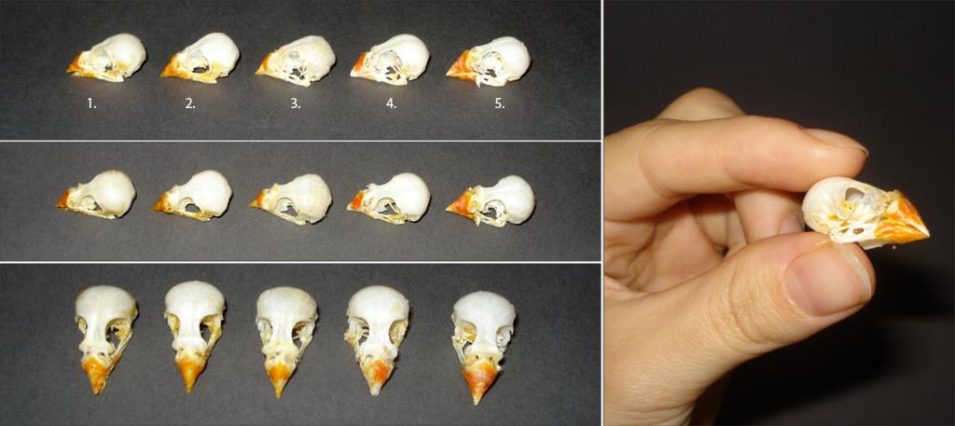
12/4/2015
19

Slide 20
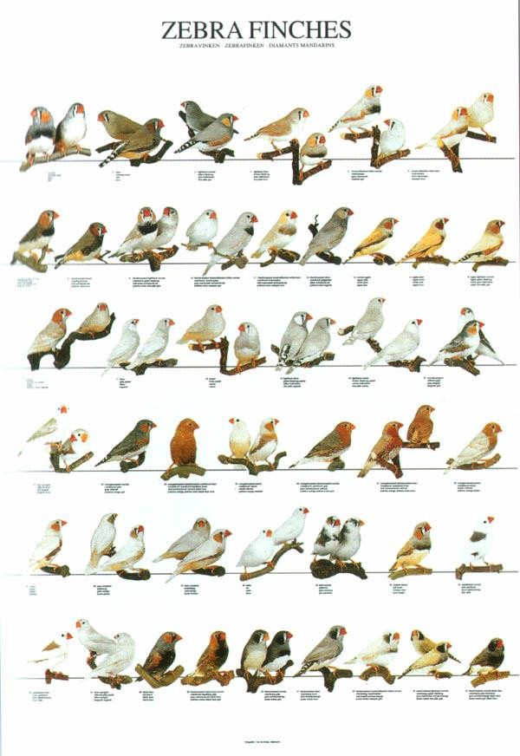
12/4/2015
20

