Slide 1
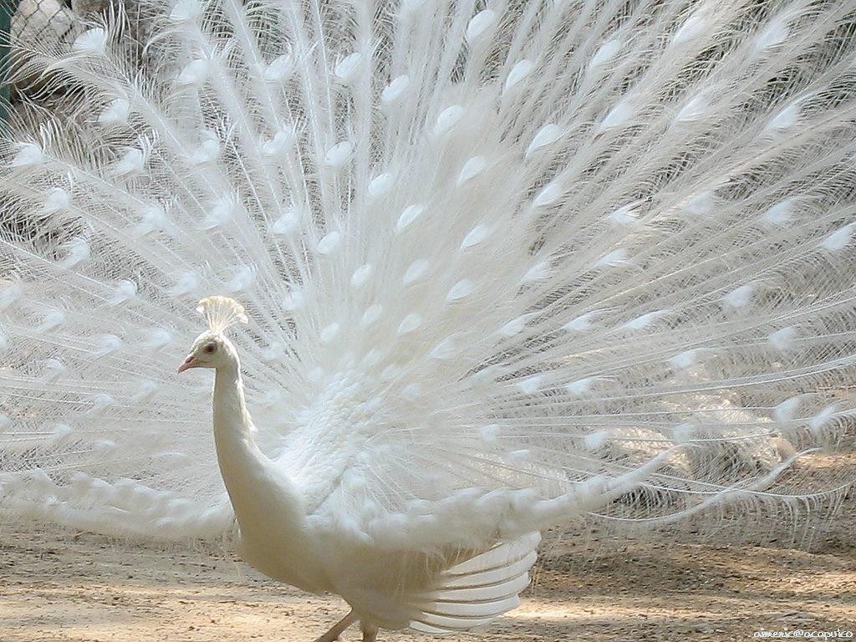
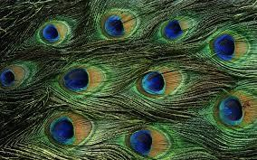
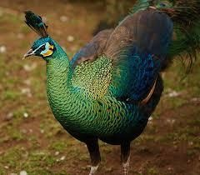
Pea Fowl
INSTRUCTOR:
SOHAIL
AHMAD
11/16/2015
1

Slide 2
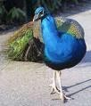
Pea Fowl
•
Pea
fowl is a fancy bird
•
It is
the most beautiful specie
present all around
the
world
•
Pea
fowl belongs to the
order
Galliformes
•
It has many varieties
•
Lifespan: 23 years
11/16/2015
2

Slide 3
•
Male peacock is more beautiful having beautiful feather on
wings
tail
and
•
Its special character is that it is the longest bird about
6
feet
•
Natural habitat is jungle
•
Mostly used as ornamental purpose
•
May also found in zoological garden or natural parks
11/16/2015
3

Slide 4
Specific quality
•
Its specific quality is dancing position
•
Male peacock dancing with extended feathers
(2^{1/2}
–
3 feet from
right side and
2^{1/2}
– 3
feet from left
side
while
body
diameter
is
about
1^{1/2}
feet)
•
they require space
for
movement
11/16/2015
4

Slide 5
•
There are many varieties of peafowl which have
so
many
colors
but the most common varieties
• Blue
• Green
are
as
follows:
• White
(through selection)
11/16/2015
5

Slide 6
Types
•
Indian pea fowl (Pavo Cristatus)
•
Green pea fowl (Pavo muticus)
•
Congo pea
fowl (Afropavo congensis)
• (Name
from
the
country
Zaire)
11/16/2015
6

Slide 7
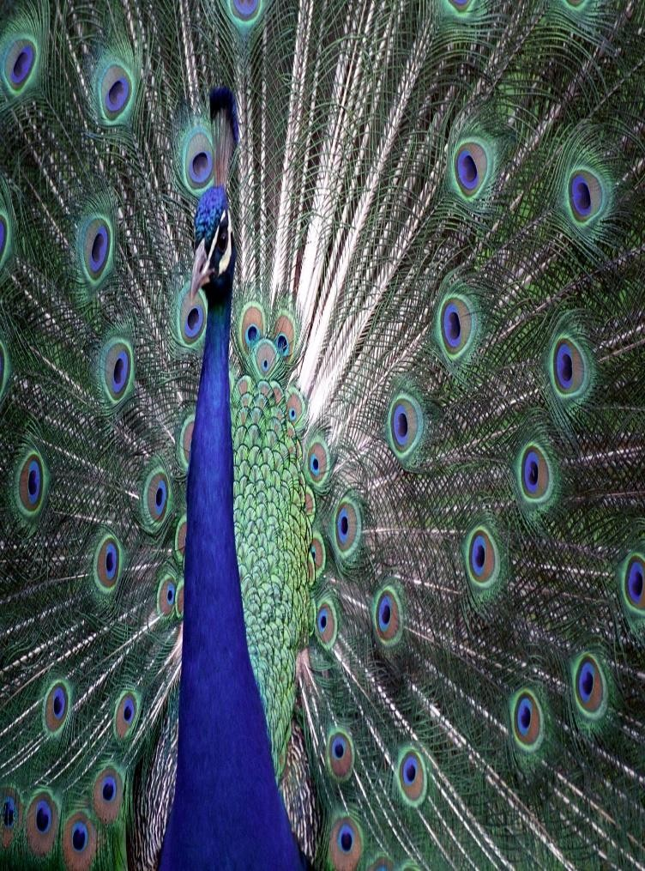
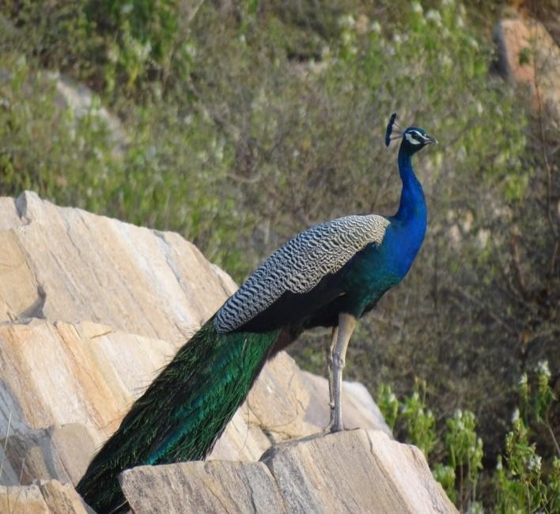
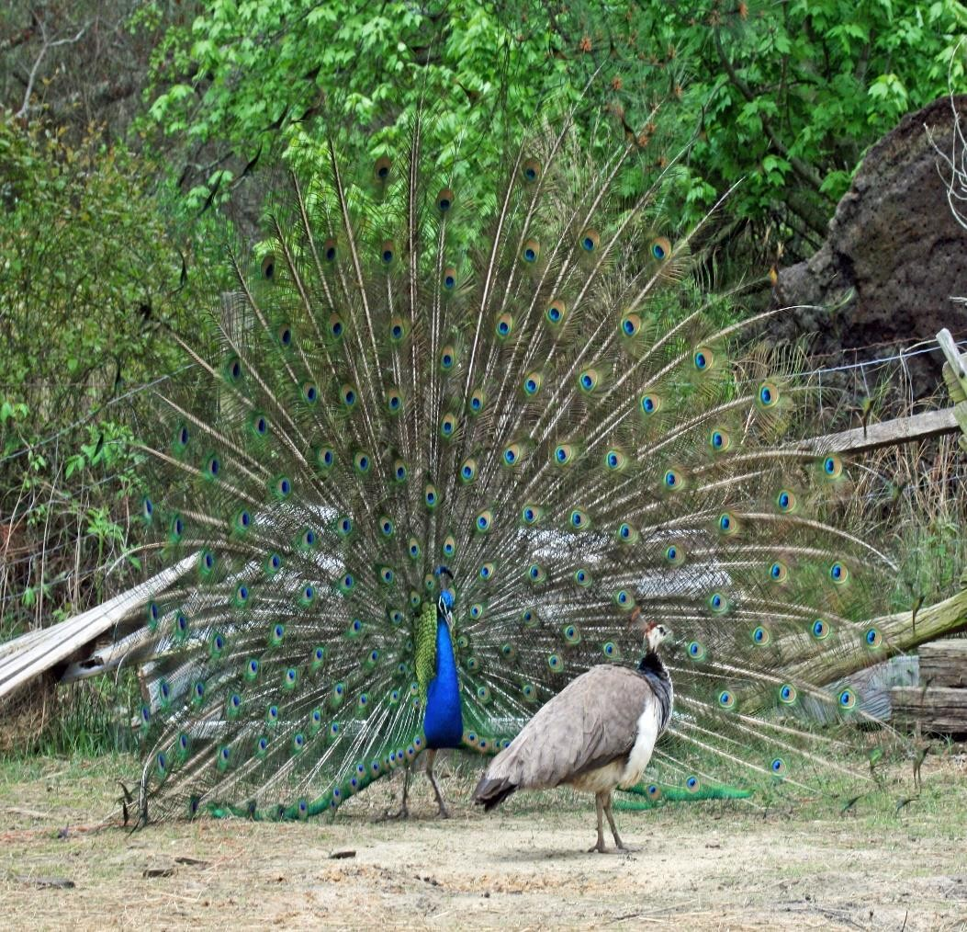
Indian Pea Fowl
11/16/2015
7

Slide 8
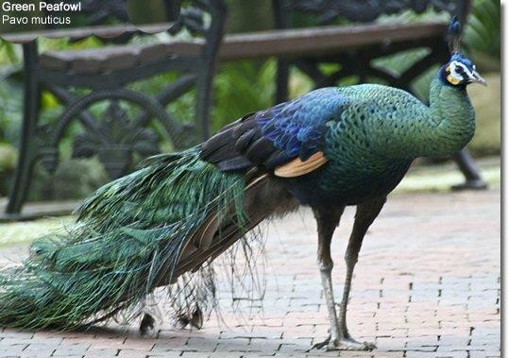
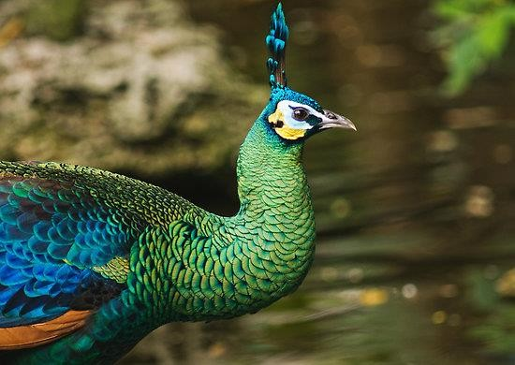
Green Pea Fowl
11/16/2015
8

Slide 9
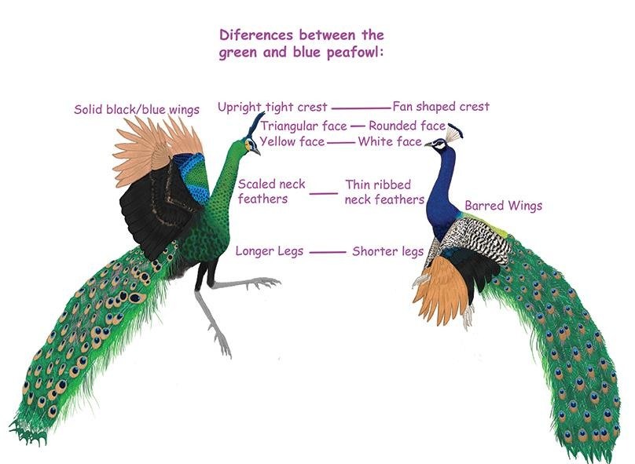
11/16/2015
9

Slide 10
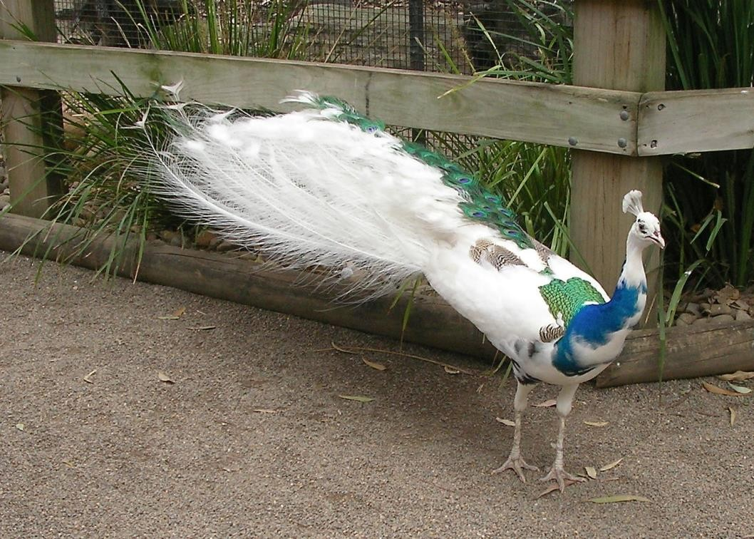
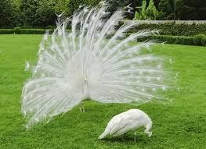
White Pea Fowl
11/16/2015
10

Slide 11
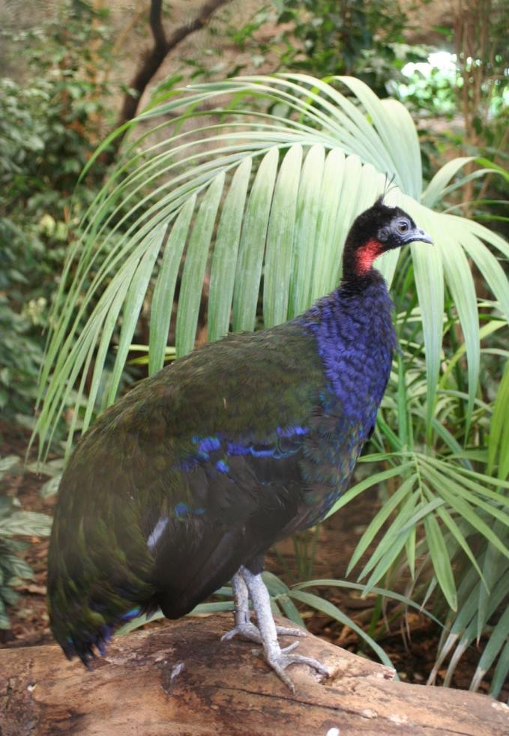
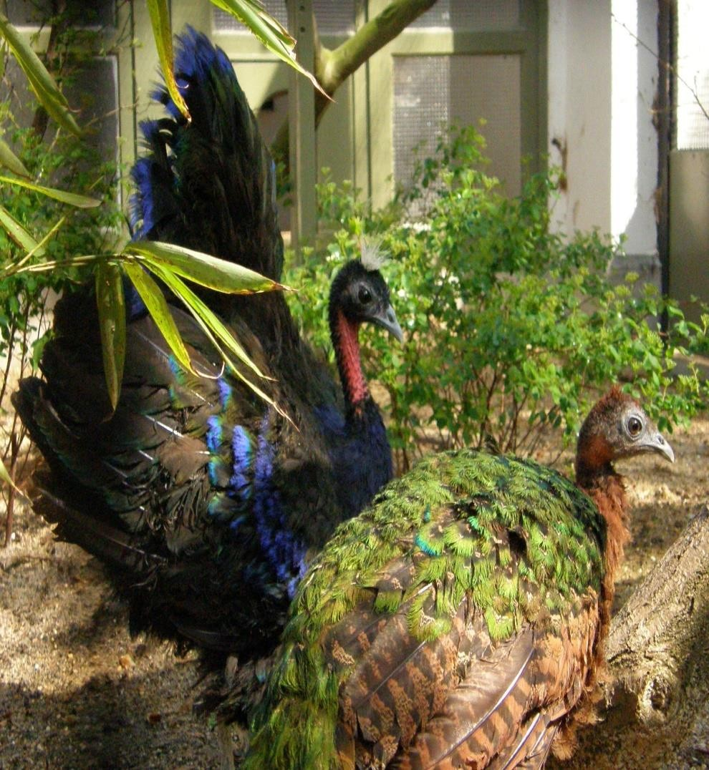
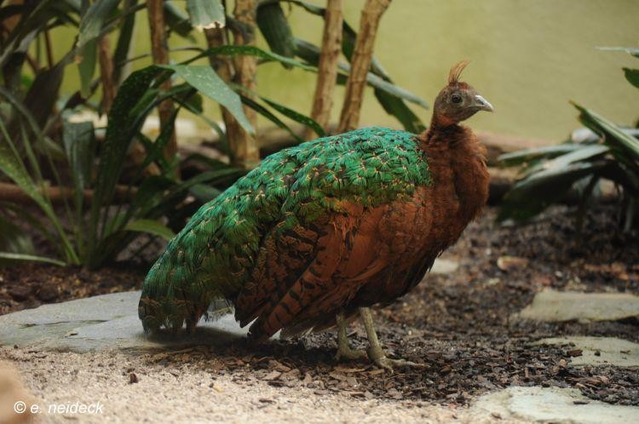
Congo
Pea
Fowl
11/16/2015
11

Slide 12

Classification
of
Pea
Fowl
Kingdom
Animalia
Phylum
Chordata
Sub-phylum
Vertebrata
Class
Aves
Order
Galliformes
Family
Phasianidae
Genus
Pavo
Specie
cristatus
The zoological name of pea fowl
is Pavo cristatus
11/16/2015
12

Slide 13
Housing system
Aviaries
Indoor
Outdoor
Combination of
indoor and
outdoor
11/16/2015
13

Slide 14
Indoor Aviary
•
We provide roof for the protection of the bird because
has ability to take flight
Pea
fowl
•
In
indoor
aviary
we
keep
Pea
fowl
in
indoor
pen
11/16/2015
14

Slide 15
Outdoor Aviary
•
•
•
In outdoor aviary we provide
For this purpose we use wire
protection from four sides and roof
netting which is very special
As
far
as
space
is
concern there
is no recommendation,
must
provide ample space so that the bird can move from one
place
to
another with extended
feathers
•
Provision
of
less
space
may
cause
damage
their
feathers
11/16/2015
15

Slide 16
Combination of indoor and outdoor
•
In this type of housing system there is combination
outdoor aviaries
of
indoor
and
•
8-12
sq
feet
space
is
required
for
one
Pea
fowl
11/16/2015
16

Slide 17
Floor System
•
•
One of the best floor systems is of cemented floor
Other
system
is
non-cemented
floor, in
non-cemented
floor
remains some conditions better because birds’ habit of scratching
•
•
•
Sometimes non-cemented floor is good source of
Cage is proper in size
contamination
Outside
aviary,
some
shrubs
may
also
present
the bird
when
birds
eat
these shrubs it may cause toxic effect to
11/16/2015
17

Slide 18
•
Age of sexual maturity is different in different species, male Pea
cock mature in 3 years of age to develop its full feathers.
•
It may vary
of 3 years
2-2^{1/2}
years. Female Pea hen starts laying
at
the
age
•
•
Male to Female ration is 1:4
sometimes
it
is
1:5
Incubation
period
is
28
days
11/16/2015
18

Slide 19
•
There are two systems
• Natural
• Artificial
of incubation:
•
Natural
incubation
is
the
procedure
of
getting
egg
hatch
Clutch
under Pea hen; 7-8
period is 8-10 eggs
eggs are kept under the Pea hen;
11/16/2015
19

Slide 20
•
In
artificial
incubation
three
factors
are
under
consideration:
• Eggs Collection frequency must
• Storage of egg at 13-18°C
be high
• Egg should not store more
than
a week
11/16/2015
20

Slide 21
• There is slight variation in brooding
• Mortality rate is high in Pea chicks during
• Mortality rate is low during rearing
• Hatchability of Pea fowl is 50-60%
brooding
• Pea
fowl
require
special
diet,
so
there
mineral
and
vitamin
profile is different
from other species
11/16/2015
21

Slide 22
Habitat
•
Pea
fowl are
omnivores,
they
eats
insects,
snakes,
vegetable or plants
•
Some special operations are performed while
rearing Pea fowls
• One
operation
that
normally
perform
is
de-beaking,
other
operation are wing cutting and spurs/claws cutting
11/16/2015
22

Slide 23
•
De beaking is the process in which we cut the beak to avoid cannibalism, if
we are maintaining wide area where vegetation is present then no need of de-beaking
•
In wings cutting we cut the wings so
remove the nails only
that bird may not fly while in claws we
•
In spur cutting we cut
natural habitat to attack
the spur to
on the spur
avoid cannibalism because it is their
11/16/2015
23

