Slide 1
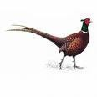
Pheasants
Instructor:
Sohail
Ahmad
11/7/2015
Pheasants
1

Slide 2
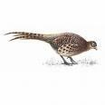
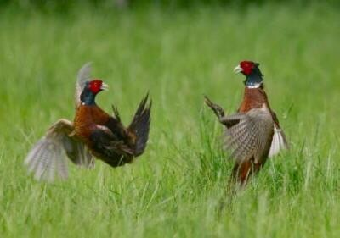

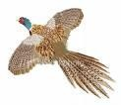
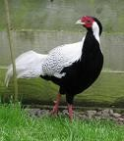

Pheasants
11/7/2015
Pheasants
2

Slide 3
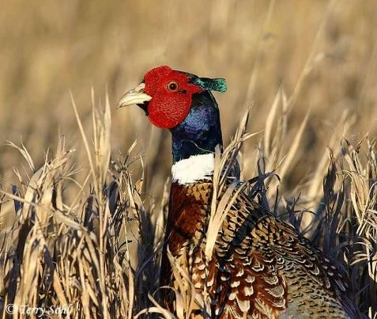
Pheasants
• Pheasants are
member
of
order
Galliformes
having
beautiful
and
multicolor feathers
•
It is a larger bird as
compared to chicken
Body weight
• Adult male
2.25kg
attain 2.70-2.75 kg weight while
in case
of female
it is
11/7/2015
Pheasants
3

Slide 4
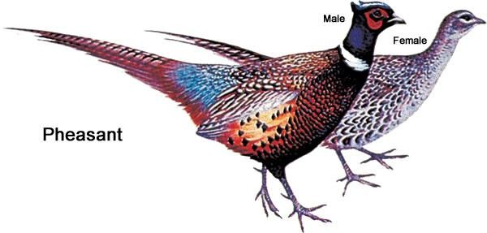
11/7/2015
Pheasants
4

Slide 5
•
There are 11 Genra and 35 Species
•
The most common pheasant is
Phasianus colchicus
•
In Pakistan;
normally Kolkass
(name
of
pheasant)
is
present
which
belongs to sub-continent
11/7/2015
Pheasants
5

Slide 6
•
Other common specie is ring-neck; its local habitat is china
•
Ring-neck pheasant is imported from china and its domestication is started
all over the world
•
In
Pakistan,
pheasants
are
present
in
Himalaya
and
northern
areas,
natural
because
these
areas
are
well
suited
for
pheasants,
they
like
environment; naturally founded in forest
11/7/2015
Pheasants
6

Slide 7
Classification
of
Pheasants
Kingdom
Phylum
Sub-phylum
Class
Order
Family
Genus
Specie
Animalia
Chordata
Vertebrata
Aves
Galliformes
Phasianidae
Phasianus
colchicus
Zoological name of pheasants
Pheasants
is Phasianus colchicus
11/7/2015
7

Slide 8
What are the objectives of keeping pheasants?
1.
2.
Pheasants are kept as ornamental purposes
Its
commercial
activity
is
very strong.
It may
be
kept
for
the
production of fertile eggs
Day old chick may be sold in very reasonable prices
People take day old chick; raise bird in the shed, when the birds
3.
4.
are
adult they sold the
Size of pheasant is obtained from one
birds in very high prices
very reasonable, its meat pheasant
5.
is half about 1.25 kg is
11/7/2015
Pheasants
8

Slide 9
•
Usually egg production is very less
•
In one clutch female pheasant gives 15 eggs
•
Normally breeding season starts in the
month
of
March
•
Female starts laying from April to June
•
Almost 15 eggs are laid in one season
11/7/2015
Pheasants
9

Slide 10
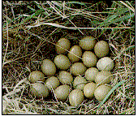
•
In natural condition females give less number of eggs which is about
4-5 eggs then females get broody
•
Under
domestic conditions
you
may
obtain
large
number
of
eggs,
when female lay egg pick the egg quickly and store it in the storage
room
•
By picking egg from the nest
the eggs almost two weeks
you
can
obtain
15
eggs
and
you
can
store
11/7/2015
Pheasants
10

Slide 11
Sex ratio
• Ideal sex ratio is 1:8; You can also keep 1:10
Incubation period
•
Incubation period vary from 26-29 days, average incubation period is
28 days
•
•
In ring-neck pheasant incubation period is shorter
about 24-26 days
3 days we shift the
First
eggs
25 days we set the egg in setter and in last
from setter to Hatcher
11/7/2015
Pheasants
11

Slide 12
Brooding Management
•
•
Brooding is very sensitive because bird is very delicate
While keeping
chicken first
1-2
weeks
are
require
for
brooding
in
which we maintain the temperature 95°F but in case of pheasants
the temperature is 10° higher, about 105°F is
weeks
maintained in first two
•
In summer
season,
pheasant
require
just
only
one
week
for
brooding
11/7/2015
Pheasants
12

Slide 13
•
During brooding period (2 weeks) 400-450 grams of feed is
required
weeks)
for
one
pheasant
while
during
5kg
growing
phase
(3-16
requirement
of
feed
is
about
11/7/2015
Pheasants
13

Slide 14
Age
of maturity
•
Age
of maturity is 16
weeks
•
During laying period one bird consume 90 grams feed daily
•
In natural condition
or
main
feeding
ingredients
in
natural
level
are
seed
and
insects
11/7/2015
Pheasants
14

Slide 15
Fancy birds
•
For
fancy bird’s
feed
we
add
some
seeds as
a grain portion.
Sometimes we give boiled eggs and meat to the birds
Male pheasant is large in weight, more beautiful that is why its price
is more than female
•
•
In pheasant; only male sings, it is also called as singing bird.
Normal
pattern is duration of
singing in domestic level
•
Normal
hatchability
and
fertility
is
major
problem
in
natural
environment
11/7/2015
Pheasants
15

Slide 16
•
Because bird
pheasant
is
very
delicate,
some
diseases
also
effect
the
1.
ND
2.
Coccidiosis
•
Hatchability is
80% when you keep bird
11/7/2015
Pheasants
16

Slide 17
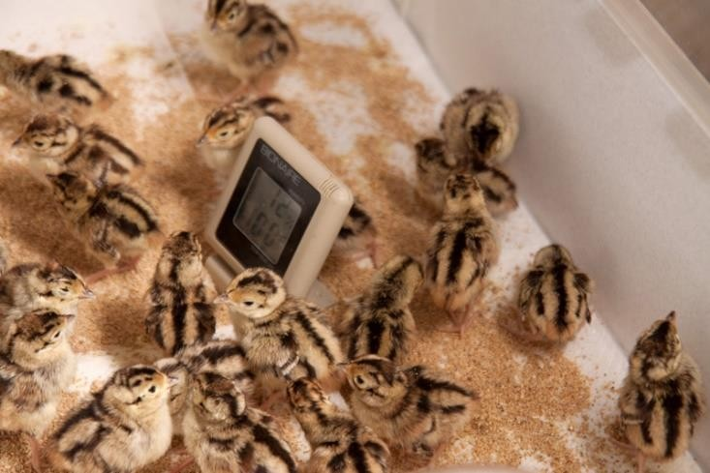
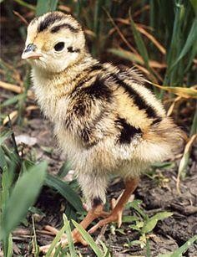
Chicks
11/7/2015
Pheasants
17

Slide 18
Common
Ring Neck
Breeds
of
Pheasants
•
•
Golden
•
Silver
11/7/2015
Pheasants
18

Slide 19
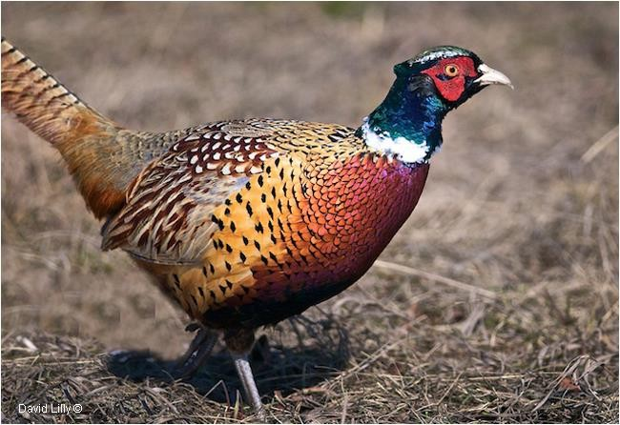
Ring
Neck
Pheasants
11/7/2015
Pheasants
19

Slide 20
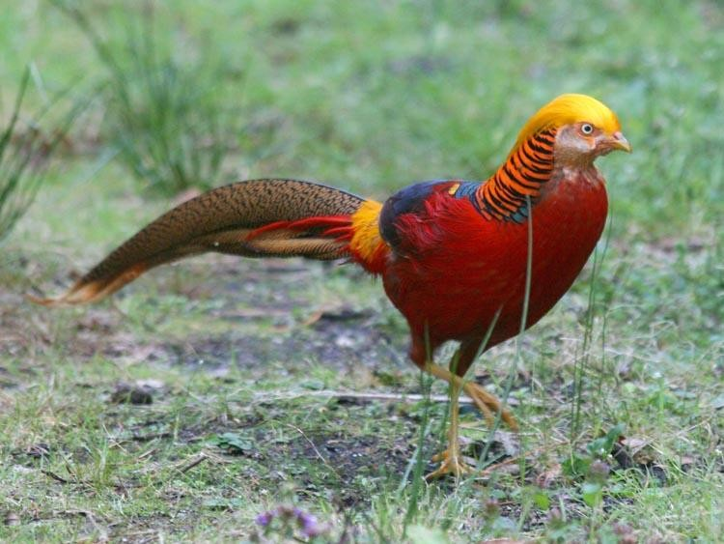
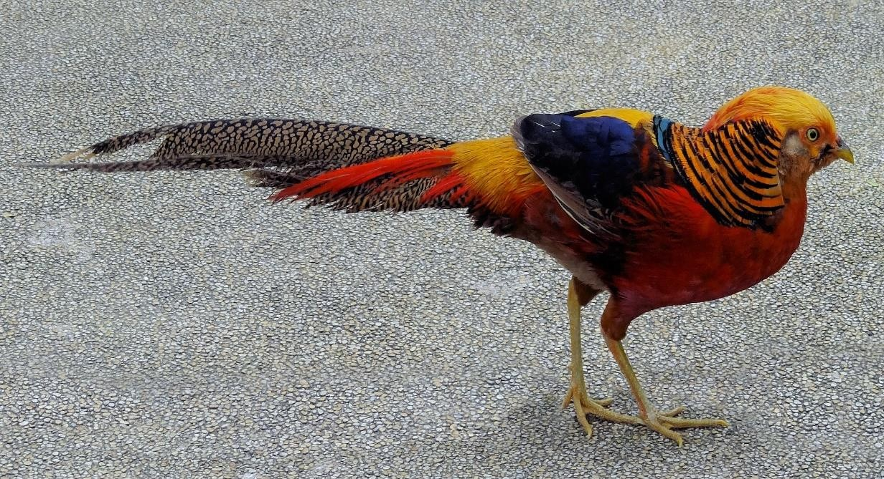
Golden
Pheasants
11/7/2015
Pheasants
20

Slide 21
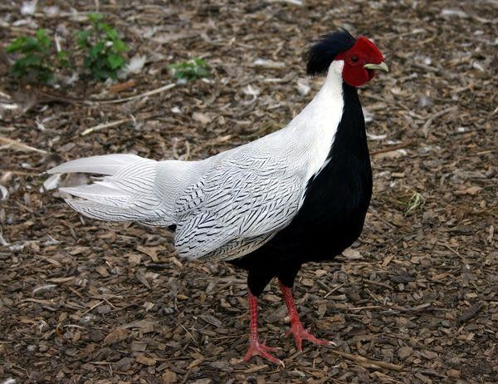
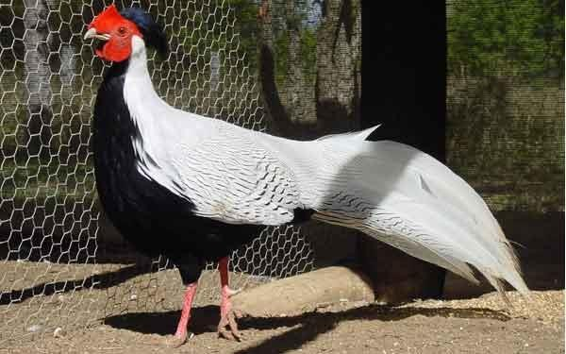
Silver
Pheasants
11/7/2015
Pheasants
21

Slide 22
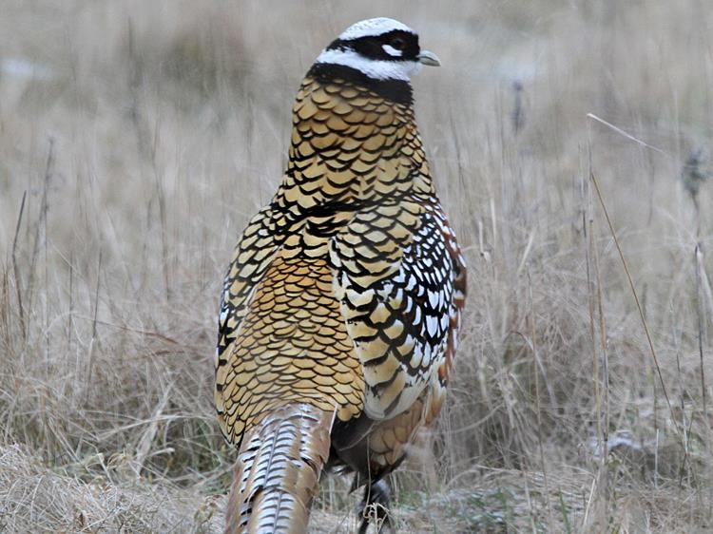
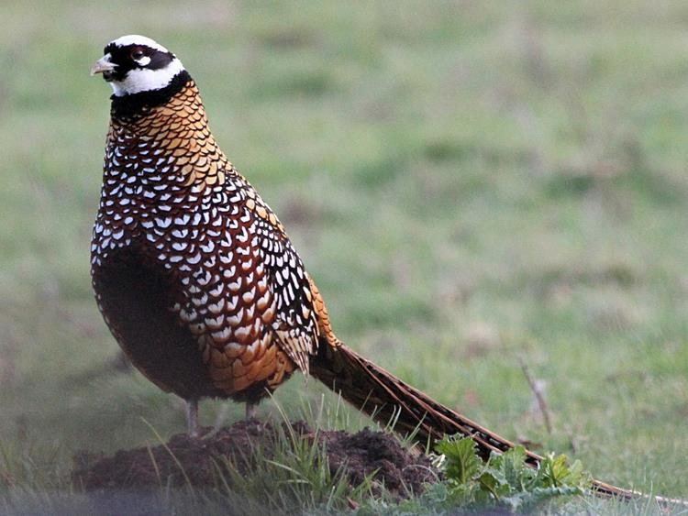
Reeves's
Pheasant
11/7/2015
Pheasants
22

Slide 23
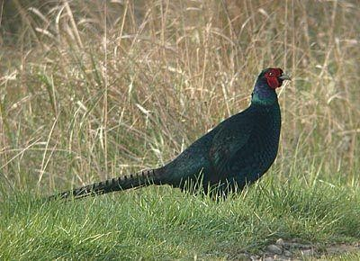
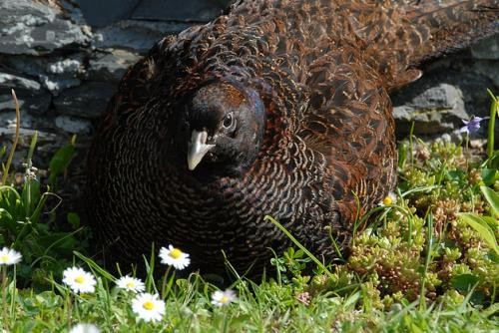
Melanistic
Pheasants
11/7/2015
Pheasants
23

