Slide 2
History
Partridges are birds in the pheasant family, Phasianidae.
According to Greek legend, the first partridge appeared when Daedalus threw his nephew, Perdix, off the sacred hill of Athena in a fit of jealous rage.

Slide 3
Introduction
Medium sized
Europe, asia and africa
Hungarian/ English/hunting
Game bird
Coveys
Non migratory
Ground nesting
Seed eaters
The taste and texture of cooked partridges compares favorably with that of bobwhite Quail.
Rounded feathers

Slide 4
Scientific classification
Kingdom: animalia
Phylum: chordata
Class: aves
Order: galliformes
Family: phasianidae
Sub family: perdicinae
Genus:Alectoris Ammoperdix Bambusicola Haematorty Melanoperdix Perdix Ptilopachus Rhizothera Rollulus Tetraophasis Xenoperdix

Slide 5
BIOMETRICS
Length: 29-31 cm Wingspan: 45-48 cm Weight: 310-455 g

Slide 6
Common species

Slide 7
Bamboo Partridge(Bambusicola thoracica)
There are two subspecies of this species. one seen in captivity is the Chinese(B. t. thoracica), native to China The other subspecies,(B. t. sonorivox), is found only on Taiwan.
Clutch size 7-9 eggs
I.P:18 days
The sexes of this species are similar, with the female being slightly smaller.
Notes:
and has been to introduced into southern Japan and on Maui in the Hawaiian Islands.

Slide 8
Bamboo Partridge

Slide 9
Barbary Partridge (Alectoris barbara)
One of the most attractive members of the Rock Partridges, genus Alectoris.
There are about six subspecies that range from Morocco across North Africa into Libya and Egypt.
Clutch size:8-15 eggs in April
I.P:24 days

Slide 10
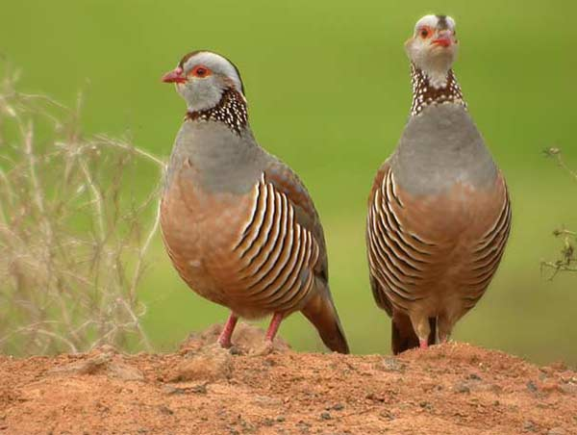
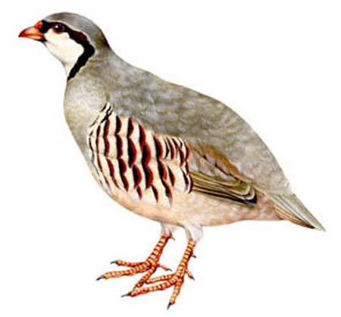
Barbary Partridge (Alectoris barbara)
male and female
male

Slide 11
Chukar Partridge (Alectoris chukar)
One of the most commonly kept and bred of all game birds
There are 14 recognized subspecies ,range from Turkey, the Mediterranean islands, Iran and east through Russia and China and south into Pakistan and Nepal.
The Chukar has also been successfully introduced into western North America, the Hawaiian Islands, England and New Zealand.

Slide 12
Chukar Partridge (Alectoris chukar)
Chukars are very versatile breeders in captivity.
They can be kept in pairs, trios and even in large colonies.
Best fertility is with the smaller groups.
Hens begin to lay in April and may lay well into the Summer.
Hens may lay a large number of eggs in a season. 40 to 50 eggs per hen is not unusual.
Chukars, as a rule, will not usually sit on their own eggs, so you will need to gather the eggs and place them in an incubator.
Small bantams may be used, but choose only the smallest hens to set.
Incubation lasts about 24 days.
Clutch size:12

Slide 13
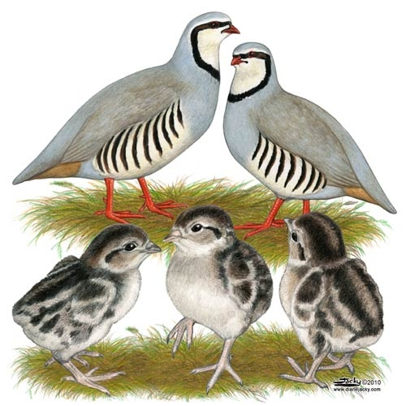

Slide 14
Hungarian Partridge (Perdix perdix)
Other Names: Gray Partridge, Hun, English Partridge, Bohemian Partridge, European Partridge.
Range: Great Britain, Northern Spain, France and Italy east through Europe into Turkey, Russia and western Siberia. Introduced throughout the world and well established in the United States.
Subspecies: There are seven subspecies.
Habitat: Prefers open areas, farmlands and brush.
Breeding Season: Begins in late April and may last into September.
Breeding Age: First year.
Clutch Size: 15, hens will lay several clutches per season.
Incubation Period: 24 days.
They are hardy birds and able to withstand temperature extremes.
Pen size:6’X2’ for pair during breeding season

Slide 16
Red-legged Partridge (Alectoris rufa)
The Red-legged Partridge is very similar to the Chukar, Although common in captivity, it is not bred on the large, commerical scale as it's close cousin.
There are four subspecies in the wild.
French Red-leg(A. r. rufa) of France and Italy, is the subspecies most often seen in captivity.
Spanish Red-leg (A. r. hispanica), is found in northern and western Spain is also kept, but not as common as the French subspecies.
Southern Spanish Red-leg (A. r. intercedens); subspecies that is resident in eastern and southern Spain, thethe last subspecies is native to Corsica,
Corsican Red-leg (A. r. corsa). There is only slight differences in the subspecies, and the Corsican is almost indistinguishable from the French. This species has been introduced into many places worldwide, including the Canary Islands, the Azores, England and some parts of North America.

Slide 17
Breeding:
The breeding season begins in late April and early May.
Like the chukar, Red-legs are unlikely to set and hatch their own eggs.
Incubation lasts about 23
They do not lay the large number of eggs as a Chukar hen,
Clutch size is 10 to 12 per bird.

Slide 18
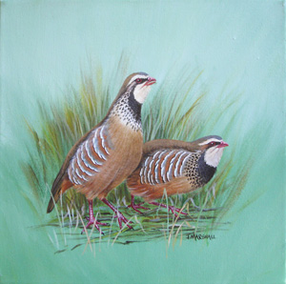

Slide 19
Roul-roul Partridge (Rollulus roulroul)
The Roul-roul Partridge is also known as the Crested Wood Partridge, Green Wood Partridge or Red-crowned Wood Partridge.
They are native to the tropical rain forests of Burma and Thailand, south to Malaysia, Borneo and Sumatra
Despite not often kept in captivity, they are charming aviary birds.
The Roul-roul Partridge is the sole member of the Genus Rollulus and has no known subspecies.

Slide 20
Breeding
Roul-roul may lay at anytime during the year. The males seem to do most of the nest building, using pine needles, branches or straw to create a tunnel like nest.
Clutches range from about 4 to 6 eggs
Incubation is done by the female and lasts 18 to 22 days.
Important
In captivity, the chicks of this species may have problems learning to eat. Provide mealworms and place a few small size chicks such as button quail in the brooder to help "teach" the little partridge to eat

Slide 21
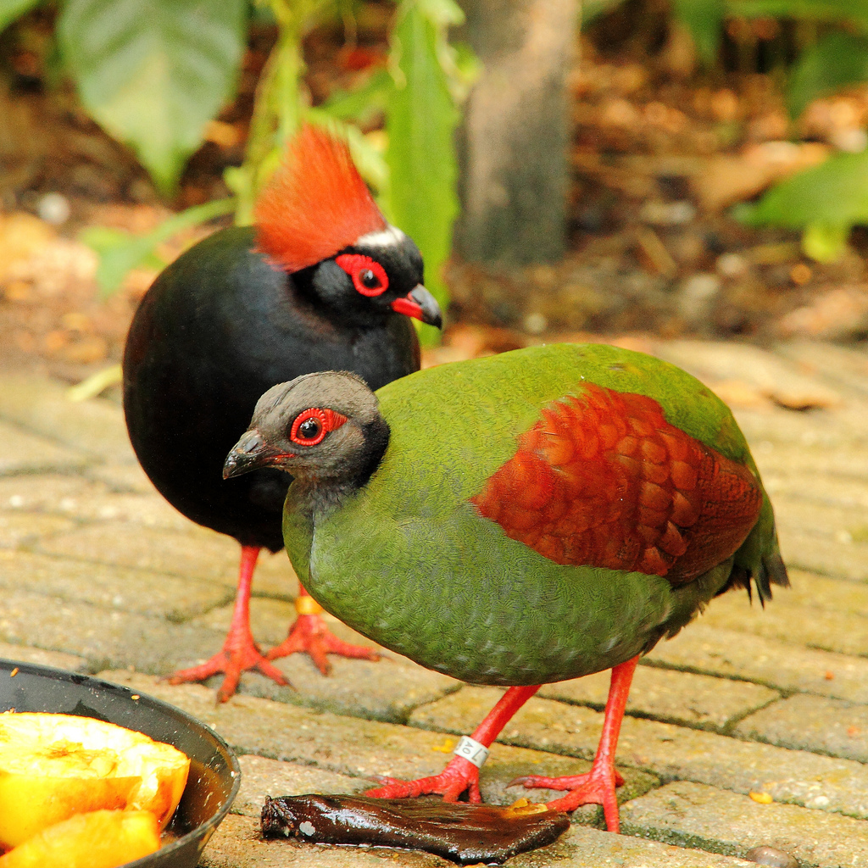

Slide 22
Habitat
Agricultural land
Pastures
Grasslands near the hedge rows
Winter landscape

Slide 23
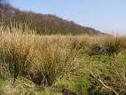
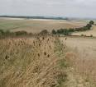

Slide 24
Feeding
Waste grains
Weed seeds
Insects
Green leaves

Slide 25
Weight gain
Male gains 1 lb at 9 weeks by consuming 3.75 lb and female gains 1 lb at 12 weeks by consuming 4.5 lb feed.
At 20 weeks live weight of bird is 600 grams while of processed meat is 1 lb

Slide 26
Breeding
Monogamous
Late feb to march
Select mates and establish weak pair bonds
Segregate from coveys
Establish a breeding territory
By modern production system 3time of 10-weeks production with each period 30-40 eggs
By artificial light start laying eggs at 30 weeks of age.

Slide 27
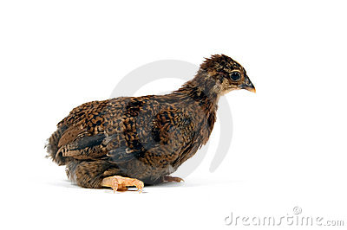
Immature/baby partridge

Slide 28
Young birds can fly at the age of 16 to 20 days
chicks which take about 60 days to reach adult size.
If another clutch is wanted, the chicks can be removed at about 30 days

Slide 29
Limiting factors for breeding
Mowing and burning of ditches
Deep crusted snow during winter
Hawks and owls
High grazing

Slide 30
Eggs Identification
Yellowish white with numerous brown speckles
Egg weight is avg. 21 gram

Slide 32
Nesting
April to June
Shallow
Depression in the ground lined with grass and leaves
Olive green eggs

Slide 33
Flight
Speed is 30-40 mph
Threatened partridge will try to fly away from a danger. It produces high-pitched "rick-rick-rick" calls when threatened.

Slide 34
Sexual Dimorphism
Male large size and colorful as compared to female.
Developed metatarsal spur in male while rudimentary or absent in female
In male there is cone-shaped protuberance which is 2.78mm in diameter(genital mark),centrally located in cloaca, while absent in female or two small nodules present in female

Slide 35
Conservation status
Still wide spread
Normal range
Life span is maximum 4-5 even upto 10 years years

Slide 36
Terms
Cock: adult male
Hen: adult female
Cheeper: young /baby partridge

Slide 37
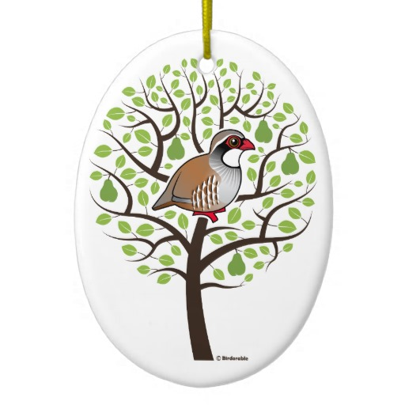
THANKS

Slide 38
QUESTIONS??

