Slide 1
RESPIRATORY SYSTEM OF POULTRY
By
Zaib-Ur-Rehman
Lecturer
Department of Poultry Science
PMAS, Arid Agriculture University, Rawalpindi, Pakistan

Slide 2
What is respiratory system?
“The respiratory system is the anatomical system of an organism that introduces respiratory gases to the interior and performs gas exchange”
Respiratory system of poultry comprise of
Nasal opening
Nasal passage
Trachea
Bronchi (bronchus)
Lungs
Air sacs

Slide 3
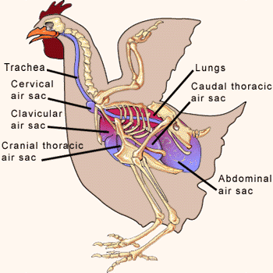

Slide 4
Differences between the respiratory system of poultry and mammals
Tracheal rings are complete in case of birds
The organ of phonation (syrinyx) is located at the bifurcation of trachea rather than near pharynx
The lungs are fixed in position and can not contract and expand in the respiration
Air sacs are present in the birds while absent in case of mammals. The air sacs are extended to the bones known as pneumatic bones. These structures have the ability to contract and expand with respiration
Diaphragm is absent in birds

Slide 5
TRACHEA
Trachea conducts the air from nasal cavity and mouth to the bronchus or bronchi
Causes the warming and moistening of air
Causes the screening of dust and foreign material
It also provides the local immunity
  By filtering or screening the dust particles with the help of cilia
  Mucous
  Production of immunoglobin (Ig A) that are antibodies
The trachea after entering into the body bifurcates into two structures known as bronchi (Right bronchus, left bronchus)

Slide 6
BRONCHI
Bronchial system of bird consists of three orders of branching before the gas exchange units are reached
Primary bronchus
Secondary bronchus
Tertiary bronchus (Para bronchi)
Peri perabronchial mental

Slide 7
PRIMARY BRONCHI
The primary bronchus arises from the bifurcation trachea. It has two parts.
Extra pulmonary primary bronchus
Intra pulmonary primary bronchus
Part of the bronchus outside the lung is known as extra pulmonary primary bronchus
Part within lungs is known as intra pulmonary primary bronchus
Primary bronchus is made up of circular cartilage rings and has a well developed layer of smooth muscles which control the diameter or size of the bronchus

Slide 8
SECONDARY BRONCHI
The bronchus arising from the primary bronchus is known as secondary bronchus. In most of the birds secondary bronchi are arranged into four groups.
Medioventral
Mediodorsal
Lateroventral
Laterodorsal
Cervical, clavicular, and cranial thoracic air sacs arise from the medioventral group of secondary bronchi
Caudal, thoracic and abdominal air sacs are derived from mediodorsal and lateroventral group of secondary bronchi

Slide 9
TERTIARY BRONCHI
The tertiary bronchi (Para bronchi) are derived from the multiple ramifications of secondary bronchi. These are long narrow tubes that display a high degree of anastomosis (The connection of separate parts of a branching system to form a network, as of leaf veins, blood vessels, or a river and its branches)
The para bronchi give rise to a specific structure known as atria which is out pocketing on the surface of Para bronchi
It give rise to extensions known as infundibuli
The infundibuli gives rise to final extensions known as air capillaries
The atria, infundibuli, and air capillaries collectively leads to the formation of a gas exchange unit peri Para bronchial mental. The blood capillaries make close contact with peri para bronchial mental and thus the exchange of gases takes place between the blood present in the blood capillaries and air present in the air capillaries

Slide 10
In most of the birds two kinds of Para bronchi are present
Paleopulmonic Para bronchi
Neopulmonic Para bronchi
The Para bronchi located towards the cranium air sacs are known as paleopulmonic para bronchi
Those located towards the posterior or caudal air sacs are known as neopulmonic para bronchi

Slide 11
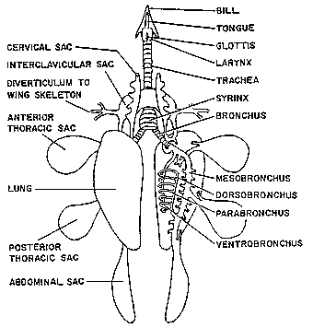

Slide 12
AIR SACS
The birds have 9 air sacs.
One clavicular
Two cervical
Two anterior thoracic/ cranial
Two posterior thoracic/ caudal
Two abdominal

Slide 13
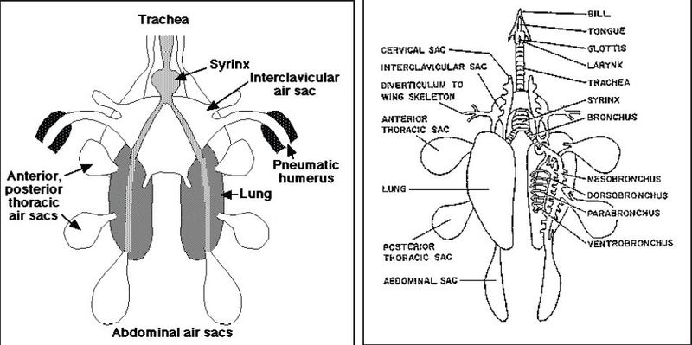

Slide 14
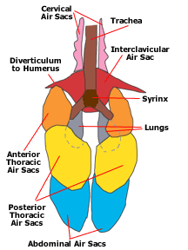

Slide 15
The air sacs are the continuation of the secondary bronchi
Air sacs are made up of thin walled structure which comprise of simple squamous epithelium and a thin layer of connective tissue
The walls of air sacs are poorly vascularized (poor blood supply) due to which non significant exchange of gas takes place
The air sacs are extended to certain bones and make them pneumatic in nature
The air sacs are extended to the cervical vertebrae, thoracic vertebrae, ribs, sternum, humerus, pelvis, head, and body of femur
The air sacs are responsible for providing the space during the respiratory cycle and there by function to increase the pulmonary ventilation

Slide 16
MECHANISM OF RESPIRATION
The respiratory mechanism is composed of two processes
Inspiration
Expiration
Inspiration or Inhalation:
Inspiration is a process during which the air is taken up by the bird and processes in the lungs
Process is active process because it consumes energy while in case of mammals this process is passive

Slide 17
Expiration or Exhalation
The discharge or removal of air into the environment is known as expiration or exhalation
This process is passive in nature in birds while active in case of mammals
As the birds are lacking in diaphragm but so the process of respiration depends upon thoracic, abdominal, and cervical muscles
During the process of inspiration the inspiratory muscles contract ultimately leading to the increase in internal abdominal thoracic volume and pressure decreases

Slide 18
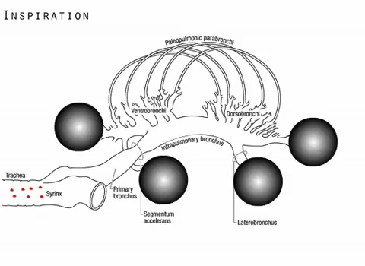

Slide 19
Due to this process the pressure in the air sacs is reduced and air from external environment moves towards the air sacs through neopulmonic para bronchi while towards cranial air sacs through paleopulmonic para bronchi
During the process of respiration the exchange of gases takes place in the mental of neopulmonic para bronchi and paleopulmonic para bronchi
The oxygen moves towards the blood from air capillaries while carbon dioxide moves towards the air capillaries from gut
The exchange of gases depends upon the difference of partial pressure of particular gas either in air capillaries or blood stream present in the blood capillaries

Slide 20
The blood capillaries and peri para bronchial mental are arranged in a specific type of arrangement known as cross current arrangement
In this type of arrangement the air capillaries and blood capillaries are present at right angle to each other due to which maximum exchange of gases takes place by diffusion
In the process of respiration the respiratory muscles contract leading to an increase in the intra thoracoabdominal pressure which ultimately generates the pressure on air sacs thus leading to expiration of inhaled air
The air present in the caudal air sacs is passed through the neopulmonic para bronchi
The air then enters the cranial air sacs while the air present in the cranial air sacs is removed and the air entering from the caudal air sacs is removed during the second respiratory cycle

Slide 21
THERMOREGULATION
The birds like mammals are homoeothermic in nature because they tend to maintain the temperature of deeply seated organs like brain, liver, heart, intestine etc. In homeothermic animals the amount of heat produced by the muscular exercise and metabolic activity like oxidation of glucose is equal to the amount of heat loss from the animal to its environment. The heat is lost to the environment by the process
Radiation
Conduction
Convection
Evaporation/panting

Slide 22
Radiation
“The heat exchanged by the radiation involves the transfer of heat by electromagnetic wave and consist of heat transfer within both the visible and infrared portion of spectrum”
Conduction
“Loss of heat by this process involves the direct transfer of heat from the animal body surface to the air. The loss of heat by the process of conduction is very low because the thermal conductivity of skin and subcutaneous tissue is also low”

Slide 23
Convection:
“Heat loss by the process of convection takes place due to direct contact of air or any other material with skin of animal. The heat loss by this process depends upon the velocity of air as well as the temperature of air. The heat loss by this process also depends upon the surface area of body in contact with air”
Evaporation\panting:
“The birds do not contain the sweat glands due to which the loss of heat from skin by the form of evaporation is not possible. On the other hand the heat loss occur by evaporation from the most lining of respiratory tract as well as the tongue”

Slide 24


