Slide 1
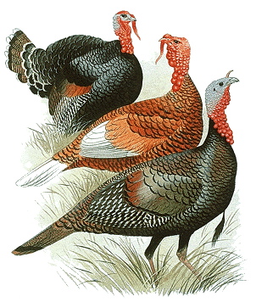
POULTRY
Turkey

Slide 2
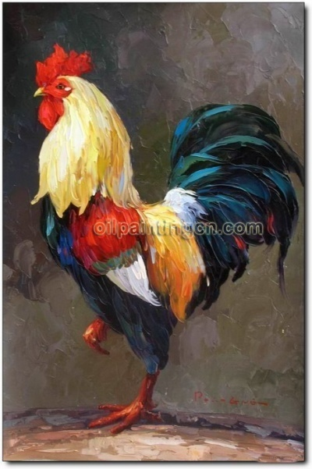
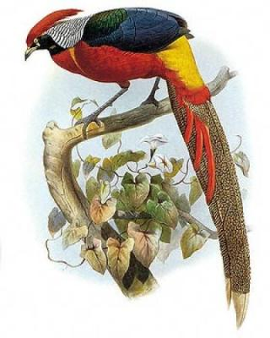
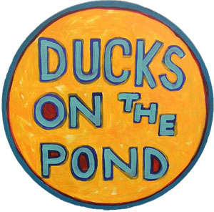
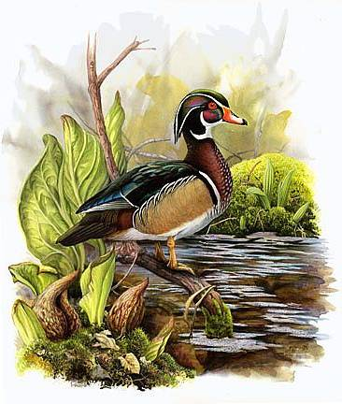
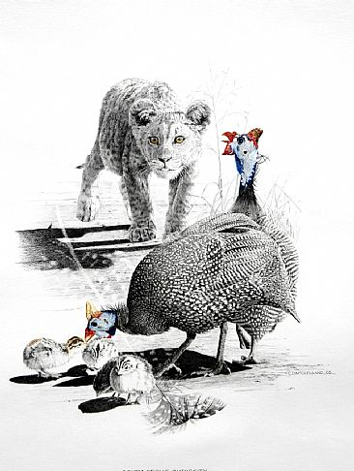
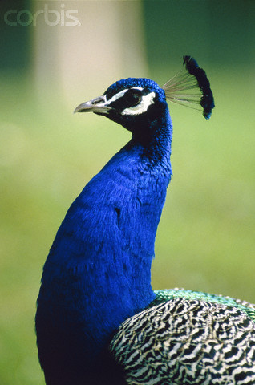
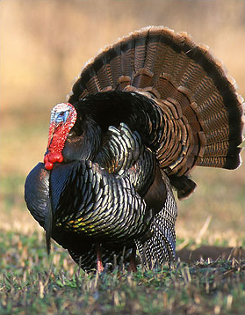
POULTRY

Slide 3
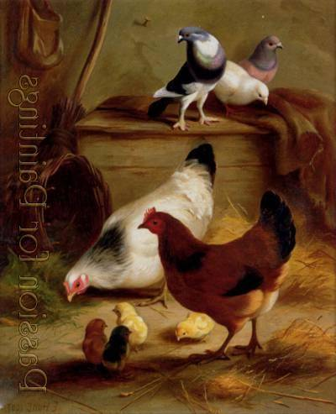
These most typically members of poultry are
Chickens
Turkeys
Quails
Ducks
Guinea Fowl
Pea Fowl
Pheasants
Partridges
Pigeons, &
Doves
http://en.wikipedia.org/wiki/Poultry

Slide 4
History
Name from “Turkey” (country) Domestication of the common turkey was probably begun by the Indians of pre-Mexico.
Turkey (Meleagris Gallopavo) is a large gallinaceous bird of the family Meleagridae
Native of North America, domesticated in Europe and are now important source of food in many parts of the world.
Columbus took specimens to Spain in 1948. Reports on turkey were there in Germany in 1530 and in England by 1541.
The first president of the United States of America, George Washington, issued a general proclamation in1789 to celebrate “thanksgiving” on November 26.
In 1893 President Lincoln proclaimed the last Thursday of November a national thanksgiving holiday. Later it was changed to the fourth Thursday of November. However, turkey is synonymous with Christmas./Easter
When the bird became popular in England, the name turkey-cock, formerly used for the of Islamic (or “Turkish”) lands, was transferred to it.
Turkeys were mainly bred for their beautifully coloured until about 1935, after which the breeding emphasis changed to their qualities.

Slide 5
Zoological Classification
Kingdom: | Animalia
Phylum: | Chordata
Class: | Aves
Order: | Galliformes
Family: | Phasianidae
Subfamily: | Meleagridina
Genus: | Meleagris
2 species
M. gallopavo M. ocellata

Slide 6
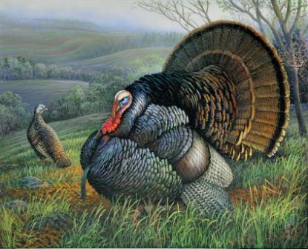
TURKEY- 02 Species
1.Meleagris gallopavo(modern).
2.Meleagris ocellata (historical).
The turkey is a large poultry bird. The modern domesticated turkey descends from the wild turkey (Meleagris gallopavo), one of the two species of turkey (genus Meleagris); however, in the past the ocellated turkey (Meleagris ocellata) was also domesticated.

Slide 7
Terms
Tom : Adult male turkey
Hen: Adult female turkey
Poult: Young one of turkey
Snood or Dew bill: The fleshy protuberance near the base of the beck
Caruncles /shooting red/ulcers: The fleshy protuberance on the head and neck usually pink or red in color which appear from about 5th week of age. The development of caruncles and this is supposed to indicate the most difficult time in the life of young turkey
Dewlap/Wattles: A large flap skin seen immediately below the chin
Beard: A tuft of hair attached to the skin of the upper chest region
Strut: Mating behavior of male turkey

Slide 8
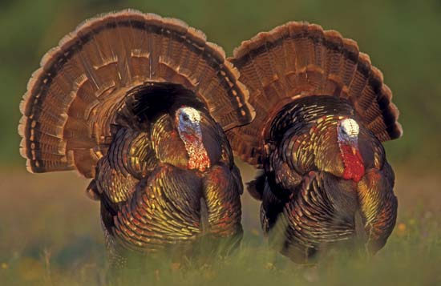
Hen
Tom

Slide 9
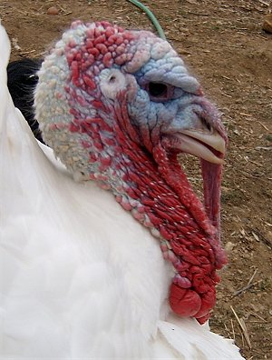

Slide 10
Breeds of turkeys in the World:
4 Parental Heavy Type Breeds:
Big six
Hybrid large white
Nicholar 900
Nicholar 700
5 Medium Heavy Types:
BUT-8
BUT-9
Big-9
hybrid super medium
Nicolas 300).
Two medium varieties in 1995 by regional breeders:
Benkova
Jancowski.
In Europe,medium type turkeys available are:
Gaubin(France),
Kvama(Poland).

Slide 11
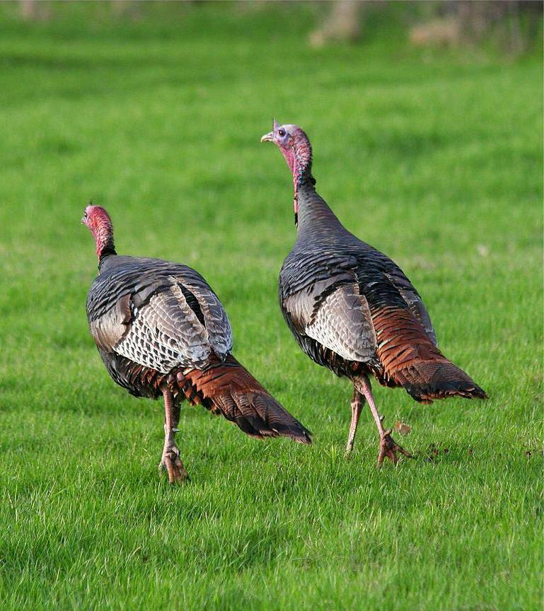
Varieties of Turkey
1. Wild Turkey
2. Domestic Turkey
8 standard varieties recognized by APA
Beltsville Small White
Black
Bourbon Red
Bronze
Narragansett
Royal Palm
Slate
White Holland turkey

Slide 12
Wild Turkey Meleagris gallopavo

Slide 13
Description
Large, dark ground-dwelling bird.
Long, powerful legs.
Large, fan-shaped tail.
Bare head and neck.
Short, slightly down curved bill.
Tip of tail chestnut-brown (in East) or
white (in Southwest).

Slide 14
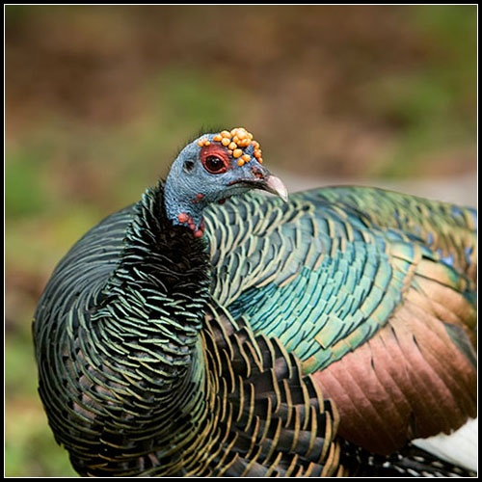
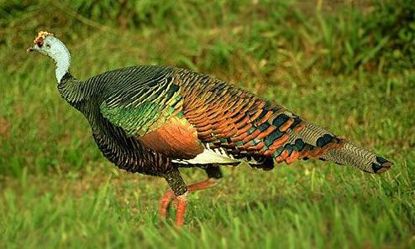
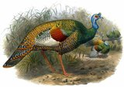
Ocellated turkey Meleagris ocellata

Slide 15
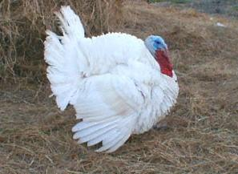
Small White(original variety)

Slide 16
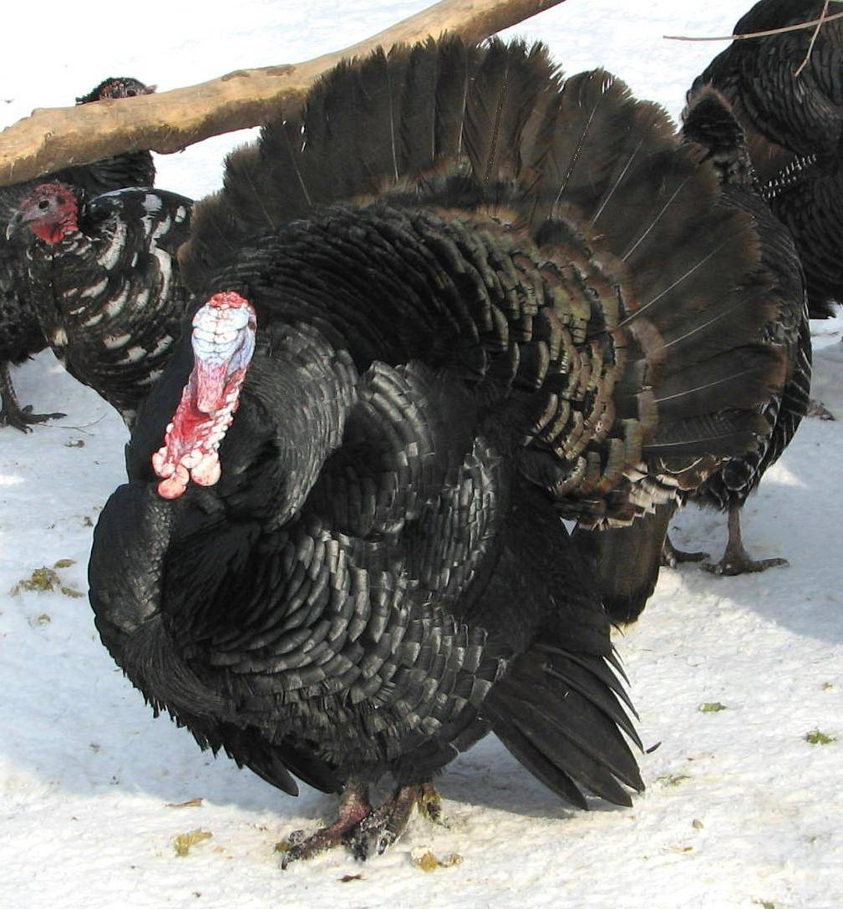
Breeds of Turkey
Black Turkey
The Black turkey should have a lustrous greenish black plumage.
The desired weights for the variety are:
Adult cock, 27 lbs(1 lb=0.45kg)
yearling cock, 22 lbs
cockerel, 18 lbs
hen, 18 lbs
pullet, 12 lbs

Slide 17
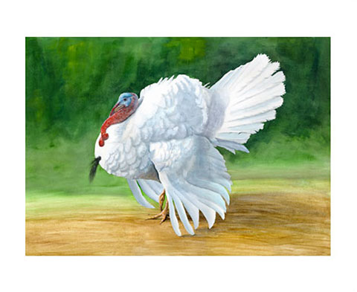
Breeds of Turkey
White Turkey
Supermarket Demand?
The broad breasted white turkey is the favorite turkey breed of the poultry industry. The broad breasted white turkey is a derivative breed of the Small White turkey. The Broad Breasted White turkey has a large breast muscle, which satisfies consumer demand for turkey breast meat. "The White Holland is a white-feathered variety that originated in Europe. Standard weights are 33 pounds for toms and 18 pounds for hens. The White Holland's advantage has been its lack of dark pinfeathers

Slide 18
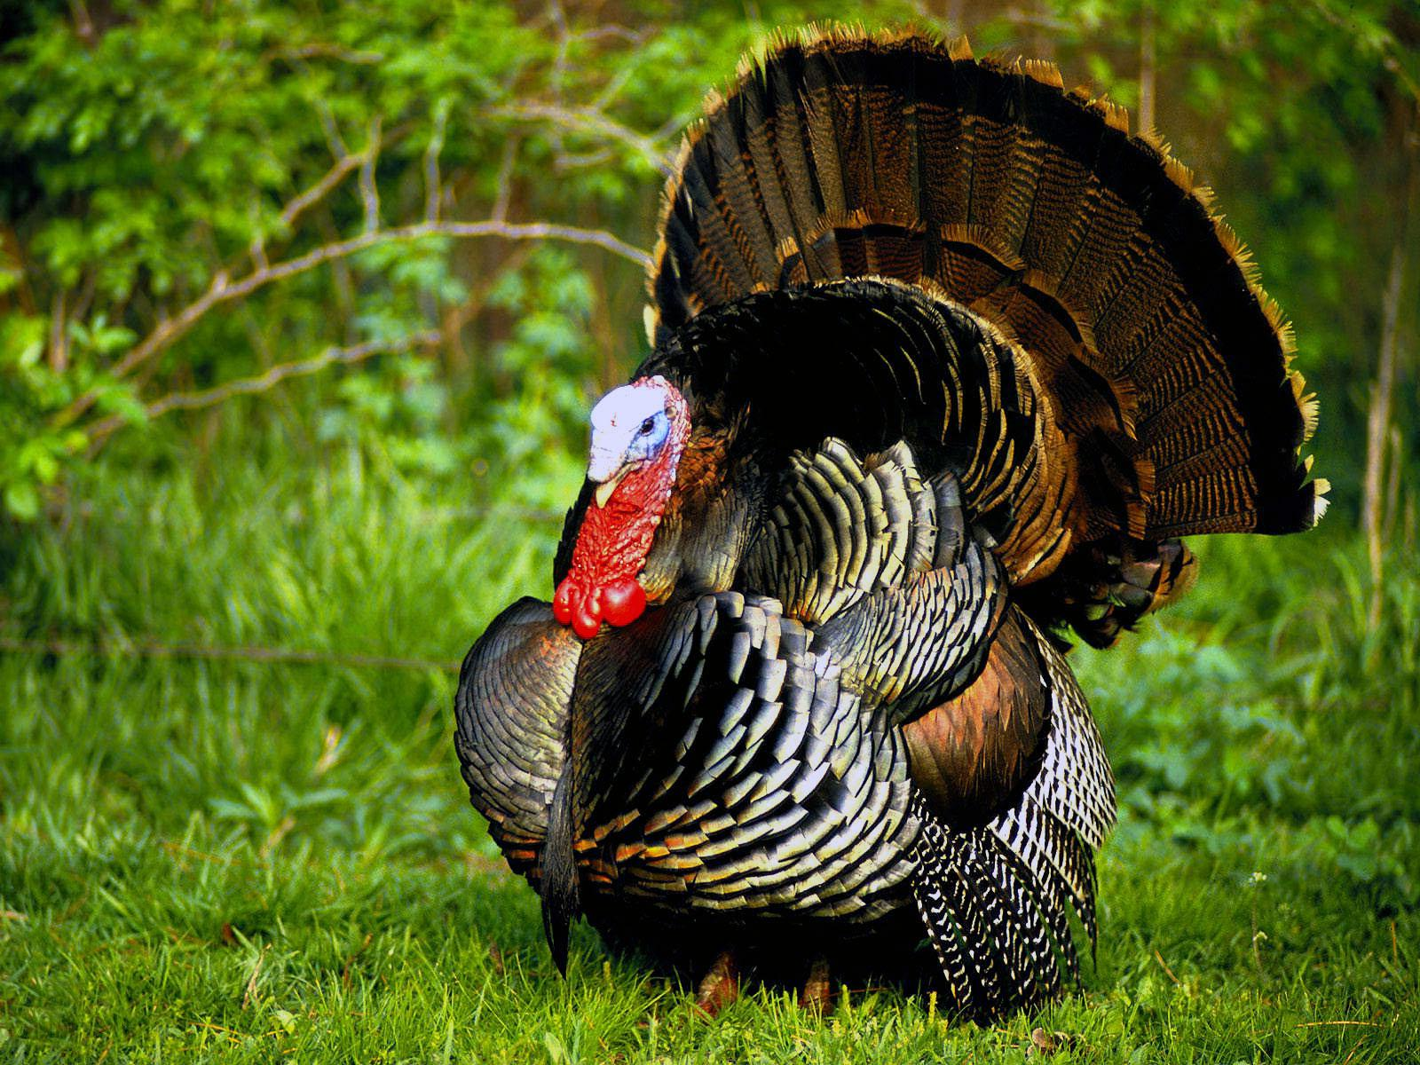
Breeds of Turkey
Bronze Turkey
The Bronze turkey is named for its unusual color, a shimmering green-bronze which appears metallic in the sunlight. It is found in two types,
the Broad-breasted
the Unimproved (or naturally-mating)

Slide 19
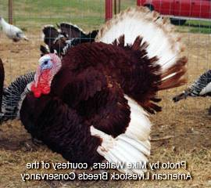
Breeds of Turkey
Bourbon Turkey
It was developed by J. F. Barbee from crosses between Buff, Bronze, and White Holland turkeys .
Male 23 lbs
Female 14 lbs

Slide 20
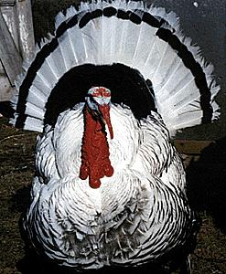
Breeds of Turkey
Royal Palm Turkey

Slide 21
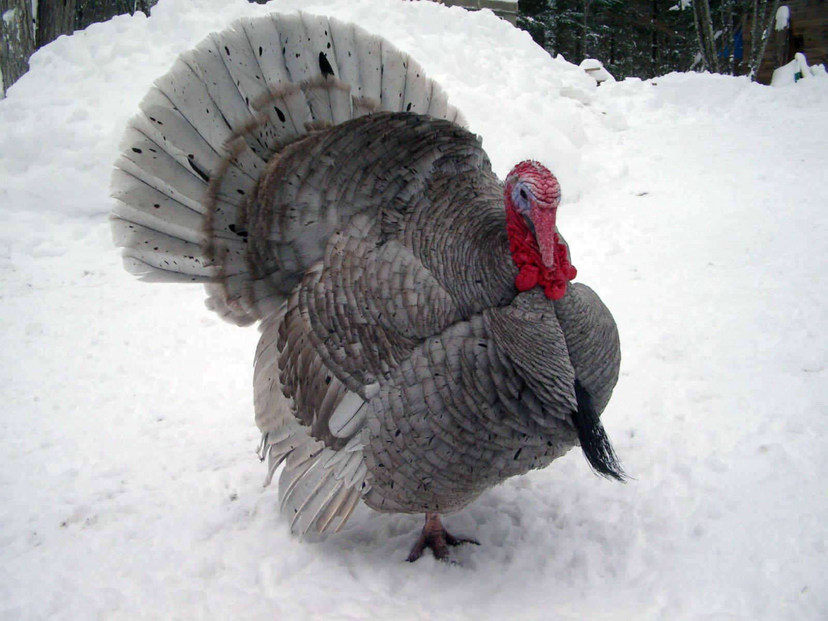
Breeds of Turkey
Slate Turkey

Slide 22
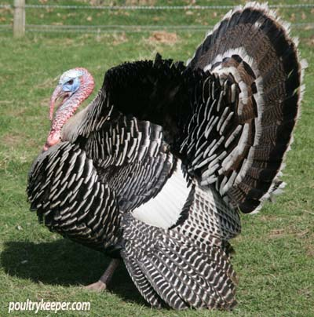
Breeds of Turkey
Narragansett Turkey

Slide 23
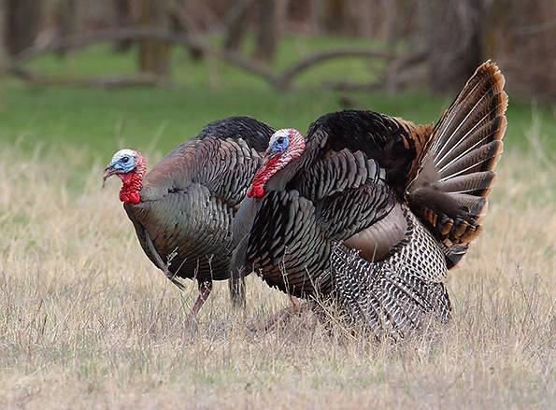
Turkey Breeding
Males perform courtship displays by strutting and gobbling.
Nests are shallow depressions scratched into the ground, concealed under brush, grass, or shrubs.
Egg-laying begins in late March;
Eggs are white with light brown spots. Incubation lasts 28 days.Within one day of hatching, the young birds, called poults, are able to walk.
Wild turkey 10-14 and ocellated 8-15 eggs in a clutch
female ratio is 1:5 for medium type turkeys
1:3 for large types.
On an average 40-50 poults is expected form each breeder hen

Slide 24
Sexing Turkeys
Toms vs. Hens
It can be difficult to tell the difference between toms (male turkeys) and hens (female turkeys) because toms and hens look very similar until maturity.
After maturity, there are significant differences.
Here are some clues to tell turkeys apart after 8 weeks.

Slide 25
Tom | Hen
Toms are significantly larger after 8 weeks. Larger head and body Longer legs Larger shank diameter (Shank = upper leg) | Hens are significantly smaller after 8 weeks. Smaller head and body Shorter legs Smaller shank diameter
Average carcass weight at show time is 27-28 lbs. | Average carcass weight at show time is 20-22 lbs.
Toms mature (develop fat) later than hens and take longer/more feed to “fill out” in the breast. | Hens mature at a younger age than toms and will have smooth body and wing feathers earlier.
Strutting (flaring of feathers) is common after toms are a few weeks old. | Hens do not strut.

Slide 26
Tom | Hen
More colorful necks and faces After maturity, toms have blue and red faces Before Maturity, tom faces are darker red than hen faces | Less colorful necks and faces Hen faces become darker with age, but are always more pale red than toms. Hens do not develop blue skin
Larger, more colorful snood Before maturity, snood is a relatively small, thin and non-elastic upward growth on the beak of both hens and toms. After maturity, toms have an elongated snood that | Smaller, paler pink snood at all stages of growth Sometimes snood is removed when poults are young.

Slide 27
Tom | Hen
Larger and more pronounced caruncles, or pink/red fleshy protuberances on the neck | Small caruncles
Mature toms have a “beard” of black coarse hairlike feathers on their white chest. | Hens can have black “beards” too.

Slide 29
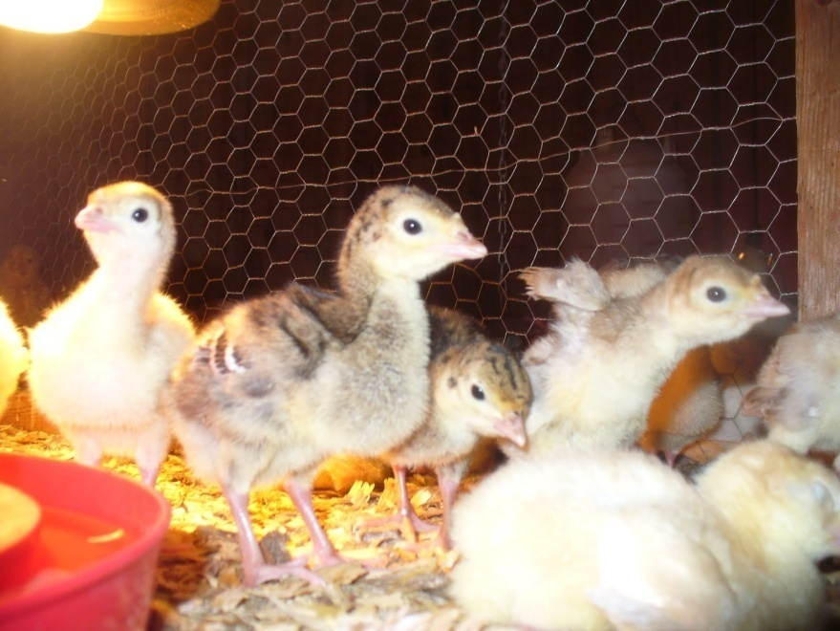
Turkey Brooding & Management
Domestic turkeys cannot fly and can be kept inside a fence in yard.
Two turkeys can be kept in a 90 square feet and at least 6 feet high area.
The best type of floor is a dirt floor. Hay can be provided as a ground cover.
The turkey pen should be kept clean. Waste should be raked out and new dirt or hay put down every few days.

Slide 30
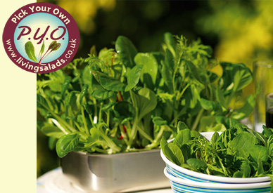
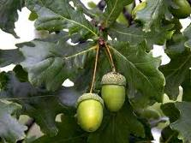
Turkey Feeding
Turkeys should be fed pellets as their main diet
can also be fed fruits, and vegetables ,some kinds of leaves, weeds, wild nuts, acorns, grass, grapes etc.
love to eat a chicken egg that is cracked on the ground

Slide 31
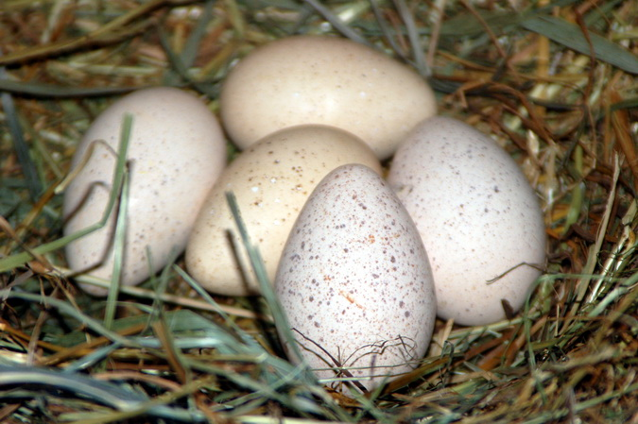
Turkey Eggs
Age at sexual maturity:30 weeks
Egg wt: 65g av.
Poult weight is 50 g
Average commercial
Turkey will lay: 60-80 eggs/year.
Incubation period is:28 days
The average lifespan of a breeding tom is 64 weeks

Slide 32
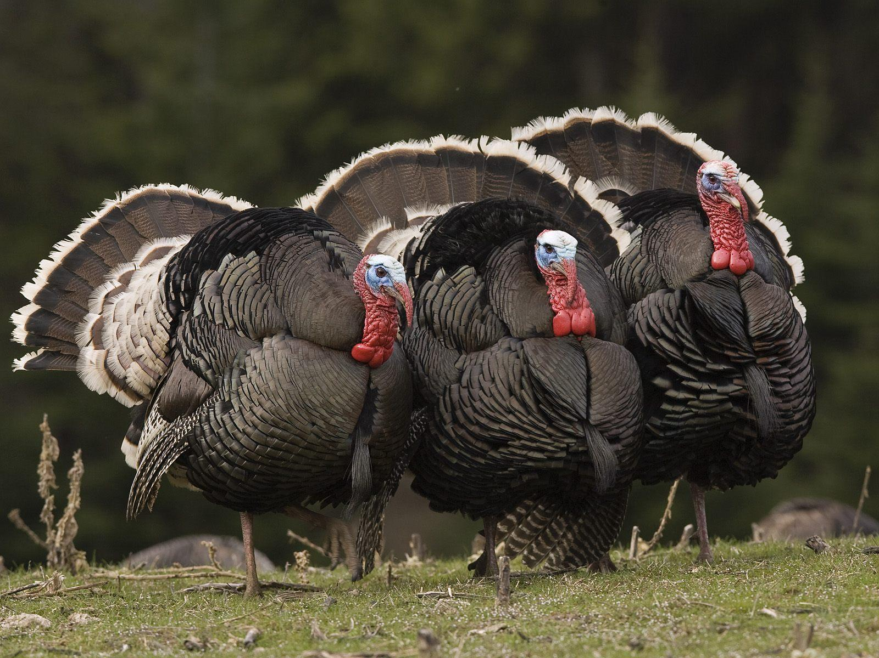
Turkey Life-span
10 years on average

Slide 33
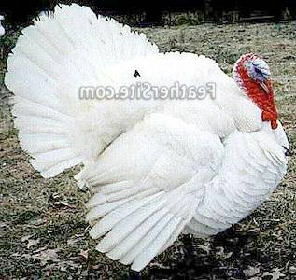
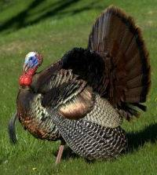
Commercial Turkey
White Holland or Broad Breasted White
Broad Breasted Bronze

Slide 34
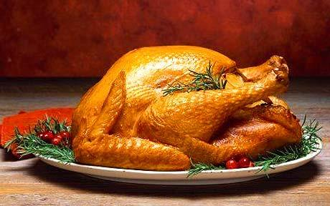
Turkey as food
Turkeys are usually baked or roasted in an oven for several hours, often while the cook prepares the rest of the meal .

Slide 35
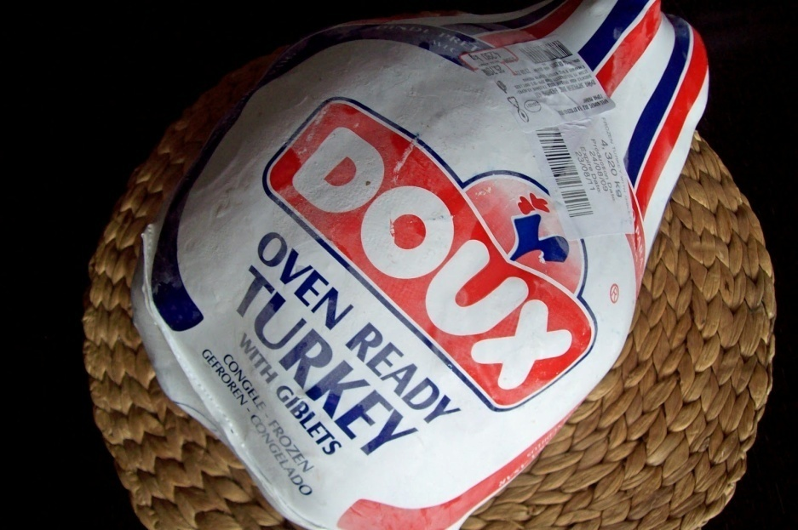
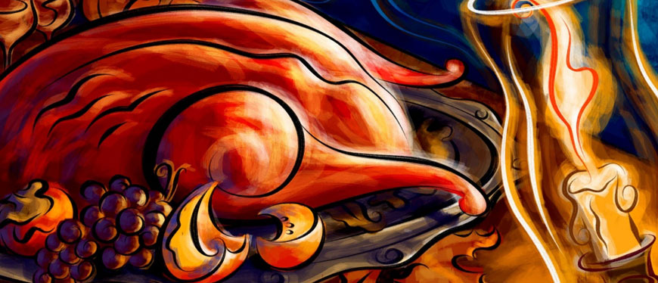
Turkey as food
Both fresh and frozen turkeys are used for cooking

Slide 36
Egg Incubation
Egg should be turned at hourly intervals daily upto 25 days of incubation only.Don’t turned eggs in Hatcher (last Three days before hatching) Eggs should be collected frequently
to prevent soiling and breakage and also to get better hatchability.
Portions Of Hatchery | Days in each Portion | Temperature Degree F | Relative Humidity %
Setter | 25 | 99.5 | 60-75
Hatcher | 3 | 98.5 | 85-90

Slide 37
Activities to avoid peck order or to avoid injuries during mating breeding
A. De- Beaking:
Poults should be debeaked to control feather picking and cannibalism. Debeaking can be done at day old or 3-5 weeks of age. Remove the beak at about one half the distance from nostril to the tip of the beak.
B De- Snooding:
Removal of the snood or dew bill is to prevent the head injuries from picking and fighting. At the day old the snood can be removed by thumbnail or finger pressure. At 3weeks of age it can be cut off close to the head with sharp scissors.
C De- Toeing or Toe Clipping:
Clipping is done at day old by removing the tip of the toe just to the inside of the outer most toe pad including the entire toenail.

Slide 38
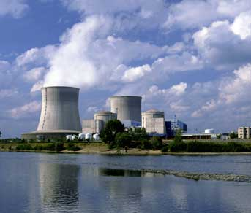
Turkey Dung as Fuel
Turkey droppings are being used as a fuel source in electric power plants. One such plant in western Minnesota provides 55 megawatts of power using 700,000 tons of dung per year. The plant began operating in 2007. Three such plants are in operation in England.

