Slide 1
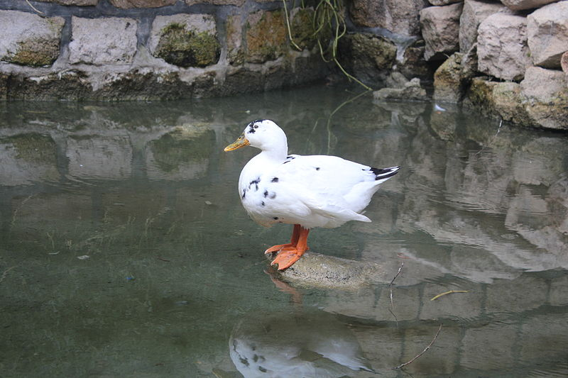
DUCKS

Slide 2
Duck Farming and Housing management

Slide 3
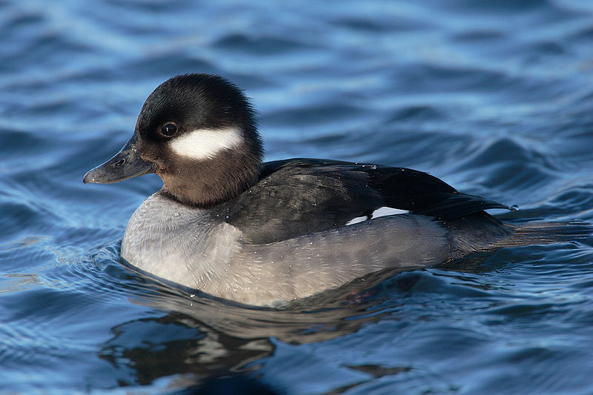
Classification:
Kingdom:Animalia
Phylum:Chordata
Class:Aves
Order:Anseriformes
Family:Anatidae

Slide 4
Genera
Anas
Aythya
Oxyura
40 breeds of ducks divide into 4 classes
Heavy
Medium
Light and
Bantam.

Slide 5
Class | Breed | General Purpose | Body Weight (Kg) | # Eggs Per Year | Variety/Color | Special Distinguishing Feature
Heavy | Aylesbury | Meat | 3.6-4.1 | 40-60 | White | White skin & bill, large deep keel
 | Pekin | Meat/eggs | 3.6-4.1 | 100-180 | White | Yellow skin, feet & orange bill
Medium | Crested | Show | 3.2-3.6 | 60-100 | Black, White | Ball of feathers on back of head
Light | Indian Runner | Eggs/show | 1.2-2.0 | 100-150 | Black, buff, chocolate | Unique upright carriage resembles a walking bowling pin
 | Campbell | Eggs | 2.0-2.3 | 200-300 | Khakhi | Seal-brown plumage
Bantam | Mallard | Show | 1.4-2.0 | 20-50 | Grey | Resembles common wild mallard

Slide 6
Physiological Norms of Waterfowl
Rectal temperature is 39.5c
Respiration rate averaging 10.8 per minute; ranges from 8.2 to 12.6
Heart rate is 185 per minute with a range of 175-194.

Slide 7
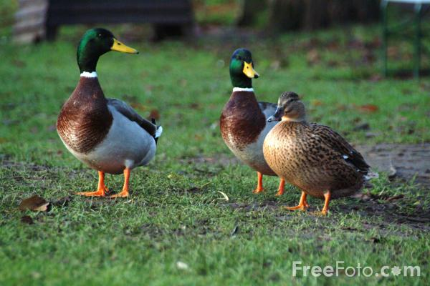
Domestication and Origin:
Ducks have been domesticated as pets for more than 500 years ago.
1st domestication started in china.
All domestic ducks are descended from either the MALLARD or MUSCOVY duck.

Slide 8
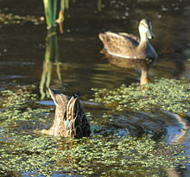
Etymology
The word duck comes from Old English duce"diver", a derivative of the verb ducan "to duck, bend down low as if to get under something, or dive", because of the way many species in the dabbling duck group feed by upending; compare with Dutch duiken and German tauchen "to dive".

Slide 9
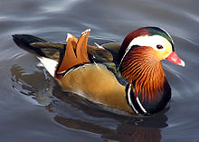
Morphology
Elongated and broad body
short neck
Bill is broad and contain serrated lamellae
Pectin along the beak
Wings are short,strong and pointed

Slide 10
Sexing male Vs.female
Vent Sexing: "Step 1: Hold the bird upside down. Hold the gosling or duckling with its feet against its belly. Use your index finger to gently press about 1/2 an inch below the vent with your knuckle. The bird might poop at this point just wipe it off and apply pressure again. Step 2: With your other hand gently tuck the tail toward the bird's back. Gently place your index and thumb at either side of the vent. Gently pinch them together. You only want to push the vent lips together and you will feel them flexing against your fingertips. Hold it like this for a few seconds and then gently push your fingers open and press down with gentle pressure to make the cloaca invert. Step 3: If the vent doesn't fully invert gently keep applying pressure until it does. At this point if you have a male his penis should be exposed. It will be either white, pink or even dark grey to almost black depending on breed. It should pop out a little if not it should after a second or two. Females are sometimes hard to sex but should be just red to pink lips with no corkscrew like tip hanging out. Some males will hold it in and can be mistaken for a female. You can always sex them again later when they get a bit bigger. Never keep them inverted more than a few seconds. I can't recall how long but I would safely say 20 seconds max. Step 4: Release pressure on belly and vent. Gently rub the vent if everything doesn't tuck back after releasing pressure. Rubbing should help gently push the vent back in place." Vent sexing is usually the method used by hatcheries when you order sexed ducklings.

Slide 11
Voice Sexing:
The quack noise usually associated with ducks ONLY comes from the females.
Males make a very monotone, deep, raspy peep noise even though both males and females start out sounding the same. As the duck matures, the voice changes.
Females can start quacking as soon as 2 weeks after hatching, but it is more likely going to take 4-6 weeks before you hear the females make a quack noise.
The female quack can also sound more like the cross between "a cough and a fart" instead of an outright quack. The key is tonal range and volume.
Male usually by 8 weeks, they will be very monotone and much quieter than females only making a raspy noise. In the case of muscovy ducks, males will hiss.

Slide 12
Plumage Sexing:
Many ducks have different feathering on males and females. Mallards are a prime example with males having shiny green heads, a white neck ring, brown chest, etc...
while the females are a more uniform dull brown. This is fine for telling adults apart, but not very helpful for ducklings.
Many ducklings go through a developmental phase where they all look like females. It isn't until they are 3 months or more that you will begin to see signs of adult feathering.
One sign is the "drake feather". On male ducks, one or two of their tail feathers will curl up while the feathers on a female's tail will remain flat.
The drake feather may not appear for 2-3 months. If the duck is molting, it is also possible to not see a drake feather until new feathers grow in.
Mature drake (furthest right) with noticeable drake feathers.
In the case of Peking ducks, both males and females are solid white. There is no plumage difference to help you tell them apart and other means must be used.

Slide 13
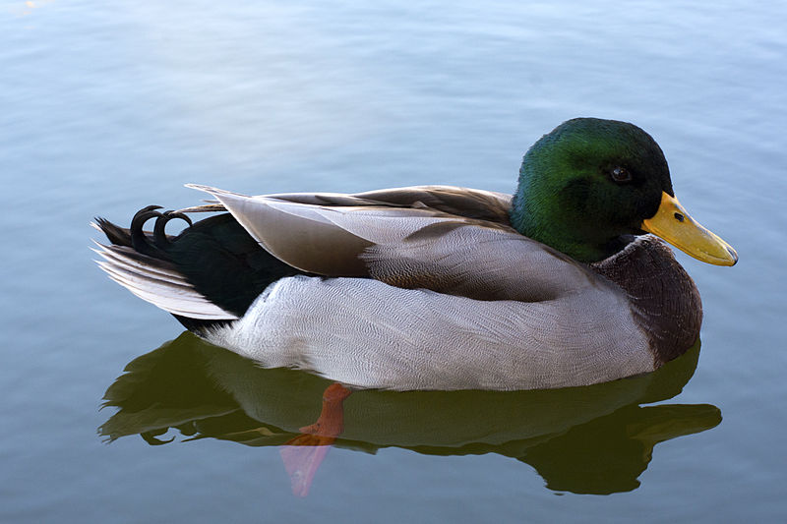
M Vs F

Slide 14
Size: In the case of muscovy ducks, males get much larger than females, though this size difference will not appear until the ducklings are several weeks old. Males will also develop a larger red "mask", but this also takes time. Other methods: There are some breeds that have subtle ways to tell apart the males in females. In the case of Welsh Harlequins, "a darker bills means a male and lighter bills ending in a dark spot are normally females. Within several days this distinction disappears." With muscovy ducks, even before a size difference between males and females becomes visible, males often have large feet and bigger claws.

Slide 15
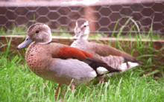
Feeding
Grasses
Aquatic plants
Fish
Insects
Small amphibian
Worms
Small molluscs

Slide 16
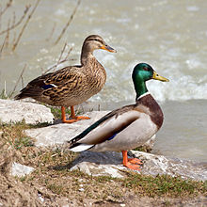
Breeding
Monogamous
Breeding once in a year
Mostly in spring-summer season
Make nest before breeding
Male has eclipse plumage after breeding season

Slide 17
Breeding
Male to female ratio is 1:5. During breeding 4-5 sq.feet to one duck
Store eggs at 50Fand 70%RH.not store eggs more than 10 days.egg laying is early in the morning,so collect eggs at 6am to 9 am.

Slide 18
Free Range
Provide 10 square feet per duck and 15 square feet per goose in outside runs

Slide 19
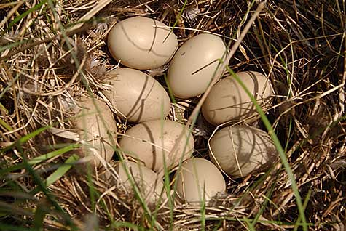
Nesting Facts:
When constructing her nest ,a hen will line it with soft down feathers,she plucks from her own breast.
This gives egg best possible cushioning and insulation.

Slide 20
Incubation And Hatching
Setter
Temperature: Set the temperature at 37.5°C (99.5°F)
Humidity: 55%.
Days:25
Hatcher
Temperature: 37.2°C (99°F)
Humidity:65%
Days:3
When piping starts the increase humidity to 80%.
When hatching is near to completion reduce temperature to 36.1(97°F) and humidity 70%

Slide 21
For Natural Hatching
Muscovy ducks are very good setters, capable of hatching 12-15 duck eggs.

Slide 22
Egg Storage
Store eggs at 13c°C (55°F) and RH 75%

Slide 23
Brooding(0-4 weeks)
Egg Type:3 to 4 weeks.
Meat type: 2 to 3 weeks
Space:90 to 100 sq.cms./duckling
Brooder: Hover type
A temperature of 29 to 32oC (85 to 90oC) is maintained during the first week. It is reduced by about 3oC per week till it reaches 24oC (75oF) during the fourth week.

Slide 24
Brooding…..
A wire floor space of (1/2 sq, ft.) per bird or
solid floor space of (1 sq.ft.) per bird would be sufficient up to 3 weeks of age.
Water Drinker:Water in the drinkers should be 5 to 7.5 cm (2 to 3”) deep just sufficient to drink and not dip themselves.

Slide 25
Rearing(15-16 week)
Intensive system:3 sq.ft. space up to 16 weeks of age/bird
Semi-intensive system:2.5-3 sq.ft inside at night and 10-15sq.ft space/bird in outside run .
Water drinker5-6” deep; only allow to immerse their heads.
Free range: Under range system a flock of 1000 can be reared per 0.405 hectare (one acre).

Slide 26
Adult stock (above 17 weeks of age)
Intensive system:4-5sq.ft/bird
Semi-intensivre:3 sq.ft at night for shelter and 10-15 sq.feet in outside run.
Feeder space:mash or pellet feeding adlib in hoppers, a feeding space of 5 to 7.5 cm.(2 to 3”) per duck would be sufficient.
One nest box of size 30x 30 x 45 cms.(12 x12 x18”) to every three ducks be provided.

Slide 27
Reproduction!!!
Mating ratio: in laying breeds 1 drake to 6-7 ducks
and in table breeds 1 drake to 4-5 ducks is allowed.
Photo period/light hours: of 14 to 16 hours per day is essential for optimum production.

Slide 28
Water and ducks
Duck is a water fowl and very fond of water,
water for swimming is not essential at any stage of duck rearing.
water in drinkers should be sufficiently deep to allow the immersion of their heads and not themselves. If they cannot do this, their eyes seem to get scaly and crusty and in extreme cases, blindness may follow.
In addition, they also like to clean their bills periodically and wash them to clear off the feed.
While in meat strains a slight increase in body weight of ducks at seven weeks of age has been noticed (weight advantage of swimming ducks to non-swimming ducks is 0.3%)
but for egg laying strains, swimming is a disadvantage.

Slide 29
Nutrition specification
 | Layer duck |  |  | Broiler duck
Item | starter | grower | layer |  | Broiler starter | Broiler finisher
M.E(kcal)/kg | 2600 | 2500 | 2600 |  | 2800 | 2900
Crude protein % | 20 | 16 | 18 |  | 23 | 20
Calcium % | 1.00 | 1.00 | 3.00 |  | 1.2 | 1.2

Slide 30
Sexual maturity
Muscovy:26 to 28 weeks(female) and 27 to 29 weeks(male)
Mallard:7 months
Breeding season. August-May

Slide 31
Eggs
Clutch size: 8-12 eggs
Chicks are precocial.
Hatching Period variable.
28 days for pekins ducks egg.
35 days for Muscovy ducks egg.

Slide 32
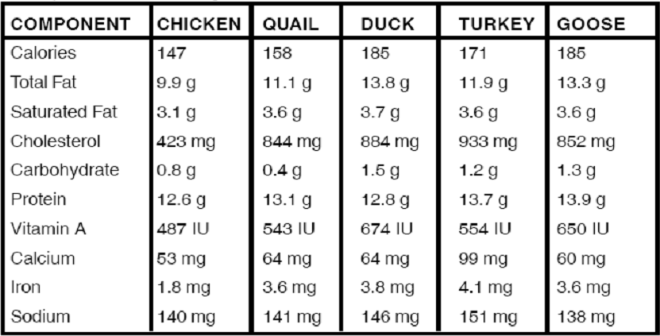
Egg Composition(1oo gram of whole eggs)

Slide 33
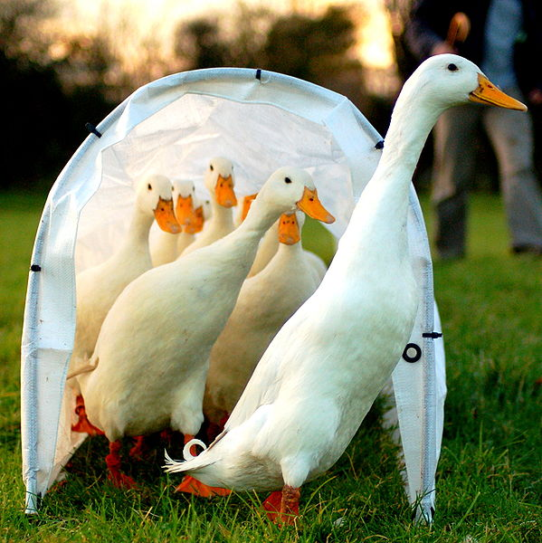
Interesting Facts:
Adult Male duck is called Drake
Adult female is called Hen
Baby duck is called Duckling
Group of ducks is called Raft,Team or paddling

Slide 34
Interesting Facts:
Ducks feet have no nerves or blood vessels,so they never feel cold even if they swim in ice cold water.
Ducks have webbed feet which act like paddles during swimming.
Ducks can live from 2-12 years depending upon the species.

Slide 35
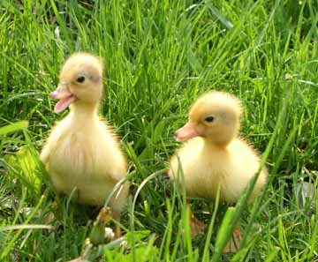
Interesting Facts:
Male ducks are Silent
Female ducks calls Quack.
It is a myth that ducks quack won’t echo,which has been disproved.

Slide 36
Fictional characters
Because of their familiarity and comic nature, ducks are often featured as fictional characters.

Slide 37
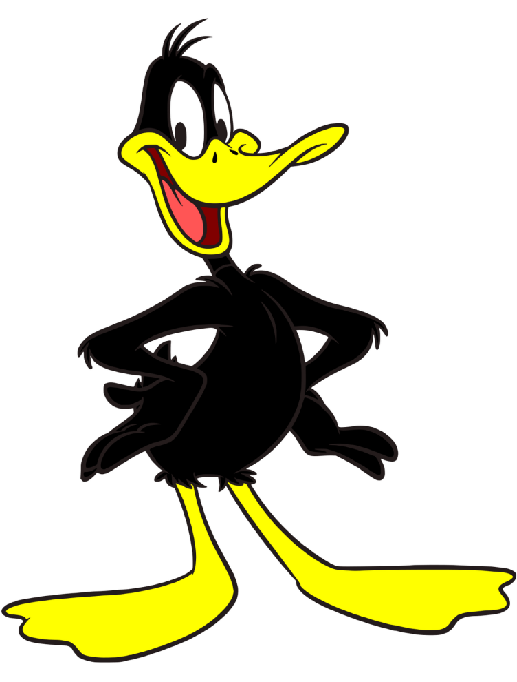
Notes:
The two most famous fictional ducks are:
Disney's Donald Duck, who premiered in 1934
and Warner Bros.' Daffy Duck, who premiered in 1937

Slide 38
Difference Between Duck Egg and Chicken Egg:
The ducks eggs are larger than chicken eggs.
Shell is slightly tougher to crack, so long shelf life in refrigerator about 6 weeks.
Yolk is larger in proportional to the albumin as compared to chicken egg.

Slide 39
Nutrition Profile Of EGG:
Total energy = 130cal
Out of which,86cal from FATS.
Fats mostly unsaturated.
100 grams of duck egg contains more amount of Vitamin B6,B12 and vit.A than the same amount of chicken egg.

Slide 40
Khakhi Campbell(europe, Mrs. Adah Campbell 1898,(Anas platyrhynchos) They are a cross between Mallard, Rouen andRunner ducks

Slide 41
Indian Runner(Anas platyrhynchos domesticus)

Slide 42
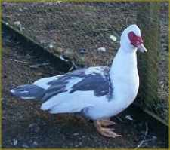
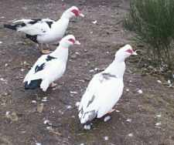
MUSCOVY DUCKS(Cairina moschata)

Slide 43
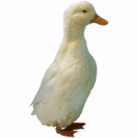
Pekin Duck(Anas platyrhynchos domestica,
Pekin Duck

