Slide 1
Different Systems of the Fowl

Slide 2
Female reproductive system

Slide 3
Male reproductive system

Slide 4
Skeletal system

Slide 5
Vertebral formula
C-
T-
LS-
Cy-

Slide 6
Nervous system

Slide 8
12 N
I. The Olfactory Nerve
II. The Optic Nerve
III. The Oculomotor Nerve
IV. The Trochlear Nerve
V. The Trigeminal Nerve
VI. The Abducens Nerve
VII. The Facial Nerve
VIII. The Vestibulocochlear Nerve
IX. The Glossopharyngeal
X. The Vagus Nerve
XI. The Accessory Nerve or Spinal Accessory Nerve
XII. The Hypoglossal nerve

Slide 9
Renal system

Slide 10
Circulatory system

Slide 11
Respiratory system

Slide 12
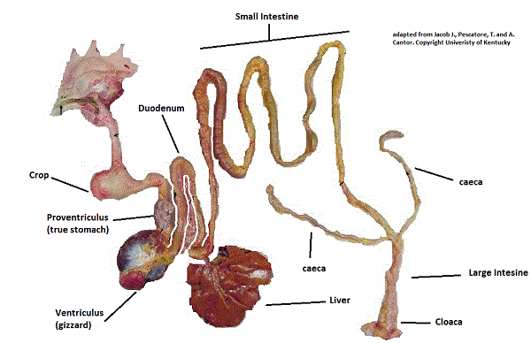
Digestive system

Slide 13
GIT

