Slide 1
Goose Production
By
Dr. Muhammad Waqas
DVM,R.V.M.P (PVMC)

Slide 2
Kingdom: Animalia
Phylum: Chordata
Class: Aves
Superorder: Galloanserae
Order: Anseriformes
Family: Anatidae
Subfamily: Anserinae
Genus 3---
Anser Branta Chen

Slide 3
Terms
Gander
Goose
Goslings……………before fledging
Gaggle
Skein/team/wedge
Plump

Slide 4
96 breeds
Domestication 5500 years ago in Egypt
Modern commercial breeds descendent of genus Anser wild swan goose and grey lag goose
Heavy breeds lay 30-60 eggs
Smaller Houyan produce 200 eggs/season
Anser anser anser (grey lag goose)---western
Anser anser rubriostris (Eatern)

Slide 5
Heavy Breeds Of Geese

Slide 6
African Goose

Slide 7
American Buff

Slide 8
Embden

Slide 9
Toulouse

Slide 10
West of England

Slide 11
Medium Breeds of Geese

Slide 12
Brecon-Buff

Slide 13
Pomeranian

Slide 14
Buff Back

Slide 15
Light breeds of Geese

Slide 16
Chinese

Slide 17
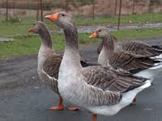
Pilgrim

Slide 18
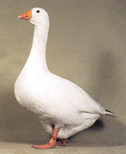
Roman

Slide 19
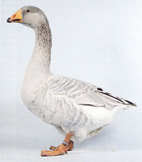
Steinbacher

Slide 20
Back buff light

Slide 21
Emperor goose (Chen canagica)

Slide 22
snow goose (Chen caerulescens), also known as the blue goose

Slide 23
Anser cygnoides

Slide 24
Genus Anser
All have legs and feet that are pink, or orange, and bills that are pink, orange, or black.
All have white under- and upper-tail coverts, and several have some extent of white on their heads. The neck, body and wings are grey or white, with black or blackish primary—and also often secondary—remiges(pinions)

Slide 25
Genus Anser
includes all-----------------
10 living species, which span nearly the whole range of true goose shapes and sizes.
The largest is the greylag goose at 2.5–4.1 kg (5.5–9.0 lb) weight,
the smallest is the Ross's goose at 1.2–1.6 kg (2.6–3.5 lb).

Slide 26
Swan goose, Anser cygnoides – sometimes separated in Cygnopsis
Taiga bean goose, Anser fabalis
Tundra bean goose, Anser serrirostris
Pink-footed goose, Anser brachyrhynchus
Greater white-fronted goose, Anser albifrons
Greenland white-fronted goose, Anser (albifrons) flavirostris
Lesser white-fronted goose, Anser erythropus
Greylag goose, Anser anser
Bar-headed goose, Anser indicus – sometimes separated in Eulabeia

Slide 27
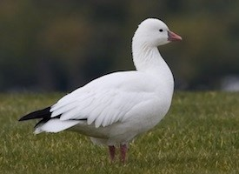

Slide 28
Genus Branta
It includes-------------------------
occur in the northern coastal regions of the Palearctic and all over North America, migrating to more southernly coasts in winter, and as resident birds in the Hawaiian Islands.
6-8 species
derive their vernacular name for the
prominent areas of black coloration found in all species.
legs and feet are black or very dark grey.
they have black bills and large areas of black on the head and neck, with white markings that can be used to tell apart most species.
As with most geese, their undertail and uppertail coverts are white.
They are also on average smaller than other geese

Slide 29
Brant goose, Branta bernicla
Pale-bellied brant goose, Branta (bernicla) hrota
Black brant, Branta (bernicla) nigricans
Barnacle goose, Branta leucopsis
Canada goose, Branta canadensis
Cackling goose, Branta hutchinsii – formerly included in B. canadensis
Bering cackling goose, Branta hutchinsii asiatica – a doubtfully distinct subspecies; extinct (c.1929)
Red-breasted goose, Branta ruficollis
Nene, nēnē, or Hawaiian goose, Branta sandvicensis
Nēnē-nui or woods-walking goose

Slide 31
Genus Chen
It includes------------------
They breed on subarctic areas of North America and around the Bering Strait, migrating south in winter.
their feet and legs are colored in reddish hues. The bill is also reddish in these birds as in most grey geese, except in adult males of Ross's goose which have a blue-black grainy cere.
3 species

Slide 32
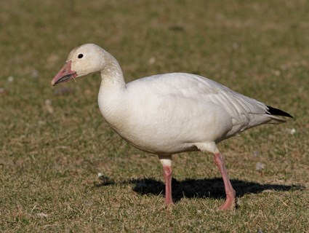
Snow goose, Chen caerulescens
Ross's goose, Chen rossii
Emperor goose, Chen canagica

Slide 33
Clutch size:12-15 eggs or 5
Egg weight 120-170 g

Slide 34
Reproduction
By nature monogamous
Sexual maturity: 2-5 years
Ratio 1:1 or 1:5
Mostly spring season

Slide 35
Marketing
At 5-6 month-----11-15 lbs or
Full fed at 10-13 weeks------10-12lbs as young ,junior or green geese.
Products
Liver-----1 kg
Fat in skin >500g/kg
Down-----30g/5kg
Feathers 100----130g/5kg
Geese molt at 9-10 weeks of age

Slide 36
Nutrient Specifications
For Goslings Energy(MJ) Cp g/kg Ca g/kg
Week, 1-3 11.7 170 8
Week, 4-6 11.3 116 7.5
Week, 7-12 11.3 102 6.5
For layer
Layer 1 9.2 130 26
Layer 2 10.5 148 30

Slide 37
Sexing

