Slide 1
OSTRICH

Slide 2
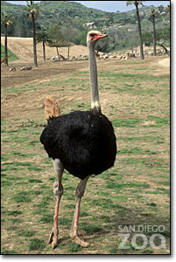
Kingdom:Animalia
Phylum:Chordata
Subphylum:Vertebrata
Class: Aves (Birds) Order: Struthioniformes Family: Struthionidae Genus: Struthio Species: camelus Subspecies: • camelus (North African) • molybdophanes (Somali) • massaicus (Masai) • australis (South African)

Slide 3
S. c. syriacus, Arabian ostrich or Middle Eastern ostrich, Middle East. Was formerly very common in the Arabian Peninsula, Syria,and Iraq. But now has become Exticnt

Slide 4
Range: Central and southern Africa Habitat: savanna
and desert

Slide 5
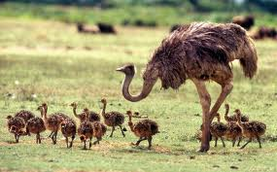
Height: male—6.9 to 9 feet (2.1 to 2.7 meters); female—5.7 to 6.2 feet (1.7 to 1.9 meters) Life span: 30 to 40 years Size of egg: averages 6 x 5 inches (15 x 13 centimeters) in size and weighs about 3 pounds (1,500 grams)

Slide 6
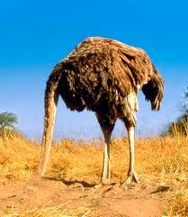
Weight: male—220 to 287 pounds (100 to 130 kilograms); female—198 to 242 pounds (90 to 110 kilograms)

Slide 7
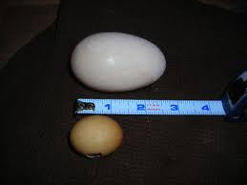

Slide 8
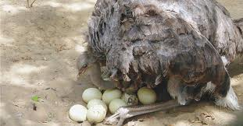
Incubation: 42 to 46 days;
Number of young at hatch: up to 25 from different females in a common nest Age of maturity:3 to 4 years Conservation status:
lower risk

Slide 9
WHY Ostrich CAN NOT FLY?

Slide 10
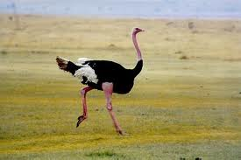
The ostrich is a flightless bird because it does not have a breastbone called a keeled sternum that flying birds have.
Feathers are also different from those of birds that fly:
Fluffy, and don't hook together like flight feathers.
Not waterproof, and in the rain an ostrich looks very shaggy and drenched.
No Preen/Uropygeal gland

Slide 11
Why Ostrich is Unique??

Slide 12
Unique facts
• An ostrich’s eye is almost 2 inches (5 centimeters) across, the largest eye of any land animal.

Slide 13
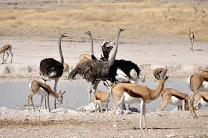
Unique Facts:
When family groups of ostriches meet, they may challenge each other with short chases, then the winning adult pair takes all the chicks with them.

Slide 14
Some of these "ostrich nurseries" can end up with 300 chicks and only a couple of adults to look after them all!
6 months earlier female becomes mature.
March or April goes up to September.

Slide 15
The ostrich's sternum is flat, lacking the keel to
which wing muscles attach in flying birds.
The beak is flat and broad, with a rounded tip.
Like all ratites, the ostrich has no crop, and it also lacks a gallbladder.

Slide 16
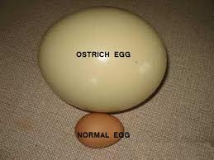
One ostrich egg is equivalent to the weight of about 2 dozen chicken eggs! • Ostriches are attracted to small, shiny objects and peck curiously at them.

Slide 17
The skin of the female's neck and thighs is pinkish gray,
while the male's is blue-gray, gray or pink dependent on subspecies
Male feathers are black
Female feathers are brown
But the tips of feathers are white at tips
Male is large size ,female is smaller in size
Male has distinguised copulatory organ,phallus
Female has cloacal opening for mating.both mate in sitting position
Ostrich/retites are only birds that have separate opening for GIT,REPRODUCTIVE AND urinary systems.

Slide 18
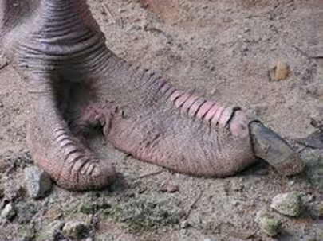

Slide 19
Ostrich Egg Fun Facts
The shells of ostrich eggs are thick and strong - necessary because adult ostriches are heavy and sit on the eggs in the nest.
Sometimes if the nest is unprotected briefly, large birds called vultures drop stones from the air to try and break an egg for food, and a strong shell prevents too much breakage.

Slide 20
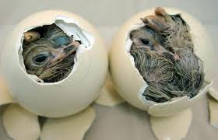
The eggs in a nest are laid over several weeks, yet they hatch together. The chicks inside the eggs chirp to each other and then start hatching together.

Slide 21
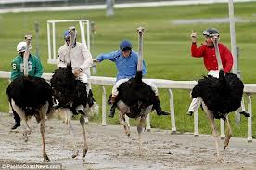
Born to run
The largest and heaviest living bird.
Flightless bird that can never take to the skies, so instead it’s built for running.
Its long, thick, and powerful legs can cover great distances without much effort, and its feet have only two toes for greater speed.

Slide 22
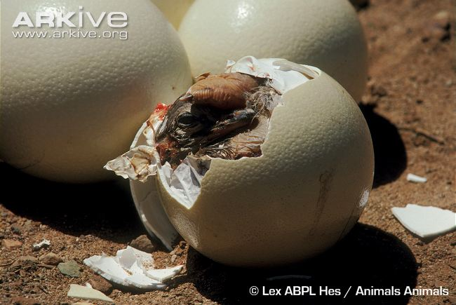
Ostrich eggs are so big that the Bushmen of the Kalahari desert use empty eggs to store water. They fill empty shells and bury them in shade under trees. An ostrich egg shell can hold about a litre of water.

Slide 23
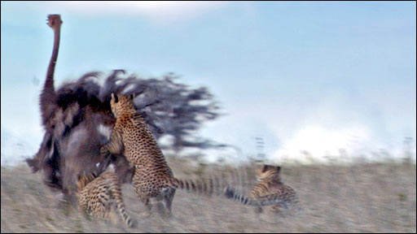
RUNNING AND SPEED:

Slide 24
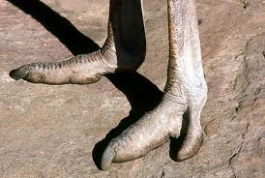
RUNNING AND SPEED:
Ostriches can sprint in short bursts up to 43 miles per hour (70 kilometers per hour), and they can maintain a steady speed of 31 miles per hour (50 kilometers per hour).

Slide 25
Just one of an ostrich’s strides can be 10 to 16 feet (3 to 5 meters) long
When danger threatens, ostriches can escape pretty easily by running away. They can also defend themselves.
They have a 4-inch (10-centimeter) claw on each foot, and their kick is powerful enough to kill a lion.

Slide 26
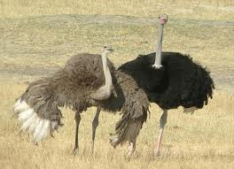
If Ostrich Can’t Fly then What are the wings for?

Slide 27
Wings are not useless.!!!
If they can't fly, why do they have wings?
For one thing, ostriches hold their wings out to help them balance when they run, especially if they suddenly change direction.
Their main use, though, is for displays and courtship, along with the tail feathers.

Slide 28
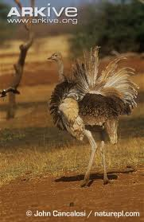
To show dominance, an ostrich holds its head up high and lifts its wings and tail feathers; to show submission, the head, wings, and tail droop down.

Slide 29
Birds of a feather
Unlike many birds, ostrich feathers are loose, soft, and smooth.
They don’t hook together the way feathers of other birds do, giving ostriches that "shaggy" look.
The feathers can also get soaked in the rain, because ostriches do not have the special gland many birds have to waterproof their feathers while preening.

Slide 30
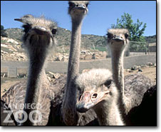

Slide 31
A big bird herd:
Ostriches like to live in groups, which helps with defense. With their long necks and keen vision, they can see long distances, so in a group at least one of them is likely to see danger coming.

Slide 32
Ostriches sometimes gather in large groups of 100 or more, but most groups are smaller, usually about 10 birds, or just a male and female pair.

Slide 33
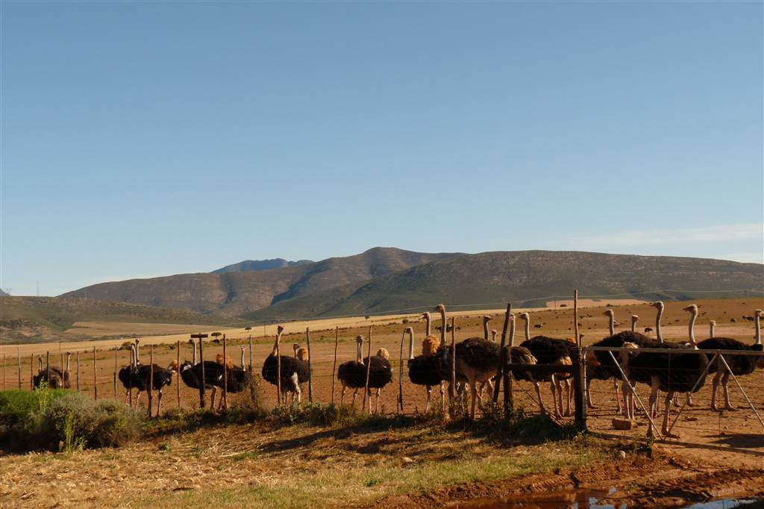

Slide 34
The groups have a pecking order, with a dominant male that establishes and defends a territory, a dominant female called the "main hen," and several other females. Lone males may also come and go during breeding season.

Slide 36
Do they put their heads in the sand?

Slide 37
Actually, that’s a myth: ostriches do not bury their heads in the sand!
When an ostrich senses danger and cannot run away, it flops to the ground and remains still,
with its head and neck flat on the ground in front of it.

Slide 38
Because the head and neck are lightly colored, they blend in with the color of the soil.
From a distance, it just looks like the ostrich has buried its head in the sand, because only the body is visible.

Slide 39
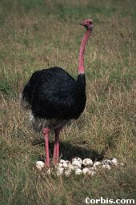
MALE ROLE IN EGG PROTECTION:
A male ostrich protects a nest of eggs laid by several females that he has mated with The male protects the eggs at nighttime.

Slide 40
Nesting duty
The dominant or "alpha" hen mates with the territorial male, and they share the tasks of incubating the eggs and caring for the chicks.
The other females may mate with that male or other wandering males.
Then lay their eggs in the same nest as the main hen’s eggs.

Slide 41
The main hen puts her eggs in the center of the nest to make sure they have the best chance of hatching, but many of the other eggs may also be incubated.
Usually the main hen takes incubation duty during the day, then the male takes over and incubates during the night.
A few days after the chicks hatch, they leave the nest—

Slide 42
which is really just a scrape in the ground—to travel with their parents.
The adults shelter them under their wings to protect them from sun and rain.
They defend the chicks against predators.

Slide 43
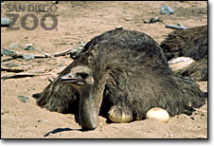

Slide 44
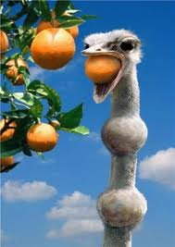
Stones with dinner
Ostriches are omnivores, and they eat whatever is available in their habitat and at different times of the year. They mostly eat plants, especially roots, leaves, and seeds.

Slide 45
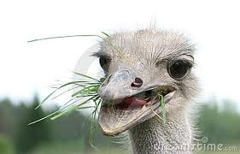
but they also munch on insects like locusts and small animals like lizards. When an ostrich eats, food is collected in the gullet at the top of the throat until there is a large enough lump to slide down the neck.

Slide 46
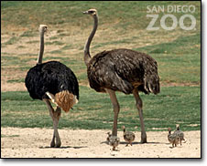

Slide 47
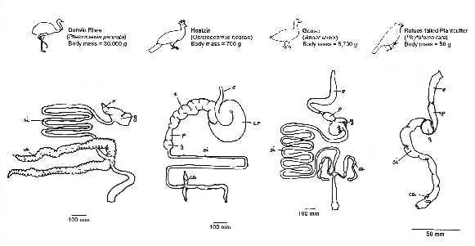
Ostriches eat things that other animals can’t digest. They have tough intestines that are 46 feet (14 meters) long—if you stretched them out—in order to absorb as many nutrients as possible.

Slide 48
Diet Ostriches are omnivores. They eat fruit, seeds, leaves, shoots, and shrubs as well as insects and lizards. They get the water they need from the plants they eat. They also swallow stones to help them digest their food.

Slide 49
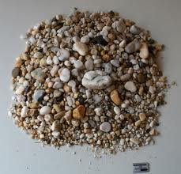

Slide 50
These big birds also swallow sand, pebbles, and small stones that help grind up food in the gizzard.
Ostriches do not need to drink water, since they get what they need from the plants they eat, although they will drink if they come to a water hole. 25% water loss by dehydration and can survive even by this.

Slide 51
Comparing ostrich versus other meats (per 100 grams serving)
Type of Meat | Protein (%) | Fat (Grams) | Calories (KCal) | Iron (mg) | Cholesterol (mg)
Ostrich | 26.9 | 3.0 | 142 | 3.2 | 81
Beef* | 28.1 | 10.5 | 209 | 3.0 | 83
Veal* | 33.9 | 9.4 | 225 | 1.2 | 124
Pork* | 29.3 | 15.2 | 256 | 1.1 | 91
Chicken | 28.9 | 7.4 | 190 | 1.2 | 89
Turkey | 29.36 | 5.0 | 170 | 1.8 | 76
Lamb* | 30.4 | 9.4 | 215 | 1.2 | 95

Slide 52
Nutrition Specification
Nutrients | Chick (0–3 months) | Grower I (3–6 months | Grower II (6–12 months) | Conditioner (12–18 months) | Breeder (>18 months)
C.P. (%) | 20.86 | 20.9 | 19.28 | 19.1 | 20.03
M.E(kcal/kg) | 2225 | 2205 | 2191 | 2103 | 2428
Calcium% | 0.53 | 0.63 | 0.67 | 0.7 | 3.45

Slide 53
Incubation
Setter
Temperature:
Humidity:%
Days:1-39
Hatcher
Temperature:F
Humidity:%
Days:?????

Slide 54
