Slide 2
History
Partridges are birds in the pheasant family, Phasianidae. They are a non-migratory Old World group.
These are medium-sized birds, intermediate between the larger pheasants and the smaller quails. Partridges are native to Europe, Asia,Africa and the Middle East. Partridges are ground-nesting seed-eaters.
According to Greek legend, the first partridge appeared when Daedalus threw his nephew, Perdix, off the sacred hill of Athena in a fit of jealous rage. Supposedly mindful of his fall, the bird does not build its nest in the trees, nor take lofty flights and avoids high places.

Slide 3
Introduction
Medium sized
Europe, asia and africa
Hungarian/ English/hunting
Game bird
Coveys
Non migratory
Ground nesting
Seed eaters
The taste and texture of cooked partridges compares favorably with that of bobwhite Quail.

Slide 4
Scientific classification
Kingdom: animalia
Phylum: chordata
Class: aves
Order: galliformes
Family: phasianidae
Sub family: perdicinae
Genus:Alectoris Ammoperdix Bambusicola Haematorty Melanoperdix Perdix Ptilopachus Rhizothera Rollulus Tetraophasis Xenoperdix

Slide 5
Identification
Greyish color
White belly
Orange face
Horse shoe or U-shaped patch
Grey bill
Cinnamon marking
Rounded feathers

Slide 6
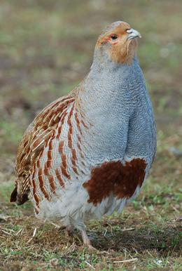

Slide 7
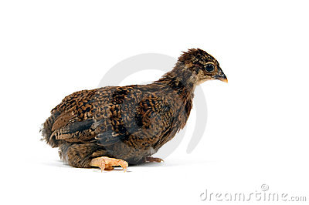
Immature

Slide 8
Common species

Slide 9
Bamboo Partridge(Bambusicola thoracica)
There are two subspecies of this species. one seen in captivity is the Chinese(B. t. thoracica), native to China The other subspecies,(B. t. sonorivox), is found only on Taiwan.
Clutch size 7-9 eggs
I.P:18 days
The sexes of this species are similar, with the female being slightly smaller.
They have a bright rufous throat and face; gray above the eye and extending to the base of the neck.
The breast and back is mottled with black, buff and chestnut.
The Chinese subspecies is much lighter than the subspecies from Taiwan.
Notes:
and has been to introduced into southern Japan and on Maui in the Hawaiian Islands.

Slide 10
Bamboo Partridge

Slide 11
Barbary Partridge (Alectoris barbara)
One of the most attractive members of the Rock Partridges, genus Alectoris.
There are about six subspecies that range from Morocco across North Africa into Libya and Egypt.
The face is light gray, surrounded by a chestnut band that is flecked with white.
The breast is more buff than other Alectoris species, while the shoulders and back are the same bluish-gray.
The sexes are alike, with male being slightly larger and may have small spurs on the red legs.
Clutch size:8-15 eggs in April
I.P:24 days

Slide 12
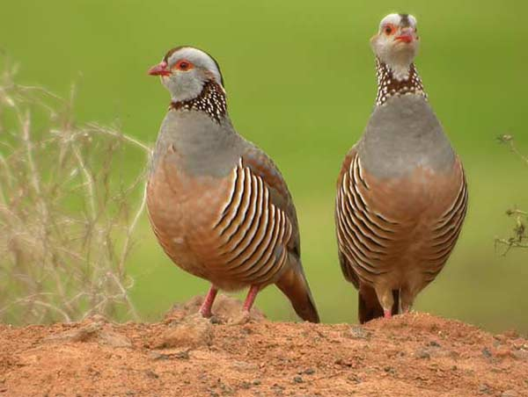
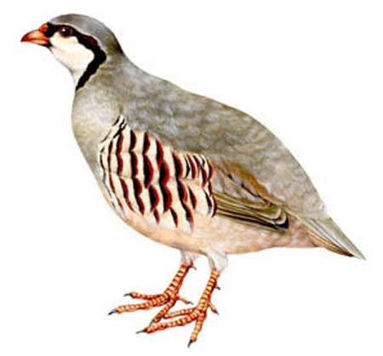
Barbary Partridge (Alectoris barbara)
male and female
male

Slide 13
Chukar Partridge (Alectoris chukar)
One of the most commonly kept and bred of all game birds
There are 14 recognized subspecies ,range from Turkey, the Mediterranean islands, Iran and east through Russia and China and south into Pakistan and Nepal.
The Chukar has also been successfully introduced into western North America, the Hawaiian Islands, England and New Zealand.
Gray all over with a black band from the eyes, down to below the neck.
They also have several black bars on the flanks. The sexes are similar, with the female having a smaller knob on the legs than the males.
Males also appear to be somewhat larger as well. Both sexes share the bright red bill and legs. Chukars have been known to hybridize with other members of the genus.

Slide 14
Chukar Partridge (Alectoris chukar)
Chukars are very versatile breeders in captivity.
They can be kept in pairs, trios and even in large colonies.
Best fertility is with the smaller groups.
Hens begin to lay in April and may lay well into the Summer.
Hens may lay a large number of eggs in a season. 40 to 50 eggs per hen is not unusual.
Chukars, as a rule, will not usually sit on their own eggs, so you will need to gather the eggs and place them in an incubator.
Small bantams may be used, but choose only the smallest hens to set.
Incubation lasts about 23 days.

Slide 15
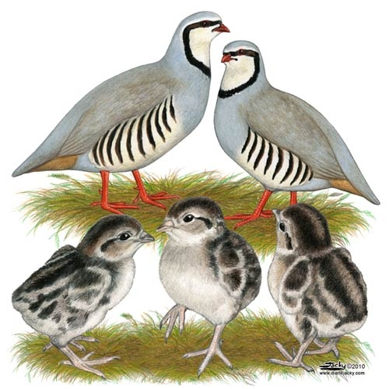

Slide 16
Hungarian Partridge (Perdix perdix)
Other Names: Gray Partridge, Hun, English Partridge, Bohemian Partridge, European Partridge.
Range: Great Britain, Northern Spain, France and Italy east through Europe into Turkey, Russia and western Siberia. Introduced throughout the world and well established in the United States.
Subspecies: There are seven subspecies.
Habitat: Prefers open areas, farmlands and brush.
Description Male: face and throat is rusty-orange.
The breast is finely vermiculated gray with a dark-chestnut horseshoe marking on the upper abdomen;
the belly is white and to light buff. The upper back is vermiculated brown, gray and white;
the wings are mottled with dark brown. The tail is chestnut.
Description Female: The hen is similar to the male. The horeshoe marking on the breast maybe absent, smaller or lighter than in the male.

Slide 17
Breeding Season: Begins in late April and may last into September.
Breeding Age: First year.
Clutch Size: 15, hens will lay several clutches per season.
Incubation Period: 24 days.
They are hardy birds and able to withstand temperature extremes.
Pen size:6’X2’ for pair during breeding season

Slide 19
Red-legged Partridge (Alectoris rufa)
The Red-legged Partridge is very similar to the Chukar, Although common in captivity, it is not bred on the large, commerical scale as it's close cousin.
There are four subspecies in the wild.
French Red-leg(A. r. rufa) of France and Italy, is the subspecies most often seen in captivity.
Spanish Red-leg (A. r. hispanica), is found in northern and western Spain is also kept, but not as common as the French subspecies.
Southern Spanish Red-leg (A. r. intercedens); subspecies that is resident in eastern and southern Spain, thethe last subspecies is native to Corsica,
Corsican Red-leg (A. r. corsa). There is only slight differences in the subspecies, and the Corsican is almost indistinguishable from the French. This species has been introduced into many places worldwide, including the Canary Islands, the Azores, England and some parts of North America.

Slide 20
The colors of both sexes are similar to other members of the genus,
But has a white forehead and a broken black line on the neck and throat which distinguishes them from the other species.
The flanks are also more barred with brown and buff, mixed with white.
The males have small spurs and are slightly larger than the females.
Breeding:
The breeding season begins in late April and early May.
Like the chukar, Red-legs are unlikely to set and hatch their own eggs.
Incubation lasts about 23
They do not lay the large number of eggs as a Chukar hen,
Clutch size is 10 to 12 per bird.

Slide 21
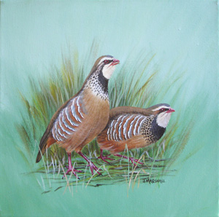

Slide 22
Roul-roul Partridge (Rollulus roulroul)
The Roul-roul Partridge is also known as the Crested Wood Partridge, Green Wood Partridge or Red-crowned Wood Partridge.
They are native to the tropical rain forests of Burma and Thailand, south to Malaysia, Borneo and Sumatra
Despite not often kept in captivity, they are charming aviary birds.
The Roul-roul Partridge is the sole member of the Genus Rollulus and has no known subspecies.
the sexes are different. The male has a large red crest, red orbital skin, overall glossy bluish-purple body and red feet and bill.
The hen is much drabber in comparison. She lacks the bright crest, has an overall greenish color with chestnut-brown wings, black bill and red feet.

Slide 23
Breeding
Roul-roul may lay at anytime during the year. The males seem to do most of the nest building, using pine needles, branches or straw to create a tunnel like nest.
Clutches range from about 4 to 6 eggs
Incubation is done by the female and lasts 18 to 22 days.
Important
In captivity, the chicks of this species may have problems learning to eat. Provide mealworms and place a few small size chicks such as button quail in the brooder to help "teach" the little partridge to eat

Slide 24
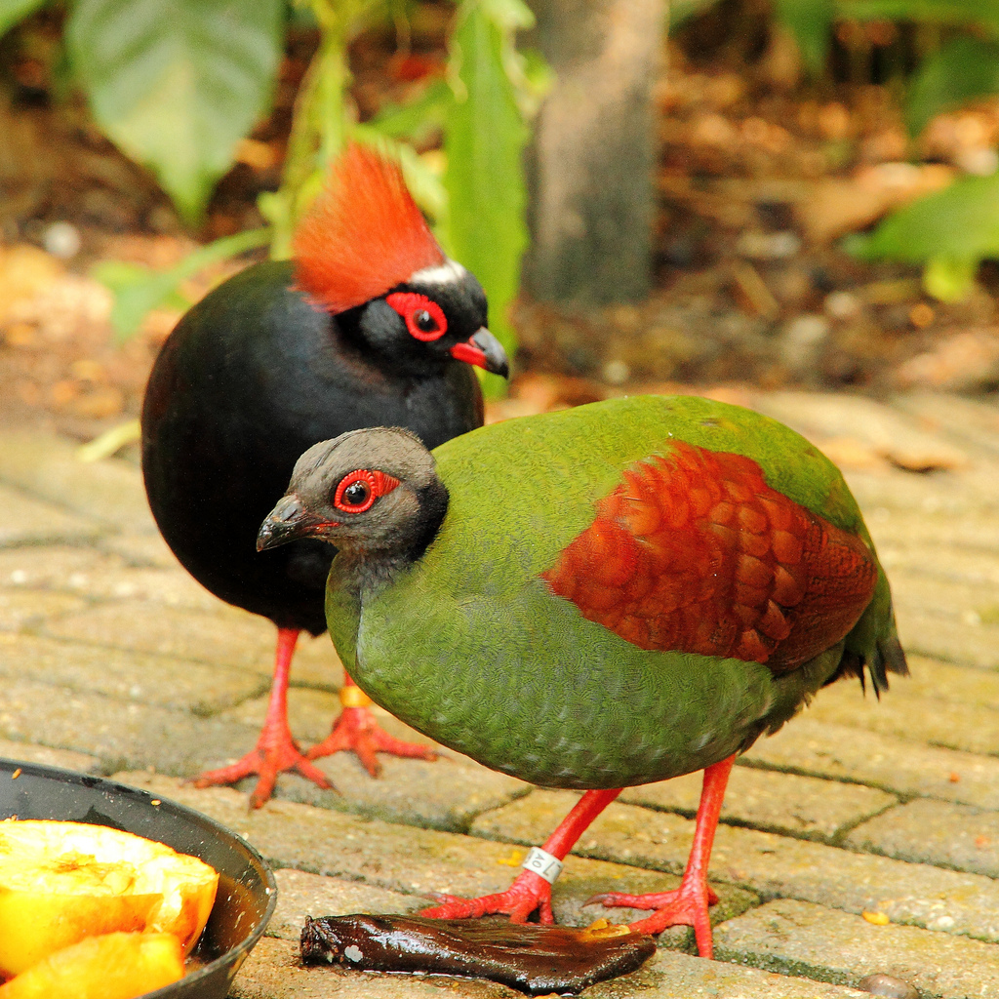

Slide 25
Habitat
Agricultural land
Pastures
Grasslands near the hedge rows
Winter landscape

Slide 26
Brooding
Temperature 98F DOC-reduce 5F per week upto 4 weeks then maintain temperature.use one red heat lamp for 200 chicks and hang it 14’’ above floor level.and use chickgaurd of 5’dia.
Floor space
1-10 days:9 birds/sq.ft.
10days-6 weeks 6 birds /sq.ft.
6weeks to mature 1 bird/sq.ft.
Wire floor
4-14 days:1/4’’

Slide 27
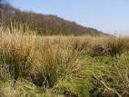
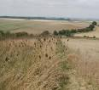

Slide 28
Feeding
Waste grains
Weed seeds
Insects
Green leaves

Slide 29
Nutrient | Starter 0- 2weeks | Grower(1) 3-6weeks | Grower(2) 6-20weeks | Adult Breeder >(16 or 18 weeks)
Crude protein % | 24.0–28.0 Average 25.00 | 24 | 20 | 16
Metabolizable energy (Kcal) | 1315. | 1325. | 1325 | 1340
Calcium % | 1.20 | 1.00 | 1.00 | 3.00
Non Phytate Phosphorus % | 0.50 | 0.42 | 0.42 | 0.45

Slide 30
Growing chukar
Flight pen
Size L.100feet and W.12 feet and each bird is given space 2 sq.foot
Double deck colony cage system
For 25 birds up to 16 weeks of age a cage is constructed with W 5 feet, depth 2.5 feet and height 2 feet

Slide 31
Weight gain
Male gains 1 lb at 9 weeks by consuming 3.75 lb and female gains 1 lb at 12 weeks by consuming 4.5 lb feed.
At 20 weeks live weight of bird is 600 grams while of processed meat is 1 lb

Slide 32
Breeding
Late feb to march
Select mates and establish weak pair bonds
Segregate from coveys
Establish a breeding territory
By modern production system 3time of 10-weeks production with each period 30-40 eggs
By artificial light start laying eggs at 30 weeks of age.
For 3 males and 9 females a 60sq.inc floor space with 16 inc.head room space

Slide 33
Breeding
By light stimulation these start egg laying at 28 weeks
Male to female ratio is 1:4
Breeding management
2 types
Individual cage mgt(for pair or 1M and 2 F)
W.12 inch, depth 24inch and height 15 inch
Colony cage mgt (for 12 bird,3m and 9 F)
W.60 inch, depth 28 inch and height 20 inch
Notes:
,giving 2 s

Slide 34
Limiting factors for breeding
Mowing and burning of ditches
Deep crusted snow during winter
Hawks and owls
High grazing

Slide 35
Eggs Identification
Yellowish white with numerous brown speckles
Egg weight is avg. 21 gram

Slide 37
Nesting
April to June
Shallow
Depression in the ground lined with grass and leaves
Olive green eggs

Slide 38
Flight
Wing span is 18-22 inches
Speed is 30-35 mph
Body weight is 14 ounce
1 oz=28.34grams

Slide 39
Sexual Dimorphism
Male large size and colorful as compared to female.
Developed metatarsal spur in male while rudimentary or absent in female
In male there is cone-shaped protuberance which is 2.78mm in diameter(genital mark),centrally located in cloaca, while absent in female or two small nodules present in female

Slide 40
Conservation status
Still wide spread
Normal range
Life span is maximum 3 years

Slide 41
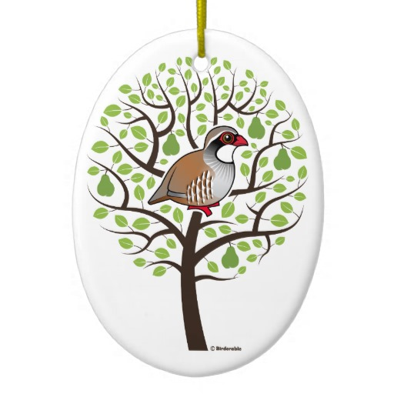
THANKS

Slide 42
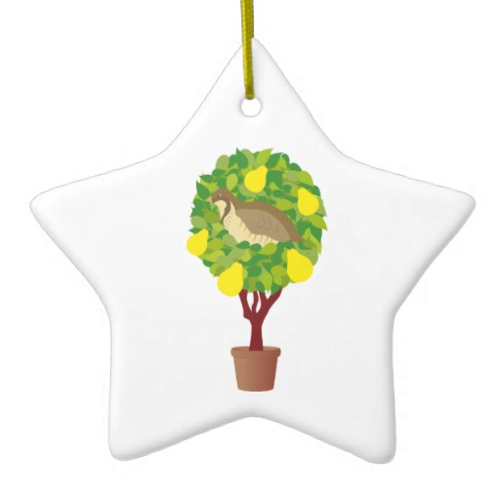
QUESTIONS??

