Slide 1
Pigeon

Slide 2
External Anatomy

Slide 3
External Anatomy

Slide 4
Breeds & Species
Species are abundant, estimated population of 17 to 28 million feral and wild birds in Europe
1:White-crowned Pigeon (Columba leucocephala)
2:Band-tailed Pigeon (Columba fasciata)
3:Feral Pigeon (Columba livia)
Many domestic birds have escaped or been released over the years, given rise to feral pigeon

Slide 5
White Crowned Pigeon

Slide 6
Band Tailed Pigeon

Slide 7
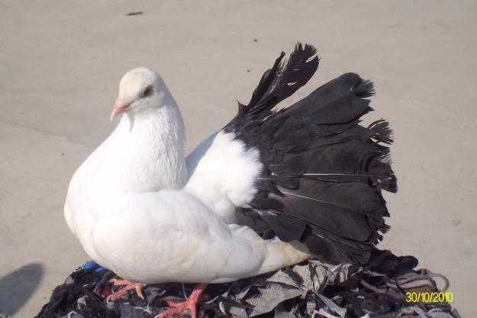
Fan Tail Pigeon

Slide 8
Feral Pigeon

Slide 9
Rock Pigeon
O

Slide 10
Wild Type

Slide 11
Common Name:
Rock Pigeon
Pigeon
Rock Dove
Feral Pigeon
Flying Rat (slang)

Slide 12
Roller Pigeon

Slide 13
Tippler

Slide 14
White King

Slide 15
Fulvous whistling duck
reddish brown plumage, long legs and a long grey bill, and shows a distinctive white band across its black tail in flight.whistling sound and found in tropical areas of America, Africa and Asian subcontinent
(Dendrocygna bicolor)

