Slide 1
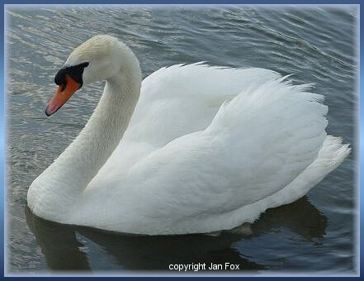
SWANS

Slide 2
Zoological classification
Kingdom: Animalia
Phylum: Chordata
Class: Aves
Order: Anseriformes
Family: Anatidae
Genus: Cygnus

Slide 3
The swans are the largest members of the waterfowl family Anatidae, and are among the largest flying birds.
They form the tribe Cygnini
Sometimes, they are considered a distinct Subfamily, Cygninae.

Slide 4
There are six or seven(6 or 7) species of swan in the genus Cygnus
In addition there is another species known as the Coscoroba Swan, although this species is no longer considered one of the true swans.

Slide 5
Coscoroba Swan

Slide 6
Etymology and Terminology
The word swan is derived from Old English swan which means to sound or to sing.
Young swans -cygnets
An adult male is called------------
An adult female is called-------------
A group of swans in flight - bevy or wedge

Slide 7
The largest species-
Description
Notes:
can reach length of over 1.5 m (60 inches)
weigh over 15 kg (33 pounds)
wingspans can be 3 m (10 ft)
Compared to the closely related geese they are much larger in size and have proportionally larger feet and necks.
They also have a patch of unfeathered skin between the eyes and bill in adults.
The sexes are alike in plumage, but males are generally bigger and heavier than females.

Slide 8
TYPES OF SWANS
Northern Hemisphere Swans
The Northern Hemisphere species of swan have pure white plumage
Mute Swan and Polish Mute Swan
Trumpeter Swan (Cygnus buccinator )
Whooper Swan
Whistling or Tundra Swan
Bewick’s Swan
Jankowski's or Eastern Bewick's Swan

Slide 9
Southern Hemisphere Swans
The Southern Hemisphere species are mixed black and white
Black Swan
Black-necked Swan
Coscoroba Swan
Extinct Swans
Giant / Maltese Swan
Pouwa Swan
Cygnus paleoregonus
Pere David's Swan

Slide 10
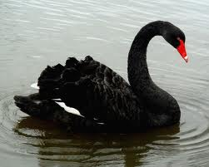
BLACK SWAN
The Australian Black Swan (Cygnus atratus) is completely black except for the white flight feathers on its wings also introduced to New-Zealand
chicks of black swans - light grey color
South American - Black-necked Swan
The legs of swans are normally a dark blackish grey color

Slide 11
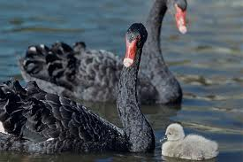
Bill color varies: the four Subarctic species have black bills with varying amounts of yellow, and all the others are patterned red and black.
Swans have small jagged 'teeth' as part of their beaks used for catching and eating fish.
The Mute Swan and Black-necked Swan have a lump at the base of the bill on the upper mandible.

Slide 12
Lump

Slide 13
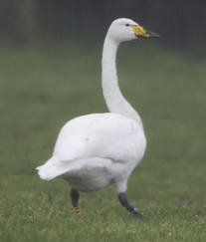
WHOOPER SWAN (Cygnus cygnus)
Whooper Swans migrate from Iceland, Scandinavia, and Northern Russia to Europe, Central Asia, China, and Japan
The Whooper Swan are wholly migratory

Slide 14
MUTE SWAN( Cygnus olor)
Eurasian species
Mute Swan is a partial migrant, being resident over areas of Western Europe but wholly migratory in Eastern Europe and Asia
Behavior
Mute Swan's nest with two unhatched eggs
Swans feed in the water and on land.
They are almost entirely herbivorous (roots, tubers, stems and leaves of aquatic and submerged plants)

Slide 15
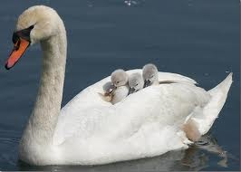
MUTE SWAN

Slide 16
The lifespan of the mute swan is often over 10 years, and sometimes over 20, whereas the black-necked swan survives for less than a decade in captivity.
Although swans only reach maturity between 4 and 7 years of age
Mute Swans fly in a V-shaped formation when flying in groups

Slide 17
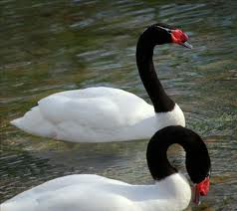
Black Neck Swan(Cygnus melancoryphus)
It is of South America and now introduced in New Zealand
New Zealand Swan, an extinct subspecies of the Black Swan from New Zealand and the Chatham Islands

Slide 18
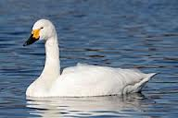
Tundra Swan (Cygnus columbianus)
It is a small swan that breeds on the North American tundra, further north than the Trumpeter Swan. It winters in the USA.

Slide 19
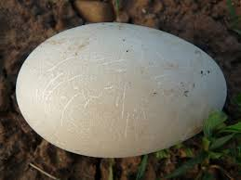
Egg Description
Swans are known to aggressively protect their nests.

Slide 20
Migration
The mute swan is a partial migrant, being resident over areas of Western Europe but wholly migratory in Eastern Europe and Asia.
The whooper swan and tundra swan are wholly migratory, and the trumpeter swans are almost entirely migratory.
There is some evidence that the black-necked swan is migratory over part of its range.

