Slide 1
BASIC CONCEPTS OF ECOLOGY
Types of Ecology
Subject: Basic Ecology (ZOL-502)
(BS Zoology 6th Semester)
By: Shozab Seemab Khan
(PhD Zoology Scholar)
ABAIDULLAH COLLEGE PAKPATTAN

Slide 2
What is Ecology?
Ecology is a branch of science that focuses on the relationship between living organisms and their environment.
The concepts can be studied at various levels, such as organism, population, community, biosphere and ecosystem.
Ecology is the scientific study of how living things interact with each other and their natural environment.
The Word Ecology is the combination of two Greek words; “Oikos” which means, Home and the “Logos” which means Knowledge or study.

Slide 3
Primary Goal of an Ecologist
Ecology is relationships of living organisms with their environment from various perspectives.
An ecologist’s primary goal is to improve the understanding of the life processes, adaptations and habitats, interaction and biodiversity of organisms.

Slide 4
Basic Concepts of Ecology:
(1). Ecosystem
(2). Biome
(3). Biosphere
(4). Habitat
(5). Organisms
(6). Populations
(7). Communities
(8). Niche
(9). Trophic Level
(10). Food Chain
(11). Food Web
(12). Energy Flow
(13). Biogeochemical Cycle
(14). Biodiversity
(15). Population Dynamics
(16). Succession
(17). Biotic Components
(18). Abiotic Components

Slide 5
Basic Concepts of Ecology:
1. Ecosystem
An ecosystem is a community of living organisms interacting with each other and their physical environment (like air, water, and soil). Ecosystems can be as large as a forest or ocean or as small as a pond or a fallen log.
2. Biome
A biome is a large geographic biotic unit characterized by climate, soil, and vegetation. Examples include forests, grasslands, deserts, and aquatic environments. Biomes are made up of several ecosystems that share similar climate conditions. Tundra, Forest, Grassland, Desert Biome etc.

Slide 6
Basic Concepts of Ecology:
3. Biosphere:
Thin layer of earth inhabited by living organism.
The biosphere is the global ecosystem encompassing all living organisms (biotic factors) and their physical environment (abiotic factors), including the land, water, and atmosphere, where life exists.
4. Organisms:
Organisms are individual living beings, like animals, plants, fungi, or microorganisms.

Slide 7
Basic Concepts of Ecology:
5. Habitat:
A habitat is the natural environment where an organism lives, providing the resources and conditions necessary for its survival, including food, water, shelter, and space.
Habitats consist of both biotic (living) and abiotic (non-living) factors.
Habitats can range from large geographical areas like forests or oceans to smaller locations like a a single tree.

Slide 8
Basic Concepts of Ecology:
6. Population:
A population is a group of individuals of the same species living in a specific area, capable of interbreeding and producing fertile offspring.
7. Communities
An ecological community refers to all the populations of different species living and interacting in a particular area. These interactions can include competition, predation, and mutualism.

Slide 9
Basic Concepts of Ecology:
8. Niche
A niche describes an organism's role in its environment, including how it obtains food, shelter, and interacts with other organisms. Each species has a unique niche that helps avoid competition.
9. Trophic Levels
Organisms in an ecosystem are often categorized into trophic levels, which describe their feeding relationships:
Producers, Consumers and Decomposers

Slide 10
9. Trophic Levels
i. Producers (Autotrophs):
Organisms that make their own food, usually through photosynthesis (e.g., plants and algae).
ii. Consumers (Heterotrophs):
Organisms that consume other organisms for energy. These can be herbivores (primary consumers), carnivores (secondary or tertiary consumers), or omnivores (eat both plants and animals).
iii. Decomposers:
Organisms like fungi and bacteria that break down dead organic matter, recycling nutrients back into the ecosystem.

Slide 11
Basic Concepts of Ecology:
10. Food Chains
A food chain is a linear sequence of organisms through which energy and nutrients flow.
11. Food Webs
In nature, food chains are often interconnected, forming a food web that is more complex and realistic.
12. Energy Flow
Energy flows through an ecosystem starting from the sun, which provides energy to plants (producers) via photosynthesis. This energy then moves through the food chain as organisms eat and are eaten, with energy lost as heat at each level (according to the second law of thermodynamics).

Slide 12
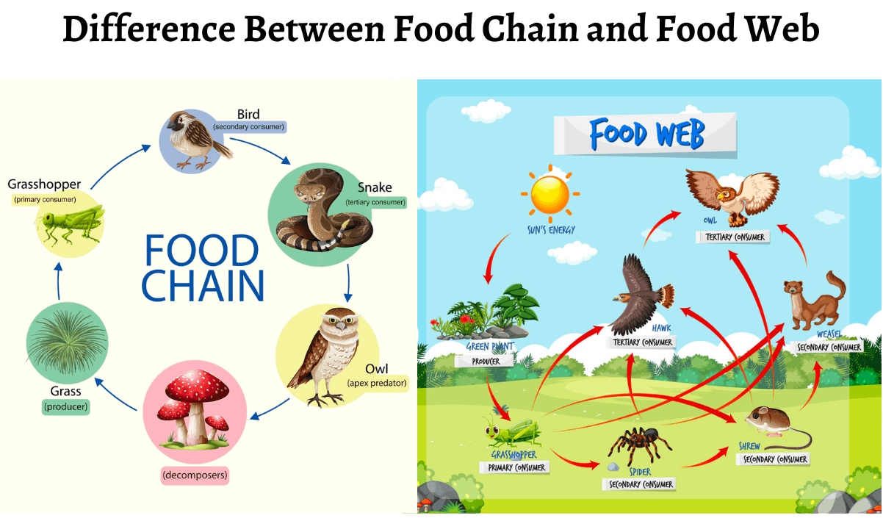

Slide 13
Basic Concepts of Ecology:
13. Biogeochemical Cycles
Nutrients like carbon, nitrogen, and water cycle through ecosystems in biogeochemical cycles. These cycles involve various processes like evaporation, precipitation, and decomposition to maintain the balance of elements in the ecosystem.
14. Biodiversity
Biodiversity refers to the variety of life in a given area, including species diversity, genetic diversity, and ecosystem diversity. High biodiversity is crucial for ecosystem stability and resilience.

Slide 14
Basic Concepts of Ecology:
15. Population Dynamics
This refers to how and why populations of organisms change over time, including factors like birth rates, death rates, immigration, and emigration. These dynamics influence the distribution and abundance of species.
16. Succession
Ecological succession is the process by which ecosystems change and develop over time. There are two types:
Primary succession: Occurs in a previously uninhabited area (e.g., after a volcanic eruption).
Secondary succession: Occurs in areas where a community has been disturbed but soil remains (e.g., after a forest fire).

Slide 15
Basic Concepts of Ecology:
17. Biotic Components:
All living organisms within an ecosystem, including plants, animals, fungi, bacteria, and any other life forms.
Plants (producers), Animals (consumers), Fungi and bacteria (decomposers)
18. Abiotic Components:
Abiotic factors are the non-living chemical and physical components of an ecosystem that influence the survival and distribution of organisms.
Physical factors: Temperature, sunlight, water, soil, air, humidity, pH.
Chemical factors: Nutrients, minerals, and gases

Slide 16
Types of Ecology:
Ecology is the study of the interactions between organisms and their environment. There are several branches of ecology, each focusing on different levels of organization and types of interactions. Here are some of the key types:
1. Autecology 2. Synecology
3. Population Ecology 4. Community Ecology
5. Ecosystem Ecology 6. Landscape Ecology
7. Global Ecology (or Biosphere Ecology)
8. Behavioral Ecology, 9. Conservation Ecology
10. Human Ecology 11. Aquatic Ecology
12. Terrestrial Ecology 13. Microbial Ecology

Slide 17
Types of Ecology:
1. Autecology
Studies the ecology of individual species and their interactions with the environment.
How a single species adapts to its environment, its role in the ecosystem, and its responses to abiotic factors like temperature, light, and soil type.
2. Synecology
Examines the interactions of groups of organisms (populations, communities) within ecosystems.
Species interactions (competition, predation, mutualism), community structure, and the dynamics of ecosystems.

Slide 18
Types of Ecology:
3. Population Ecology
Investigates the dynamics of populations of a single species, including their size, density, structure, and how they change over time.
Birth rates, death rates, immigration, emigration, and factors influencing population growth, such as resources and predation.
4. Community Ecology
Looks at how different species within a community interact with each other and how these interactions shape the structure and function of the community.
Species diversity, food webs, ecological niches, and interspecies relationships (e.g., competition, predation, symbiosis).

Slide 19
Types of Ecology:
5. Ecosystem Ecology
Focuses on the flow of energy and cycling of nutrients in ecosystems.
Energy transfer through food chains and webs, carbon and nitrogen cycles, primary production, and the role of decomposers.
6. Landscape Ecology
Examines the spatial patterns and processes at a landscape scale, integrating ecological processes across multiple ecosystems.
Habitat fragmentation, corridors, land use changes, and the effects of landscape configuration on biodiversity.

Slide 20
Types of Ecology:
7. Global Ecology (or Biosphere Ecology)
Studies ecological processes at the global scale, considering the entire biosphere.
Global climate change, the impact of human activities on ecosystems, carbon cycles, and biodiversity conservation on a planetary scale.
8. Behavioral Ecology
Investigates how an organism’s behavior is shaped by its environment and evolutionary pressures.
Adaptive behavior, foraging strategies, mate selection, social structures, and communication.

Slide 21
Types of Ecology:
9. Conservation Ecology
Applies ecological principles to the preservation of biodiversity and the management of natural resources.
Habitat loss, species extinction, restoration ecology, and strategies for conserving endangered species and ecosystems.
10. Human Ecology
Looks at the relationship between humans and their environment, particularly the impact of human activity on ecosystems.
Urbanization, resource management, pollution, sustainability, and the social, economic, and cultural factors affecting environmental issues.

Slide 22
Types of Ecology:
11. Aquatic Ecology
The study of organisms in freshwater and marine environments.
Aquatic ecosystems, water quality, nutrient cycling in aquatic systems, and the relationship between organisms and water.
12. Terrestrial Ecology
Focuses on land-based ecosystems, such as forests, grasslands, deserts, and tundra.
Climate influence, vegetation types, soil characteristics, and terrestrial species interactions.

Slide 23
Types of Ecology:
13. Microbial Ecology
Examines the role of microorganisms in ecosystems.
Microbial communities in soil, water, and living organisms, their role in nutrient cycling, and their relationship with other species.

Slide 24
THANK YOU

