Slide 1
Biogeochemical Cycles: Carbon Cycle
Subject: Basic Ecology (ZOL-502)
(BS Zoology 6th Semester)
By: Shozab Seemab Khan
(PhD Zoology Scholar)
ABAIDULLAH COLLEGE PAKPATTAN

Slide 2
🌍 Carbon Cycle
The carbon cycle is a biogeochemical cycle where carbon is exchanged among the biosphere, pedosphere, geosphere, hydrosphere, and atmosphere of Earth.
Carbon is a key element in all known life forms, and its circulation is crucial for maintaining ecological balance

Slide 3
🔄 Main Components of the Carbon Cycle
1. Atmospheric Carbon
2. Photosynthesis
3. Consumption
4. Respiration
5. Decomposition
6. Oceanic Carbon
7. Fossilization
8. Combustion
9. Sedimentation

Slide 4
1. Atmospheric Carbon
Exists mostly as carbon dioxide (CO₂) and methane (CH₄).
Acts as a greenhouse gas, trapping heat in the atmosphere.
Enters and exits the atmosphere through various natural and anthropogenic (human-caused) processes.

Slide 5
2. Photosynthesis: Carbon Inflow to Biosphere
Autotrophs (mostly green plants, algae, cyanobacteria) absorb CO₂ from the air.
They use sunlight to convert CO₂ and water into glucose (C₆H₁₂O₆) via:
Carbon becomes part of plant biomass (roots, leaves, stems).

Slide 6
3. Consumption: Carbon Transfer Through Food Chains & Webs
Heterotrophs (animals, humans, insects) eat plants or other animals.
They assimilate organic carbon into their bodies.
Carbon moves up the food chain through feeding.

Slide 7
4. Respiration: Return of Carbon to Atmosphere
All organisms (plants, animals, decomposers) respire.
During cellular respiration, glucose is broken down to release energy:
This process releases CO₂ back to the atmosphere.

Slide 8
5. Decomposition: Recycling of Carbon to Soil and Atmosphere
Decomposers (bacteria, fungi) break down dead organic matter.
They release CO₂ (or CH₄ under anaerobic conditions) during decay.
Some organic material becomes humus (stable organic matter in soil).

Slide 9
6. Oceanic Carbon: Major Carbon Sink
Oceans absorb large amounts of atmospheric CO₂.
CO₂ dissolves in seawater, forming carbonic acid (H₂CO₃):
Marine organisms use bicarbonate (HCO₃⁻) to build calcium carbonate shells.
When organisms die, shells accumulate on the ocean floor, forming limestone (later into chalk).
Notes:
Corals, Molluscs, Foraminiferans

Slide 10
7. Fossilization: Long-Term Carbon Storage
Under pressure and time, some dead plants and animals become fossil fuels (coal, oil, gas).
This is a slow process (millions of years), storing carbon underground.

Slide 11
8. Combustion: Carbon Released from Fossil Fuels
Burning fossil fuels (coal, oil, natural gas) releases stored CO₂ quickly.
Also occurs during forest fires and biomass burning.
This is the main human contribution to the carbon cycle imbalance.

Slide 12
9. Sedimentation: Geological Carbon Storage
Some carbon is locked into sedimentary rocks like limestone.
It can return to the atmosphere through volcanic eruptions or weathering.

Slide 13
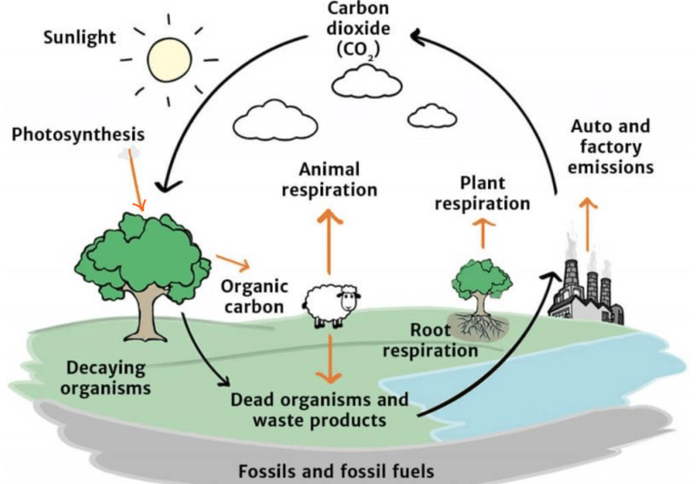

Slide 14
🌱 Ecological Importance of the Carbon Cycle
Regulates climate by controlling CO₂ levels.
Drives primary productivity (photosynthesis).
Recycles nutrients between living and non-living components of ecosystems.
Imbalances (e.g., due to deforestation or fossil fuel use) can cause climate change.

Slide 15
🔁 Summary: Carbon Flow Pathways
Carbon Reservoir | Process | Direction
Atmosphere → Plants | Photosynthesis | Inflow
Plants → Animals | Feeding | Transfer
Organisms → Atmosphere | Respiration | Outflow
Dead matter → Soil | Decomposition | Transfer
Fossils → Atmosphere | Combustion | Outflow
Atmosphere ↔ Ocean | Diffusion | Both

Slide 16
THANK YOU

