Slide 1
Biogeochemical Cycles:
Nitrogen Cycle
Subject: Basic Ecology (ZOL-502)
(BS Zoology 6th Semester)
By: Shozab Seemab Khan
(PhD Zoology Scholar)
ABAIDULLAH COLLEGE PAKPATTAN

Slide 2
Biogeochemical Cycles
Biogeochemical cycles are natural processes that recycle nutrients in various chemical forms from the environment to organisms and back to the environment.
These cycles are crucial for sustaining life on Earth because they regulate the flow of essential elements like carbon, nitrogen, oxygen, phosphorus, and water through the biosphere, atmosphere, hydrosphere, and lithosphere.

Slide 3
Nitrogen Cycle
The nitrogen cycle is the process by which nitrogen moves through the atmosphere, soil, water, plants, animals, and microorganisms.
Nitrogen is essential for living things because it's a key part of amino acids, proteins, chlorophyl, DNA and RNA.
However, most organisms cannot use nitrogen in its gaseous form (N₂), which makes up about 78% of the atmosphere.

Slide 4
Nitrogen Cycle (Stages)
1. Nitrogen Fixation
2. Nitrification
3. Assimilation
4. Ammonification (Decomposition)
5. Denitrification
Principal stages are Nitrification, Assimilation and Ammonification.

Slide 5
🌱 1. Nitrogen Fixation
Conversion of atmospheric nitrogen gas (N₂) into a form usable by plants — mainly ammonia (NH₃) or ammonium ions (NH₄⁺).
Nitrogen fixation is done by mainly 3 ways.
1. Biological fixation:
Done by nitrogen-fixing bacteria (e.g., Rhizobium, Azotobacter, Clostridium).
Rhizobium lives in symbiotic relationships inside root nodules of leguminous plants (beans, peas, clover).

Slide 6
🌱 1. Nitrogen Fixation
2. Abiotic fixation:
Lightning breaks N₂ and allows it to react with O₂ to form nitrogen oxides, which dissolve in rain to form nitrates (NO₃⁻) which returns to soil with water.
3. Industrial fixation: Humans convert N₂ into ammonia using the Haber-Bosch process to make fertilizers.
✅ Why it matters:
Most organisms can't use N₂ gas directly.
Fixation is the only natural way nitrogen enters ecosystems in a usable form.
Notes:
The process converts N₂ from atmosphere into NH₃ through the reaction with H₂ by employing a metal catalyst (typically an iron catalyst) under high pressures and high temperatures.

Slide 7
🔄 2. Nitrification
Two-step process where ammonia (NH₃) or ammonium (NH₄⁺) is oxidized into nitrates (NO₃⁻).
Step 1: Ammonia → Nitrite (NO₂⁻)
Carried out by Nitrosomonas bacteria.
Step 2: Nitrite → Nitrate (NO₃⁻)
Carried out by Nitrobacter bacteria.
✅ Why it matters:
Plants absorb nitrogen primarily as nitrates.
It prevents toxic build-up of ammonia in the soil.

Slide 8
🌿 3. Assimilation
Plants take up nitrates (NO₃⁻) and ammonium (NH₄⁺) from the soil and incorporate them into organic molecules like amino acids, proteins, and DNA.
Plants absorb nitrogen compounds and build their body tissues.
Animals eat plants (or other animals) to obtain nitrogen.
✅ Why it matters:
This is how nitrogen moves into the living (biotic) part of ecosystems through food chains and food webs.
It's essential for the growth and reproduction of all organisms.

Slide 9
💀 4. Ammonification (Decomposition)
Decomposers break down dead organisms, urine, and feces, converting organic nitrogen back into ammonia (NH₃) or ammonium (NH₄⁺).
Saprotrophic Fungi and Bacteria.
✅ Why it matters:
Recycles nitrogen back into the soil, making it available again for nitrification or plant uptake.

Slide 10
🌬️ 5. Denitrification
Conversion of nitrates (NO₃⁻) back into nitrogen gas (N₂) or nitrous oxide (N₂O), which is released into the atmosphere.
Denitrifying bacteria (e.g., Pseudomonas, Paracoccus) in anaerobic conditions (like waterlogged soils or wetlands).
✅ Why it matters:
Completes the nitrogen cycle.
Prevents the accumulation of excess nitrogen in ecosystems.
Returns nitrogen to the atmosphere.

Slide 11
🔁 Full Nitrogen Cycle Summary:
1. Nitrogen Fixation: N₂ → NH₃/NH₄⁺
2. Nitrification: NH₃/NH₄⁺ → NO₂⁻ → NO₃⁻
3. Assimilation:
NO₃⁻ Absorbed by Plants → Animals
4. Ammonification:
Dead matter and wastes → NH₃/NH₄⁺
5. Denitrification:
NO₃⁻ → N₂ → Back to Atmosphere

Slide 12
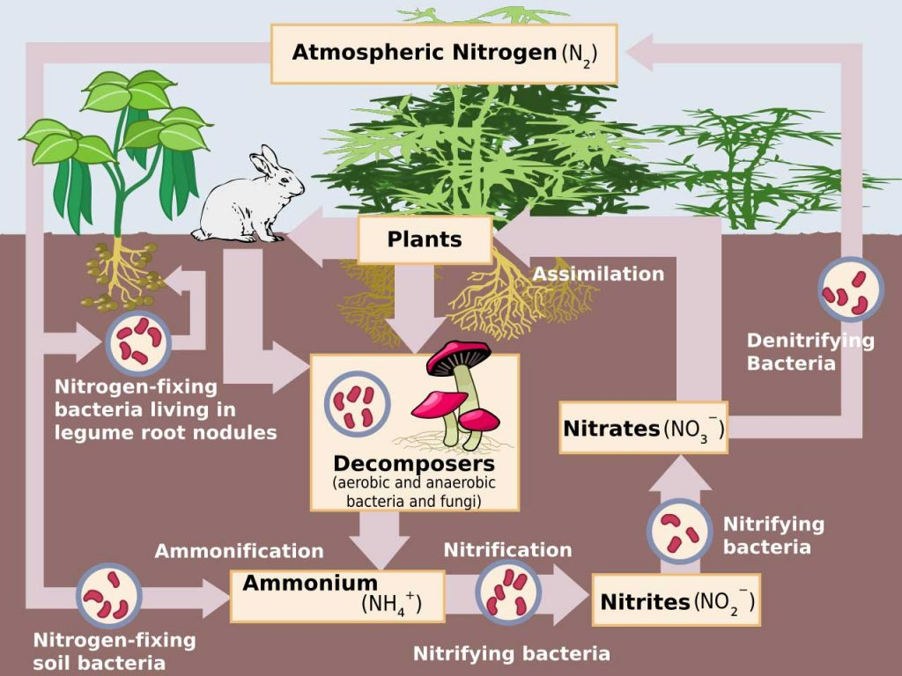

Slide 13
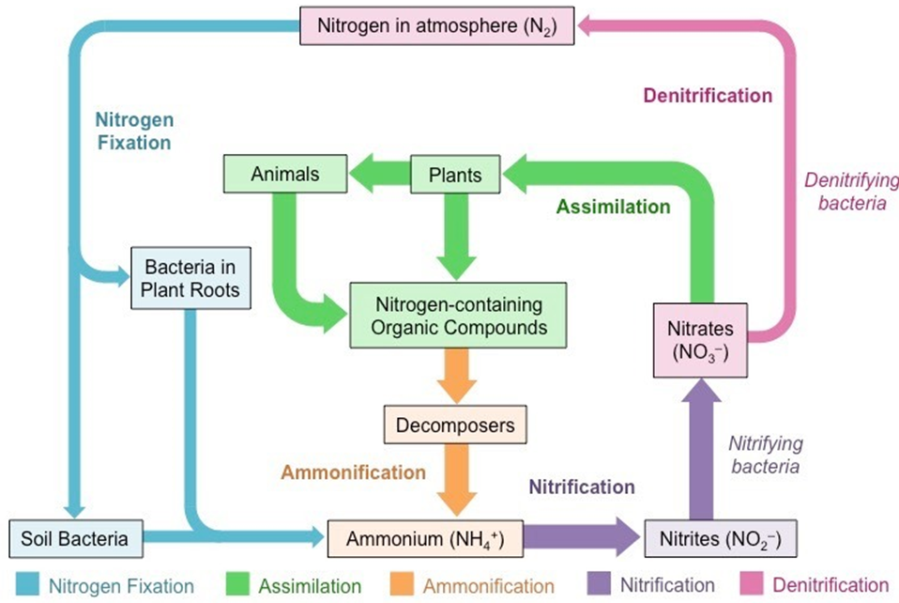

Slide 14
THANK YOU

