Slide 1
Biogeochemical Cycles: Phosphorous Cycle
Subject: Basic Ecology (ZOL-502)
(BS Zoology 6th Semester)
By: Shozab Seemab Khan
(PhD Zoology Scholar)
ABAIDULLAH COLLEGE PAKPATTAN

Slide 2
Phosphorous Cycles
The Phosphorus Cycle is another crucial biogeochemical cycle, but it’s a bit different from others like the nitrogen or carbon cycles — because phosphorus does not have a gaseous phase under normal conditions.
Instead, it cycles mainly through rocks, soil, water, and living organisms.

Slide 3
What is the Phosphorus Cycle?
The Phosphorus Cycle describes how phosphorus moves through the lithosphere (earth’s crust), hydrosphere (water), and biosphere (living things).
Phosphorus is crucial for life because it’s a key part:
DNA & RNA
ATP (the energy currency of cells)
Phospholipids (components of cell membranes)
Bones and teeth (in the form of calcium phosphate)

Slide 4
🔁 Main Steps of the Phosphorus Cycle
1. Weathering of Rocks
2. Absorption by Plants
3. Movement Through the Food Chain
4. Decomposition
5. Sedimentation and Rock Formation

Slide 5
1. Weathering of Rocks
Where it starts:
Phosphorus is found in phosphate rocks (as minerals like apatite).
Over time, weathering and erosion release phosphate ions (PO₄³⁻) into the soil and water.
This process is very slow compared to other cycles.

Slide 6
2. Absorption by Plants
Plants absorb inorganic phosphate from the soil through their roots.
Phosphates are used to make organic molecules like DNA, ATP, etc.
This phosphate then moves through food chains as animals eat plants (and each other).

Slide 7
3. Movement Through the Food Chain
Phosphate present in plants then moves through food chains and food webs as animals eat plants (and each other).
Animals get phosphorus by eating plants or other animals (primary consumers).
Phosphorus becomes part of animal tissues, especially bones and teeth.

Slide 8
4. Decomposition
When plants, animals, and waste products (like dung and urine) decompose, phosphorus is returned to the soil in organic form.
After death of Animals and Plants, decomposers (like bacteria and fungi) convert organic phosphorus back into inorganic phosphate, which can be reused by plants.

Slide 9
5. Sedimentation and Rock Formation
Some phosphorus in soil and water is carried into rivers, lakes, and oceans.
It settles as sediments at the bottom.
Over long geological periods, these sediments form new phosphate rocks — completing the long-term cycle.

Slide 10
🧂 Human Impact on the Phosphorus Cycle
Humans significantly alter the natural phosphorus cycle by:
Mining phosphate rocks for fertilizers and detergents.
Overusing fertilizers, which leads to excess phosphates running off into water bodies.
This causes eutrophication: a process where nutrient-rich water leads to algal blooms, oxygen depletion, and the death of aquatic life.

Slide 11
🌍 Summary of the Phosphorus Cycle (Step-by-Step)
1. Weathering releases phosphates from rocks into the soil.
2. Plants absorb phosphates from the soil.
3. Animals consume plants, gaining phosphorus.
4. Decomposition of organic matter returns phosphorus to the soil.
5. Runoff carries some phosphorus to water bodies.
6. Sedimentation leads to formation of new rocks — completing the cycle.

Slide 12
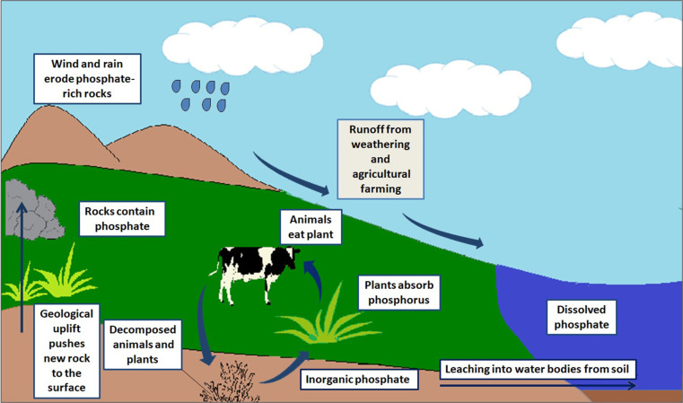

Slide 13
THANK YOU

