Slide 1
Biogeochemical Cycles:
Sulfur Cycle
Subject: Basic Ecology (ZOL-502)
(BS Zoology 6th Semester)
By: Shozab Seemab Khan
(PhD Zoology Scholar)
ABAIDULLAH COLLEGE PAKPATTAN

Slide 2
Sulfur Cycle
The sulfur cycle is a biogeochemical cycle that describes the movement of sulfur through the biosphere (living things), lithosphere (Earth’s crust), hydrosphere (water bodies), and atmosphere.
Sulfur is a vital element for all life because it’s a key component of proteins, vitamins, and enzymes.

Slide 3
🔁 Main Stages of the Sulfur Cycle
1. Weathering of Rocks
2. Assimilation by Plants and Animals
3. Decomposition
4. Bacterial Action
5. Volcanic and Geothermal Activity
6. Atmospheric Reactions and Deposition

Slide 4
1. Weathering of Rocks
(Lithosphere to Biosphere)
Sulfur-containing rocks (e.g. pyrite and gypsum) break down through weathering, releasing sulfur as sulfates (SO₄²⁻) into the soil and water.
Plants absorb these sulfates through their roots.

Slide 5
2. Assimilation by Plants and Animals
Plants take up sulfates from the soil and incorporate sulfur into organic molecules (like amino acids).
Animals get sulfur by eating plants or other animals.
Sulfur moves through the food chain.

Slide 6
3. Decomposition
(Return to Soil and Air)
When organisms die or excrete waste, decomposers (like bacteria and fungi) break down the organic matter.
This process returns sulfur to the soil as hydrogen sulfide (H₂S), sulfide ions (S²⁻), or sulfates (SO₄²⁻).

Slide 7
4. Bacterial Action
(Microbial Transformation)
Anaerobic bacteria in swamps and bogs convert organic sulfur compounds into hydrogen sulfide (H₂S).
Other bacteria convert:
H₂S into elemental sulfur (S).
Elemental sulfur into sulfates (SO₄²⁻) again, completing the cycle.

Slide 8
5. Volcanic and Geothermal Activity (Lithosphere to Atmosphere)
Volcanoes, geysers, and hydrothermal vents release sulfur dioxide (SO₂) and hydrogen sulfide (H₂S) into the atmosphere.
Natural fires (burning of biomass) also release sulfur gases.

Slide 9
6. Atmospheric Reactions and Deposition
In the atmosphere, SO₂ reacts with oxygen and water to form sulfuric acid (H₂SO₄).
This returns to Earth via acid rain or dry deposition.
The deposited sulfur re-enters soils and water systems.

Slide 10
🧪 Forms of Sulfur in the Cycle
Form | Description
Sulfate (SO₄²⁻) | Water-soluble, taken up by plants
Hydrogen Sulfide (H₂S) | Gas, smells like rotten eggs, produced by bacteria
Sulfur Dioxide (SO₂) | Gas from volcanoes and fossil fuels
Elemental Sulfur (S) | Found in soil or produced by bacteria

Slide 11
🌿 Ecological Importance of the Sulfur Cycle
Role | Importance
Supports life | Sulfur is essential for making proteins, vitamins (like biotin and thiamine), and enzymes.
Nutrient cycling | Connects soil, plants, microbes, and animals through natural sulfur transfers.
Energy metabolism | Some bacteria use sulfur in chemosynthesis, especially in deep-sea vents.
Soil fertility | Sulfates in soil help support plant growth.

Slide 12
⚠️ Human Impact on the Sulfur Cycle
Activity | Impact
Burning fossil fuels | Releases large amounts of SO₂, contributing to acid rain.
Industrial processes (smelting) | Emit sulfur compounds into the air, affecting air quality.
Agriculture (fertilizers) | Increases sulfur in soil and water, can disrupt natural microbial communities.
Deforestation | Reduces vegetation that absorbs sulfur, leading to imbalances.
Notes:
Smelting is a process used to extract metals from their ores by melting them at high temperatures, often with the help of reducing agents

Slide 13
🌍 Summary
The sulfur cycle is crucial for maintaining life and ecosystem health. Though it naturally moves between Earth's systems, human activities have significantly altered this cycle, often resulting in environmental problems like acid rain and soil degradation.

Slide 14
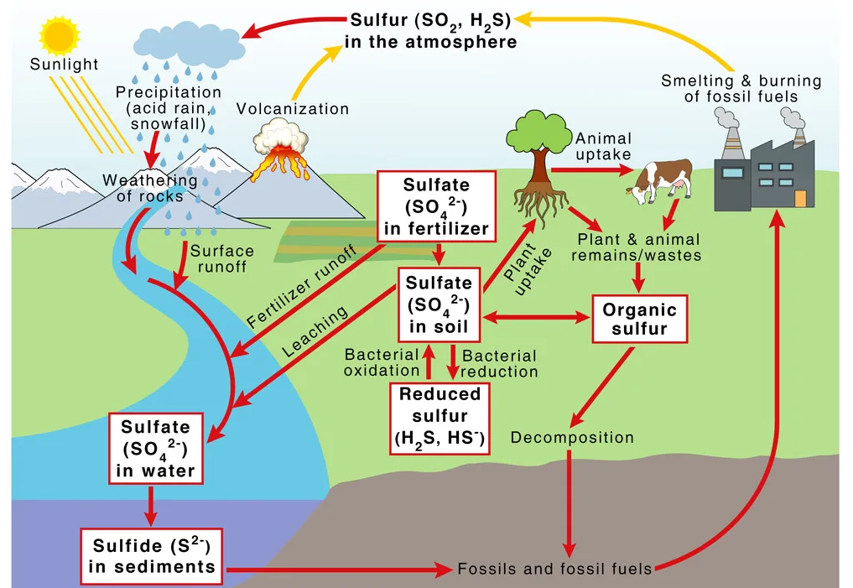

Slide 15
THANK YOU

