Slide 1
Biogeochemical Cycles: Water Cycle
Subject: Basic Ecology (ZOL-502)
(BS Zoology 6th Semester)
By: Shozab Seemab Khan
(PhD Zoology Scholar)
ABAIDULLAH COLLEGE PAKPATTAN

Slide 2
Water Cycles
Water never leaves the Earth. It is constantly being cycled through the atmosphere, ocean, and land. This process, known as the water cycle, is driven by energy from the sun.
The water cycle is crucial to the existence of life on our planet.
Water cycle is a key ecological process that ensures the availability of water across all living systems.

Slide 3
Water Cycles
The water cycle (also called the hydrologic cycle) is a biogeochemical cycle that describes how water moves continuously through the biosphere, atmosphere, geosphere, and hydrosphere.
It is essential for ecosystem stability, plant and animal survival, nutrient cycling, and climate regulation.

Slide 4
Water Cycles Stages / Steps
1. Evaporation
2. Transpiration
3. Condensation
4. Precipitation
5. Infiltration and Percolation
6. Runoff
7. Collection

Slide 5
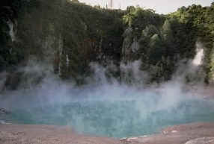
1. Evaporation
During part of the water cycle, the sun heats up liquid water and changes it to a gas by the process of evaporation. Water that evaporates from Earth’s oceans, lakes, rivers, and moist soil rises up into the atmosphere.

Slide 6
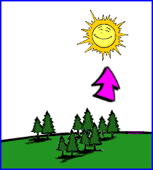
2. Transpiration
The process of evaporation from plants is called transpiration. (In other words, it’s like plants sweating.)

Slide 7
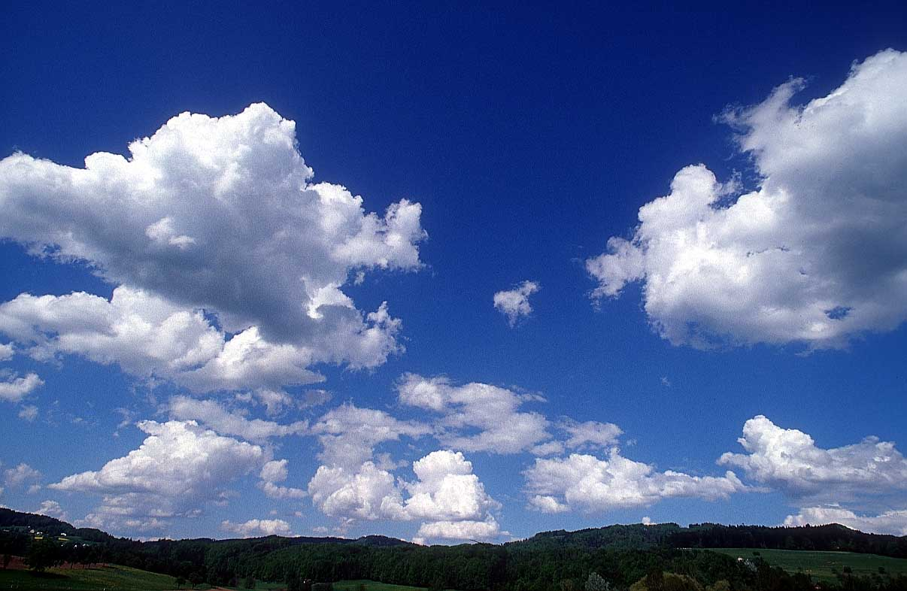
3. Condensation
As water (in the form of gas) rises higher in the atmosphere, it starts to cool and become a liquid again. This process is called condensation. When a large amount of water vapor condenses, it results in the formation of clouds.

Slide 8
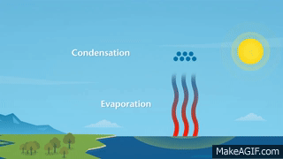
3. Condensation

Slide 9
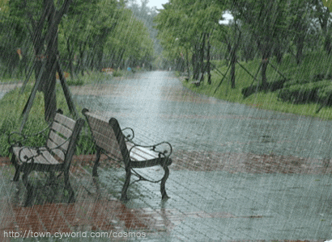
4. Precipitation
When the water in the clouds gets too heavy, the water falls back to the earth (Rain, snow, hail). This is called precipitation.

Slide 10
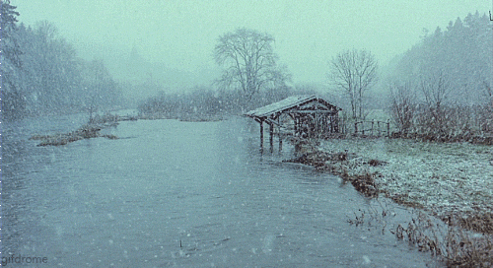
4. Precipitation (Snow)

Slide 11
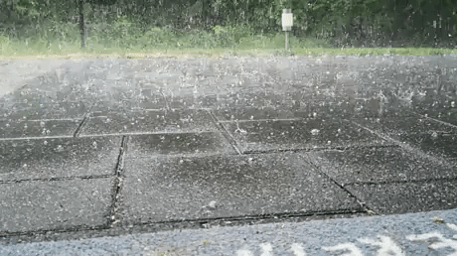
4. Precipitation (Hail)

Slide 12
5. Infiltration and Percolation
Some of the water that reaches the ground infiltrates (soaks) into the soil. It may stay near the surface (soil moisture) or percolate deeper to become part of groundwater.

Slide 13
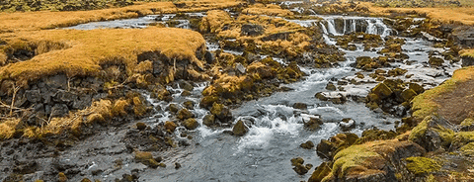
6. Runoff
When rain falls on the land, some gets absorbed in soil while most of the water runs directly into streams or rivers. Water that collects in rivers, streams, and oceans is called runoff.

Slide 14
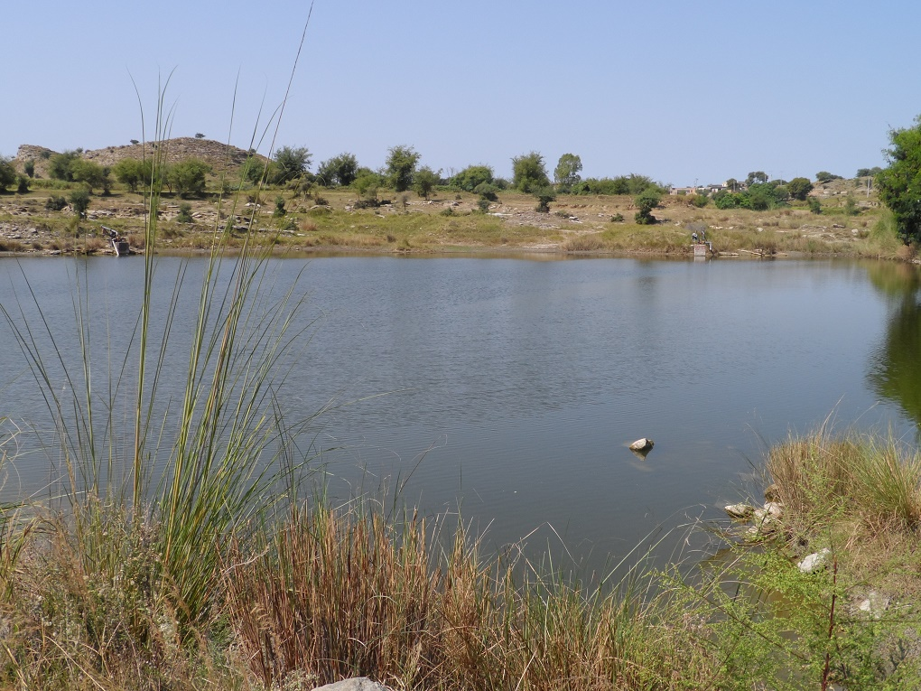
7. Collection
Water collects in oceans, lakes, rivers, glaciers, and underground aquifers. From here, it can re-enter the cycle via evaporation or plant uptake.

Slide 15
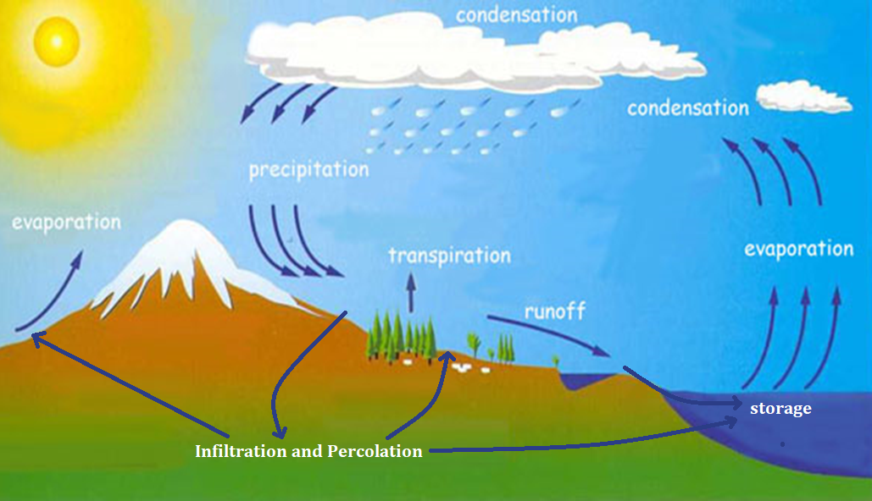

Slide 16
💡 Additional Concepts
☁️ Sublimation
Solid water (ice or snow) turns directly into vapor without becoming liquid.
Happens in very cold, dry environments (e.g., mountain peaks).
💨 Deposition
Opposite of sublimation: water vapor turns directly into ice (like frost formation).

Slide 17
🌍 Human Influence
Urbanization, deforestation, and climate change can alter the natural water cycle:
Less infiltration due to paved surfaces.
Increased runoff and flooding.
Changes in precipitation patterns.

Slide 18
THANK YOU

