Slide 1
Global Ecosystems
Subject: Basic Ecology (ZOL-502)
(BS Zoology 6th Semester)
By: Shozab Seemab Khan
(PhD Zoology Scholar)
ABAIDULLAH COLLEGE PAKPATTAN

Slide 2
🌎 What Are Global Ecosystems?
Global ecosystems, also called biomes, are large-scale ecological zones found across Earth. Each one is defined by a unique combination of:
Climate (temperature, rainfall)
Soil type
Flora (plants)
Fauna (animals)
They cover vast areas and support distinct communities of life that have adapted to specific environmental conditions.

Slide 3
🌍 Major Global Ecosystems (Biomes)
1.Tropical Rainforest
2. Desert
3. Savanna
(Tropical Grassland)
4. Temperate Forest
5. Taiga
(Boreal Forest)
6. Tundra
7.Temperate Grassland
(Prairie/Steppe)
8. Mountains
(Alpine)
9. Polar Regions
10. Marine Ecosystems (Saltwater)
11.Freshwater Ecosystems

Slide 4
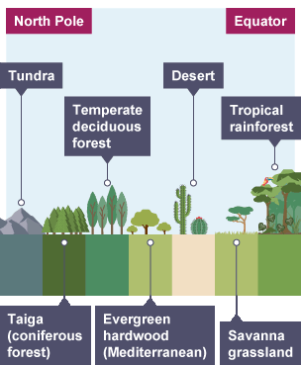

Slide 5
🔄 How Are They Connected?
All global ecosystems are interconnected through climate, water cycles, and species migration.
Changes in one biome (e.g., deforestation in the Amazon) can affect global climate patterns, water cycles, and even ecosystems thousands of miles away.

Slide 6
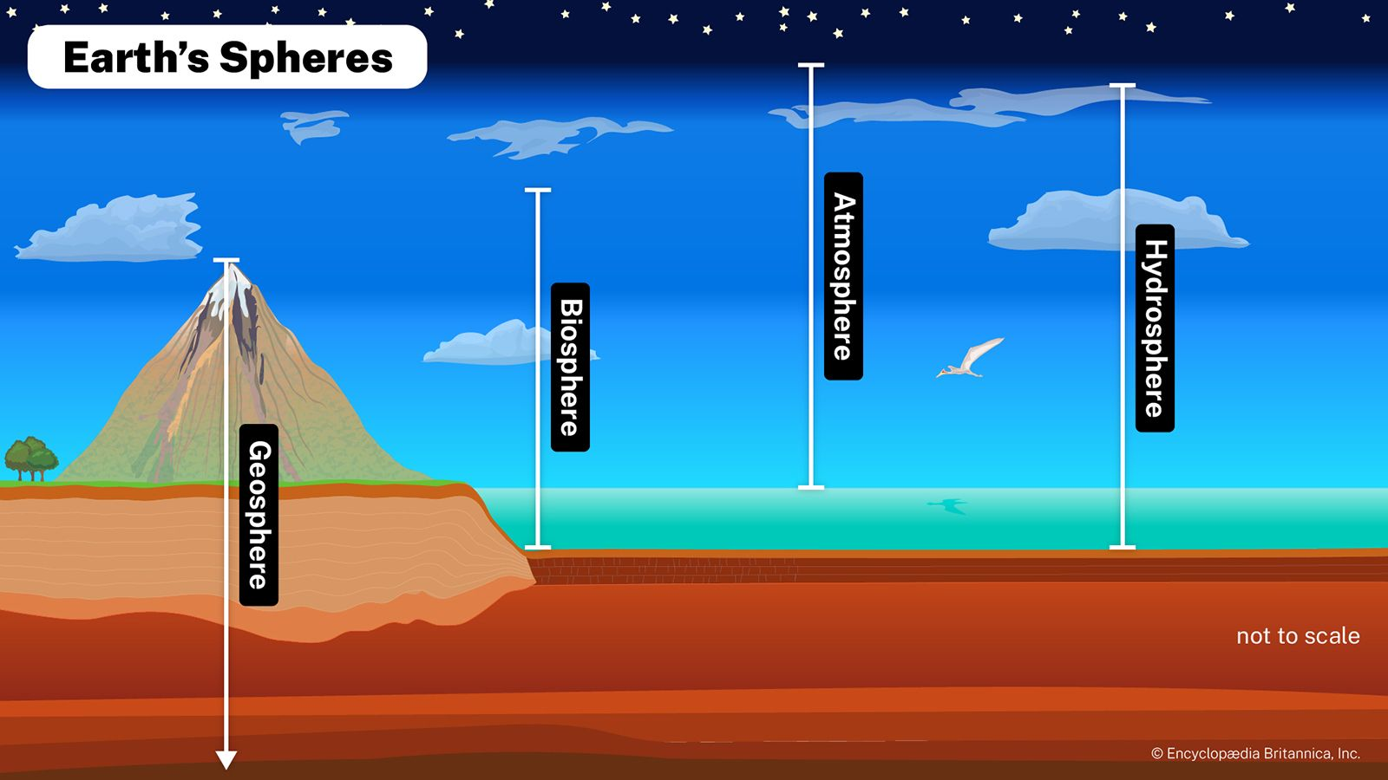

Slide 7
🌍 1. Atmosphere (Air Layer Around Earth)
🌫️ Structure:
Troposphere (0–12 km): Where weather and life occur.
Stratosphere (12–50 km):
Contains ozone layer that blocks harmful UV rays.
Mesosphere, Thermosphere, Exosphere:
Higher layers with less ecological relevance.
🌀 Ecological Functions:
Climate Regulation: Greenhouse gases (CO₂, CH₄) trap heat → maintain temperature suitable for life.
Clouds and aerosols influence Earth's albedo (reflectivity).

Slide 8
🌍 1. Atmosphere (Air Layer Around Earth)
Photosynthesis and Respiration:
Plants use CO₂ and release O₂.
Animals and microbes consume O₂ and release CO₂.
Wind Patterns:
Disperse seeds, spores, and pollutants.
Drive ocean currents via surface wind friction.
Air Quality:
Pollution (SO₂, NOx) causes acid rain → affects soil and water pH.
Ozone layer protects living organisms from UV radiation.

Slide 9
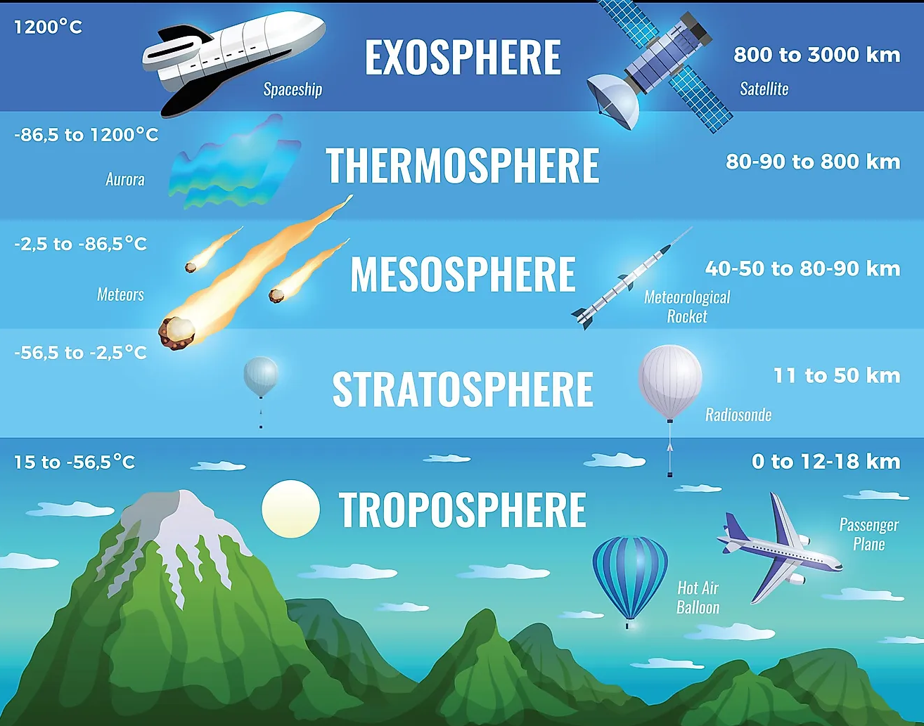

Slide 10
🌊 2. Hydrosphere (All Water Bodies on Earth)
💧 Components:
Oceans (97% of Earth’s water)
Freshwater (rivers, lakes, glaciers, groundwater – ~3%)
Atmospheric water vapor and soil moisture
🐟 Ecological Functions:
Aquatic Habitats:
Coral reefs, estuaries, deep sea vents host unique ecosystems.
Water Cycle (Hydrological Cycle):
Evaporation, condensation, precipitation, infiltration, runoff.
Links terrestrial, atmospheric, and aquatic ecosystems.

Slide 11
🌊 2. Hydrosphere (All Water Bodies on Earth)
Heat and Climate Regulation:
Ocean currents (like Gulf Stream) regulate coastal climates.
Water has a high heat capacity → buffers climate extremes.
Biogeochemical Cycles:
Dissolves and transports nutrients (carbon, nitrogen).
Reservoir for carbon
(CO₂ absorbed in ocean → carbonic acid).
Human Impact:
Pollution (plastics, oil spills, heavy metals).
Overfishing disrupts food chains.

Slide 12
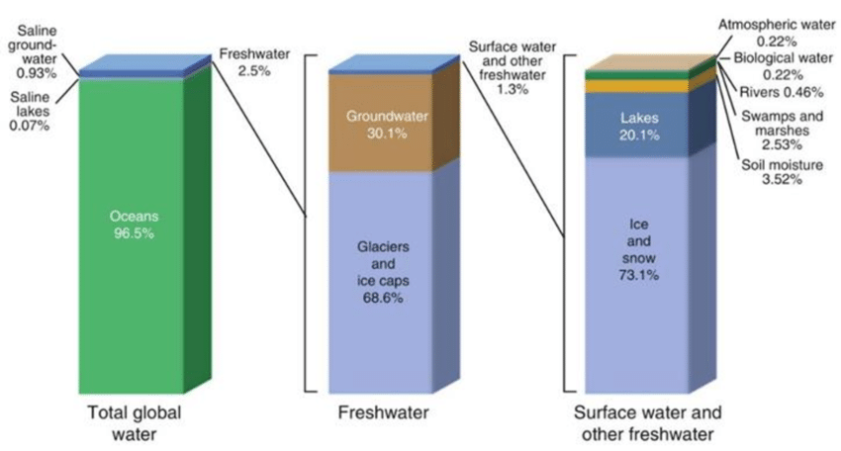

Slide 13
3. Lithosphere (Earth’s Solid Outer Layer)
⛰️ Components:
Continental and oceanic crust (rocks, minerals)
Soil layers
Mountains, volcanoes, deserts
🌾 Ecological Functions:
Soil as a Life Support System:
Contains organic matter, minerals, air, and water → vital for plants.
Supports billions of microorganisms crucial to decomposition and nutrient cycling.

Slide 14
3. Lithosphere (Earth’s Solid Outer Layer)
Nutrient Cycling:
Rock weathering releases minerals like calcium, phosphorus, potassium.
Habitat Provision:
Caves, cliffs, and forest floors are unique microhabitats.
Tectonic Activity:
Creates new landforms → biodiversity hotspots (islands, rift valleys).
Human Impact:
Deforestation, mining, urbanization → soil erosion and habitat loss.

Slide 15
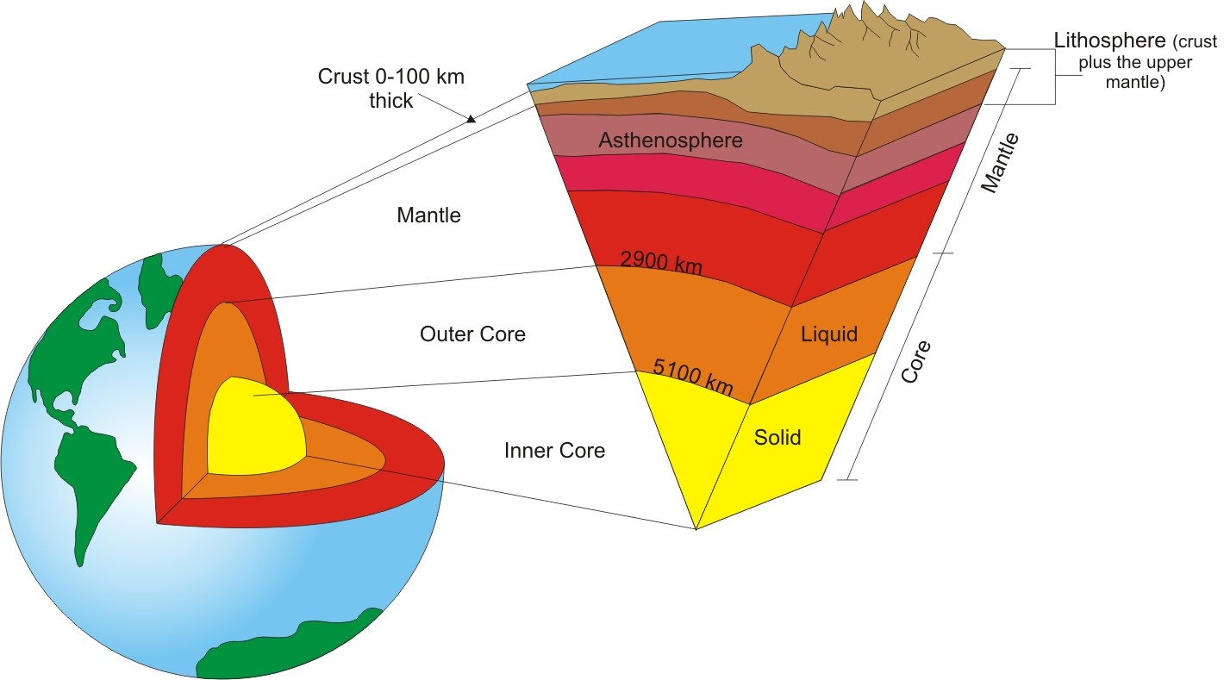

Slide 16
🌱 4. Ecosphere (Biosphere) – The Living Layer
🌐 Definition:
The global ecosystem – all living organisms and their relationships with the non-living environment (air, water, rock).
Includes all biomes (tundra, desert, rainforest, ocean, etc.)
🌳 Ecological Functions:
Energy Flow:
Sunlight → producers (plants) → consumers (animals) → decomposers.
Energy moves in food chains and food webs.

Slide 17
🌱 4. Ecosphere (Biosphere) – The Living Layer
Biogeochemical Cycles:
Carbon Cycle: Photosynthesis, respiration, decomposition, fossil fuels.
Nitrogen Cycle: Fixation by bacteria, uptake by plants, release via decay.
Water Cycle: Movement through air, ground, organisms.
Biodiversity:
Increases ecosystem resilience and productivity.
Key for medicine, food, and ecosystem services (pollination, water purification).

Slide 18
🌱 4. Ecosphere (Biosphere) – The Living Layer
Feedback Loops:
Deforestation → more CO₂ → climate change → affects all spheres.
Melting ice → less sunlight reflected → more warming → permafrost melts → more CO₂/methane.
🔁 Interconnectedness Example:
A volcanic eruption (lithosphere) releases gases into the atmosphere, changes local climate, and affects hydrosphere (acid rain), which disrupts the biosphere (plant and animal life).

Slide 19
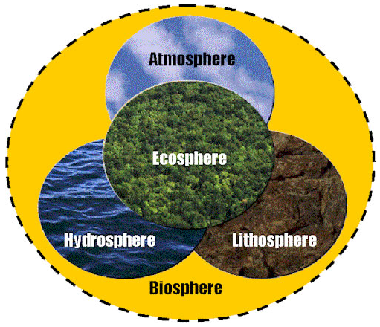

Slide 20
THANK YOU

