Slide 1
LAWS OF THERMODYNAMICS
Subject: Basic Ecology (ZOL-502)
(BS Zoology 6th Semester)
By: Shozab Seemab Khan
(PhD Zoology Scholar)
ABAIDULLAH COLLEGE PAKPATTAN

Slide 2
Laws of Thermodynamics
Zeroth Law:
If two systems are in thermal equilibrium with a third system, they are in thermal equilibrium with each other. This defines the concept of temperature.
First Law:
Energy cannot be created or destroyed, only converted from one form to another. The total energy of an isolated system remains constant.

Slide 3
Laws of Thermodynamics
Second Law:
The entropy (disorder) of an isolated system always increases over time. Energy transformations are never 100% efficient, and heat flows from hot to cold.
Third Law:
As temperature approaches absolute zero, the entropy of a system approaches its minimum value, often zero. It’s impossible to reach absolute zero in a finite number of steps.

Slide 4
Laws of Thermodynamics (Ecology)
In the context of animal ecology, the laws of thermodynamics are applied to understand how energy flows through ecosystems and how organisms interact with their environment.
These laws help explain how animals acquire, use, and transform energy to maintain life processes.

Slide 5
1. Zeroth Law of Thermodynamics (Thermal Equilibrium)
This law explains how animals maintain thermoregulation. Animals are constantly exchanging heat with their environment to maintain internal body temperatures that support life functions.
When an animal is in thermal equilibrium with its environment, it means its body temperature is stable.
(No exchange of Heat b/w body and environment)

Slide 6
1. Zeroth Law of Thermodynamics (Thermal Equilibrium)
For instance, ectotherms (like reptiles) rely on external heat sources to regulate their body temperature, while endotherms (like mammals and birds) regulate their own internal body heat by producing energy through metabolism.
Example:
A lizard basking in the sun is in thermal equilibrium with the third system (the sun), raising its body temperature to an optimal level.

Slide 7
2. First Law of Thermodynamics (Energy Conservation)
The First Law emphasizes that energy cannot be created or destroyed but can change forms.
In ecological terms, animals acquire energy from their food (chemical energy) and convert it into other forms, such as kinetic energy (for movement) or thermal energy (for maintaining body temperature).
Some energy is also lost as heat.

Slide 8
2. First Law of Thermodynamics (Energy Conservation)
The energy flow through an ecosystem is also governed by this law. Primary producers (like plants) absorb solar energy, which is passed on to herbivores, then carnivores, and so on.
Not all the energy from one trophic level is passed to the next due to losses (mainly as heat).
Example:
A rabbit consumes plants and stores chemical energy. The rabbit uses some of this energy for movement and growth, while the mostly is lost as heat and some energy is transferred to next trophic level.

Slide 9
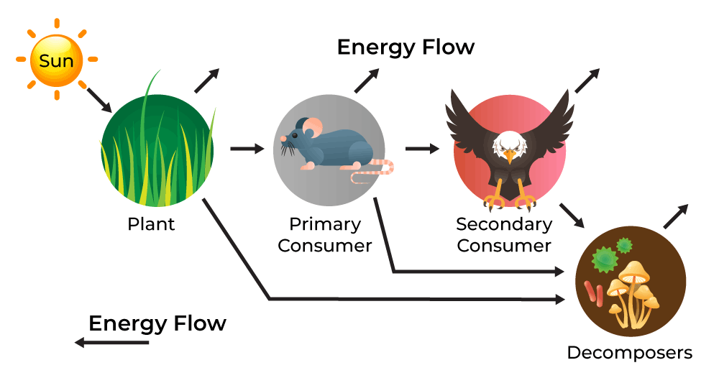
2. First Law of Thermodynamics (Energy Conservation)

Slide 10
3. Second Law of Thermodynamics (Entropy)
The Second Law explains that energy transfer is never perfectly efficient; there is always some loss, typically as heat. This has direct implications for how energy moves through ecosystems.
In an ecological context, energy transfer between trophic levels is inefficient. For example, only about 10% of the energy from one trophic level (e.g., plants) is passed on to the next level (e.g., herbivores), while the rest is lost as heat or used for metabolism.

Slide 11
3. Second Law of Thermodynamics (Entropy)
The increase in entropy (disorder) in the system explains why ecosystems require constant energy input (such as sunlight) to maintain their structure and function.
Example:
When a wolf eats a deer, much of the energy from the deer is used by the wolf for movement and bodily functions, and only a fraction of the energy becomes stored in the wolf’s body for growth or reproduction.

Slide 12
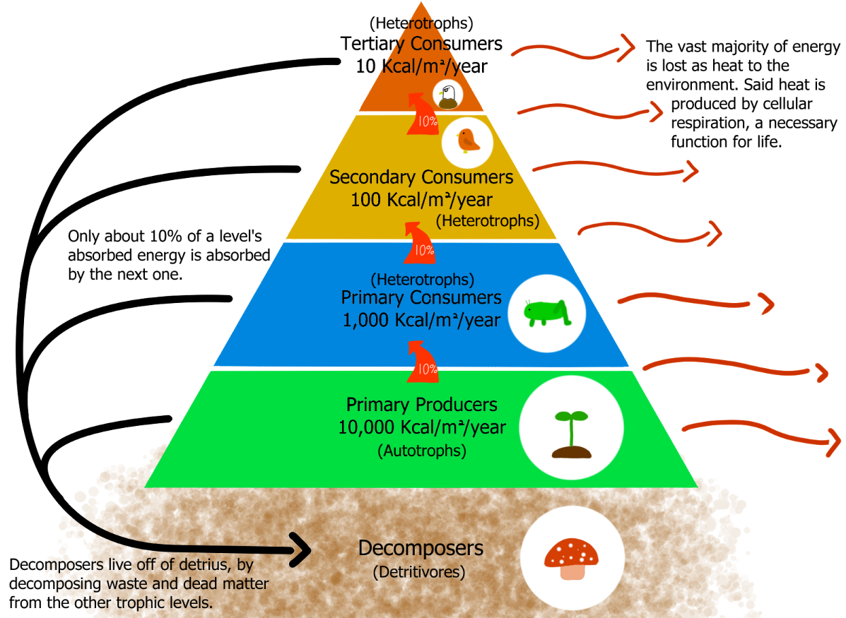

Slide 13
4. Third Law of Thermodynamics (Absolute Zero and Entropy)
The Third Law is less directly applied in everyday ecological processes, but it has implications for organisms living in extreme environments, such as those near the poles or at high altitudes.
As temperature decreases, metabolic processes slow down, and at absolute zero (0 Kelvin), all biological processes stop. In nature, this law influences the hibernation or torpor of some animals in cold environments, where metabolic activity slows considerably.
Example: Bears hibernate during winter slowing their metabolism drastically to conserve energy. While they don’t reach absolute zero, their metabolic processes drop to near minimum levels.

Slide 14
Summary in Ecological Terms
Energy Flow:
Energy from the sun is captured by plants and passed through the food chain to animals. This energy is used by animals for growth, reproduction, and maintenance. However, some of it is always lost as heat due to the inefficiency of energy transfers (Second Law).
Energy Conservation:
Animals must consume energy to fuel their biological functions. This energy is transformed from one form to another (e.g., chemical energy in food to kinetic or heat energy), but the total energy in the system remains constant (First Law).

Slide 15
Summary in Ecological Terms
Thermoregulation:
Animals exchange energy with their environment to regulate body temperature and survive in their habitat, whether by absorbing heat from the environment or generating it internally (Zeroth and First Laws).
In short, the laws of thermodynamics help explain how animals interact with energy in their environments, from capturing and using energy for survival to dealing with energy losses and maintaining balance within ecosystems.

Slide 16
THANK YOU

