Slide 1
Trophic levels and energy variation with increasing trophic levels, energy flow, food chains and food webs.
Subject: Basic Ecology (ZOL-502)
(BS Zoology 6th Semester)
By: Shozab Seemab Khan
(PhD Zoology Scholar)
ABAIDULLAH COLLEGE PAKPATTAN

Slide 2
Introduction
In an ecosystem, energy flows from one organism to another through feeding relationships.
Trophic levels categorize organisms based on their position in the food chain, while energy transfer explains how energy decreases as it moves up each level in an ecosystem.
Food chains and food webs illustrate these interactions, showing how ecosystems maintain balance.

Slide 3
Basic Terms
Biosphere: The part of the earth that supports life.
Ecosystem: Organisms and the non-living environment in a particular place.
Community: All the interacting organisms living in an area belonging to different species.
Population: All the members of a same species that live in one place at the same time.
Organism: An individual member of a species.
Biotic factors: Living components of the environment.
Abiotic factors: Non-living factors (rocks, water, air).

Slide 4
Trophic Level
Each of several hierarchical levels in an ecosystem, consisting of organisms sharing the same function in the food chain and the same nutritional relationship to the primary sources of energy makes a trophic level.
Trophic levels represent the feeding positions in a food chain.

Slide 5
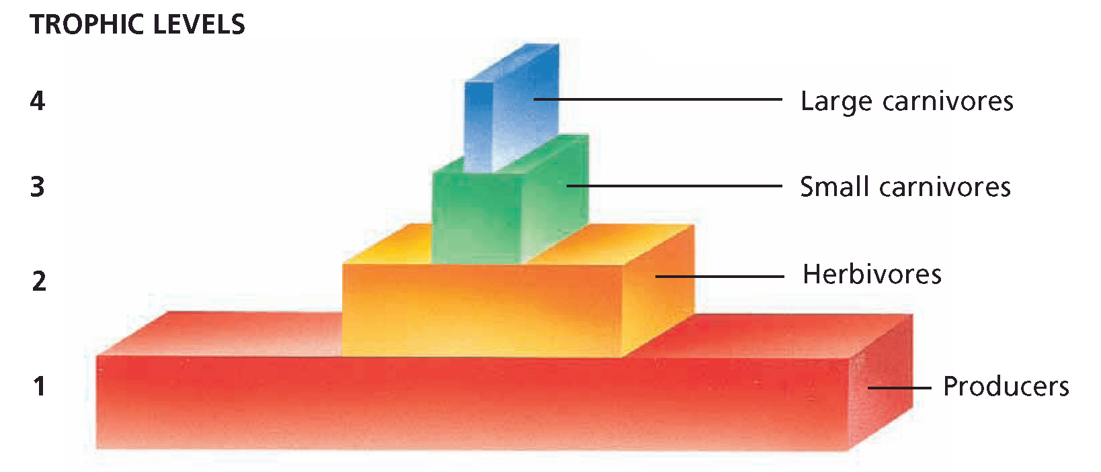

Slide 6
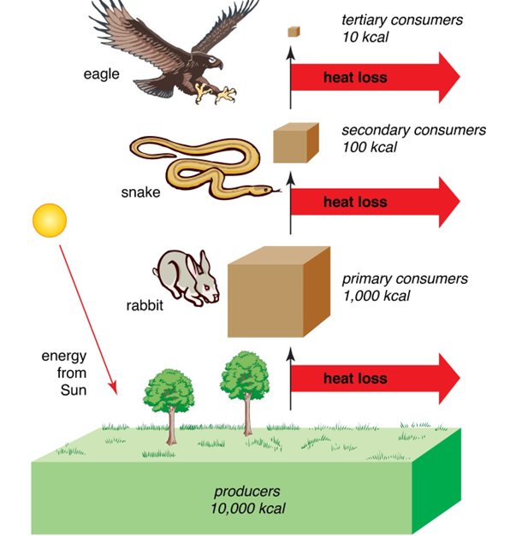

Slide 7
Trophic Level | Description | Examples
1. Producers | Autotrophs that make their own food via photosynthesis or chemosynthesis. | Plants, algae, bacteria, cyanobacteria.
2. Primary Consumers | Herbivores that eat producers. | Deer, rabbits, zooplankton.
3. Secondary Consumers | Carnivores that eat herbivores. | Frogs, small fish, spiders.
4. Tertiary Consumers | Top carnivores that eat secondary consumers. | Hawks, lions, sharks.
5. Quaternary Consumers (rare) | Apex predators with no natural enemies. | Killer whales, polar bears.
6. Decomposers & Detritivores | Break down dead matter, recycling nutrients. | Fungi, bacteria, earthworms.

Slide 8
Energy Variation Across Trophic Levels
The 10% Energy Rule (Lindeman’s Rule)
Only ~10% of energy is transferred from one trophic level to the next.
90% is lost due to:
Metabolism (growth, respiration, movement).
Heat loss (second law of thermodynamics).
Undigested matter (feces, decomposition).

Slide 9
Energy Variation Across Trophic Levels
Example: Energy Pyramid
Producers (Plants) → 10,000 kcal (100%) from 1% sunlight
Primary Consumers (Herbivores) → 1,000 kcal (10%)
Secondary Consumers (Carnivores) → 100 kcal (1%)
Tertiary Consumers (Top Predators) → 10 kcal (0.1%)
Why are food chains usually short?
Energy loss limits the number of trophic levels (typically 3-5).
Apex predators require large territories to sustain energy needs.

Slide 10
Food Chain
A food chain is a linear sequence of organisms through which energy and nutrients are passed as one organism eats another.
It shows how energy flows from one organism to another, starting from producers and moving through various levels up to top consumers.
Example, the simple food chain looks like this:
Grass → Rabbit → Fox → Wolf → Fungi

Slide 11
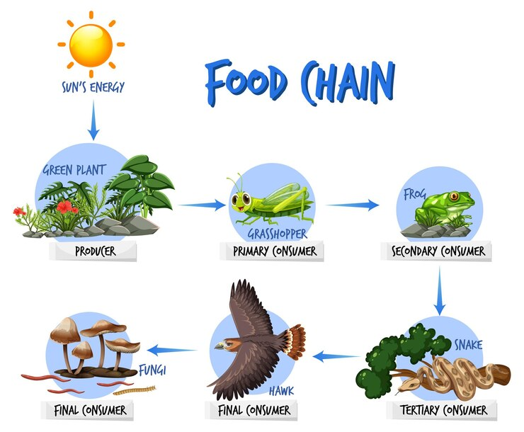

Slide 12
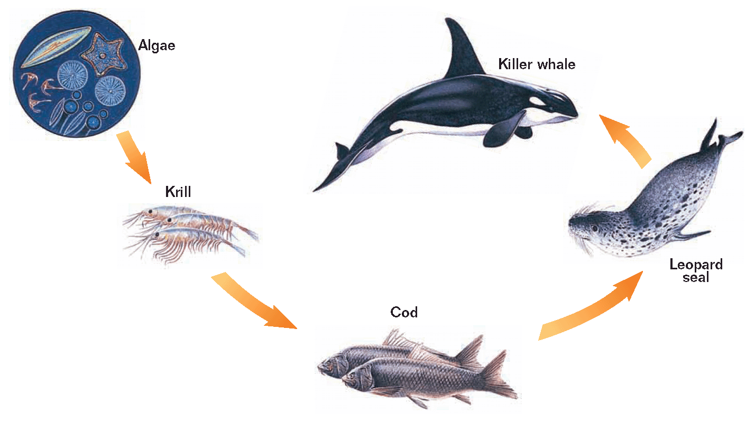
Aquatic Food Chain

Slide 13
Food Web
A food web is a more complex and interconnected system of feeding relationships in an ecosystem, where multiple food chains overlap.
It shows how various organisms are linked through different feeding pathways and how energy and nutrients circulate within an ecosystem.
In a food web, one organism might be part of several food chains.
Grasses may be eaten by grasshopper, cow, frog, rats and rabbits.
Rabbits can be eaten by foxes, dogs, lions, tigers and wolves.
This interconnectedness of multiple food chains makes the food web more resilient, as the loss of one species might have less impact on the overall ecosystem.

Slide 14
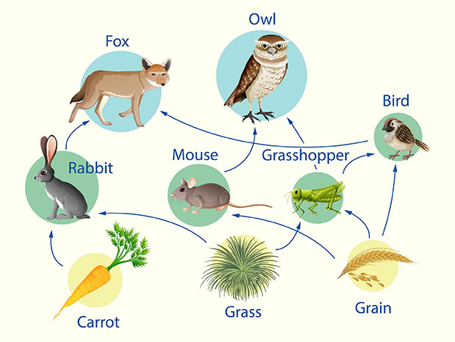

Slide 15
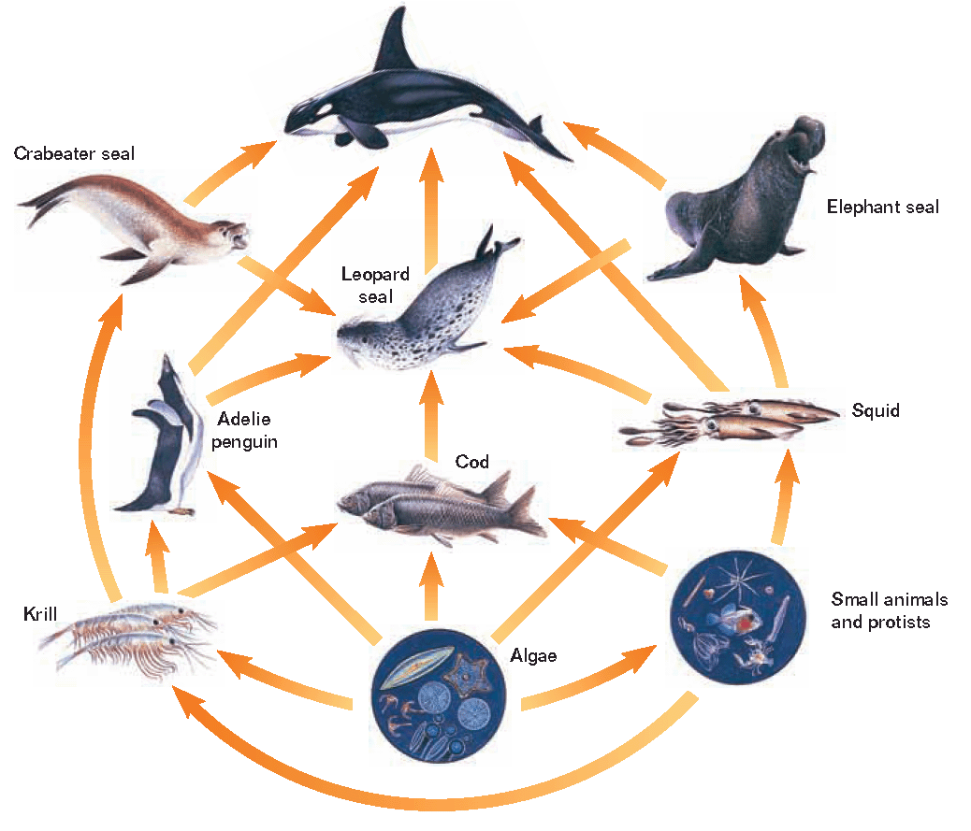
Aquatic Food Web

Slide 16
Feature | Food Chain | Food Web
Definition | A single, linear pathway of energy flow. | A complex network of interconnected food chains.
Complexity | Simple (one direction). | Complex (multiple interactions).
Stability | Fragile (disruption affects entire chain). | Resilient (alternative pathways).
Example | Grass → Grasshopper → Frog → Snake. | Multiple predators and prey linked together.

Slide 17
Ecological Implications
Biomagnification
Toxins (e.g., mercury, lead) accumulate at higher trophic levels.
Example: Plankton → Small fish → Large fish → Humans (increasing toxicity).
Keystone Species
A species whose removal disrupts the entire food web (e.g., Producers of ecosystem).
Human Impact
Overfishing → Collapse of marine food webs.
Deforestation → Loss of producers → Ecosystem collapse.

Slide 18
Conclusion
Energy flows always in one-way (direction)
(Sun → Producers → Consumers).
Only 10% energy transfers between trophic levels.
About 90% energy is lost while transfer as heat.
In an ecosystem, food webs are more complex and stable than food chains.
Human activities can disrupt energy flow, leading to ecological imbalances.

Slide 19
THANK YOU

