Slide 1
Subject: Animal Behaviour (ZOL-509)
Topic: Proximate and Ultimate Causes of Behaviour
By: SHOZAB SEEMAB KHAN
(PhD Zoology Scholar)
ABAIDULLAH COLLEGE PAKPATTAN

Slide 2
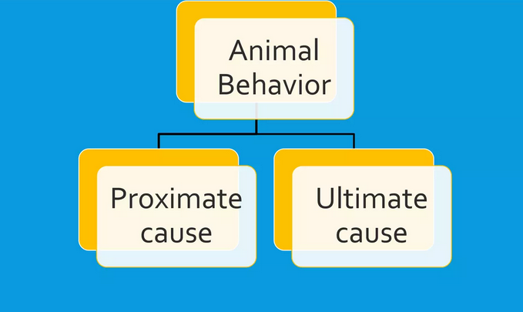
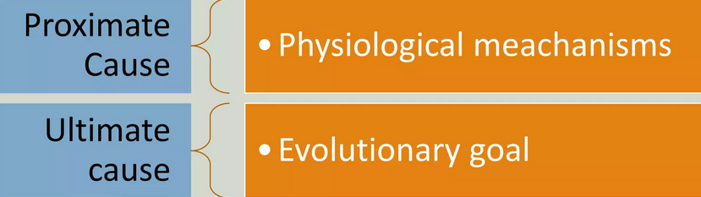
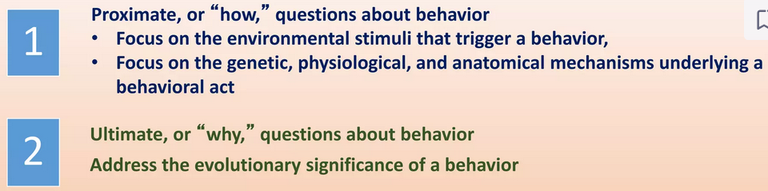

Slide 3
Proximate and Ultimate Causes of Behavior
  Behavioral Ecology:
  Behavioral ecology is the study of the evolutionary basis for animal behavior due to ecological pressures. Behavioral ecology emerged after Nikolas Tinbergen outlined four questions to address when studying animal behaviors.
  Adaptation is defined a heritable, behavioral, morphological, or physiological trait that has evolved through the process of natural selection, and maintains or increases the fitness of an organism under a given set of environmental conditions.
  Adaptive Traits are those that produce more copies of the individual's genes in future generations.

Slide 4
Proximate and Ultimate Causes of Behavior
  Behavioral Ecology:
  The study of behavioral ecology focuses on the ways organisms behaviorally interact with their physical and social environment.
  Maladaptive traits are those that leave fewer. For example, if a bird that can call more loudly attracts more mates, then a loud call is an adaptive trait for that population because a louder bird mates more frequently than less loud birds—thus sending more "loud-calling" genes into future generations.
  Conversely, loud calling birds may attract the attention of predators more often, decreasing their presence in the gene pool.

Slide 5
The study of behavior and Tinbergen's four questions
  Tinbergen's four questions, named after Nikolas Tinbergen, are complementary categories of explanations for animal behaviour.
  These are also commonly referred to as levels of analysis.
  Behaviour must include:
  Both Proximate (Physiological) and Ultimate (Evolutionary) explanations, in particular behaviour
  (1) Adaptive Function
  (2) Phylogenetic History
  (3) Physiological Mechanisms
  (4) Ontogenetic / Developmental History.

Slide 6
The study of behavior and Tinbergen's four questions
  When we ask about the purpose of sight in humans and animals, even elementary-school children can answer that animals have vision to see, help them find food and avoid danger (1. Function / Adaptation).
  Biologists have three additional explanations:
  Sight is caused by a particular series of evolutionary steps
  (2. Phylogeny)
  The mechanics of the eye function
  (3. Mechanism / Causation)
  Process of an individual's development (4. Ontogeny).

Slide 7
Summary of Tinbergen's four questions

Slide 8
Evolutionary (Ultimate) Explanations
  1. Function (Adaptation):
  Darwin's theory of evolution by natural selection is the only scientific explanation for why an animal's behavior is usually well adapted for survival and reproduction in its environment.
  However, claiming that a particular mechanism is well suited to the present environment is different from claiming that this mechanism was selected for in the past due to its history of being adaptive.
  The literature conceptualizes the relationship between function and evolution in two ways.
  On the one hand, function and evolution are often presented as separate and distinct explanations of behaviour.

Slide 9
Evolutionary (ultimate) explanations
  1. Function (Adaptation):
  The common definition of adaptation, a central concept in evolution, is a trait that was functional to the reproductive success of the organism and that is thus now present due to being selected for; that is, function and evolution are inseparable.
  However a trait can have a current function that is adaptive without being an adaptation in this sense, if for instance the environment has changed.
  Imagine an environment in which having a small body suddenly conferred benefit on an organism when previously body size had had no effect on survival.

Slide 10
Evolutionary (ultimate) explanations
  1. Function (Adaptation):
  A small body's function in the environment would then be adaptive, but it wouldn't become an adaptation until enough generations had passed in which small bodies were advantageous to reproduction for small bodies to be selected for.
  Given this, it is best to understand that presently functional traits might not all have been produced by natural selection.
  The term "function" is preferable to "adaptation", because adaptation is often construed as implying that it was selected for due to past function.

Slide 11
Evolutionary (Ultimate) Explanations
  2. Phylogeny (Evolution):
  Evolution captures both the history of an organism via its phylogeny, and the history of natural selection working on function to produce adaptations. There are several reasons why natural selection may fail to achieve optimal design.
  One entails random processes such as mutation and environmental events acting on small populations. Another entails the constraints resulting from early evolutionary development.
  Each organism harbors traits, both anatomical and behavioral, of previous phylogenetic stages, since many traits are retained as populations evolve.

Slide 12
Evolutionary (ultimate) explanations
  2. Phylogeny (Evolution):
  Reconstructing the phylogeny of a species often makes it possible to understand the "uniqueness" of recent characteristics: Earlier phylogenetic stages and (pre-) conditions which persist often also determine the form of more modern characteristics.
  For instance, the vertebrate eye (including the human eye) has a blind spot, whereas octopus eyes do not. In those two lineages, the eye was originally constructed one way or the other.
  Once the vertebrate eye was constructed, there were no intermediate forms that were both adaptive and would have enabled it to evolve without a blind spot.

Slide 13
Proximate Explanations
  3. Mechanism (Causation):
  In examining living organisms, biologists are confronted with diverse levels of complexity (e.g. chemical, physiological, psychological, social). They therefore investigate causal and functional relations within and between these levels.
  A biochemist might examine, for instance, the influence of social and ecological conditions on the release of certain neurotransmitters and hormones, and the effects of such releases on behaviour, e.g. stress during birth has a tocolytic (contraction-suppressing) effect.

Slide 14
Proximate explanations
  3. Mechanism (Causation):
  Some prominent classes of causal mechanisms include:
  The brain: Broca's area, a small section of the human brain, has a critical role in linguistic capability.
  Hormones: Chemicals used to communicate among cells of an individual organism. Testosterone, for instance, stimulates aggressive behaviour in a number of species.
  Pheromones: Chemicals used to communicate among members of the same species. Some species (e.g., dogs and some moths) use pheromones to attract mates.

Slide 15
Proximate explanations
  4. Ontogeny (Development History):
  Ontogeny is the process of development of an individual organism from the zygote through the embryo to the adult form.
  In the latter half of the twentieth century, social scientists debated whether human behaviour was the product of nature (genes) or nurture (environment in the developmental period, including culture).
  Many forms of developmental learning have a critical period, for instance, for imprinting among geese and language acquisition among humans. In such cases, genes determine the timing of the environmental impact.

Slide 16
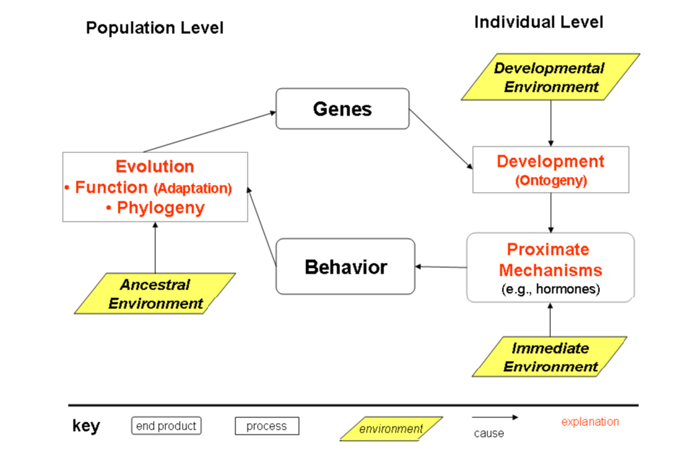

Slide 17
Examples
  Let's look at a couple of examples of explaining a trait or behavior using Tinbergen's four questions:
  Visual perception
  Function: to find food and avoid danger.
  Phylogeny: the vertebrate eye initially developed with a blind spot, but the lack of adaptive intermediate forms prevented the loss of the blind spot.
  Causation: the lens of the eye focuses light on the retina.
  Development: neurons need the stimulation of light to wire the eye to the brain

Slide 18
Examples (Sleep)
  Function: energy restoration, metabolic regulation, thermoregulation, boosting immune system, detoxification, brain maturation, circuit reorganization, synaptic optimization, avoiding danger.
  Phylogeny: sleep exists in invertebrates, lower vertebrates, and higher vertebrates. NREM and REM sleep exist in eutherian, marsupials, and also evolved in birds.
  Mechanisms: mechanisms regulate wakefulness, sleep onset, and sleep. Specific mechanisms involve neurotransmitters, genes, neural structures, and the circadian rhythm.
  Ontogeny: sleep manifests differently in infants, babies, children, adolescents, adults, and older adults. Differences include the stages of sleep, sleep duration, and sex differences.

Slide 19
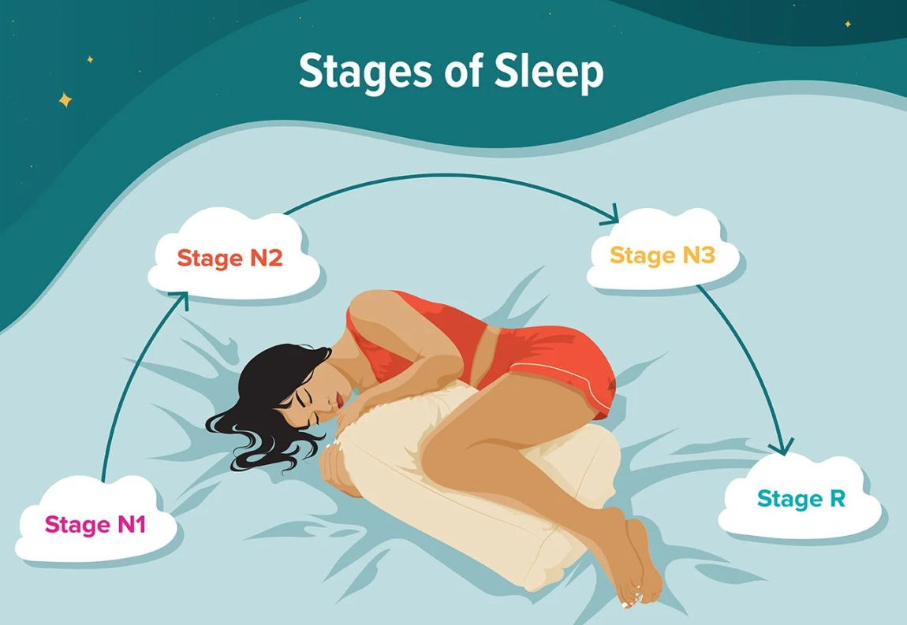

Slide 20
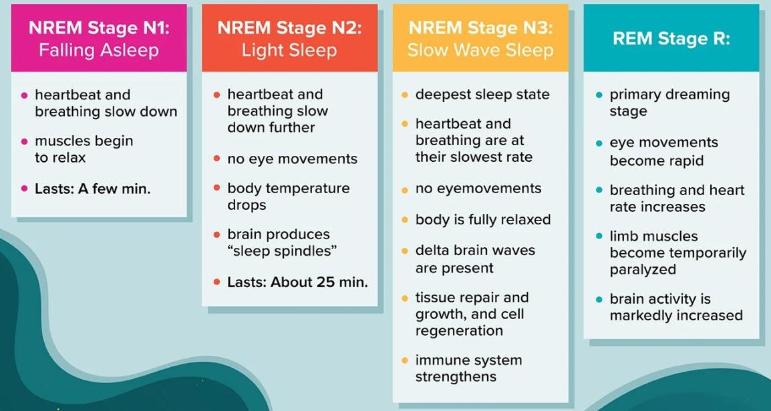

Slide 21
THANK YOU

