Slide 1
Subject: Animal Behaviour (ZOL-509)
Development of behavior and impact of neural and physiological mechanisms;
role of external and internal stimuli and animal responses.
Physiology of behavior in changed environments.
By: Shozab Seemab Khan ABAIDULLAH COLLEGE PAKPATTAN

Slide 2
Understanding Behavioural Development
The development of behaviour in animals is influenced by a combination of genetic predispositions, neural development, physiological processes, and environmental experiences.
These factors work together to shape an organism's responses to its internal and external environments.
Behaviour is an adaptive trait, evolving to optimize survival and reproduction within specific ecological niches.

Slide 3
Neural Mechanisms Influencing Behaviour:
1. Neural Plasticity and Learning:
Neural plasticity, the brain's ability to adapt and reorganize in response to experience, is central to behavioural development.
Critical periods in development allow organisms to learn specific behaviours or responses, often driven by sensory inputs from the environment (e.g., bird song learning in certain species).
Neural pathways, including those involving the hippocampus and prefrontal cortex, facilitate memory formation, spatial navigation, and decision-making.

Slide 4
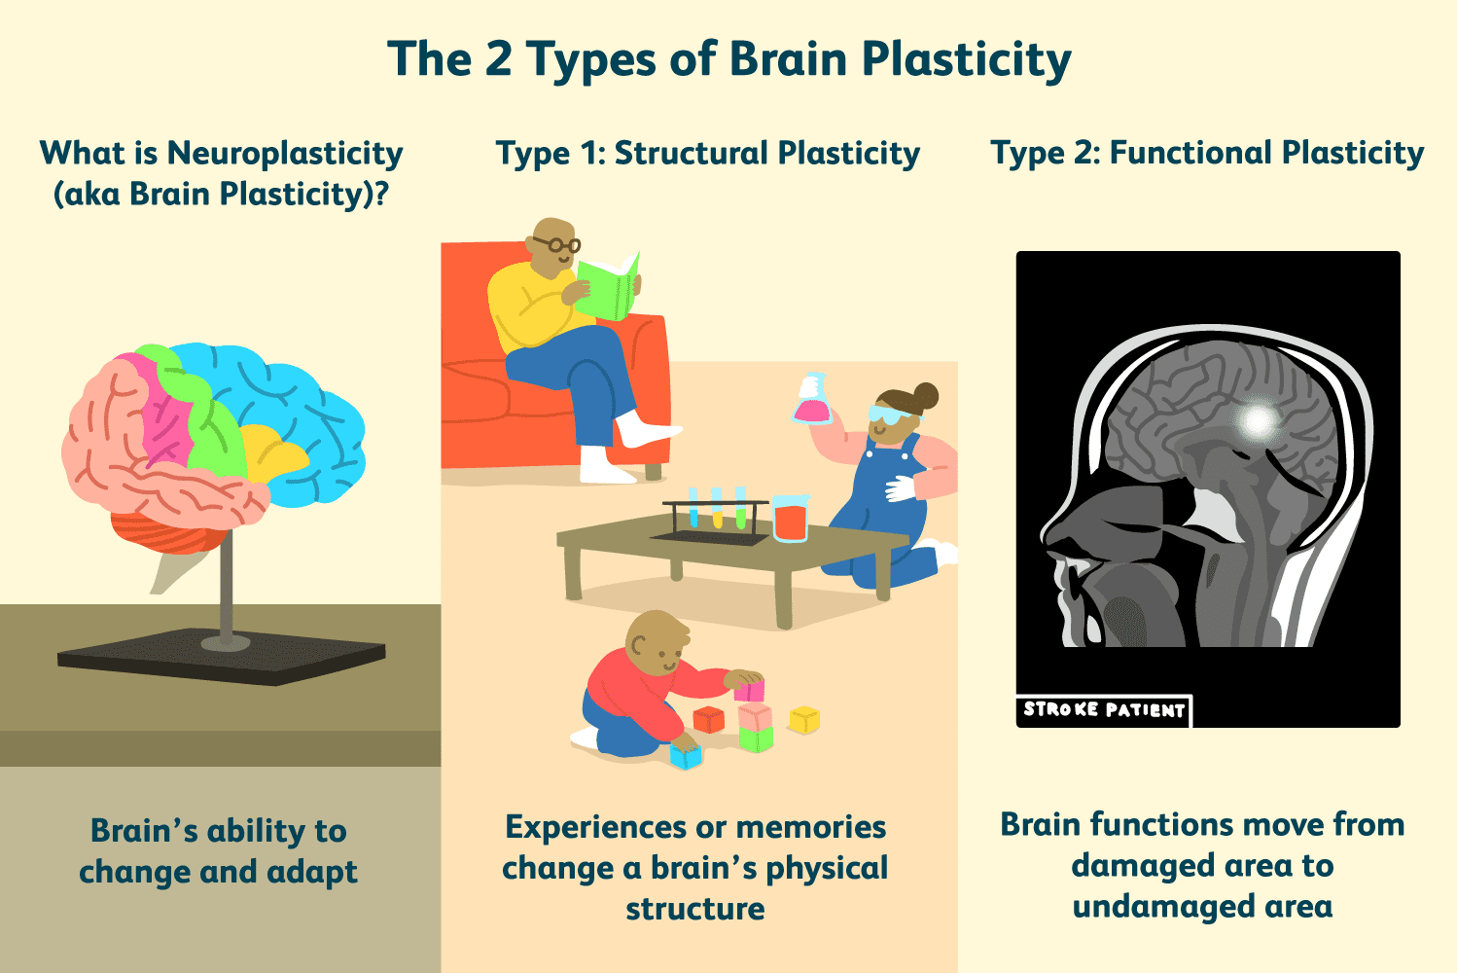

Slide 5
Neural Mechanisms Influencing Behaviour:
2. Neurotransmitters and Modulators:
Chemicals like dopamine, serotonin, and acetylcholine influence mood, arousal, and motor control. For example, dopamine plays a significant role in reward-driven learning.
Neuromodulation adjusts the intensity of neural responses, allowing animals to prioritize certain stimuli or behaviours.

Slide 6
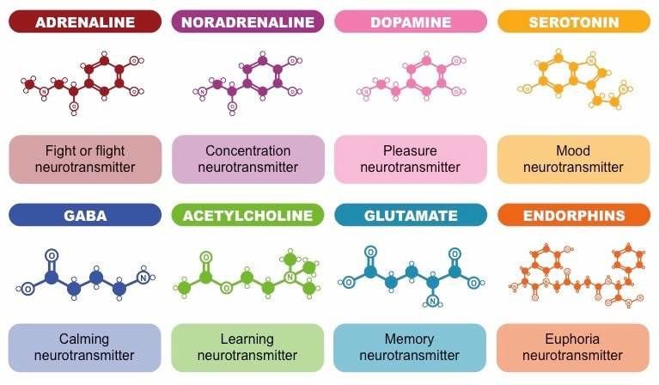

Slide 7
Neural Mechanisms Influencing Behaviour:
3. Reflexes and Instincts:
Reflexive behaviours (e.g., withdrawal reflex from pain) are governed by neural circuits called reflex arcs, which bypass the brain for speed.
Instinctive behaviours, like mating rituals or predator avoidance, are encoded in neural circuitry shaped by evolutionary pressures.

Slide 8
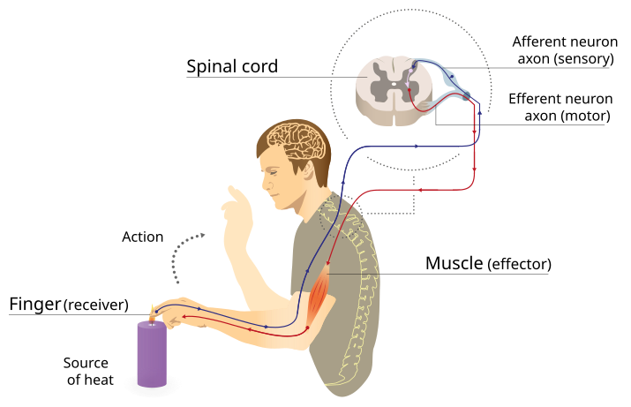

Slide 9
Physiological Mechanisms Underlying Behaviour
1. Hormonal Regulation:
Hormones like cortisol (stress), adrenaline (fight-or-flight), and testosterone (aggression and mating) act as mediators of physiological states that influence behaviour.
Seasonal changes in hormone levels, such as melatonin, regulate circadian and seasonal behaviours like reproduction and migration.

Slide 10
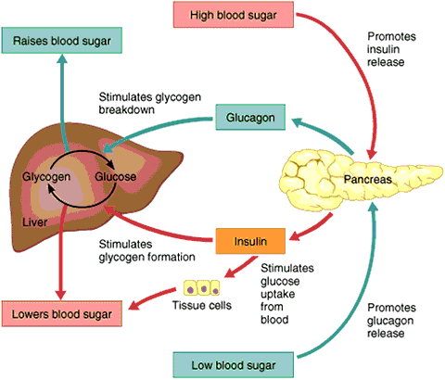

Slide 11
Physiological Mechanisms Underlying Behaviour
2. Homeostatic Processes:
Behavioural responses, such as seeking food or water, are driven by internal signals that maintain homeostasis.
For example, hunger is mediated by the hormone ghrelin, while thirst is regulated by antidiuretic hormone (ADH) and neural signals from the hypothalamus.

Slide 12
Physiological Mechanisms Underlying Behaviour
3. Autonomic Nervous System (ANS):
The ANS, comprising the sympathetic (arousal) and parasympathetic (calming) branches, coordinates rapid physiological adjustments to external challenges.
During stress, the sympathetic system increases heart rate, redirects blood flow to muscles, and prepares the body for immediate action.

Slide 13
Role of External Stimuli in Behaviour
1. Environmental Cues:
Changes in temperature, light, sound, and chemical signals in the environment guide animal behaviour. For example, photoperiod changes regulate migration in birds.
2. Social Interactions:
Social structures and group dynamics (e.g., hierarchies in primates) influence behaviours like aggression, cooperation, and mating.
3. Threats and Predators:
Presence of predators triggers fight, flight, or freeze responses, mediated by rapid sensory processing and activation of the ANS.

Slide 14
Role of Internal Stimuli in Behaviour
1. Physiological Needs:
Hunger, thirst, and fatigue act as drivers of exploratory or consumptive behaviours to restore balance.
For example, low glucose levels prompt feeding behaviour.
2. Emotional States:
Fear, stress, or excitement, often mediated by the limbic system, drive immediate behavioural responses.
3. Reproductive Hormones:
Internal hormonal cycles influence courtship, reproductive cycle, mating, and parental care behaviours.

Slide 15
Animal Responses to Changed Environments
Environmental changes—whether acute or chronic—pose significant challenges to animals. These changes may be natural (e.g., seasonal shifts) or anthropogenic (e.g., habitat destruction, climate change).
1. Short-Term Responses:
Acute Stress Responses: Animals respond to immediate challenges, such as predator attacks or sudden temperature changes, by activating the hypothalamic-pituitary-adrenal (HPA) axis and releasing stress hormones like cortisol.
Behavioural Adjustments: Animals may hide, flee, or modify foraging patterns to cope with rapid changes.

Slide 16
Animal Responses to Changed Environments
2. Long-Term Adaptations:
Behavioural Plasticity:
Animals learn and adjust their behaviours to cope with prolonged environmental changes, such as urbanization. For instance, certain bird species adapt to noisy urban areas by modifying the frequency of their songs.
Physiological Adaptations:
Long-term exposure to environmental stressors can lead to changes in metabolism, immune function, and reproductive strategies.
Evolutionary Changes:
Over generations, populations may develop heritable traits better suited to new environments, such as resistance to pollutants or changes in body size to cope with temperature variations.

Slide 17
Physiology of Behaviour in Changed Environments
The physiological mechanisms underlying behaviour are particularly evident when animals encounter new or stressful environments. These mechanisms involve:
1. Thermoregulation:
Animals in extreme climates, such as deserts or polar regions, exhibit behaviours like burrowing or hibernation, driven by physiological needs to conserve energy and maintain body temperature.
2. Hydration and Osmoregulation:
Aquatic animals in changing salinity environments regulate their internal osmotic balance through specialized organs, such as gills or kidneys.

Slide 18
Physiology of Behaviour in Changed Environments
3. Metabolic Adjustments:
In low-resource environments, animals may lower their metabolic rates (e.g., torpor in small mammals) to conserve energy.
4. Stress and Chronic Environmental Change:
Prolonged exposure to environmental stressors (e.g., deforestation or climate change) can lead to chronic activation of stress pathways, affecting reproduction, immunity, and longevity.
For example, coral bleaching is a physiological response to thermal stress, where symbiotic algae are expelled.

Slide 19
Conclusion
The development of behaviour and its underlying neural and physiological mechanisms are deeply interconnected.
Internal and external stimuli drive responses essential for survival and adaptation. However, environmental changes pose unique challenges, requiring both immediate and long-term physiological and behavioural adjustments.
Understanding these processes is crucial for conserving biodiversity and managing ecosystems in the face of global change.

Slide 20
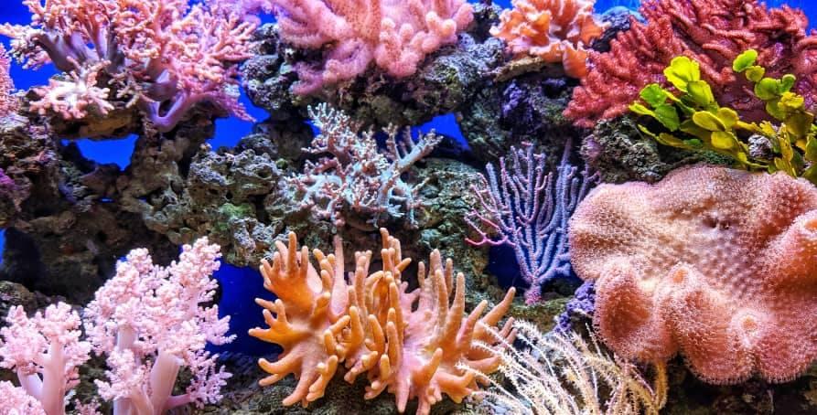

Slide 21
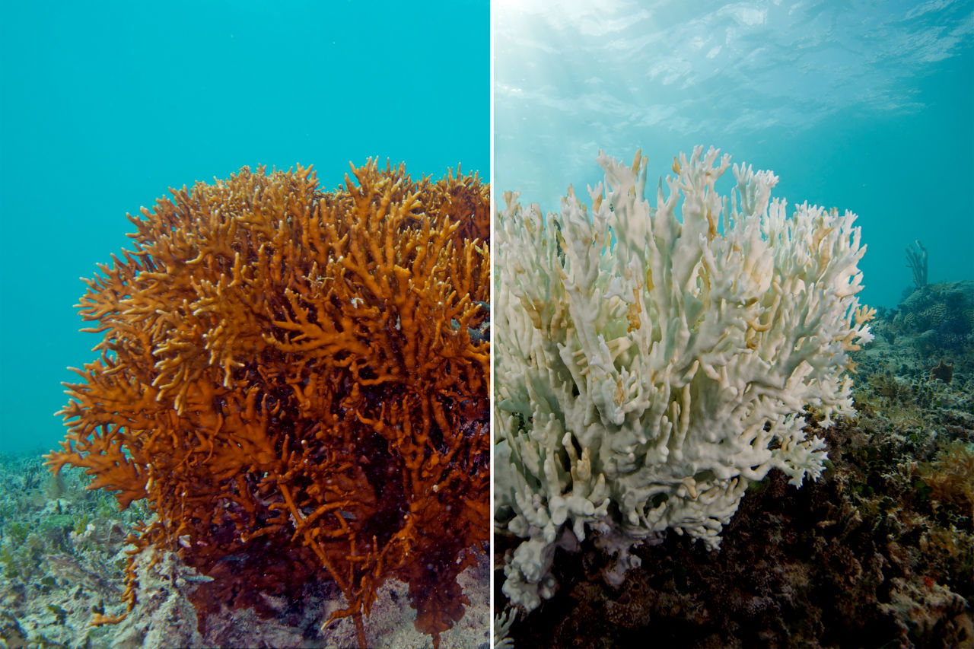

Slide 22
THANK YOU

