Slide 1
Subject:
Animal Behaviour
(ZOL-509)
Hormones and animal behaviour
By: Shozab Seemab Khan
Abaidullah college Pakpattan

Slide 2
INTRODUCTION
Hormones are chemical messenger secreted by a specific endocrine gland of the body, transported by body fluids (blood), producing specific effect on a target tissue or organ in the body.
Many intricate neuroendocrine feedback systems control the production & release of hormone in the organism.
A number of hormones like MSH, ACTH, Vasopressin, Oxytocin etc. also affect the behaviour of the organism.

Slide 3
INTRODUCTION
A new branch called “Behavioural Endocrinology” or
“Psycho-Endocrinology” has developed, which deals with the hormones and behaviour in animals.
Generally hormones show various effects or behavioural changes in animals which affects social life of animal and adaptation.
Natural selection is better seen when comes to behaviour as the more powerful an animal is can survive worthly.

Slide 4
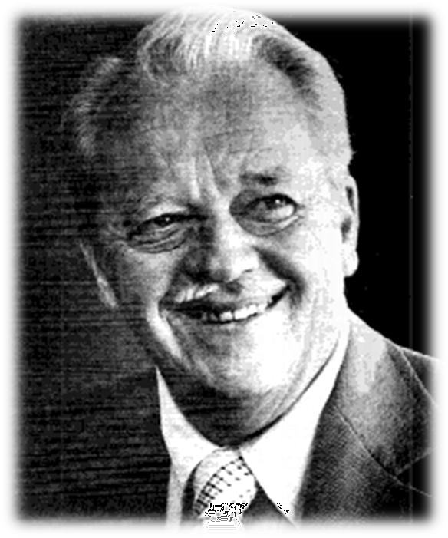
HISTORY
In order to understand the role of hormones in our behaviour scientists have conducted fundamental research using laboratory animals. Frank Beach is generally considered to be the founding father of the study of the effects of hormones on behaviour.
FRANK BEACH

Slide 5
HISTORY
An area of scientific investigation that is known today as behavioural endocrinology or psycho endocrinology.
His first book, Hormones and Behavior (1948), summarizes all that was known at the time and organized the field for all subsequent investigators.
FRANK BEACH

Slide 6
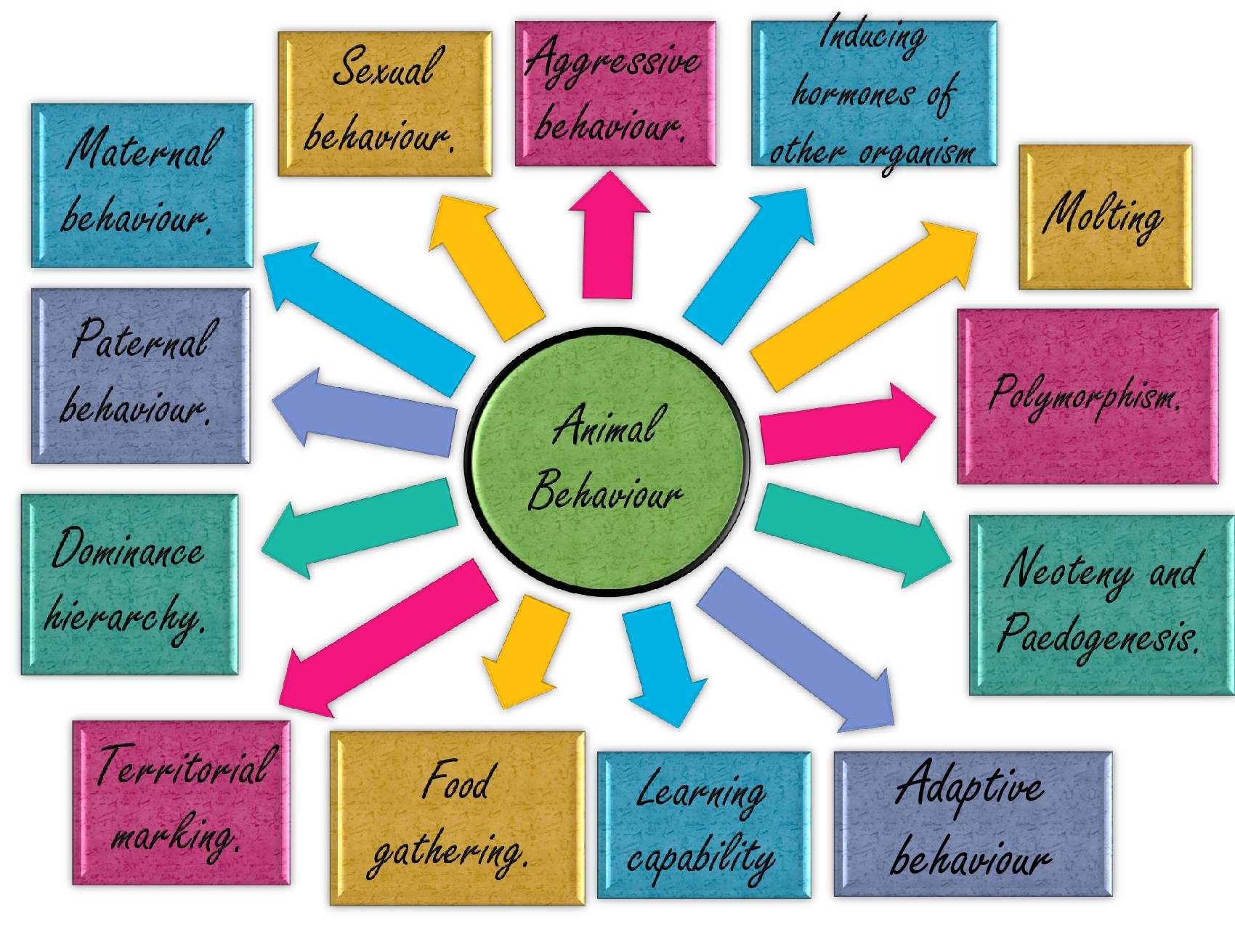

Slide 7
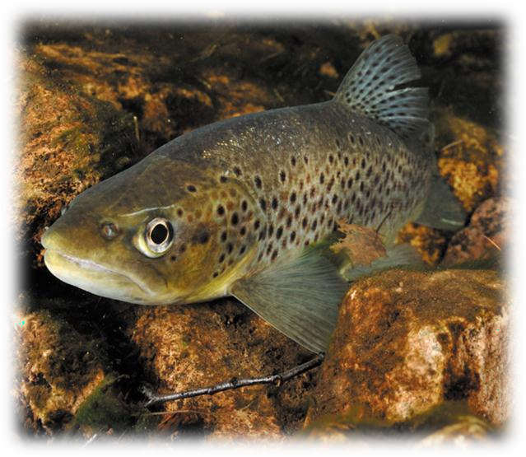
AGGRESSIVE BEHAVIOR
It has been that in several animals male androgens are responsible for aggressiveness.
Sevenster & Wilz (1961) performed an experiment on stickleback fishes. It had been observed male stickleback due to aggressiveness kill other males by biting when injected high level of testosterone.
Stickleback Fish

Slide 8
AGGRESSIVE BEHAVIOR
Wilz (1970) confirmed that even when the dead males are removed from that particular site aggressive male starts killing female ones.
The main hormone responsible for the aggressive behaviour of an animal is high level of testosterone and low level of serotonin.
This is the reason males are more aggressive than females.
Stickleback Fish

Slide 9
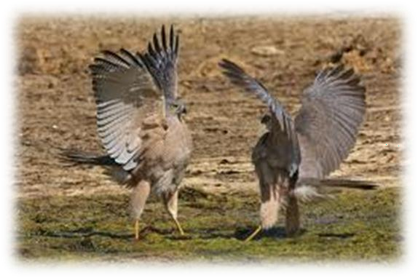
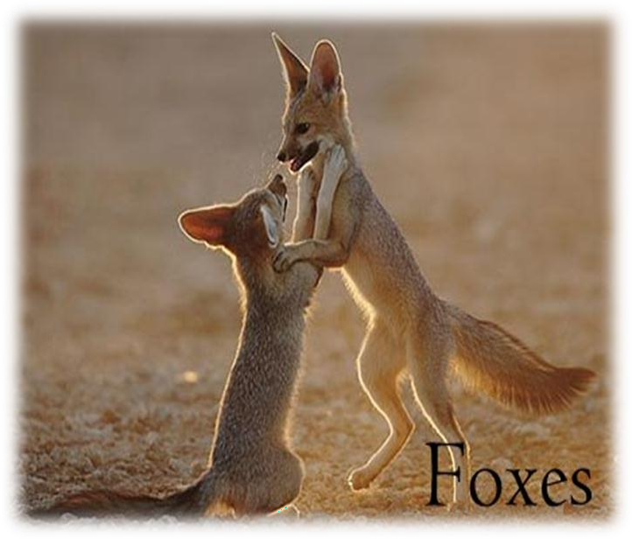
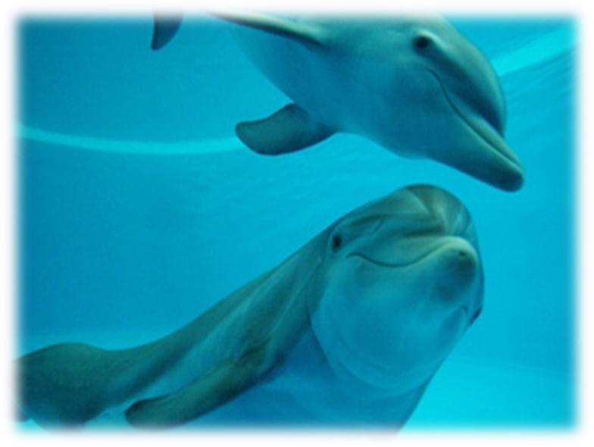
AGGRESSIVE BEHAVIOR

Slide 10
SEXUAL BEHAVIOR
Internal hormonal cycles profoundly influence courtship, mating, and parental care behaviors in many species by regulating physiological and behavioral readiness for reproduction.
These cycles are tightly linked to the endocrine system, which coordinates the release of hormones like estrogen, testosterone, oxytocin, and prolactin.

Slide 11
SEXUAL BEHAVIOR (Courtship Behaviors)
Females: In species with estrous cycles, the peak of fertility (ovulation) is marked by heightened estrogen levels, which often trigger behaviors that signal reproductive readiness. For example: Vocalizations, displays, or scent marking (as in many mammals).
Changes in receptivity and mate preference (e.g., choosing dominant or genetically compatible males).
Males: Testosterone: Levels rise in response to female pheromones or visual cues, enhancing courtship behaviors like singing (in birds), scent marking, or displays of strength.

Slide 12
Sexual Behaviour In Female And The Release Of Hormone During Estrus Cycle in Rats

Slide 13
SEXUAL BEHAVIOR (Mating Behaviors)
Hormonal synchronize mating behaviors with optimal fertility periods.
Females: High estrogen during ovulation increases receptivity to mating. In many animals, females only mate during this fertile window, termed estrus.
Hormones like luteinizing hormone (LH) trigger ovulation, ensuring mating occurs when conception is likely.
Males: Testosterone drives libido and mating behaviors, including dominance displays and aggression toward rival males.
Hormonal responses to environmental stimuli (e.g., female pheromones) prepare males for copulation.

Slide 14
MATERNAL BEHAVIOUR
Maternal behaviour is elicited in the absence of certain hormones.
Lisk (1971) has observed that estrogen and progesterone work in synergy in stimulating maternal nest building.
During parturition, oxytocin level is high which affects the behaviour of mother.
Experimentally injections of oxytocin influence maternal behaviour.
Various hormone like progesterone, oxytocin, relaxin, estrogen, prolactin etc. complete maternity of female.

Slide 15
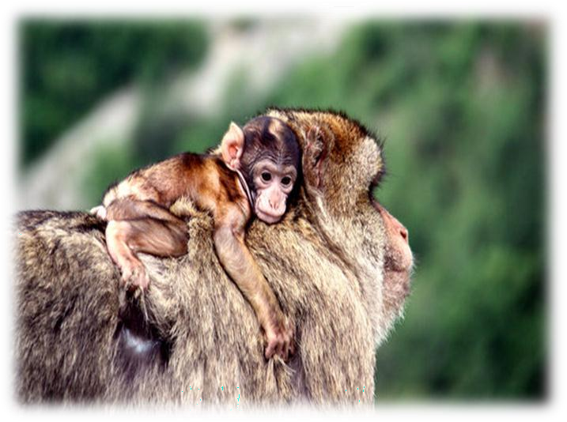
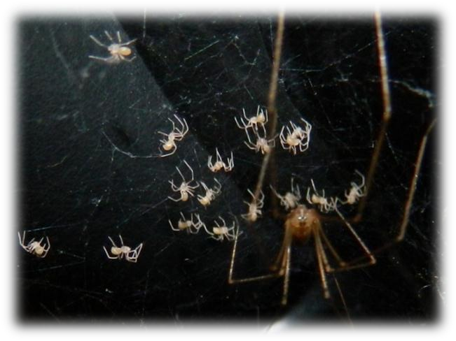
Maternal care in Monkey
Spider building Web

Slide 16
PATERNAL BEHAVIOUR
In only 6% mammalian species, including humans, the father also plays a significant role in caring for his young.
An increase in levels of oxytocin, glucocorticoids, estrogen and prolactin occur in the paternal brain. These hormonal changes occur through the father's interaction with the mother and his offspring.
Oxytocin levels are positively correlated with the amount of affection the father displays towards the child.

Slide 17
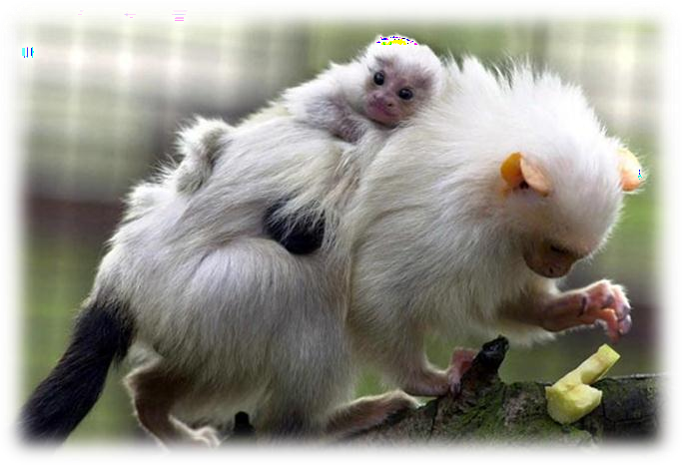
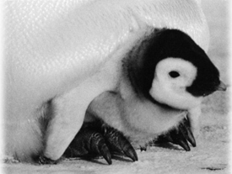
Silvery hair Marmoset with baby marmoset
Baby penguin under the care of father

Slide 18
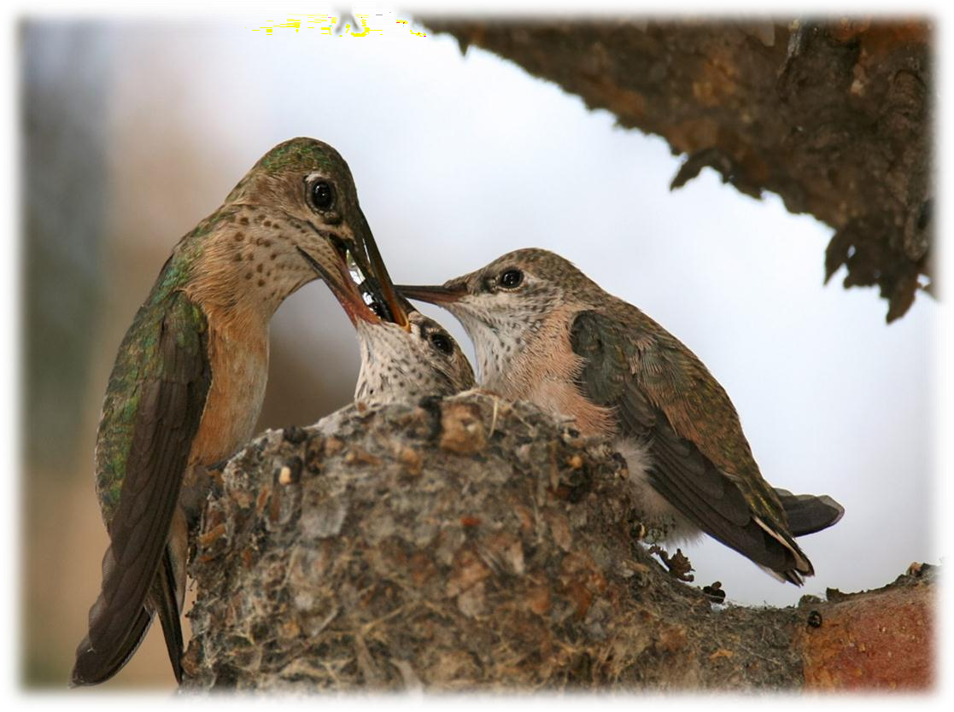
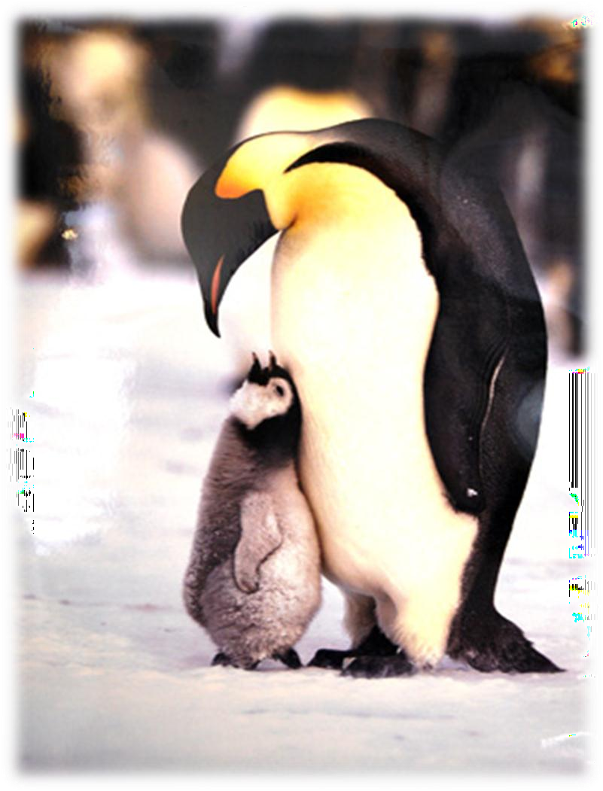
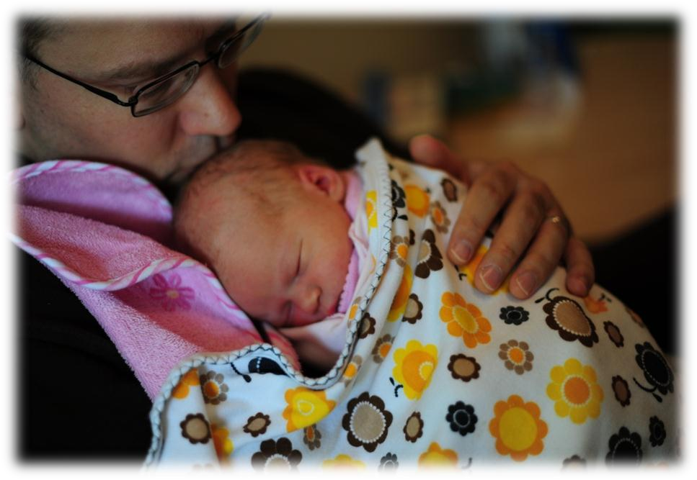

Slide 19
DOMINANCE HIERARCHY
Dominance hierarchies are best known in social mammals, such as baboons and wolves, and in birds, notably chickens.
A dominant animal is one whose sexual, feeding, aggressive and other behavior patterns subsequently occur with relatively little influence of the other group members.
Subordinate animals are opposite; their behavior can be relatively easily influenced or inhibited by other group members.
It have been observed that male hormones mainly testosterone and androgen are responsible for this behaviour.

Slide 20
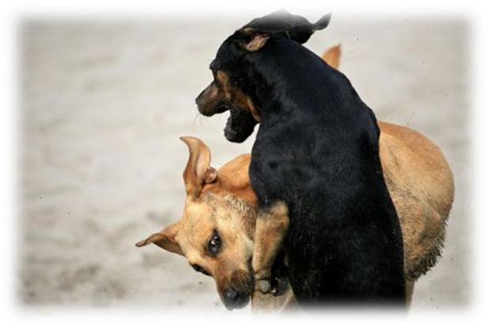
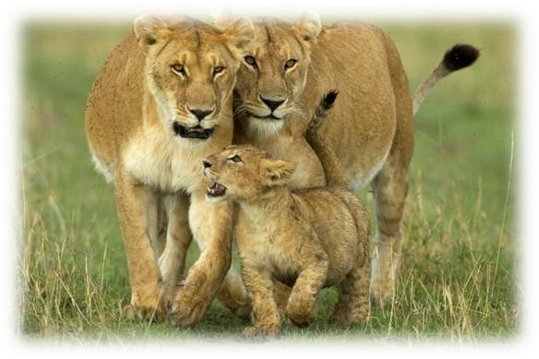
Fighting for dominance in Dogs
Best example can be seen in Lions for dominance hierarchy

Slide 21
TERRITORIAL MARKING
In ethology, the term territory refers to any sociographical area that an animal of a particular species consistently defends against others.
The ultimate function of animals inhabiting and defending a territory is to increase the individual fitness or inclusive fitness of the animals expressing the behaviour. Fitness in this biological sense relates to the ability of an animal to survive and raise young.
Most commonly, this is accomplished by depositing strong- smelling substances contained in the urine, faeces, or, from specialized scent glands located on various areas of the body.
This type of marking includes pheromones in insects and discharge of typical scent through urine or sweat glands.

Slide 22

Territory marking
in Dog by Urine

Slide 23
FOOD GATHERING
It is an animal behavior is the storage of food in locations hidden from the sight of both conspecifics (animals of the same or closely related species) and members of other species.
The term hoarding is most typically used for rodents, whereas caching is more commonly used in reference to birds, but the behaviors in both animal groups are quite similar.
It has been observed that low level of testosterone and estrogen make the organism to hoard food.

Slide 24
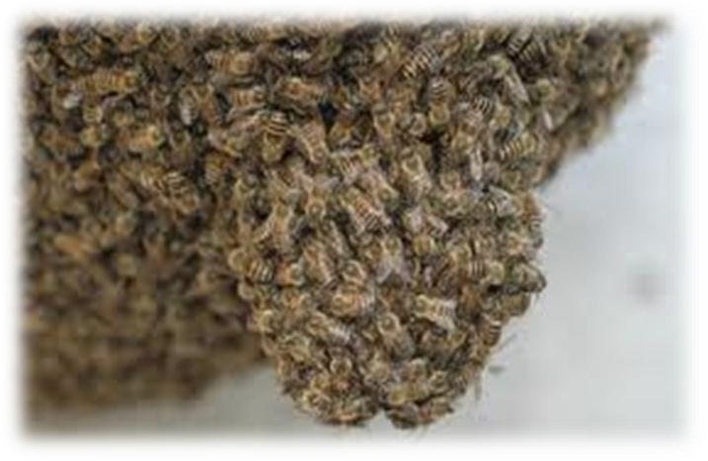
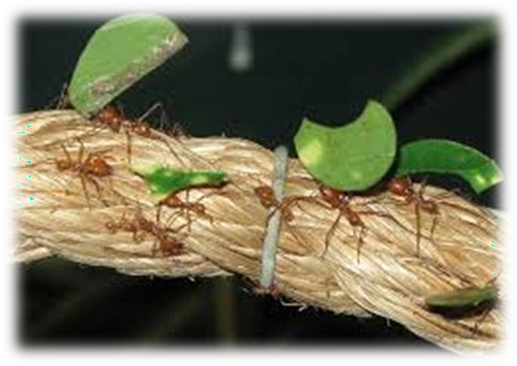
Honey bees and Ants gathering food

Slide 25
LEARNING CAPABILITY
Learning capability in animals refers to their ability to acquire, process, retain, and apply knowledge or skills through experience, observation, or instruction.
This capacity is a fundamental aspect of animal behavior and varies widely among species.
Animals rely on learning to adapt to their environment, find food, avoid predators, and interact with others.
ACTH and MSH are responsible for learning capability of an animal.

Slide 26
PAEDOGENESIS
Neoteny also called juvenilization, is one of the three ways by which paedomorphism can arise.
Paedomorphism or paedomorphosis is the retention by adults of traits previously seen only in juveniles, and is a subject studied in the field of developmental biology.
In Neoteny, the physiological (or somatic) development of an organism (typically an animal) is slowed or delayed.
In contrast, in paedogenesis, sexual development occurs faster. Both processes result in paedomorphism. Ultimately this process results in the retention, in the adults of a species, of juvenile physical characteristics well into maturity and paedogenesis, the reproduction in a neotenized state.
Growth hormones are responsible for this process.

Slide 27
POLYMORPHISM
The occurrence of different forms, stages, or types in individual organisms or in organisms of the same species, independent of sexual variations is called polymorphism.
In bees, the presence of queen, worker, and drone is an example of polymorphism. The occurrence of several forms or colors in one species of insect is also an example of polymorphism.
Differences between the sexes and between breeds of domesticated animals are not considered examples of polymorphism.
The hormones responsible for polymorphism are mainly Juvenile hormone and MSH.

Slide 28
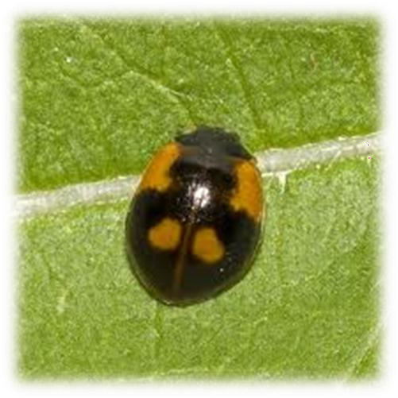
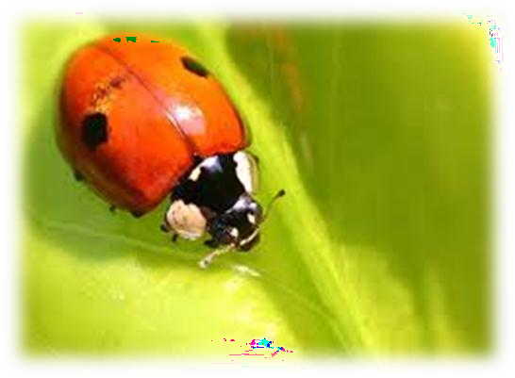
Polymorphism in bugs

Slide 29
MOLTING
Molting or ecdysis, is the manner in which an animal routinely casts off a part of its body (often, but not always, an outer layer or covering), either at specific times of the year, or at specific points in its life cycle.
Brain releases ecdysiotropin which stimulates release of molting hormone (Ecdysone) from Prothoracic Gland in arthropods.
Growth hormones are responsible for molting in vertebrates.

Slide 30
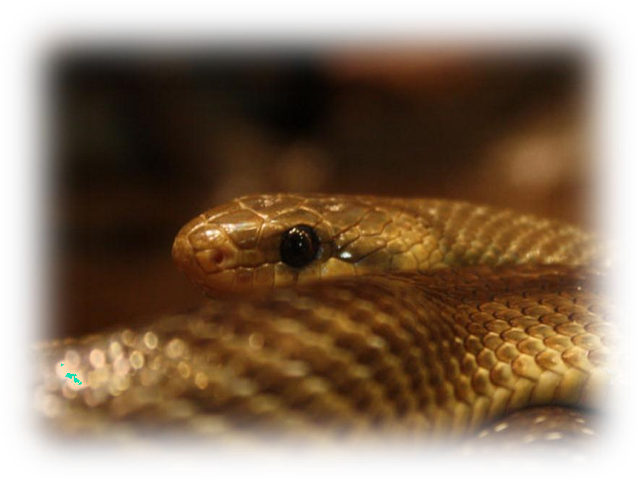
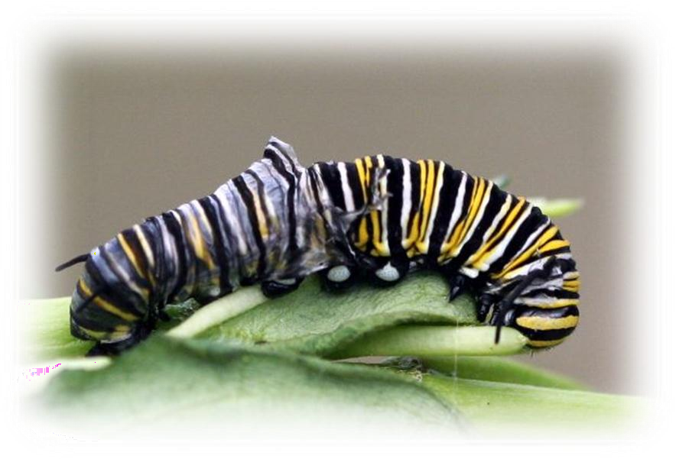
Molting in pupa
Molting in snakes

Slide 31
INDUCED HORMONES OF OTHERS
When male frog croaks, it has been seen the female starts attracting towards them. This is due inducing of gonadotropin releasing hormone (GnRH) and there after gonadotropins in female are released.
Also in other animals like parrot, whenever male starts singing the female swings with the tune and is attracted to male due to induced action in it for the release of gonadotropin.

Slide 32
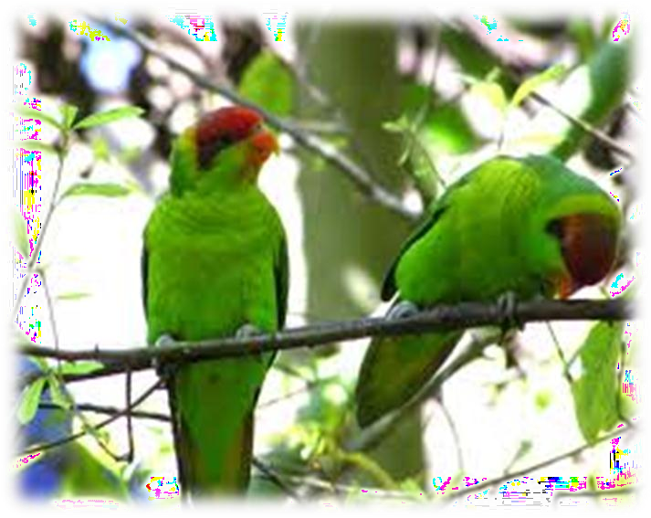
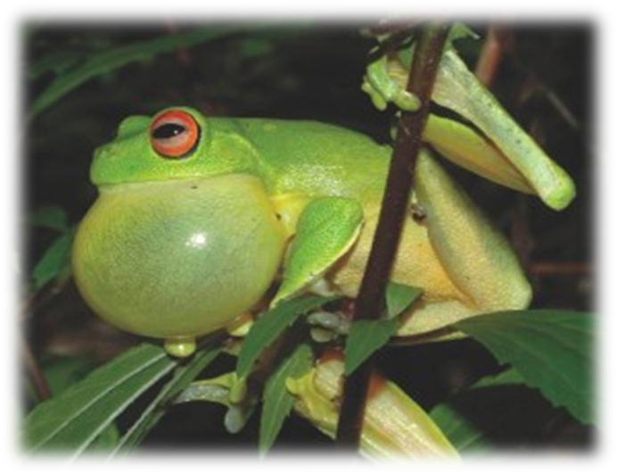
Parrot Singing
Frog Croaking

Slide 33
ADAPTIVE BEHAVIOUR
Adaptive behavior is a type of behavior that is used to adjust to another type of behavior or situation. This is often characterized by a kind of behavior that allows an individual to change an unconstructive or disruptive behavior to something more constructive.
These behaviors are most often social or personal behaviors.
Vasopressin and ACTH are responsible for adaptive behaviour.

Slide 34
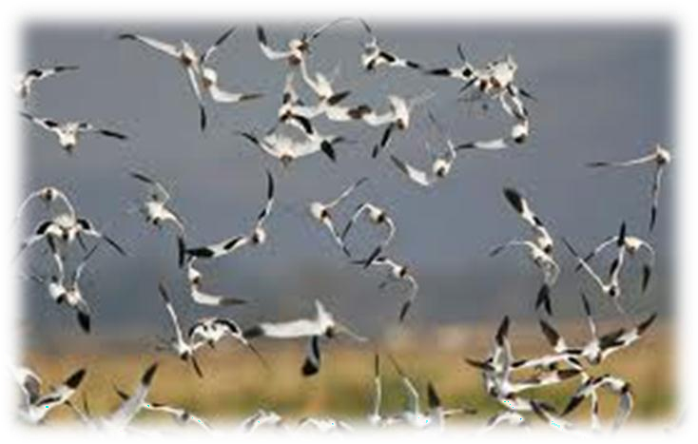
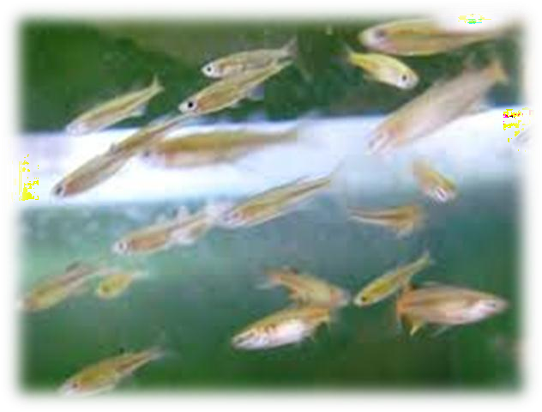
All animals adjust according to environment for survival

Slide 35
ANIMAL BEHAVIOUR | HORMONES RESPONSIBLE
1. Aggressive behaviour | High level of testosterone and low level of serotonin
2. Sexual behaviour | Estrogens and androgens
3. Maternal behaviour | Estrogen, progesterone & oxytocin
4. Paternal behaviour | Glucocorticoids increase in paternal brain
5. Dominance hierarchy | Testosterone and androgen
6. Territorial marking | Pheromones
7. Food gathering | Low level of testosterone and estrogen

Slide 36
ANIMAL BEHAVIOUR | HORMONES RESPONSIBLE
8. Learning capability | ACTH and MSH
9. Neoteny & Paedogenesis | Growth hormones
10. Polymorphism | Juvenile hormone and MSH
11. Molting | Growth hormones
12. Inducing hormone of other | Inducing of gonadotropins in female
13. Adaptive behaviour | Vasopressin and ACTH

Slide 37
THANK YOU

