Slide 1
Subject: Animal Behaviour (ZOL-509)
Innate behavior and innate releasing mechanisms;
built in programmed performance by offspring to that of parents.
Innate behavior of three spined stickle back fish
By: Shozab Seemab Khan ABAIDULLAH COLLEGE PAKPATTAN

Slide 2
FIXED ACTION PATTERN
It is a series of sequences of acts that occur behaviorally in animals.
It is automatic and involuntary.
The sequence is unchangeable and will be carried out to completion once started, regardless of changes in the original stimulus.
It is triggered by a key stimulus.
Fixed action patterns, or similar behaviour sequences, are produced by a neural network known as the innate releasing mechanism in response to an external sensory stimulus known as a sign stimulus or releaser.

Slide 3
CASE STUDY OF FIXED ACTION PATTERN
Herring gull caring for its chicks
The parent gull has a red spot on its beak. when it taps its beak on the ground, the chick will peck at the spot several times.
This pecking triggers a response in the parent: it throws up food for the chick

Slide 4
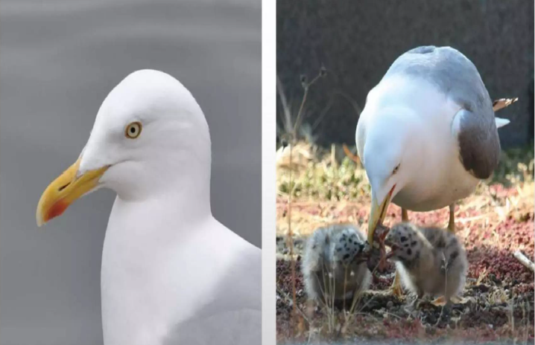

Slide 5
CASE STUDY OF FIXED ACTION PATTERN
The tapping behaviour is innate, or genetically pre-programmed.
Herring gull chicks will peck at the red dots of their parents’ beaks without any prior training.
In fact, a baby herring gull can be tricked by a yellow stick adorned with a red dot—it will peck at the stick just as eagerly as it would at a parent's beak.
What is sign stimulus here?

Slide 6
CASE STUDY OF FIXED ACTION PATTERN
Ground Nesting water birds, like Graylag geese.
If a female Graylag goose's egg rolls out of her nest, she will instinctively use her bill to push the egg back into the nest in a series of very stereotyped, predictable, movements.
The sight of an egg outside the nest is the stimulus that triggers the retrieval behavior.

Slide 7
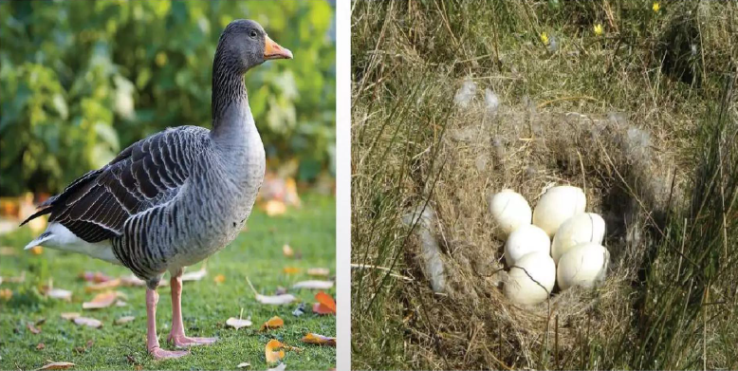

Slide 8
CASE STUDY OF FIXED ACTION PATTERN
However, this fixed action pattern can also occur under circumstances where it is not useful.
If the egg that rolls out of the nest is picked up and taken away, the goose will keep moving her head as though pushing an imaginary egg.
The goose will try to push any egg-shaped object, such as a golf ball, if it is placed near the nest.
ADVANTAGES: Geese with this heritable behavior will tend to have more offspring that survive to hatch than geese without the behavior.

Slide 9
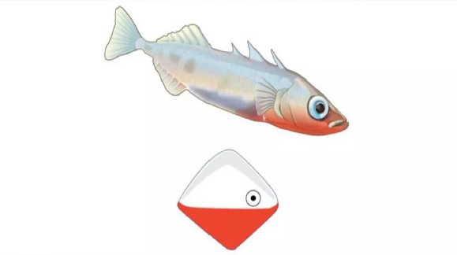
MALE STICKLE BACK FISH

Slide 10
CASE STUDY OF FIXED ACTION PATTERN
Three Spine Stickleback, a small freshwater fish.
During the breeding season, male sticklebacks develop a red belly and display innate aggressive behavior towards other males.
When a male stickleback spots another nearby male, he will launch into a fixed action pattern involving aggressive displays designed to scare off the stranger.
The specific stimulus that triggers this fixed action pattern is the red belly coloration pattern characteristic of males during breeding season.

Slide 11
CASE STUDY OF FIXED ACTION PATTERN
How do we know that this is the trigger?
In the lab, researchers exposed male fish to objects that were painted red on their lower halves but didn't otherwise look like a fish,
The male sticklebacks responded aggressively to the objects just as if they were male sticklebacks.
In contrast, no response was triggered by lifelike male stickleback models that were painted white.

Slide 12
FEATURES OF INNATE BEHAVIOUR
Innate behaviour is genetically programmed.
Individuals inherit a suite of behaviors just as they inherit physical traits such as body color and wing venation.
1. Heritable: Encoded in DNA and passed from generation to generation.
2. Intrinsic: Present in animals raised in isolation from others.
3. Stereotypic: Performed in the same way each time by every individual.

Slide 13
FEATURES OF INNATE BEHAVIOUR
4. Inflexible: Not modified by development or experience (but some exceptions)
5. Consummate: Fully developed or expressed at first performance
Example:
Sucking reflexes by new offspring, reflex action, rolling of egg back to nest by graylag geese, spot pecking behaviour in herring gulls etc.

Slide 14
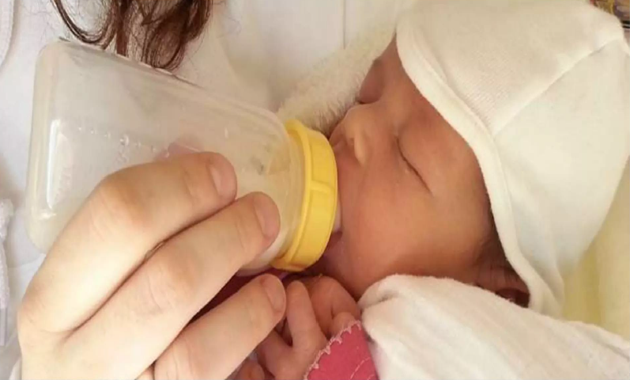

Slide 15
INTRINSIC
Digging behaviour in the deer mouse.
Researchers raised mice in the lab with no exposure to sand or opportunity to burrow.
Then, they provided them with sand, a cue for burrow construction.
Given sand, each naive mouse dug exactly the type of burrow made by its species in the wild.

Slide 16
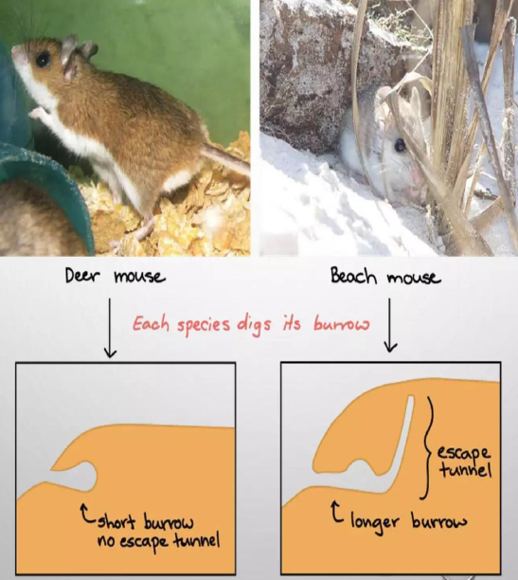

Slide 17
SIGN STIMULUS
“Sign Stimulus’, or ‘releaser’, is used to denote a simple feature of complex stimulus that can initiate a FAP.
For example, the red belly of a male stickleback starts an aggressive, attack behaviour in other male sticklebacks.
Konrad Lorenz (1972) was the first biologist to identify sign stimuli which he called key stimuli because they function as keys to release and unlock the fixed action pattern of the animal. He proposed the Innate Release Mechanism in response to sign stimuli.

Slide 18
SIGN STIMULUS TYPES
Visual Releasers: Morphological characters that are displayed to elicit response, as display of feathers or dancing in birds. Example: Three-spined stickleback fish
Auditory Releasers: Stimuli include sounds or calls that trigger specific innate behaviors in animals. Example: Cricket Mating Calls and Birdsong in Courtship
Chemical Releasers: Pheromones are different types of volatile chemicals released in the atmosphere that act as releasers on the individuals of the same species or other species.

Slide 19
Examples of Chemical Releasers:
Ant Trail Pheromones: When foraging ants find food, they release trail pheromones to mark the path back to the nest. This chemical trail acts as a releaser, guiding other ants to the food source.
Sex Pheromones in Moths: Female moths release species-specific sex pheromones to attract males from a distance. These pheromones act as chemical releasers that trigger courtship and mating behaviors in males.
Alarm Pheromones in Bees: When a honeybee stings an intruder, it releases an alarm pheromone that attracts other bees to the area and triggers aggressive and defensive behaviors.
Nursing Behavior in Mammals: In some mammals, like rabbits, the smell of pheromones produced by the mother’s mammary glands acts as a chemical releaser that triggers the nursing behavior in her offspring.

Slide 20
Innate Releasing Mechanism (IRM)
The ethological explanation proposes that aggression can be the result of an evolved automatic biological response in the brain.
It is believed that animals have a built-in neural structure (a network of neurons) which, when exposed to specific stimuli (signs or releasers) such as facial expressions, will cause the release of an automatic behavioural response (a fixed action pattern).
This inbuilt biological structure or process is called the innate releasing mechanism (IRM).

Slide 21
Example of Innate Releasing Mechanism (IRM)
For example, when a dog sees a cat running away from them, they have an instinctive response to chase the cat.
When the cat is still, the innate releasing mechanism is not activated; however, it is the cat running that activates the innate releasing mechanism.
Consequently, the dog chasing the cat is an example of a fixed action pattern which is activated by an innate releasing mechanism. The dog’s desire to chase is automatic and instinctual in response to a cat or any other small animal running away.

Slide 22
MOTIVATIONAL (ACTION SPECIFIC ENERGY)
Lorenz gave this concept which says:
Each response has its own energy supply, which builds up until the organism encounters the appropriate stimulus (releasers) that triggers the response and thus depletes the energy supply.
After the response and in the absence of the releaser, the action-specific energy begins to build up again.
He explained things with the help of hydraulic model.
Because it views motivation as a liquid whose accumulation and discharge influences behaviour.

Slide 23
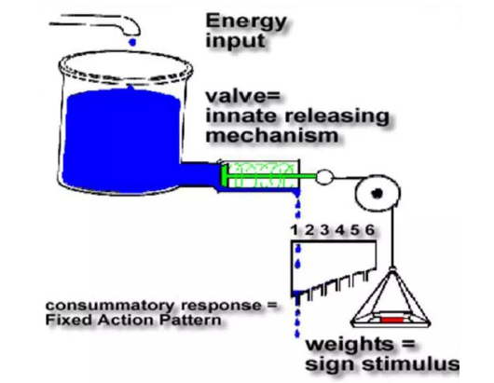

Slide 24
VACUUM ACTIVITY
Lorenz coined the term vacuum activity to describe behaviour which apparently occurs in the absence of any external stimulus.
In the hydraulic model, action specific energy can accumulate to such a high level that the pressure of water in the reservoir is capable of pushing open the restraining valve.
This causes water to flow into the trough, and out through holes in the floor that represent fixed action patterns.

Slide 25
BEHAVIOURAL QUIESCENCE
An important feature of the model s that after the animal has engaged in a particular behaviour (FAP) there is a period of time when they less likely to respond even if the same stimulus is presented again - behavioural quiescence.
This occurs because the reservoir has been drained of action specific energy.
Never the less the model has now fallen out of favour because it proved impossible to locate structures in the brain where action specific energy accumulated within a reservoir.

Slide 26
THANK YOU

