Slide 1
Subject: Animal Behaviour (ZOL-509)
Concept of Animal Cognition
By: Shozab Seemab Khan ABAIDULLAH COLLEGE PAKPATTAN

Slide 2
Animal Cognition
Cognition is the ability of an animal’s nervous system to perceive, store, process, and use information gathered by sensory receptors.
The logic of fighting is decidedly suspect in most cases. One animal is going to win and the other will lose.
The loser has gained nothing, and may well have sustained disastrous injury.
Relatively minor injury is likely to have fatal consequences by preventing capture of prey or allowing a predator to catch an individual with, for example, a slight muscle strain.
In case of severe injury, even death of looser may occur.

Slide 3
Animal Cognition
Even the winner may be damaged, and must balance the risk of injury with the potential gain in food, territory or mating success.
Threat displays allow animals to assess the likelihood of winning or losing before actually taking the risk of battle.
Agonistic behaviour is social behaviour consisting of threats and combat that settles disputes between individuals in a population.
Rituals involving agonistic behaviour often resolve confrontations between competitors. Agonistic behaviour can directly affect an individual's evolutionary fitness.

Slide 4
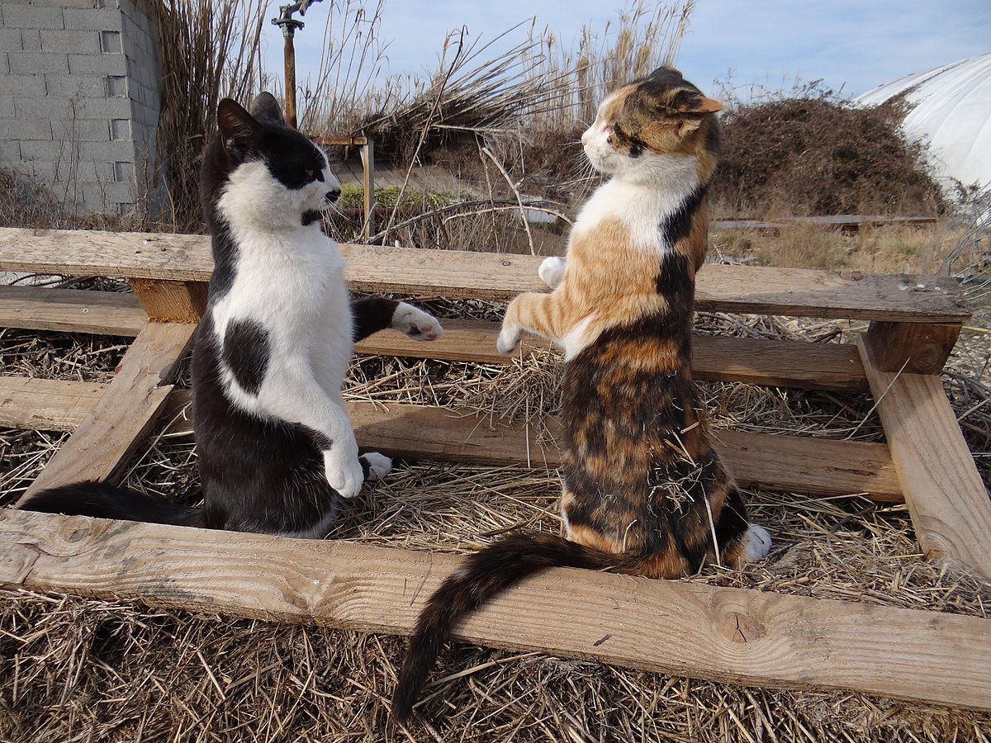

Slide 5
Animal Cognition
The victor often gains first or exclusive access to mates, food, etc.
Threat displays usually involve displaying either strength is usually enough for the smaller or weaker to realize that further conflict would be pointless.
Problem solving can be learned by observing the behavior of other animals.

Slide 6
Concept of Animal Cognition: Key to Understanding and Developing Multiple Behavioural Choices
Animal cognition refers to the study of how animals perceive, think, and make decisions, focusing on their ability to process information from their environment to guide behaviour.
It encompasses an understanding of sensory inputs, learning processes, memory, problem-solving, communication, and social interaction.
The concept of animal cognition provides a framework to analyze how animals generate diverse behavioural responses based on past experiences, current conditions, and potential future outcomes.

Slide 7
The Link Between Animal Cognition and Behavioural Choices
Animal cognition plays a pivotal role in enabling animals to adapt their behaviour to different environmental and social contexts. It allows for the assessment of complex situations and the development of behavioural strategies, increasing survival and reproductive success. For example:
A predator uses its cognitive skills to choose between stalking a specific prey or abandoning the hunt based on energy costs and success likelihood.
A foraging animal evaluates food availability, safety, and competition to decide where and when to feed.

Slide 8
Key Cognitive Processes Underpinning Behavioural Choices
1. Perception and Sensory Processing:
Animals rely on their sensory systems to detect relevant cues in their surroundings.
Perception shapes how they identify threats, locate resources, and recognize social partners.
For instance, Bats and dolphins use echolocation to navigate and hunt in the dark.
Bees interpret patterns of light and color to find flowers rich in nectar.
Notes:
Echolocation is the use of sound waves and their echoes to locate objects or navigate an environment, commonly used by animals like bats and dolphins.

Slide 9
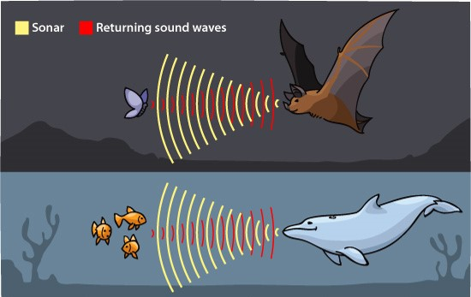

Slide 10
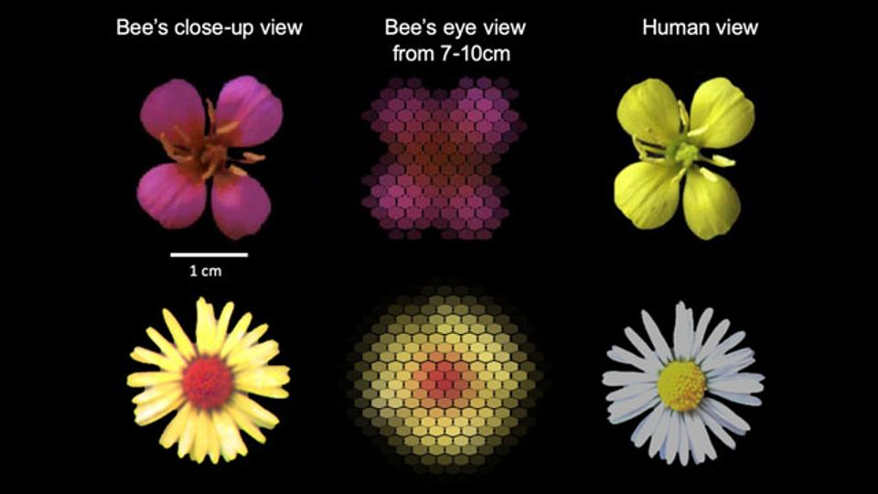

Slide 11
Key Cognitive Processes Underpinning Behavioural Choices
2. Learning and Memory:
Learning allows animals to modify behaviour based on experience, while memory helps retain this information over time. Animals can use this knowledge to anticipate outcomes and make informed decisions.
Rats learn to navigate mazes by associating specific turns with food rewards.
Migratory birds remember geographical landmarks and celestial cues to travel thousands of miles.
Notes:
Celestial cues are natural markers like the position of the sun, moon, stars, or Milky Way, used by animals and humans for navigation.

Slide 13


Slide 14
Key Cognitive Processes Underpinning Behavioural Choices
3. Problem-Solving and Innovation:
Animals often encounter novel challenges, such as accessing food or escaping predators. Cognitive flexibility enables them to innovate solutions, which in turn expands their behavioural collection.
Crows use sticks to extract insects from tree bark.
Dolphins have been observed using sponges to protect their snouts while foraging on the seafloor.

Slide 15
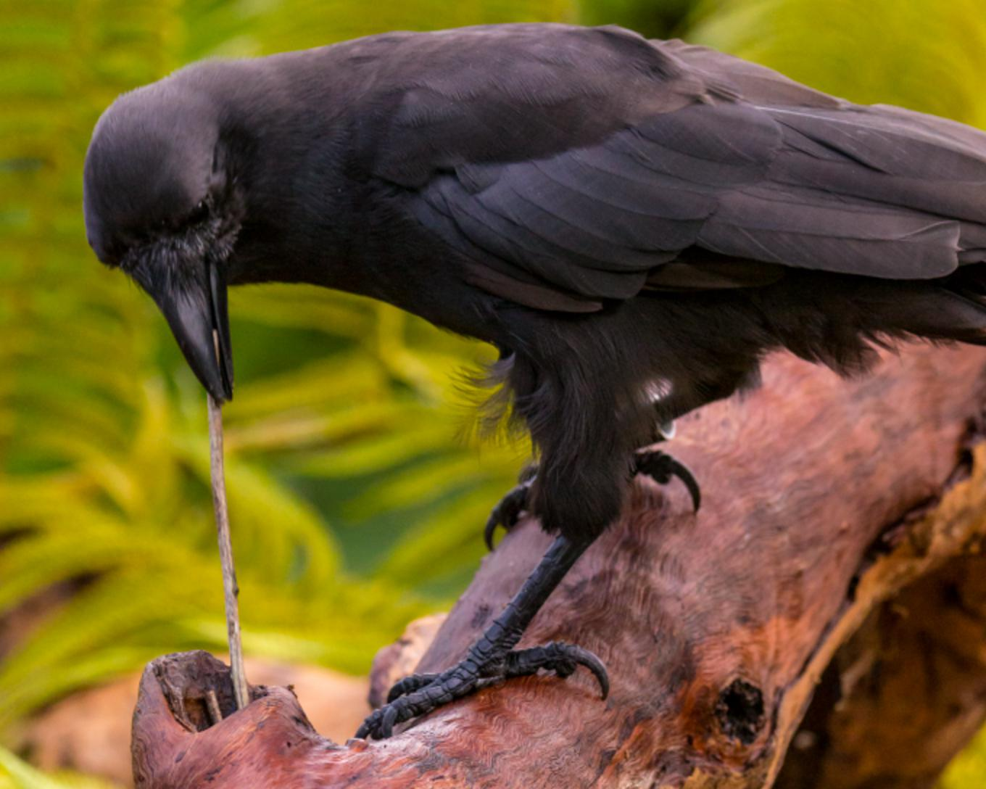

Slide 16


Slide 17
Key Cognitive Processes Underpinning Behavioural Choices
4. Decision-Making:
Animals evaluate multiple options by weighing costs and benefits, risks, and rewards. Decision-making is a dynamic process influenced by both immediate needs and long-term goals.
A squirrel decides whether to eat a nut immediately or bury it for future use, considering environmental conditions and competition.
Ant colonies use collective decision-making to determine optimal nesting sites.

Slide 19
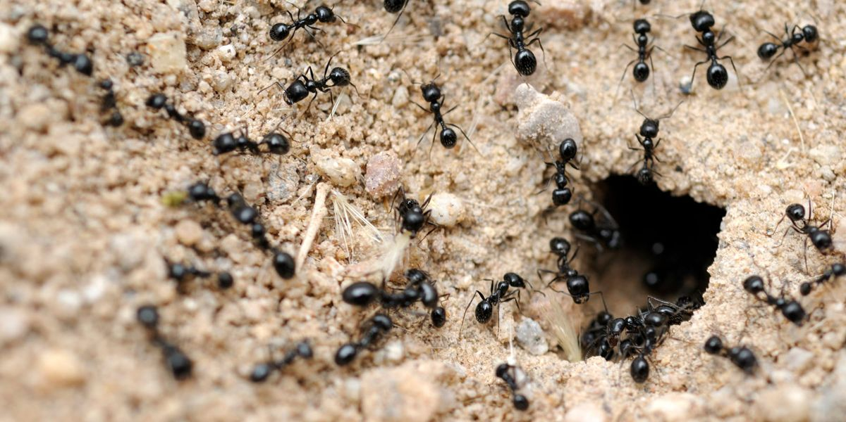

Slide 20
Key Cognitive Processes Underpinning Behavioural Choices
5. Social Cognition and Cooperation:
Many species exhibit advanced social behaviours that require an understanding of group dynamics and relationships. Social cognition involves recognizing individuals, interpreting intentions, and coordinating actions.
Primates engage in grooming to maintain alliances and reduce stress.
Orcas work together to create waves that knock seals off ice floes.

Slide 21
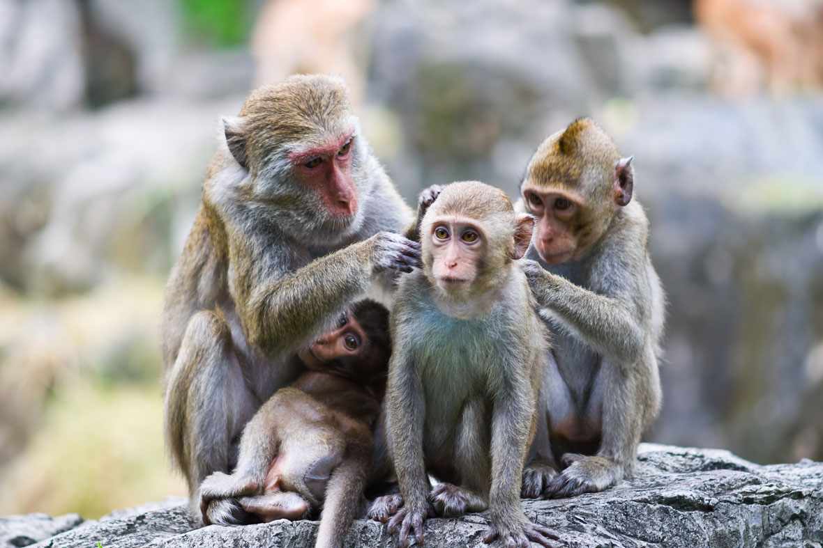

Slide 23
Key Cognitive Processes Underpinning Behavioural Choices
6. Communication and Information Sharing:
Through vocal, visual, and chemical signals, animals convey information about danger, resources, or reproductive status. This communication often influences group behaviour and decision-making.
Honeybees perform waggle dances to communicate the location of food sources.
Vervet monkeys use distinct alarm calls to warn about specific predators.

Slide 24
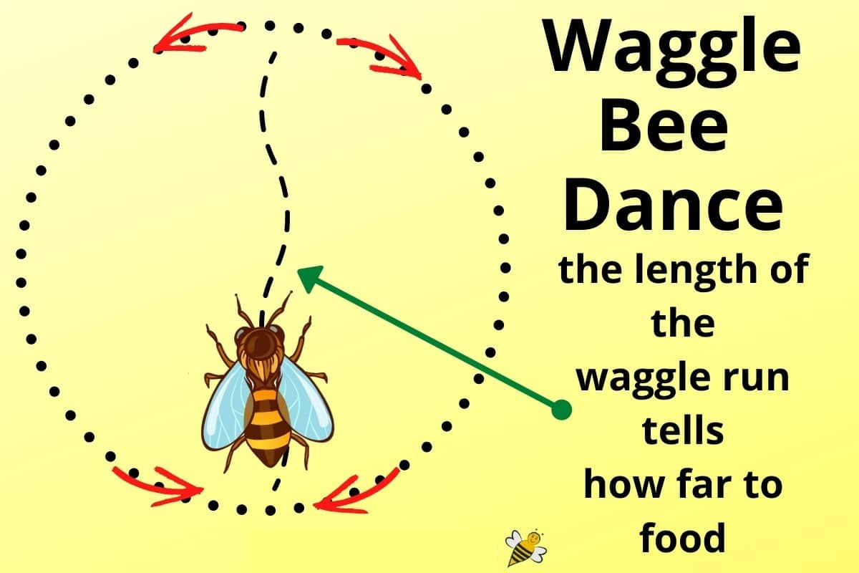

Slide 26
Behavioural Choices and Adaptability
Cognitive abilities allow animals to exhibit multiple behavioural choices in response to their environment. These choices enhance adaptability and improve fitness by enabling animals to:
Exploit a wider range of habitats and resources.
Develop strategies to avoid predation.
Optimize reproductive opportunities.
Maintain social cohesion and manage conflicts.

Slide 27
Applications and Importance
1. Conservation: Understanding animal cognition helps in designing effective conservation strategies, such as creating enriched habitats that promote natural behaviours or mitigating human-wildlife conflict.
2. Ethology and Welfare: Recognizing animals' cognitive abilities informs ethical treatment and improves their welfare in captivity by catering to their mental and emotional needs.
3. Robotics and AI: Insights from animal cognition inspire the development of artificial intelligence and robotics, particularly in areas like problem-solving, adaptability, and decision-making.

Slide 28
Conclusion:
The concept of animal cognition serves as a cornerstone for understanding how animals navigate the complexities of their environments and develop a range of behavioural choices.
By studying the cognitive processes that drive behaviour, we gain deeper insights into the diversity of life on Earth, the evolutionary roots of intelligence, and the interconnectedness of all species.
This knowledge not only enhances scientific understanding but also promotes a more harmonious coexistence between humans and animals.

Slide 29
THANK YOU

