Slide 1
Subject: Animal Behaviour (ZOL-509)
Ecological and Genetic Factors in Maintaining Animal Behaviour
By: Shozab Seemab Khan ABAIDULLAH COLLEGE PAKPATTAN

Slide 2
Ecological and Genetic Factors in Maintaining Animal Behaviour
Animal behaviour is shaped and maintained by the intricate interplay of ecological and genetic factors.
While ecology focuses on the interactions between animals and their environments, genetics provides the biological framework that influences behaviour through inherited traits.
Together, these elements dictate how animals adapt, survive, and reproduce, ensuring the continuity of behaviour across generations and its alignment with ecological demands.

Slide 3
Ecological Factors Maintaining Animal Behaviour
Ecological factors refer to the environmental conditions and interactions that influence an animal’s behaviour.
These include abiotic (non-living) factors like climate and resources, and biotic (living) factors such as predators, prey, and competitors.
These factor are classified into following categories.
A. Environmental Conditions
B. Resource Availability
C. Predation and Threats
D. Social Interactions

Slide 4
A. Environmental Conditions
1. Habitat Selection: Animals adapt their behaviour to specific habitats to optimize survival and reproduction.
Example: Arctic foxes exhibit seasonal changes in foraging behaviour depending on snow cover and prey availability.
2. Climate and Weather: Temperature, rainfall, and seasonal changes shape behaviours like migration, hibernation, and breeding.
Example: Monarch butterflies migrate thousands of miles to avoid harsh winters and find suitable breeding grounds.

Slide 5
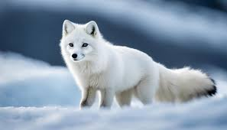

Slide 6
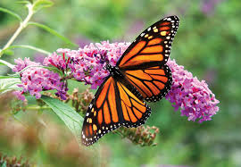

Slide 7
B. Resource Availability
1. Foraging Behaviour: Optimal foraging theory explains how animals maximize energy intake while minimizing effort and risk.
Example: Honeybees adjust their foraging routes based on the abundance and distribution of flowering plants.
2. Water and Shelter: Access to water sources or suitable shelter influences behaviours like nest-building and territory defense.
Example: Beavers construct dams to create aquatic habitats that provide food, protection, and breeding grounds.

Slide 8
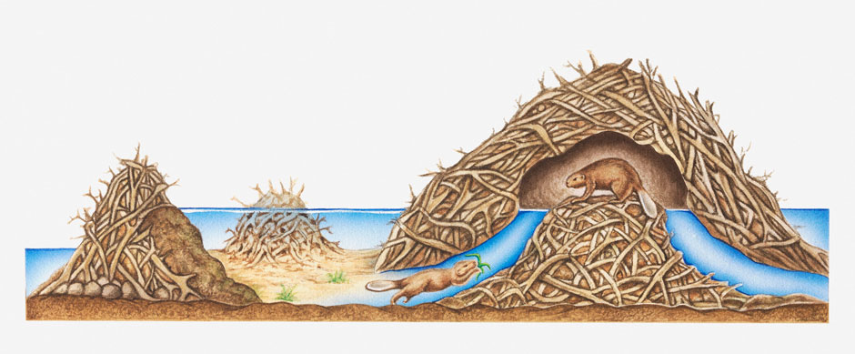

Slide 9
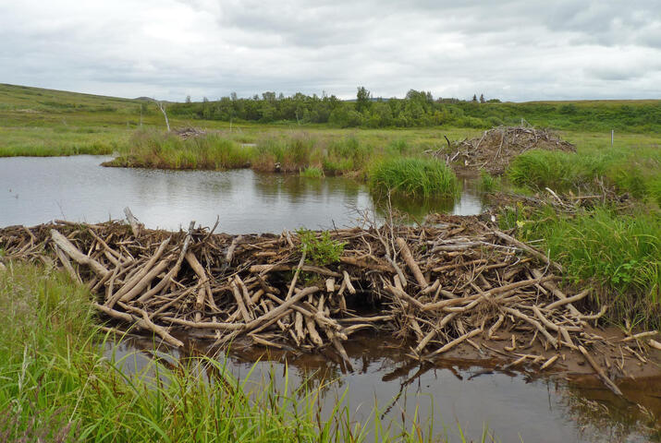

Slide 10
C. Predation and Threats
1. Anti-Predator Behaviour: Animals develop strategies like camouflage, fleeing, and forming groups to evade predators.
Example: Meerkats use sentinel behaviour, where one member watches for predators while others forage.
2. Risk Assessment: Behaviour adjusts based on perceived predation risk.
Example: Deer feed more cautiously in open areas where visibility to predators is high.

Slide 11
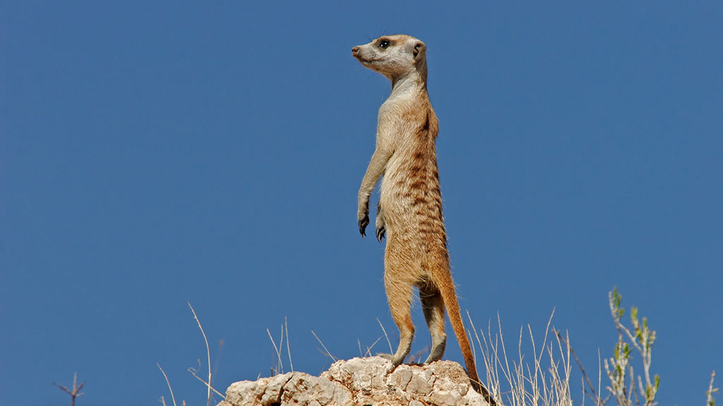

Slide 12
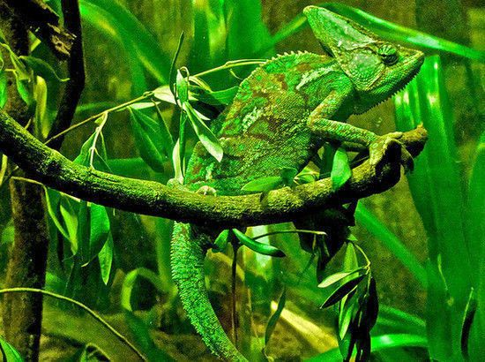

Slide 13
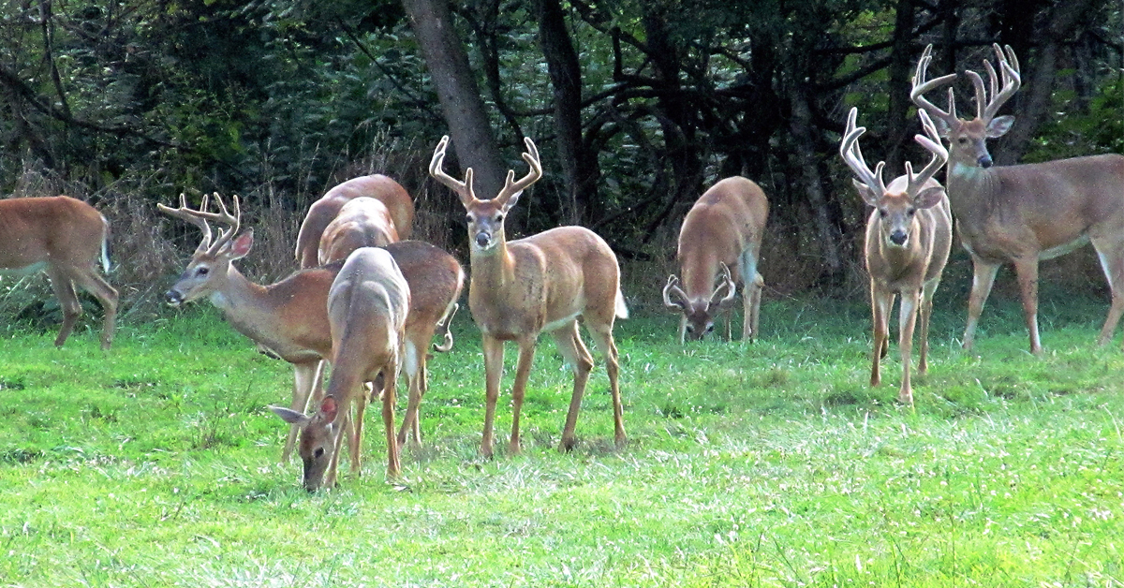

Slide 14
D. Social Interactions
1. Group Living and Cooperation: Social animals often show behaviours that enhance group survival, such as coordinated hunting or communal defense.
Example: Wolves hunt in packs to take down larger prey.
2. Territoriality: Animals defend resources, mates, or space through aggressive or display behaviours.
Example: Male lions patrol and mark their territory to ward off rivals.

Slide 16
Genetic Factors Maintaining Animal Behaviour
Genetics provides the biological blueprint for behaviour, governing how traits are inherited, expressed, and regulated.
While ecological factors influence the expression of behaviours, genetic mechanisms ensure their heritability and long-term stability.
A. Inheritance of Behavioural Traits
B. Gene-Environment Interactions
C. Molecular and Neural Mechanisms
D. Evolutionary Stability

Slide 17
A. Inheritance of Behavioural Traits
1. Innate Behaviours: These are hardwired behaviours that are genetically encoded and require little to no learning.
Example: Sea turtle hatchlings instinctively move toward the ocean immediately after birth.
2. Heritability: Traits with a genetic basis can be passed on to offspring, maintaining behaviours across generations.
Example: Birdsong patterns in many species are influenced by genetic predispositions.

Slide 19
B. Gene-Environment Interactions
1. Phenotypic Plasticity: Genetic predispositions interact with environmental conditions to shape behaviour.
Example: Locusts exhibit solitary or swarming behaviour depending on population density, a change influenced by genetic and ecological triggers.
2. Epigenetics: Environmental factors can modify gene expression without altering DNA, influencing behaviour.
Example: Maternal care in rats affects stress-related gene expression in offspring, shaping their stress responses.

Slide 20
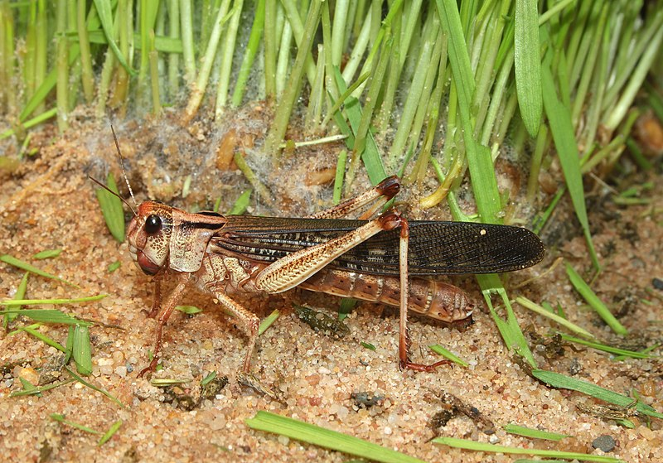

Slide 21
C. Molecular and Neural Mechanisms
1. Gene Expression: Specific genes regulate neural pathways associated with behaviours like mating, aggression, and learning.
Example: The FOXP2 gene is associated with vocal learning in both humans and songbirds.
2. Neurogenetics: The genetic basis of neural development impacts behaviours like memory, decision-making, and social interaction.
Example: Mutations in genes affecting dopamine pathways can alter reward-seeking behaviour in animals.

Slide 22
D. Evolutionary Stability
1. Natural Selection: Behaviours that enhance survival and reproduction are more likely to be passed on.
Example: The courtship dances of birds of paradise, shaped by sexual selection, demonstrate how genetics and mate preferences interact.
2. Genetic Drift: Random genetic changes can influence behaviours, especially in small populations.
Example: Unique vocalizations in isolated populations of birds may result from genetic drift.

Slide 24
Integration of Ecology and Genetics in Animal Behaviour
The maintenance of animal behaviour is not solely ecological or genetic; it arises from the dynamic interplay between these domains. Some behaviours are tightly constrained by genetics, while others are highly plastic and influenced by ecological factors.
A. Behavioural Adaptation
B. Learning and Cultural Transmission
C. Behavioural Flexibility

Slide 25
Integration of Ecology and Genetics in Animal Behaviour
A. Behavioural Adaptation
Adaptive behaviours emerge when ecological pressures favor specific genetic traits.
Example: Darwin’s finches evolved diverse beak shapes and foraging behaviours to exploit different food sources.

Slide 26
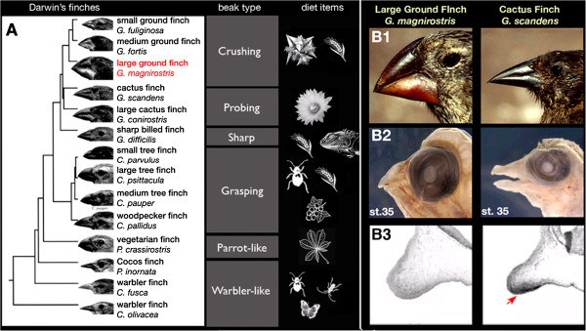

Slide 27
Integration of Ecology and Genetics in Animal Behaviour
B. Learning and Cultural Transmission
While some behaviours are inherited, others are learned and culturally transmitted within populations.
Example: Orcas teach their offspring hunting techniques unique to their pod.

Slide 28
Integration of Ecology and Genetics in Animal Behaviour
C. Behavioural Flexibility
Animals with genetic predispositions for cognitive flexibility can adapt their behaviour to changing ecological conditions.
Example: Octopuses exhibit problem-solving behaviours that are not rigidly genetically programmed but influenced by individual experience.

Slide 29
4. Applications and Importance
Understanding the ecological and genetic foundations of animal behaviour has broad implications:
1. Conservation Biology:
Helps identify critical behaviours that need to be preserved for species survival (e.g., migration routes or breeding behaviours).
2. Animal Welfare:
Provides insights into creating environments that meet the behavioural needs of captive animals.

Slide 30
4. Applications and Importance
3. Evolutionary Studies:
Offers a window into how complex behaviours evolve and adapt over time.
4. Human Impact Mitigation:
Aids in understanding how human activities, such as habitat destruction, affect behaviour and genetic diversity.

Slide 31
Conclusion
Ecology and genetics work in tandem to maintain animal behaviour, creating a balance between adaptability and stability. Ecology shapes the immediate expression and utility of behaviours in response to environmental pressures, while genetics ensures the inheritance and continuity of these traits.
Together, they form the foundation for the diversity and complexity of animal behaviour observed across species, highlighting the remarkable adaptability of life in the face of ever-changing environments.

Slide 32
THANK YOU

