Slide 1
Subject: Animal Behaviour (ZOL-509)
LEARNING BEHAVIOUR
By: Shozab Seemab Khan ABAIDULLAH COLLEGE PAKPATTAN

Slide 2
LEARNING
Learning is the modification of behavior based on specific experiences.
Learned behaviors range from very simple to very complex. Progress over time tends to follow learning curves.
Learning is not compulsory; it is contextual. It does not happen all at once, but builds upon and is shaped by what we already know.

Slide 3
TYPES OF LEARNING
1: Habituation
2: Imprinting
3: Classical Conditioning
4: Trial and Error Learning
5: Latent Learning
6: Insight Learning
7: Reasoning
8: Cognition

Slide 4
1. Habituation
Habituation is a loss of responsiveness to stimuli that convey little or no harm (effect).
If a noxious stimulus is applied, the animal becomes sensitized to stimulus.
Habituation is a decrease in response to a stimulus after repeated presentations.
The habituation process is a form of adaptive behavior that is classified as non-associative learning.
‘Habituation is the decrease of a response to a repeated eliciting stimulus that is not due to sensory adaption or motor fatigue.

Slide 5
1. Habituation
Sensory adaptation occurs when an animal can no longer detect the stimulus as efficiently as when first presented and motor fatigue suggests that an animal is able to detect the stimulus but can no longer respond efficiently.
Habituation is a non-associative process, however, is a learned adaption to the repeated presentation of a stimulus, not a reduction in sensory or motor ability.

Slide 6
1. Habituation
The characteristics first described by Thompson and Spence.
Repeated presentation of a stimulus will Cause a decrease in reaction to the stimulus.
Habituation is learned behavior which allows animal to disregard meaningless stimuli; ignore repeated, irrelevant stimulus

Slide 7
Examples of Habituation
Prairie dogs, give alarm calls when mammals, large birds, or snakes approach.
Individual prairie dogs are particularly susceptible to becoming food for a coyote, hawk, or rattlesnake, but collectively they are quite well-defended, as their alarm calls facilitate escape in burrows.
When prairie dog towns are located near trails used by humans, giving alarm calls every time a person walks by is a waste of time and energy for the group.
Habituation to humans to an important adaptation in this context.

Slide 8
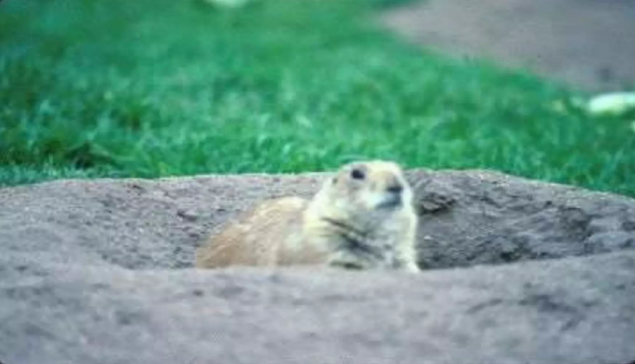
Examples of Habituation

Slide 9
Examples of Habituation
Classic example of habituation is the following observation on the snail Helix.
If the snail is moving along a wooden surface, it will immediately withdraw into its shell, if the experimenter taps on the surface.
It emerges after a pause, only to withdraw again if the tap is repeated.
But continued repetition of the same tapping at regular intervals elicits a briefer and more perfunctory withdrawal response.
Eventually, the stimulus, which initially elicited a clear-cut, immediate response, has no detectable effect on the snail’s behaviour. Habituation has occurred.

Slide 11
2. Imprinting
Imprinting is a type of behavior that includes both learning and innate components and is generally irreversible form of learned behavior closely associated with instinct.
Imprinting is distinguished from other types of learning by a sensitive period —a limited phase in an animal's development that is the only time when certain behaviors can be learned.
A rapid learning process by which a newborn or very young animal establishes a behavior pattern of recognition and attraction to another animal of its own kind or to a substitute or an object identified as the parent.

Slide 12
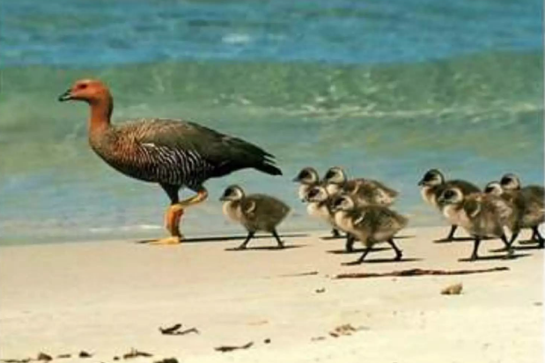

Slide 13
2. Imprinting
It was first reported in domestic chickens, in 19th-century by Douglas Spalding. It was rediscovered by the early ethologist Oskar Heinroth, and studied extensively and popularized by his disciple Konrad Lorenz working with graylag geese.
Organism will acquire a specific behavior if an appropriate stimulus is experienced during a critical period limited time interval of life of animal, usually within a few hours after birth (or hatching) between 13-16 hours shortly after hatching.

Slide 14
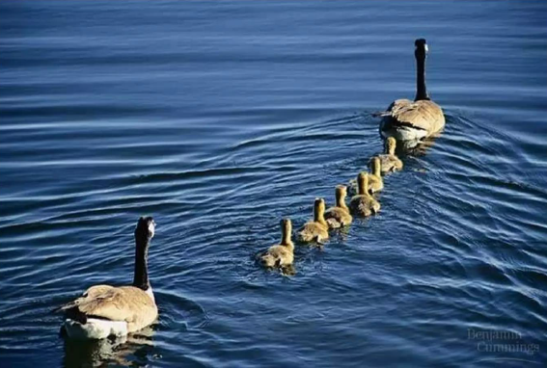
An example of imprinting is young geese following their mother.

Slide 15
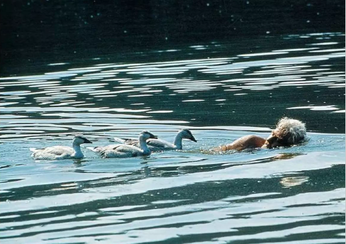
Konrad Lorenz showed that when baby geese spent the first few hours of their life with him, they imprinted on him as their parent.

Slide 16
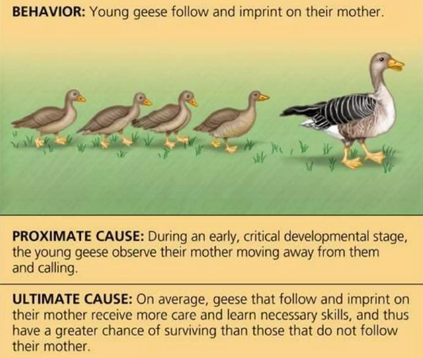

Slide 17
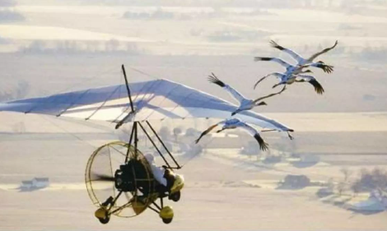
Conservation biologists have taken advantage of imprinting in programs to save the whooping crane from extinction.

Slide 18
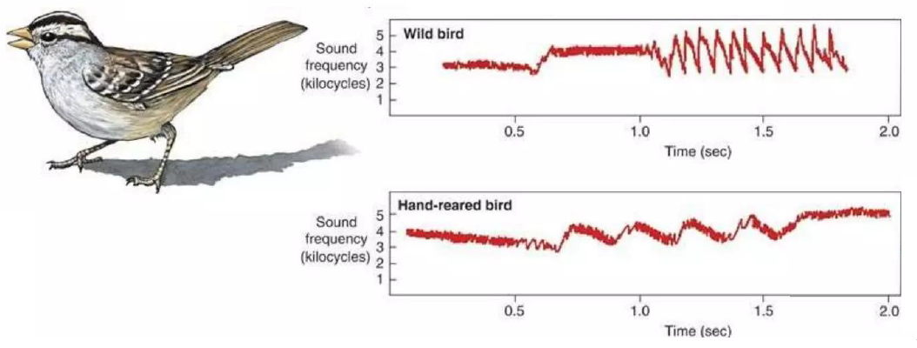
Young male white-crowned sparrows learn their song by listening to their father. A bird raised in isolation will have an abnormal song. If he hears a recording of the song during a critical period, he will learn it. He can only learn the song of his species.

Slide 19
3. Conditional Learning
By ‘conditional learning’, we mean where someone is conditioned to behave in a particular way by rewards and punishments.
A process in which an animal learns to respond to a stimulus which doesn’t normally elicit that response.
Ivan Pavlov provided the most famous example of classical conditioning, though E. B. Twitmyer published his findings a year earlier (a case of simultaneous discovery). During his research on the physiology of digestion in dogs, Pavlov noticed that, rather than simply salivating in the presence of food, the dogs began to salivate in the presence of the lab technician who normally fed them. Pavlov called this anticipatory salivation psychic secretion.

Slide 20
2. Conditional Learning
From this observation he predicted that, if a particular stimulus in the dog's surroundings was present when the dog was given food, then this stimulus would become associated with food and cause Salivation on its own.
In his initial experiment, Pavlov used a bell to call the dogs to their food and, after a few repetitions, the dogs started to salivate in response to the bell. Pavlov called the bell the conditioned (or conditional) stimulus (CS) because its effect depended on its association with food. He called the food the unconditioned stimulus (US) because its effect did not depend on previous experience.

Slide 21
2. Conditional Learning
Likewise, the response to the CS was the conditioned response (CR) and that to the US was the unconditioned response (UR).
The timing between the presentation of the CS and US is integral to facilitating the conditioned response.
Pavlov found that the shorter the interval between the bell's ring and the appearance of the food, the more quickly the dog learned the conditioned response and the stronger it was.

Slide 22
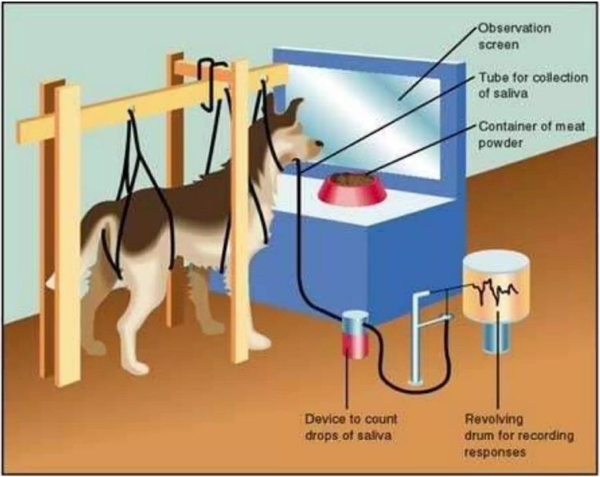

Slide 23
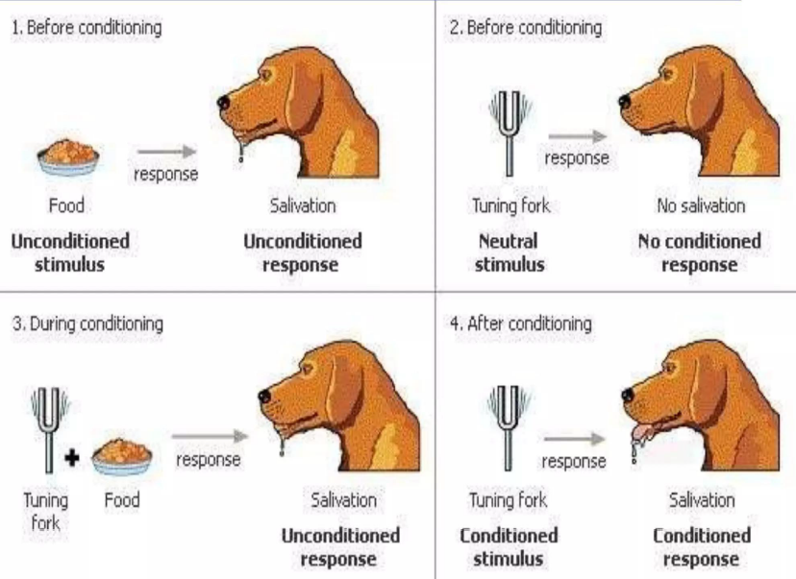

Slide 24
4. Trial and Error Learning
Trial and error, or trial by error, is a heuristic method of problem solving, repair, tuning, or obtaining knowledge.
“Learning doesn't happen from failure itself but rather from analyzing the failure, making a change, and then trying again.
Trial and error is not to be confused with experiment.

Slide 25
Thorndike Puzzle Experiment on Cats
Thorndike put a hungry cat in a ‘puzzle box’ and placed fish outside the box where it could be seen, but was out of reach.
In order to escape from the box to get the food, the cat had to operate a lever to release a door on the side of the box.
Through a process of trial and error the cat learned that pushing the lever opened the door.

Slide 26
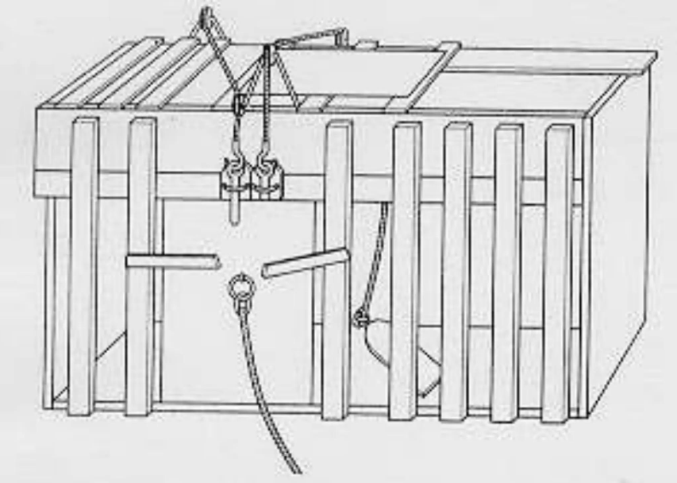

Slide 27
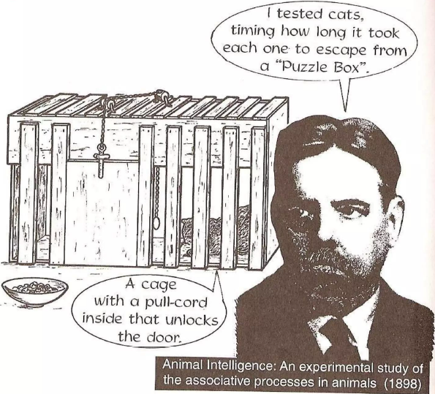

Slide 28
5. Latent Learning
Latent learning is a type of learning that occurs without any obvious immediate reinforcement and is not demonstrated until there is motivation to do so.
Essentially, the knowledge is acquired but remains hidden or "latent" until a situation calls for its use.
Interest in latent learning arose largely because the phenomenon seemed to conflict with the widely-held view that reinforcement was necessary for learning to occur.

Slide 29
5. Latent Learning
In a classical experiment by Edward C. Tolman, three groups of rats were placed in mazes and their behavior was observed each day for more than two weeks. The rats in Group 1 always found food at the end of the maze; the rats in Group 2 never found food; and the rats in Group 3 found no food for 10 days, but then received food on the eleventh.
The Group 1 rats quickly learned to rush to the end of the maze; Group 2 rats wandered in the maze but did not preferentially go to the end. Group 3 acted the same as the Group 2 rats until food was introduced on Day 11; then they quickly learned to run to the end of the maze and did as well as the Group 1 rats by the next day.

Slide 30
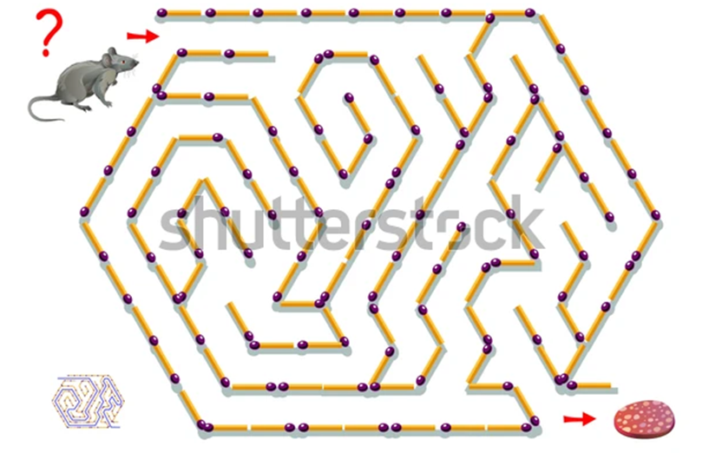

Slide 31
5. Latent Learning
Other experiments showed that latent learning can happen in shorter amounts of time such as in three or seven days.
Among other early results, it was also found that animals that were allowed to wander in the maze but were held for one minute in the empty goal box then learned the maze much more rapidly than groups that were not given such goal orientation.
In mice, knowledge of the immediate environment of its burrow may help it escape from predator. At the time of acquiring this knowledge, it has no apparent value, hence not all behavioral activities are apparently directed to satisfying a need or obtaining a reward.

Slide 32
6. Insight Learning
Insight, in learning theory, immediate and clear learning or understanding that takes place without any trial-and-error testing. Insight occurs in human learning when people recognize relationships (or make novel associations between objects or actions) that can help them solve new problems.
A type of learning that uses reason, especially to form conclusions, inferences, or judgments, to solve a problem.
Insight learning is based on advanced perceptual abilities such as thought and reasoning.
Kohler’s work on chimpanzees suggested insight learning:

Slide 33
6. Insight Learning
Much of the scientific knowledge concerning insight derives from work on animal behaviour that was conducted by German Psychologist Wolfgang Kohler.
In one experiment Kohler placed a banana outside the cage of a hungry chimpanzee, Sultan, and gave the animal two sticks, each too short for pulling in the food but joinable to make a single stick of sufficient length.
Sultan tried unsuccessfully to use each stick, and he even used one stick to push the other along to touch the banana. Later, apparently after having given up, Sultan accidentally joined the sticks, observed the result, and immediately ran with the longer tool to retrieve the banana.

Slide 34
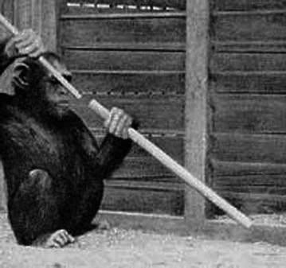
6. Insight Learning
When the experiment was repeated, Sultan joined the two sticks and solved the problem immediately.

Slide 35
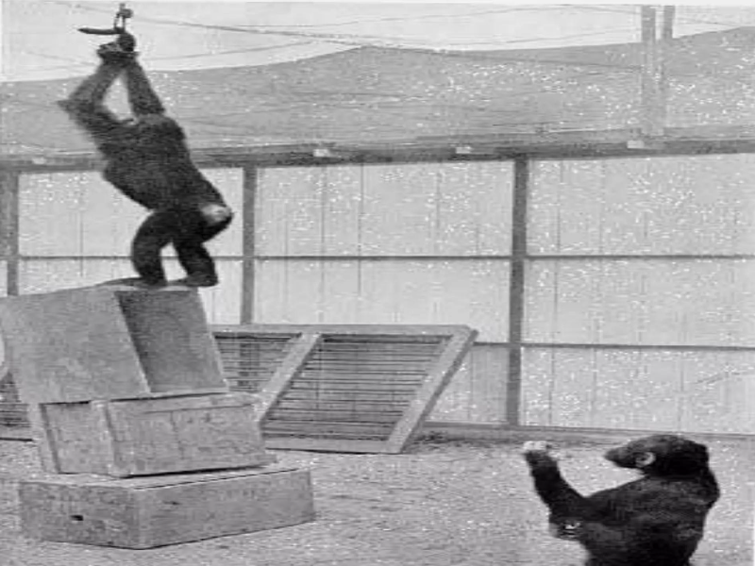

Slide 36
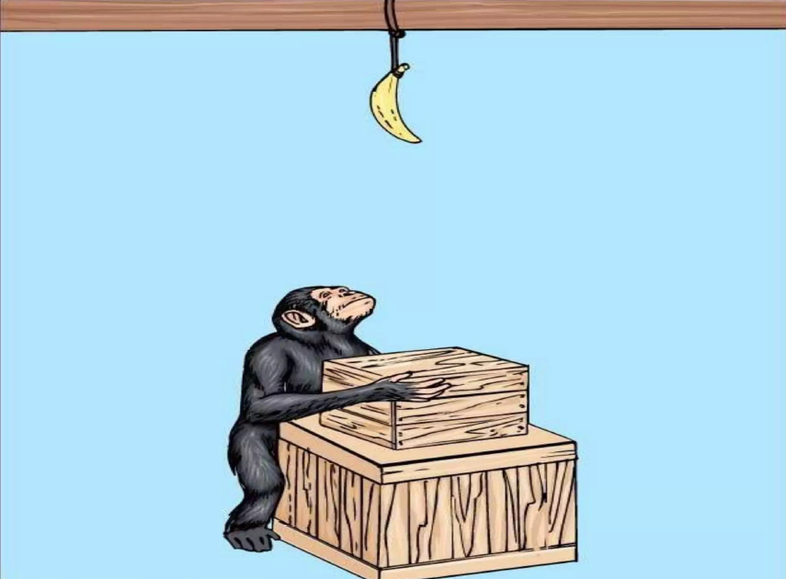

Slide 37
7. Reasoning
The drawing of inferences or conclusions through the use of reason.
Or
Evidence or arguments used in thinking or argumentation.
Humans possess the power of reasoning.
First known use of reasoning in 14th century.
The reasons, arguments, proofs, etc., resulting from this process.

Slide 38
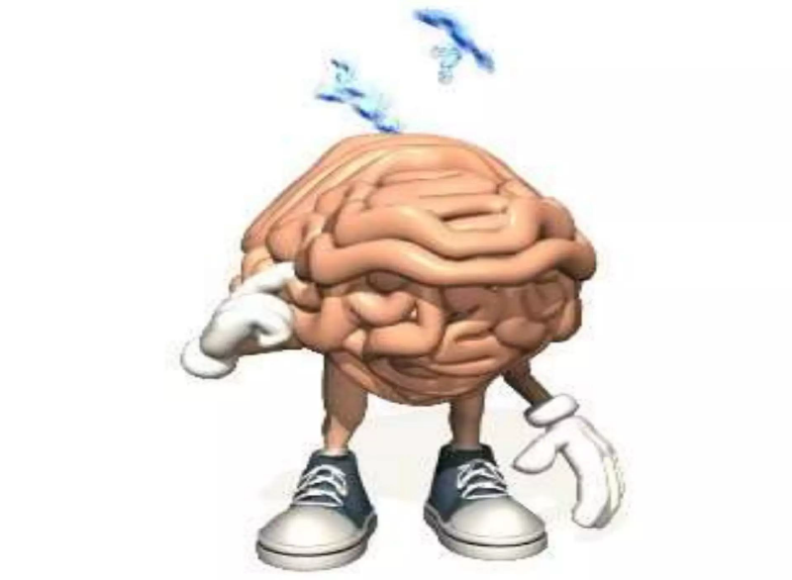

Slide 39
8. Animal Cognition
Cognition is the ability of an animal’s nervous system to perceive, store, process, and use information gathered by sensory receptors.
The logic of fighting is decidedly suspect in most cases. One animal is going to win and the other will lose.
The loser has gained nothing, and may well have sustained disastrous injury.
Relatively minor injury is likely to have fatal consequences by preventing capture of prey or allowing a predator to catch an individual with, for example, a slight muscle strain.
In case of severe injury, even dearth of looser may occur.

Slide 40
8. Animal Cognition
Even the winner may be damaged, and must balance the risk of injury with the potential gain in food, territory or mating success.
Threat displays allow animals to assess the likelihood of winning or losing before actually taking the risk of battle.
Agonistic behaviour is social behaviour consisting of threats and combat that settles disputes between individuals in a population.
Rituals involving agonistic behaviour often resolve confrontations between competitors. Agonistic behaviour can directly affect an individual's evolutionary fitness.

Slide 41
8. Animal Cognition
The victor often gains first or exclusive access to mates, food, etc.
Threat displays usually involve displaying either strength is usually enough for the smaller or weaker to realize that further conflict would be pointless.
Problem solving can be learned by observing the behavior of other animals.

Slide 42
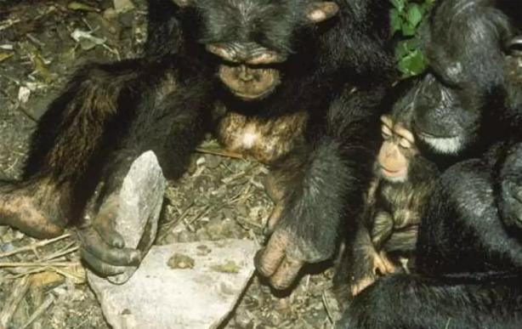

Slide 43
THANK YOU

