Slide 1
Subject:
Animal Behaviour
(ZOL-509)
Costs and benefit ratios in behavior
By: Shozab Seemab Khan
ABAIDULLAH COLLEGE PAKPATTAN

Slide 2
Costs and benefit ratios in behavior
Costs and benefits in animal behaviour are a central framework for understanding why animals behave the way they do, especially in the context of evolution and ecology.
This framework is used to assess how natural selection shapes behaviours by weighing the benefits (enhancing survival and reproductive success) against the costs (energy expenditure, risk of injury, or reduced future opportunities).

Slide 3
Cost-Benefit Analysis in Evolutionary Terms:
Benefits: These are factors that improve an animal's fitness. Examples include access to food, mates, increased survival of offspring, and improved social status.
Costs: These include risks or expenditures that reduce an animal's fitness. Examples are energy loss, predation risk, injury, or time spent on one behaviour that could have been allocated to another.

Slide 4
Cost-Benefit Analysis in Evolutionary Terms:
Optimality Models: Optimality models are used to predict the behaviour that maximizes net benefits (benefits minus costs). These models assume that animals behave in ways that maximize their evolutionary fitness.

Slide 5
Costs and benefit ratios in behavior
Foraging Behaviour:
Benefits: Obtaining energy from food.
Costs: Time spent searching and handling food, risk of predation while foraging.
Example: Birds deciding whether to forage in open areas (more food but higher predation risk) or dense cover (less food but safer).

Slide 6
Costs and benefit ratios in behavior
Mating Behaviour:
Benefits: Increased reproductive success.
Costs: Energy spent on courtship displays, fighting rivals, or parental care; risk of injury or predation.
Example: Male peacocks invest energy in growing and displaying elaborate tails, increasing attractiveness but making them more conspicuous to predators.

Slide 7
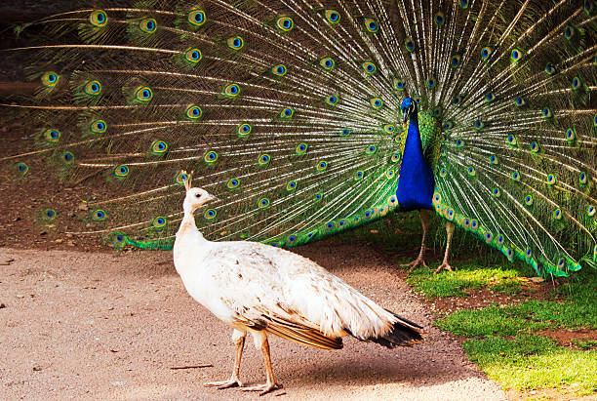

Slide 8
Costs and benefit ratios in behavior
Territoriality:
Benefits: Exclusive access to resources like food or mates.
Costs: Energy and time spent patrolling and defending territory; risk of injury from intruders.
Example: Lions defend prides to secure resources and mates but incur the cost of constant vigilance.

Slide 9
Costs and benefit ratios in behavior
Social Living:
Benefits: Group defense against predators, cooperative foraging, shared care of young.
Costs: Increased competition for resources, spread of disease, conflict within the group.
Example: Meerkats living in groups benefit from collective vigilance but face internal competition for dominance.

Slide 10
Costs and benefit ratios in behavior
Anti-Predator Behaviour:
Benefits: Increased survival by avoiding predation.
Costs: Reduced time for other activities, such as foraging or mating.
Example: Gazelles stoting (jumping high) deters predators but uses valuable energy.

Slide 11
Costs and benefit ratios in behavior
Measuring Costs and Benefits
Researchers often use empirical methods to measure costs and benefits, including:
Time-energy budgets.
Risk assessments (e.g., predation risks).
Direct observation of reproductive success.

Slide 12
Applications:
Understanding costs and benefits in animal behaviour is critical for:
Conservation efforts: Predicting how animals will respond to environmental changes.
Animal welfare: Designing environments that reduce costs for captive animals.
Behavioural ecology: Explaining diverse strategies across species.
By weighing these trade-offs, we gain insight into the adaptive value of behaviours and their role in survival and reproduction.

Slide 13
THANK YOU

