Slide 1
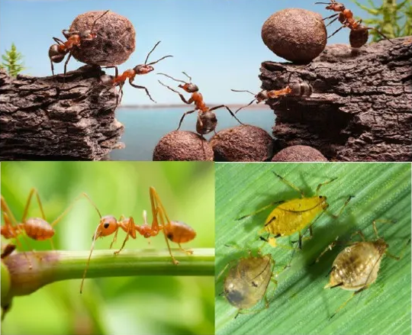
Social Organization in Insects
Abaidullah College Pakpattan

Slide 2
CONTENT
Introduction
Properties of a society
Advantages of a society
Disadvantages of a society
Social organisation and social behaviour in insects:-
1. Termites
2.Honeybees
3.Ants
4.Yellow wasp

Slide 3
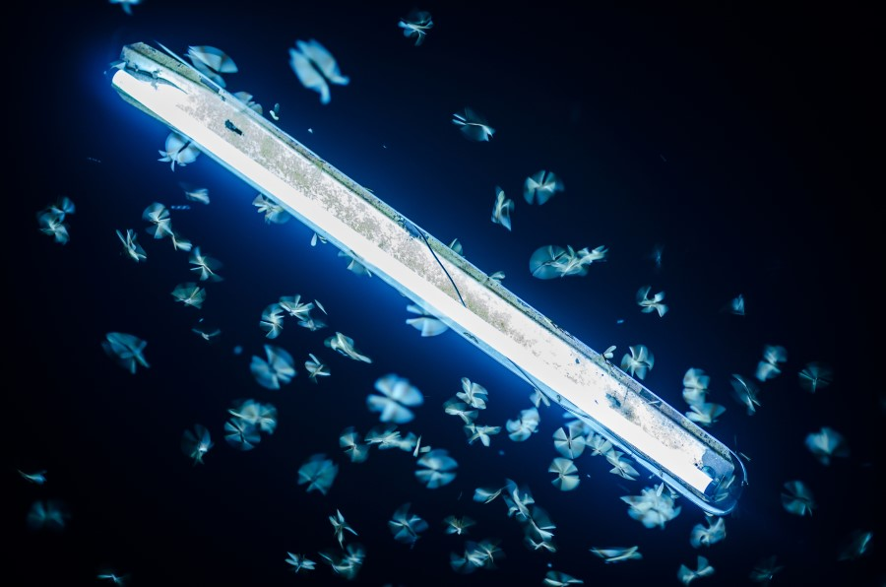
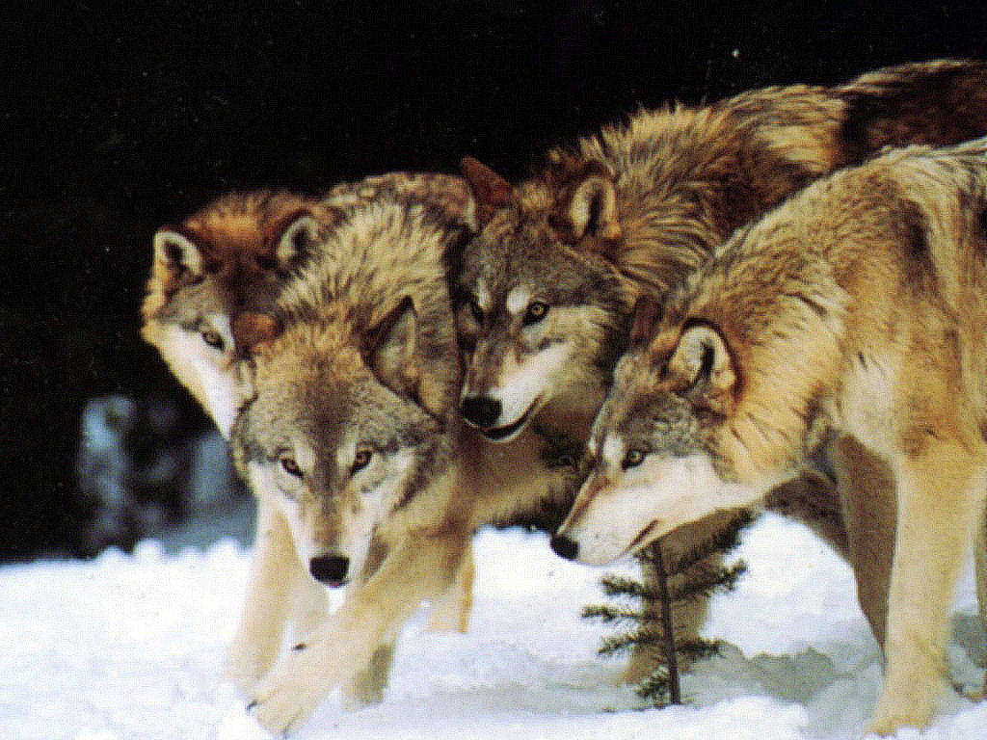
INTRODUCTION
In nature no individual animal can live in isolation.
Groups of individuals of the same species-Aggregation
Aggregations are of 2 types:-
ASSOCIATIONS | SOCIETIES/SOCIAL ORGANISATIONS
Are caused by forces external to organism. | Caused by internal forces within the organism.
Temporary union. | Permanent union.
Eg .Insects gather around a source of light. | Eg. Pack of wolves.

Slide 4
Societies/Social Organisation
Def:-A group of individuals belonging to the same species and organised in a co-operative manner-Social Organisation
Altruism:-Any behaviour that results in an increase in the fitness of another individual at the expense of one’s own fitness.
Social Behaviour:-Any interaction between one individual of a species with another member of same species.

Slide 5
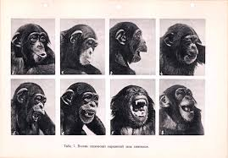
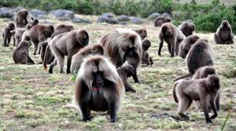
PROPERTIES OF A SOCIETY
According to Eisenberg(1965),any aggregation will be considered a social organisation if it has the follow properties:-
Division of labour
Communication
Cohesion
Permanence

Slide 6
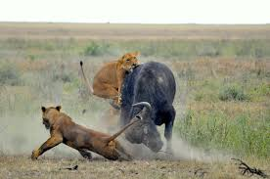
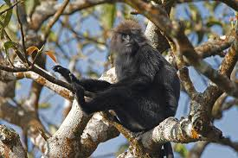
ADVANTAGES OF A SOCIETY
Guarding behaviour
Detection of predators
Mutual vigilance
Defence against predator
Co-operative foraging
Reproduction success
Division of labour

Slide 7
DISADVANTAGES OF A SOCIETY
Increase in competition
More chances of spread of diseases
Inbreeding depression

Slide 8
SOCIAL ORGANISATION AND SOCIAL BEHAVIOUR IN INSECTS
In class Insecta, two orders Hymenoptera and Isoptera possess social organisation.
Ants, honeybees and wasp come under Hymenoptera group.
Termites come under Isoptera group.
These species live in colonies of thousands of individuals, with a reproductive Queen and sterile workers and soldiers.
Caste differentiation by:-
1.Different kind of food
2.Pheromone

Slide 9
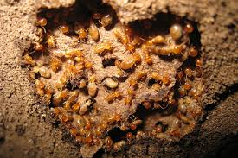
TERMITES
CASTES:
The colony has 3castes of individuals and each includes both sexes.
They are:-
Reproductive caste-Queen and King
Workers
Soldiers

Slide 10
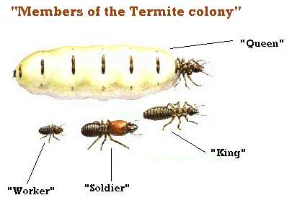

Slide 11
Swarming:
In the raining season, the king and the queen leaves the colony and fly away to new sites and start new colony.
Communication:
Sound production:-
Soldiers and workers produce sound by tapping their head on the roof.
2. Pheromones:-
Differentiation of castes
Communication among members of a colony

Slide 12
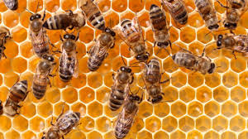
HONEYBEES
Show a high order of social organisation.
Castes:
Queen
Drones
Workers

Slide 13
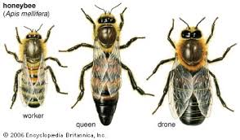
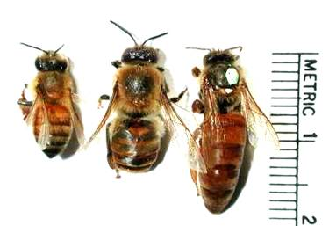
CHARACTERS | QUEEN | DRONE | WORKERS
Number per colony | 1 | Few hundreds | 10-30,000
2. Gender | Fertile female | Fertile male | Sterile female
3. Formation | Formed from a fertilized egg | Develop parthenogenetically from unfertilized egg | Formed from a fertilized egg
4. Size | Largest | Larger than worker but smaller than queen | Smallest
5. Duty | To lay eggs | Fertilize eggs Mating with Queen | Repairing comb Gathering pollen, nectar Making honey, royal jelly Feeding and taking care of queen, larvae Guarding the hive and keeping it cool

Slide 14
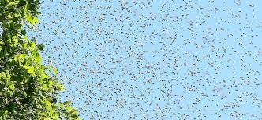
Eggs destined to become queen is laid in a larger brood cells and the larvae are feed only royal jelly.
When the colony is crowded with adult bees, the queen bee leaves with a set of workers to establish a new colony-Swarming

Slide 15
Communication:
Waggle dance:-
To communicate about the location of food and water source
A figure of 8 is traced against the surface of comb.
Number of waggles signifies the distance of the food source.
2.Pheromones:-2 categories
Those concerned with communication:-secreted by workers
Those concerned with the maintenance of colony structure or the caste system:-secreted by queen

Slide 16
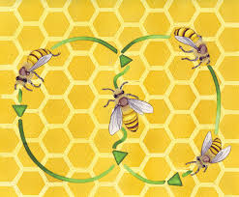

Slide 17
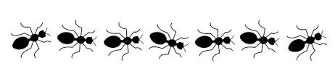
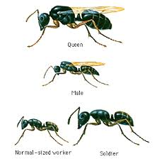
ANTS
Highly developed social insect.
Castes:
Queen
Kings
Workers
Soldiers

Slide 18
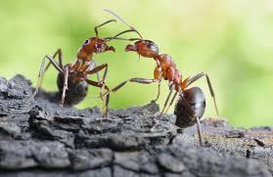
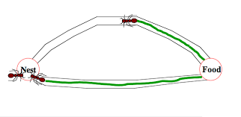
In rainy season swarming takes place.
King usually dies after mating.
Communication:
Tactile signals:- by touching and strocking each others bodies with their antennae and forelegs.
Pheromones:- facilitates mate attraction, kin recognition etc.

Slide 19
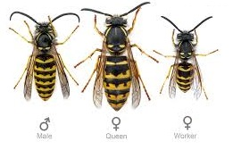
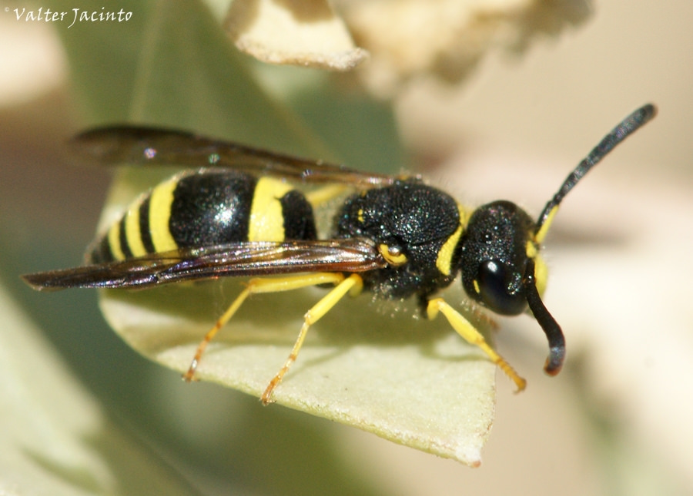
YELLOW WASP
Castes:
Queen
Drones
Workers

Slide 20
No swarming takes place.
In winters, the queen hibernates and the nest perishes.
The queen starts new colony next spring.
Communication:
Pheromone:-
Secreted by workers-to communicate with other workers
Secreted by queen-to
Inhibit ovarian development in workers
Provide stability to colony
Attract drones

Slide 21


