Slide 1
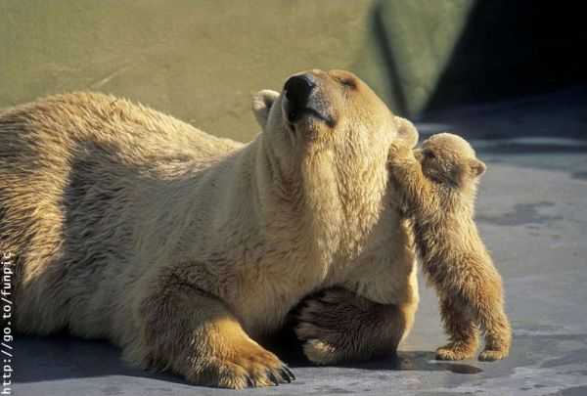
ANIMAL COMMUNICATION
ABAIDULLAH COLLEGE PAKPATTAN

Slide 2
INTRODUCTION
Animal communication is the passage of information b/w two animals.
The animal which sends is called signaler and the animal that receives signal is called receiver.
Animal communication is also known as Biological communication.
The study of animal communication is called Zoo-semiotics
The classical ethological view of communication was developed by Niko Tinbergen.

Slide 3
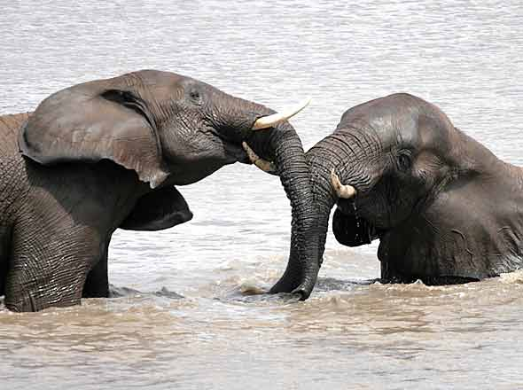
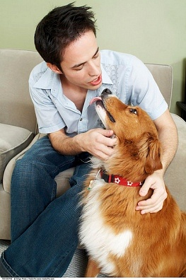
TYPES OF COMMUNICATION
Intraspecific communication
communication within a single species
Eg. Honeybee dance
Interspecific communication
Prey to predator
Eg. warning colouration in wasps
Predator to prey
Some predators communicate to prey make
them easier to catch, in effect deceiving them.
Eg. Angler fish
Human/animal communication
During domestication of animals

Slide 4
BASIC COMPONENTS
Signaller : An individual which emits signal.
Reciever : An individual which recieves signal
Signal : The behaviour emitted by the signaller
Channels : A pathway through which normally a signal travels. (ie means of communication)
Visual
Auditory (Bioacoustics)
Chemical
Tactile
Electrical

Slide 5
VISUAL COMMUNICATION
Information transmitted by visual means is called visual communication.
The visual signals may be given by various means like
movement
posture or shape of the body
Facial expressions.
colour identification
light etc.
Visual signals are used most often by species that are active during day.
Light as a visual means is used in night.

Slide 6
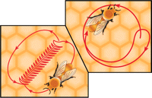
EXAMPLES
1) Visual communication in Bees
The worker bees communicate about food mainly by a dance language.
It was decoded by Karl Von Frisch in 1965.
Bees mainly perform 2 types of dances.
Round dance - If source of nectar is less than about 100m away. Does not communicate the direction.
Waggle dance – If source of nectar more than 100m away from hive. Communicates both distance and direction.

Slide 7
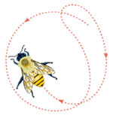
Round dance
Runs around in narrow circles, suddenly reversing direction to her original course.
After the round dance has ended, she often distributes food to the bees following her.
Essentially says "there is food closeby, get out and find the food, which smells like this.”

Slide 8
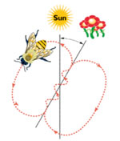
Waggle dance
Runs straight ahead for a short distance, returns in a semicircle to the starting point, runs again through the straight course, then makes a semicircle in the opposite direction to complete a full, figure-eight circuit.
While running the straight
-line course of the dance,
the bee wags abdomen,
vigorously sideways.
The angle that the bee adopts,
relative to vertical represents
angle in which food is found.

Slide 9
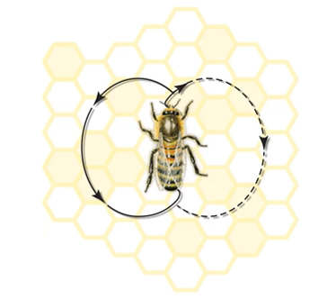
WAGGLE DANCE OF HONEYBEE

Slide 10
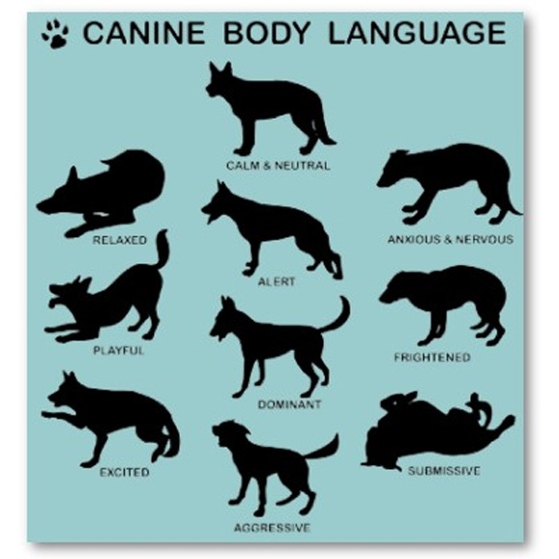
2) Postures
Some mammal species give specific signals by the position adopted by head, ears & tail.
Eg. Flattened ear – fear/ suspicion
Wagging of tail – Complete submission.
Retraction of lips to display teeth - threat display.

Slide 11
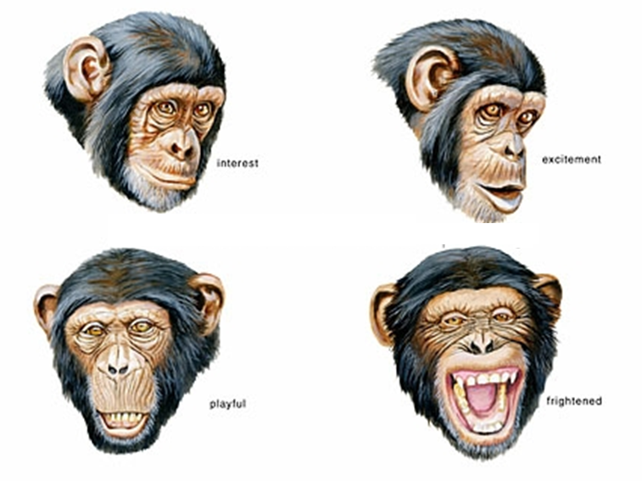
3) Facial expressions

Slide 12
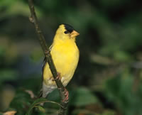
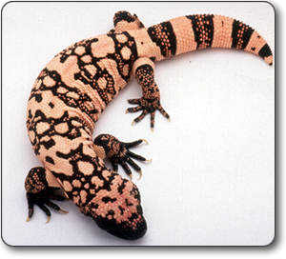
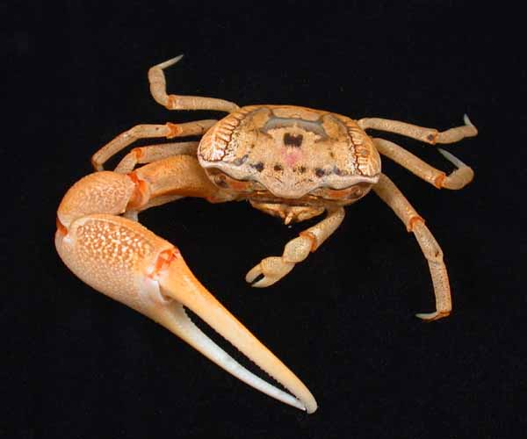
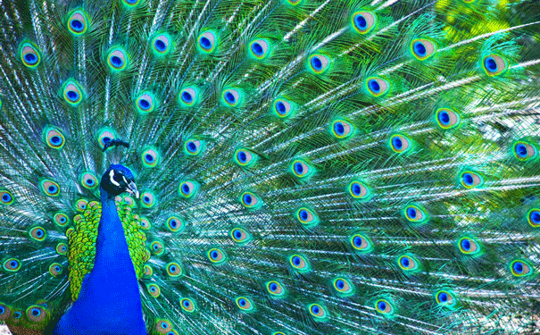
4) Colours and Displays
During mating season the male goldfinch has a bright yellow body
The gila monster's bright orange colored splotches are a warning to predators that it is poisonous and they should back-off.
When an animal exhibits a behavior that can be seen by other animals, it is called a display.
Male fiddler crabs wave their giant claw to attract female fiddler crabs.
Male peacock exhibits a visual display as part of its courtship rituals.

Slide 13
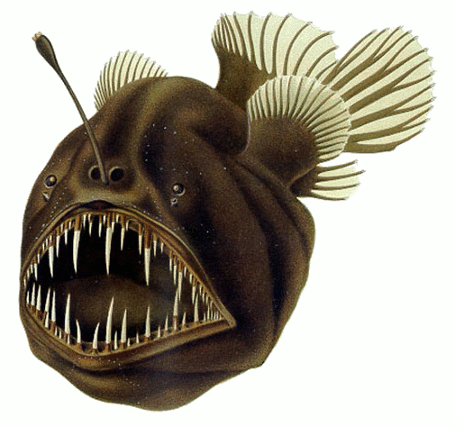
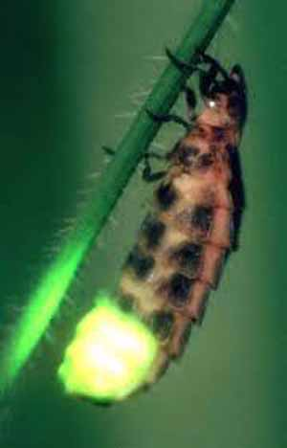
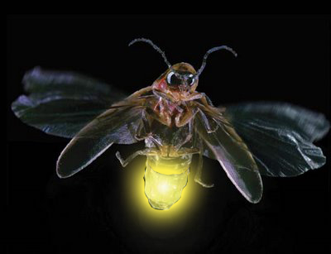
5) Light (Bioluminescence)
Certain insects and deep sea fishes communicate via their light signals.
Luminuous insects are glow worms and their relatives the fireflies.
Eg. of light producing fish include Anglerfishes
Fireflies.
Glow worms
Anglerfishes

Slide 14
AUDITORY COMMUNICATION
Sending information from one member to another by sound production is called auditory signal or bioacoustic signal.
Sound is a good means of communicating over long distances both in air and water.
It may have a vocal origin or it may be produced by some other organs
For eg. Calls of mammals and birds – vocal origin ; sound produced by crickets is rhythmic oscillation of forewings.
Sound is more effective signal at night and darkness
It can go around obstacles that would interfere with visual signals.
It is better than visual signals in getting attention of a receiver.

Slide 15
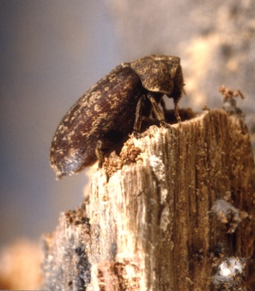
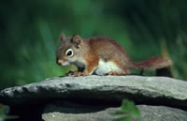
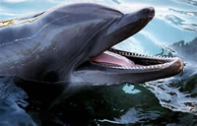
EXAMPLES
Deathwatch beetle signal to each other by producing clicking sound made by tapping their head against wood.
Red squirrels will make a series of loud rattles and screeches to warn off intruders.
The bottlenose dolphin has a wide range of vocalizations. Each dolphin also has its own unique whistling sound that it uses to identify itself.
Male birds sing a song during breeding season.
Deathwatch beetle
Red squirrels
Bottlenose dolphin

Slide 16
ODOUR OR CHEMICAL COMMUNICATION
Molecules used for chemical communication between individual animals are called pheromones.
Pheromones are involved in mate identification, marking territory, alarm spreading etc.
Odour signals can transmit informations in dark, can travel long distances, can last for hours or number of days.
Usually the message causes an immediate response.
Chemical messages that pass between animals of the same species.
Chemical communication is the most primitive type of communication.

Slide 17
EXAMPLES
Female silkworm attract males by pheromone
Queen honeybee attract males by acid.
Alarm pheromones are produced in ants in the form of formic acid to protect themselves from enemies.
Ants lay down an initial trail of pheromones as they return to the nest with food.
A female gypsy moth may influence male moths few kilometres away by producing a pheromones
Dogs and some other animals of dog family use urine to mark the boundaries of their territories.

Slide 18
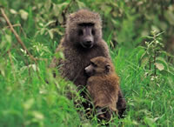
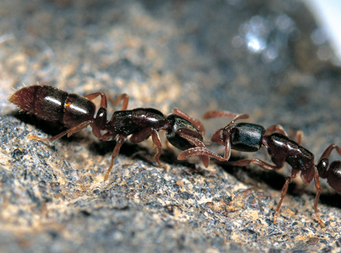
TACTILE COMMUNICATION
Information transmitted in the form of physical contact (touch signal) is called tactile communication.
Antennae of ants, termites and honeybees are involved in this process
Eg. 1) Female primates often hold and frequently cuddle their young. Helps in establishing a bond
2) Termites – blind workers totally depend on his phenomenon.
Two worker ants in tactile communication

Slide 19
ELECTRICAL SIGNALS
It is a means of communication in some fishes.
Torpedo (Electric ray), and sharks have electro receptors that they use in communication.
Sharks detect the electric field produced by prey flatfish that are buried in the sand by a specialized organ called the ampulla of lorenzini.
Electric fish communicate information about species identity and sex by discharging electric field.

Slide 20
FUNCTIONS OF COMMUNICATION
Agonistic interaction – threat displays during competition over food, mates or territory
Mating rituals – to attract and maintain the attention of potential mate
Ownership/territorality – to claim or defend territory
Food-related signals – to lead members of a social group to a food source
Alarm calls – to warn of a threat from a predator.

Slide 21
CONCLUSION
Animals do communicate which involves information transfer from the sender to a receiver.
They can convey their needs, desires and reactions to the environment via some sophisticated signaling of their own.
No animals have however evolved the sophistication of the human language - communication system.
The understanding of animal communication is essential for understanding the animal world in general.

